Slide 1
Establishment of the National Training Center for Maintenance and Management Personnel of SE NNEGC Energoatom at ZNPP

Slide 2
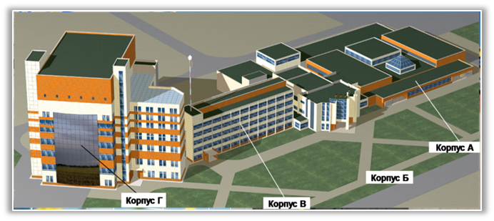
ZAPORIZHZYA NPP. NATIONAL TRAINING CENTER.
BUILDING “Г”
Building А Simulator Complex of the Training Center for operational personnel
Building “Б” Administration Building
Building В Class-room Training and Laboratory Building
Building “Г” Building of the National Training Center for Maintenance and Management Personnel
Project Completion - 2016
Objective of the Project :
Training of all category personnel to be employed in construction and operation of new nuclear power capacities
Approved total construction costs – UAH 512.5 M
Project on “Establishment of the National Training Center for Maintenance and Management Personnel of SE NNEGC Energoatom at ZNPP” was launched in 2009 under the Program on International Technical Assistance between the European Union and Ukraine.
Two independent projects were combined forming constituent parts of this Project. These are:
Establishment of the National Training Center for Maintenance Personnel of SE NNEGC Energoatom (NTCMP)
Establishment of the National Training Center for Management of SE NNEGC Energoatom (NTCM)

Slide 3
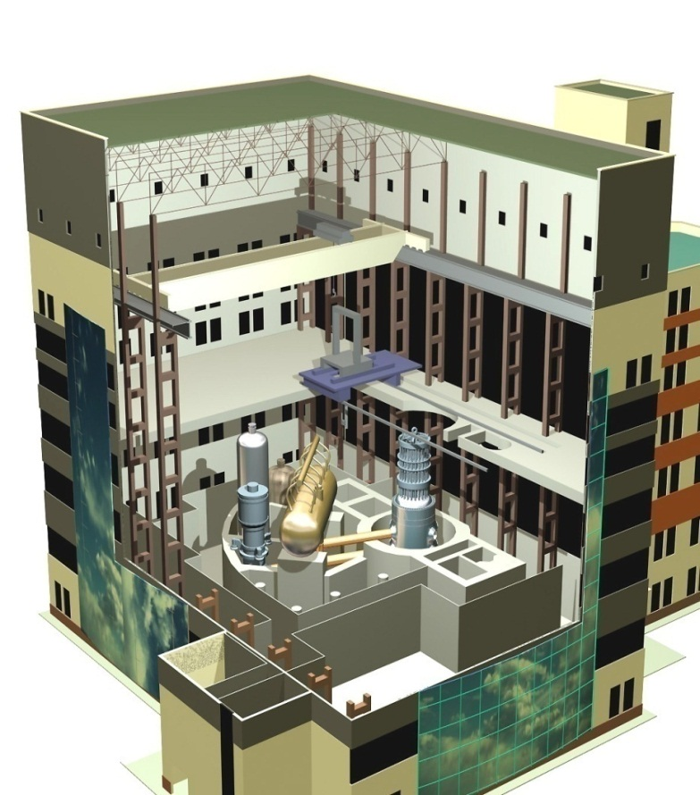
ZAPORIZHZHYA NPP.
NATIONAL TRAINING CENTER. BUILDING “Г” (Cont’d)
CORE OF THE TRAINING BUILDING OF THE NATIONAL
TRAINING CENTER FOR MAINTENANCE PERSONNEL (NTCMP)
The NTCMP core building houses the full-scale equipment of VVER-1000 power unit, i.e., a complete set of equipment of one circulation loop
Currently, 23 laboratories are being constructed in the close vicinity of the NTCMP core building, to be equipped with 159 simulators of the power unit equipment
Refueling Machine
VVER-1000 Reactor
In course of the training NPP personnel will acquire in-depth knowledge and hands-on experience in:
Conducting maintenance and repair of equipment
Assembling and disassembling a reactor
Handling the fresh and spent nuclear fuel
Servicing the safety-important systems
Working safely in the ionizing radiation areas
Crane
When completed, the National Training Center for Maintenance and Management Personnel will be a breakthrough in both the training technology and the technical training aids

Slide 4
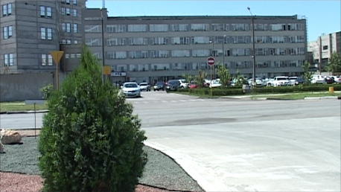
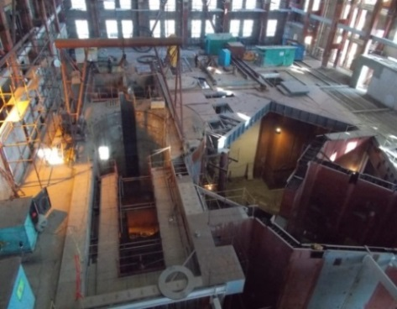
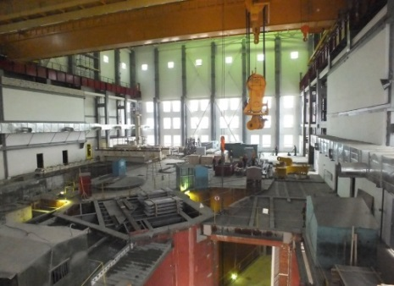
ZAPORIZHZHYA NPP
NATIONAL TRAINING CENTER. BUILDING “Г” (Cont’d)
European Commission committed itself to provide the Center with :
Methodological materials
special-purpose training aids (full-scope simulators)
technical aids for general-purpose training (office furniture, computers and projectors)
The budget of the European part of the Project is EUR 13 M
Volume of the financing allocated under the contracts amounts to EUR 7.3 M
Service contract – EUR 5.7 M
Project activities financed from the internal funds of SE NNEGC Energoatom (as of 01.10.2015):
from the beginning of works – UAH 544,7 M

Slide 5
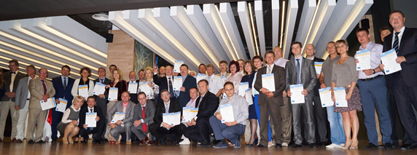
OUTCOMES OF THE EC PROJECT ON
“ESTABLISHING OF THE NTCMMP OF SE NNEGC ENERGOATOM
AT ZNPP”
The European Commission has fulfilled its commitments to:
Train the Center’s instructors
Transfer the methodology of training and procedural materials
Deliver pilot courses based on the training materials developed for:
  Maintenance personnel
  Senior and line managers
Provide the training in maintenance-oriented management
Provide the CTMP with special-purpose training aids (4 FSSМТ)
Provide the CTMP with technical aids for general-purpose training (office and industrial furniture, computers and projectors)

Slide 6
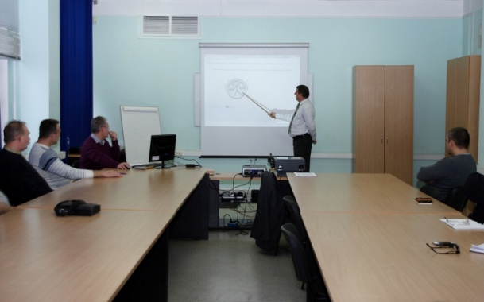
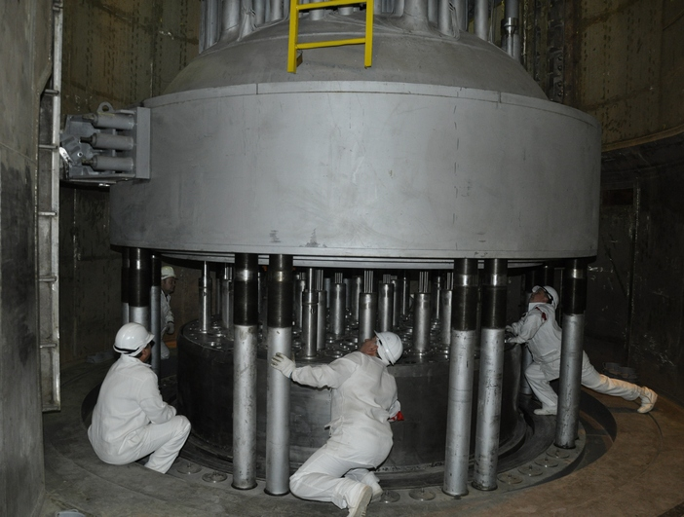
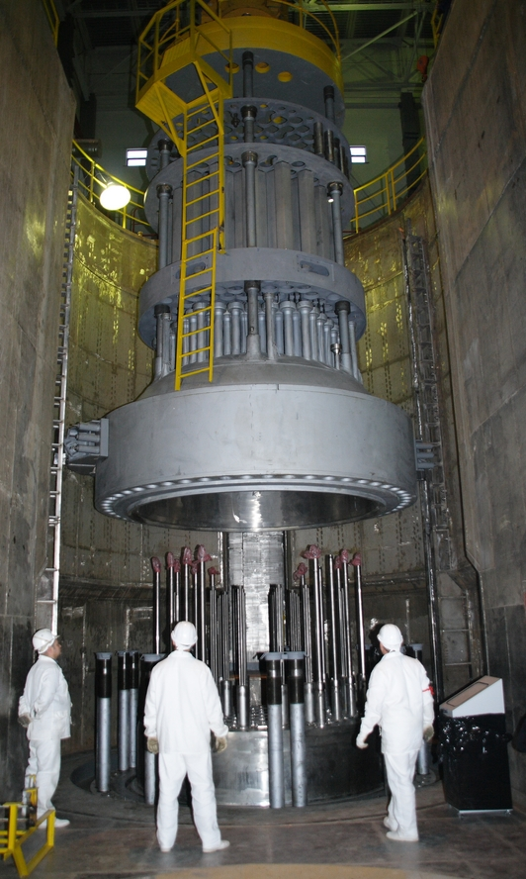
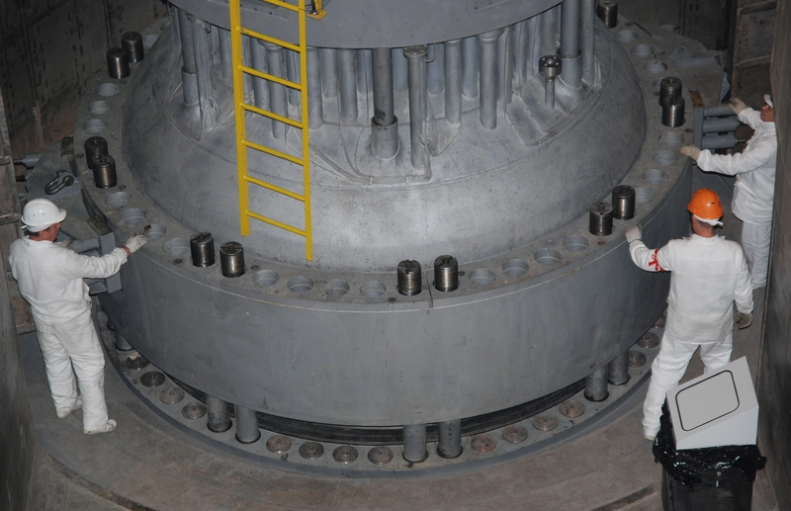
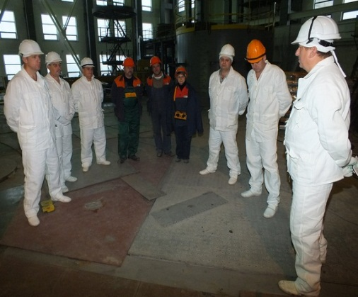
PILOT COURSE AT VVER-1000 REACTOR SIMULATOR
Removal - installation of an upper block of VVER-1000
6

Slide 7
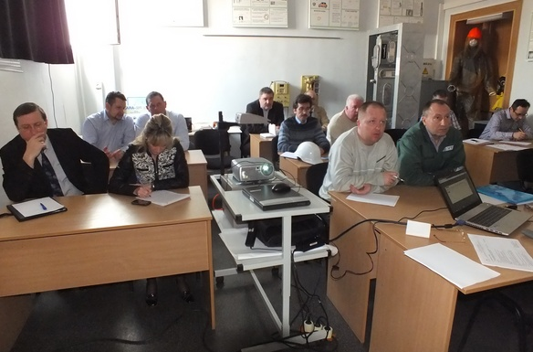
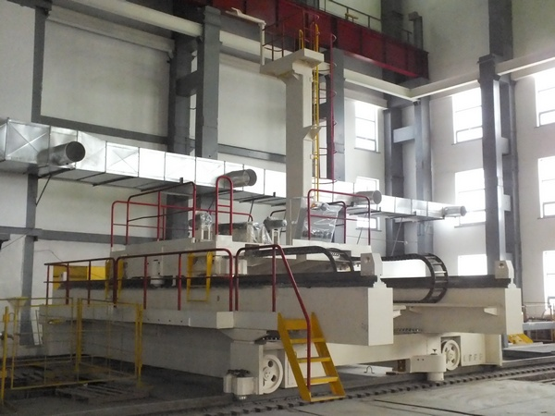
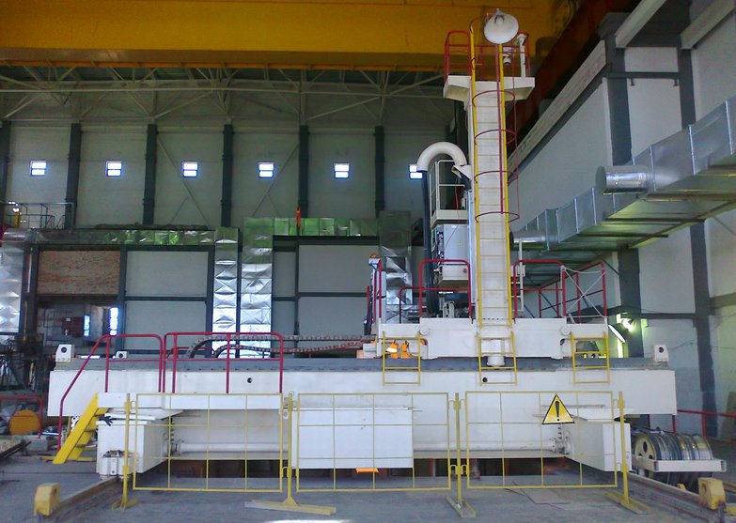
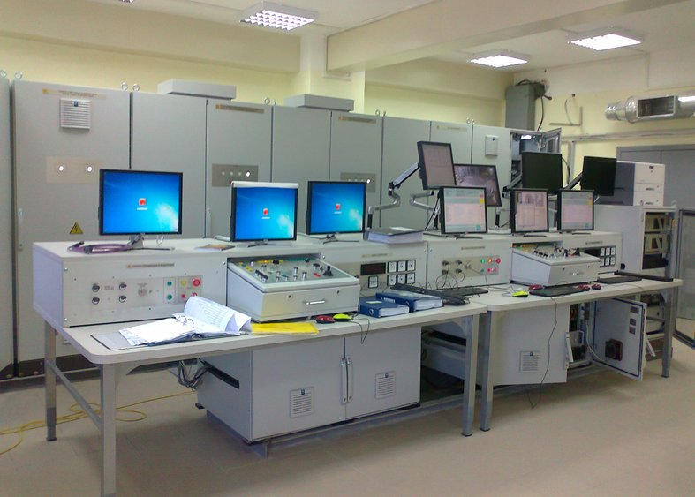
PILOT COURSES AT MPS-1000 REFUELING MACHINE SIMULATOR
Maintenance, adjustment and testing of a refueling machine mast (MPS-1000)
7

Slide 8
A Unique Training Centre for Nuclear Personnel is under completion in Ukraine
Energodar, October 2015
In partnership with the European Union, SE NNEGC Energoatom completes the construction of the National Training Centre, which boasts a first of its kind full scope simulator of a VVER 1000 reactor unit.
Co-financed between the European Union and the Ukrainian Government, Energoatom’s National Training Centre is a state-of-the-art nuclear power unit maintenance training facility, located at the site of the Zaporozhye Nuclear Power Pant. When opened for full operation in 2016, the facility will deliver maintenance training based on best international practice to maintenance personnel from the company’s fleet of VVER nuclear power units, which are located at four nuclear power plants across Ukraine.
P R E S S R E L E A S E

Slide 9
The training centre’s first of a kind simulator of a nuclear power unit will facilitate training and qualification of maintenance staff utilising a variety of full scope equipment models, in simulated environmental conditions, thus ensuring maintenance actions to be carried out on installed operational equipment, and are being implemented to the highest standards of safety for both the maintenance personnel and equipment to be maintained.
In addition to maintenance training, the project has established a management training system within NNEGC Energoatom. The management training, which is also based on international best practice, emulates management principles and practices employed by international nuclear operators that are considered to be best in class.
The combined results of these two key elements will provide Ukraine’s nuclear operator with the means to support the safe implementation of the country's energy strategy regarding electricity generation from nuclear power.
The project, which was initially launched by the Ukrainian Government in the late 1990’s, but suffered some seven years of interruption, was finally re-launched in 2007 based on a common agreement between the European Union and the Ukrainian Government. The European Union contribution to the project, was €14M from the "Instrument for Nuclear Safety Cooperation".

