Slide 1
Welcome
06 April 2021
CPI sub-committee meeting
06 April 2021,11:30-12:30 UTC/GMT

Slide 2
Virtual Meeting Protocols
Please stay on mute, background noise can interrupt audio for all participants.
If you have a comment , please use the ‘hand ’. Don’t forget to click the ‘hand’ again to put it down once you are finished.
We encourage use of the chat function for your questions or comments.
Please speak slowly and clearly.
Keep your camera turned on when possible, and especially when speaking. We want to see your lovely faces! J

Slide 3
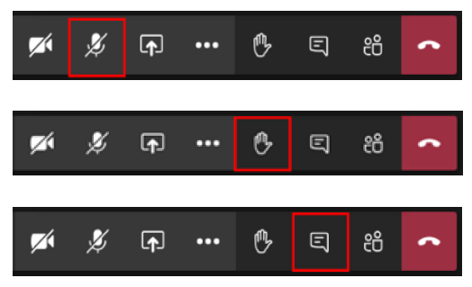
Virtual Meeting Protocols

Slide 4

Questions & Answers
There should be time for questions after each presentation. Raise your hand to ask a question or submit in the chat.
If time constraints leave questions unanswered, they will be followed up via email.

Slide 5
Meeting Agenda:
Meeting Agenda: Time UTC/GMT
11:30 | Meeting Welcome | Yu ZHANG, Sub-committee Lead
11:35 | YU presentation | Yu ZHANG
11:50 | EDF to present its own chemistry indicator « IPC » | GRESSIER Frederic
12:05 | Interactive Session: Q&A / Networking | All Members
12:30 | Adjourn

Slide 6

PI I-WG: CPI Sub-committee Lead Introduction

Slide 7
Contents
Review
Expectations
Quick look ahead
Questions ? Issues ?

Slide 8
Review
Over the past years, WANO has often received comments on the current format & methodology of the CPI indicators- Incomplete, Inconsistent, Not fully applicable to specific station circumstances …
Objective of this new Subcommittees To identify and evaluate the current issues confronting the CPI indicators If at all possible, to summaries and review some of the work that has been already done in the past. Either to develop proposals for modifying and improving the current calculation models for this indicator, or if appropriate, to propose alternatives that would better reflect industry performance.

Slide 9
Performance Indicator I-WG Virtual Meeting in 2021
Performance Indicator I-WG Virtual Meeting on April 2021 and October 2021
Current Situation –Issues to be noted
Many members have expressed their concerns regarding the current Fuel (FRI) and Chemistry (CPI) models in the existing PI DB application. In particular the Chemistry model might be obsolete and needs to be revised, but this revision has also been postponed until the new PI DB application will become available.
Meanwhile, it is proposed to initiate a new PI IWG Chemistry (CPI) subcommittee to prepare such an update of the current CPI, to ensure current member concerns get incorporated.

Slide 10
Expectations for CPI sub-committee
What’s the goal- to improve the current CPI methodology and remedy its perceived shortcomings.
When we get this goal?
Who - who will do it and who can do it?
How - how to organize the team in an effective way? How do we make that team work SMART?

Slide 11
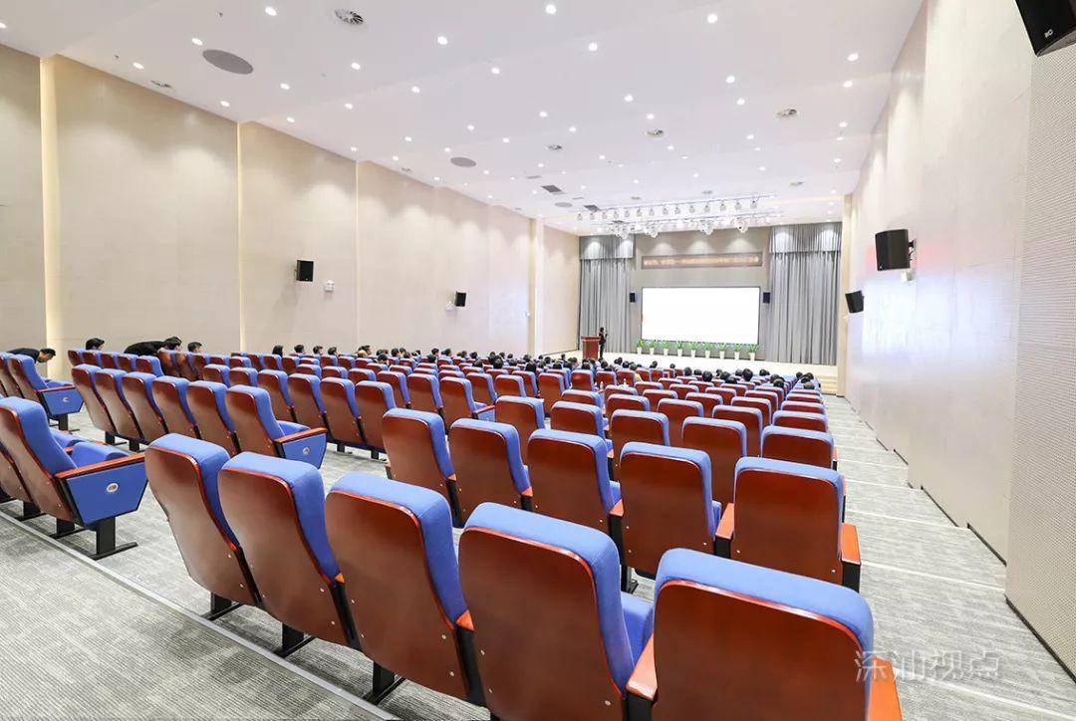
Quick look ahead

Slide 12
INPO solution
In addition to the WANO PII index (Method 4), INPO creates an INPO PII index to more accurately measure performance of the INPO fleet.
WANO PI data and additional PI data available from the INPO (US) members is included in the INPO PII index.
The INPO PII is usually revised and adjusted every 5 years. INPO 2025 PII is current version.
INPO Performance models have been developed such as PPI (plant performance index) and Neural PPI to more accurately measure performance of the INPO fleet.

Slide 13
What
Either to develop proposals for modifying and improving the current calculation models for this indicator,
Or, to propose alternatives that would better reflect industry performance
SWOT
  S: Most members (units) are now using an alternative CPI than WANO CPI.
  W: Few people in the plant know the 'Know-why' of the current model and threshold setting for calculating current WANO CPI indicator. A black box!
  O: Yes, I believe that we can do it by the global plant members together.
  T: What a great pity! INPO is no longer doing (free) sharing for the version of CPI it is using and adapting it to be suitable for global WANO member bench-marking as before.

Slide 14
When
Why do we need to improve the format and methodology of the current CPI indicator, and what do we need to focus on for WANO in the coming years, in addition to the various requests we have encountered from our members over the last few years?
Action for Excellence, WANO 2030 Goal
e-PM 2025
Evolution in CPI or overall change in CPI

Slide 15
The current WANO CPI
The WANO Performance Indicator Manual shows the CPIs used by WANO members worldwide, of which there are 13 groups, 6 groups for PWR and 4 groups for PHWR. So how can we imagine all the WANO members discussing the WANO CPIs in several meetings and trying to find a common solution for all these CPIs.
There are a few examples:
One WANO member in China uses condenser oxygen to calculate WANO CPI, however, with deaerator, this should control the oxygen in the main feed water to protect the steam generator. And industry experience has proven that a not too low oxygen will benefit the FAC challenge at the condenser site in the secondary circuit.
For the same reactor type, M310 units in CGN and EDF belong to different CPI PWR groups due to history CPI reason.

Slide 16
Who
WANO CPI is an engineering design and not a purely chemistry issue. It has been designed by engineers in the field of engineering who are responsible for material reliability. In the current WANO CPI calculation model, there are multiple subgroups even within the Pressurised Water Reactors Group.
SWOT
  S: CPI is about long-term equipment reliability, something that most senior plant managers agree on.
  W: Most of the CPI Sub-committee members are CY managers who may generally lack an in-depth technical understanding of WANO CPI. In addition, no chemist in WPC, lots of chemists in WMC or WTC or Chemists in LO?
  O: INPO knows all the knowledge and skills of the new CPIs and CPI Sub-committee has an INPO representative on the team. As I know, EDF and CGN also developed similar their own new CPI as the CEI in INPO.
  T: Currently WANO's CPI is an engineering black box and the industry need to spend millions of Euros researching how to develop a new CPI. Most importantly, collecting data from members in a confidential manner to test the new CPI is critical to the development of the new CPI.

Slide 17
How
Team work, the CPI sub-committee team.
Team Rules - Make decisions in a timely manner to obtain an outcome that is acceptable to the majority of members.
SWOT
  W: CPI Sub-committee members works in a 24 hour time zone.
  S: Targets was set by the WANO CEO and supported by the Global CNOs.
  T: Some CY managers are hesitant to change the current WANO CPI because it can provide them with a satisfied benchmark result that the majority units are the best in the world (Approximately seventy percent of the units in the world, 2016-2018).
  O: A state-of-the-art WANO CPI will help global plant members on their journey towards excellence and contribute to their long-term equipment reliability. Even if it is challenging again and needs further work to achieve excellence performance.

Slide 18
THANK YOU FOR LISTENING

