Slide 1

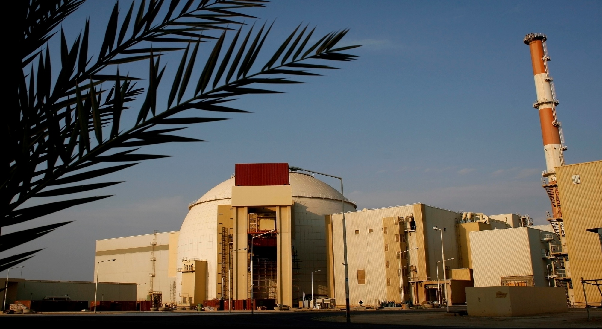
National’s and NPPD’s Plan for Nuclear Power Development for the period of five years
Nuclear Power Production & Development Co.
M. Ahmadian
Vice President of AEOI and NPPD Managing Director
Feb, 2014

Slide 2
Contents
Long-term View for National Nuclear Power Development (up to 2030)
Objectives in the State’s 5th development plan (Mid- term Planning )
Expectations and needed further assistance from the IAEA

Slide 3
Long-term View for National Nuclear Power Development
Diversification of production methods and upgrading energy security,
Sustainable development and global common responsibility,
Gaining the technologies for establishment and development of nuclear power plants,
A reasonable share of nuclear power generation in the total power generation of the country,

Slide 4
Long-term View for National Nuclear Power Development
The council of Nuclear Energy of Iran has decided that the Iranian nuclear power generation capacity should reach 8000 - 10000 MW by the year 2030,
On the basis of 2005 law that has been ratified by Iranian Parliament, total nuclear electricity generation capacity has been set to 20,000MW for the coming three decades,
To produce electricity from nuclear power plants, Pressurized Water Reactors(PWR) will be developed.

Slide 5
Objectives in the State’s 5th development plan (up to 2016)
(Mid–term Plan for Nuclear Power Development)
Safe and Reliable Operation of Bushehr Nuclear Power Plant – Unit1,
Design and construction of Darkhowin Medium sized nuclear power with PWR plant using capacities of Iranian companies,
Implementation of detailed studies, taking possession of and preparing the sites for construction of new nuclear power plants,
Starting the activities for construction of 5000 MW of nuclear power plants including 2 new large scale (PWR) at Bushehr site.
Training of expert manpower in the field of nuclear science and technologies in line with national plan for the NPP development.

Slide 6
Updated NPPD, nuclear power development plan for 2 new large scale PWR units of Bushehr site
Main tasks and milestones:
Signature of on intergovernmental agreement by March 2014
Completion of the updated NPPD organization structure and change process
Preparation for signature of the contract, including:
  Final selection of reactor technology, type and size
  Finalization of the draft of turn-key contract;
  The contract signing and effectiveness by Sept. 2014
Review of chosen design (PSAR) to meet latest international safety standards, and site specific issues
Finalization of Environmental Report with updated site specific data and analysis
Application for necessary permits/licenses (site, design, construction),
Programmes for national participation, Human Resource Development , Technical Support
First Concrete by 2016
Expected Commissioning Unit1 - 2022 Unit2 – 2024.

Slide 7
Updated NPPD, nuclear power development plan for 2 new large scale PWR units at Bushehr site (cont)
Main assumptions and risks:
Some potential limitations beyond the complete control of NPPD:
  timely availability of potential supplier/s in tender process
  change in the international environment
  pace of economic reform
Risk management – all necessary measures will be considered and timely implemented in order to:
  monitor, analyze and address potential risks
  take necessary mitigation measures to overcome negative impact on project implementation

Slide 8
Expectations and needed further assistance from the IAEA in successful planning and construction of 2 new large scale PWR units at Bushehr site
Further strengthening owner’s capabilities by focus mainly on:
  Safe and reliable utilization of NPPs,
  Safety aspects in performing independent reviews of preliminary safety analysis, site specific seismic safety and environmental impacts, based on the latest international safety standards and practices.
  Safety aspects of assessment and improvement of domestic industries capabilities and competencies for participation in construction activities
  HRD and WFP programmes review and implementation for:
    different stages of NPP project
      nuclear technology, radiation safety, nuclear security and safety culture;
      specific technical support issues;
      radioactive waste management.
      Note:
        Follow-up and building on the assistance provided under ongoing IRA/2/011 by the end of 2015
        growing difficulties in participation of qualified external experts in project field missions in Iran

Slide 9
Challenges that impacted the implementation of some work plan activities in 2013
1. For effective planning and implementation of activities:
· Timely submission of expectations, specific issues of interest, agenda, presentations, documents for review/consideration, list of participants, etc.
· Date and venue of events – preferably for the whole year, including IAEA proposals and NPPD timely confirmation or alternatives taking into account holiday periods, other important events, etc.
· Timely submissions through official channels of nomination forms of national experts for participation in events outside Iran with sufficient number and alternative candidates in order to avoid late withdrawals.
· Considering alternative International experts in order to avoid last minute withdrawals/cancellations
2. Visas for International experts(IEX) and National experts (NEX):
· For IEX – timely submission of necessary data (IAEA) and timely submission visa support letters (NPPD) to respective Embassy/Consulate in MS capitals or Vienna, including necessary arrangements trough MFA of Iran
· For NEX – timely submission of necessary data (NPPD) and timely submission of visa support letters (IAEA)

Slide 10
Challenges that impacted the implementation of some work plan activities in 2013 (cont)
3. SV/FS:
· Timely submission through official channels of all necessary documents/nomination forms with special attention to completion of requested information, e,g. needs, expectations, scope, specific issues of interest, potential host organizations, etc.
· Regular feed-back on the status and progress and any needs for adjustments
Following up and take necessary measures to select proper host country (ies) to prevent of delay in implementation of SV/FS

