Slide 1
Different levers to improve Safety Performance and enhance
Safety Culture
Valérie Lagrange
Safety management and human factor EdF fleet senior advisor
Speaker : Henri Granottier
New business processes & IT system roll out director
Notes:
Good morning Ladies & Gentlemen,
First of all, some words to present myself, in order to precise from where I’m speaking. For 9 years, I have been in charge of safety management and human factors, close to the safety director of the EDF French nuclear fleet.
I would like today to talk about How we try to improve safety performance et enhance safety culture, which are the 2 main goals of each safety management system.
Our history of safety management is quite a long one; and, I have only 20 minutes for the presentation.
So, I will begin with some elements on the EDF nuclear fleet, and on the French nuclear context.
Then, I will focus on our main actual issues, in order to progress.

Slide 2
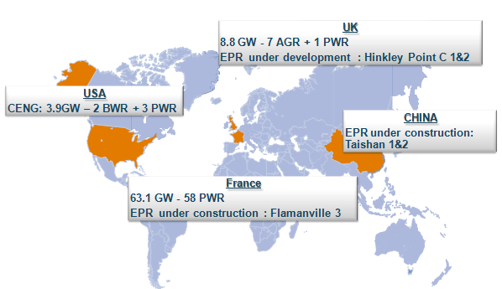
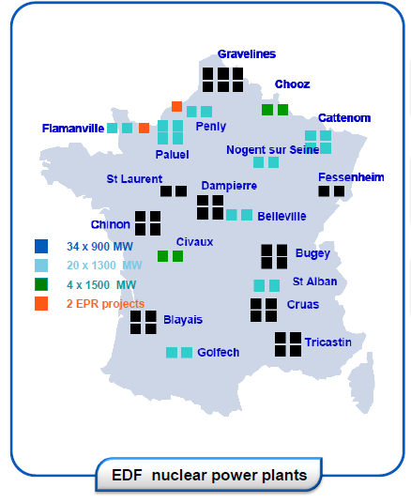

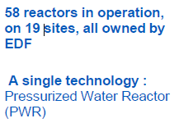
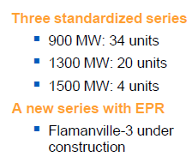

EDF Nuclear Capacity
Notes:
So first, some elements on the EDF nuclear capacity.
You can see in the map, the whole nuclear installations of the EDF group, in France, but also in UK, China and US.
For my talk today, I will be focusing only on the French fleet: it means fifty eight units, nineteen sites.

Slide 3
Context of the French Nuclear
Two years after Fukushima
A new Transparency and Nuclear Safety Law:
  A larger perimeter
  Some items more focused :
    Policy
    Integrated Management System
Huge maintenance program for life time extension
Important staff renewal
Notes:
What about the French nuclear context?
What we observe, one year after the accident of Fukushima, it is a global reinforcement of the oversight of our French regulatory. Particularly, on the conformity differences ; and, of course, on the crisis organization in a large sense.
Second observation, our public opinion is more concerned, more vigilant on nuclear topics. One of the main consequences, in our context of the different elections - mainly for the presidential – is that the nuclear has been become an important stake. Thus, the actual French president has decided to close our older NPP - Fessenheim.
Second decisive element in our context, our new Transparency and safety Law, with its decree of the beginning of this year. To be short, the perimeter of nuclear safety is larger than before. …And, some items are really more focused. Particularly, the safety policy which must define objectives, strategy and resources for nuclear safety. That policy must be spread among each agent and contractor, and be known and understood by them.
The second major focus of the law concerns the functioning of an integrated management system which guarantees safety first.
That’s one of the points that I have chosen to develop today in the following.
Two last elements of our context, for increasing the span life of the installations, we have an huge maintenance program for the next 5 years.
Finally, in this period, we will live a major staff replacement.

Slide 4
Our Preoccupation
What allows us to assure Safety First, through our 3 modes of “governance”?
Lines Management
Processes
Safety First
Projects
Notes:
So, inside this context, I will present now our main preoccupations, and our actual solutions to improve safety performance and enhance safety culture. I will conclude by our weaknesses and consequently some of our perspectives.
So, what is our actual preoccupation concerning safety? If we consider that there are 3 modes of governance in an NPP – lines management, Processes, and Projects – our question is: How can we ensure safety first in each of these 3 modes, in order to have a governance centered on safety?

Slide 5
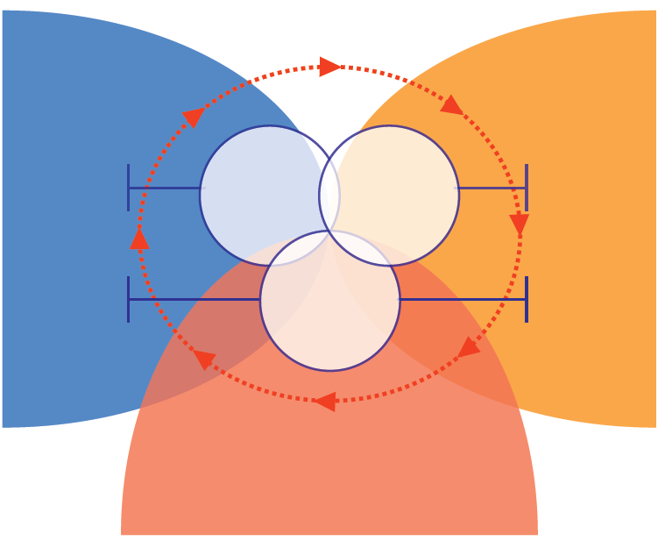
Our Safety Management Organisation
Three key-Principles must lead the managers practices :
A strong Leadership (P1), which allows also Staff Development & Commitment (P2), with an effective Control (P3)
2. Staff
Development
& Commitment
Leadership
Listening and Recognition
of the ISL
Safety
Management
Site
Commitment
of Plant
manager
Quality of
individual and
collective
practices
Commitment
of
Individuals
Safety
Management Departments
Teams
Commitment
of
managers
Management
Into the team
3. Leading with Performance,
Processes
and Continuous Improvement
Notes:
To answer, I need to begin by an overview of our disposal in Safety management.
Since 2004, and reinforced this year with a new version, we defined a disposal based on 2 pillars : one is the INSAG4, we specified what we expect for the 3 levels of managers: plant manager, department manager and first line manager. What commitment, what practices do we expect?
To explain these expectations, we use a second pillar which is the EFQM model of management. We have chosen to select only 3 key-principles; indeed, our experience feed-back has shown that there are : Leadership (safety leadership), Staff development and commitment and Control (leading with performance and processes) and Continuous improvement.
Let me now present in more detail each of these principles, and how are they deployed on our 3 modes of Governance.

Slide 6
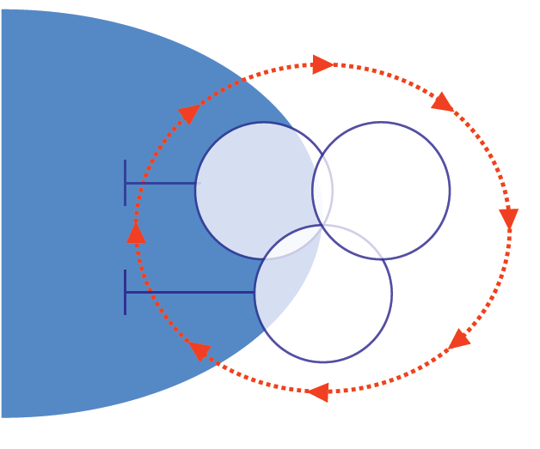


Levers for Leadership (1)
Managers at all levels:
- Develop the values ​​of transparency and openness
- Ensure safety first in their decisions
- Stimulate continuous improvement in safety
>> Safety Policy
>> Managers in the Field
>> Operating Decision
Making and “OSRDE”(1)
>> Risk Analysis
>> Independent Safety Line
>> HF Approach in design
and modifications
>> INSAG 18 Approach
Leadership
Listening and Recognition
of the ISL
Safety
Management
Site
Commitment
of Plant
manager
Commitment
of
Individuals
Safety
Management Departments
Teams
Commitment
of
managers
Leadership
(1) Decision making analysis
Notes:
First of all, Leadership.
The Safety Leadership principle is carried by how managers at all levels:
- Develop the values ​​of transparency and openness,
- Ensure safety first in their decisions,
- Stimulate continuous improvement in safety.
The goal of Leadership is changing safety practices, in order to increase individual and collective safety culture.
Managers embody the Safety Leadership, by their actions. They influence the attitudes and behaviors of everyone, by their exemplarity.
To develop this Leadership, we suggest different levers:…
I will focus now on 3 of these levers.

Slide 7
Levers for Leadership (2)
A Nuclear Safety Policy – EDF Group 2012
“known and understood by everyone”
A Policy which is based firstly on the clarity of responsibility and the need of control, secondly, on commitments:
  - Skills
  - Behavior and safety culture
  - Continuous improvement
  - Openness to best international practices
  - Preparation for emergency situation
  - Transparency and dialogue
Notes:
First lever, our new Safety Policy; it was edited in the double context of Fukushima and the new french Law.
This Policy is based on the clarity of responsibility and the need to control.
It is based also on 7 commitments:
- Skills
- Behavior and safety culture
- Continuous improvement
- Openness to best international practices
- Preparing for emergencies
- Transparency and Dialogue
As Leaders, the managers must support this policy and spread it among each agent and contractor.

Slide 8
Levers for Leadership (3)
“Managers in the Field”
A major activity
for managers effectiveness
Give the sense, share safety issues and remind requirements
Show personal Exemplarity
Detect Human error situations
Know the reality and address it in their decisions
A minimum, one visit per week, per manager
8
Notes:
28 octobre 2013
Groupe EDF
8
Second lever, managers in the field.
That’s a crucial practice for the managers effectiveness.
When managers are in the field, their goals are to :
Give the sense, share safety issues and recall requirements,
Show their exemplary through their opened listening and no blame attitude, recovery of good practices, and identification of differences with what is expected,
Detect Human error situations that could affect the serenity of workers and the final quality of activities
Know the reality, understand the environment of work and the difficulties encountered, and address it in their decisions
Our requirement is a minimum of one visit per week, per manager.
Each visit procures positive and negative reports, which feed the corrective action program of the site.

Slide 9
Levers for Leadership (4)
An Independent Safety Line “Strong & Listening”
LINE MANAGEMENT
COMMITTEES
EXPERT ADVICE,
INDEPENDENT VERIFICATION
DIRECTORSHIP & COMEX
NUCLEAR SAFETY
COUNCIL
GENERAL NUCLEAR
SAFETY INSPECTOR
CHAIRMAN OF THE BOARD
P. GADONNEIX
NUCLEAR SAFETY
DIRECTOR
OPERATIONAL
SAFETY REVIEW
COMMITTEE
NUCLEAR
INSPECTION
NUCLEAR OPERATIONS
DIVISION
NPP OPERATIONS
NS ADVISORY
GROUP
UNIE
NSG
L. STRICKER
NUCLEAR POWER PLANT
SENIOR MANAGEMENT
SAFETY TECHNICAL
COMMITTEE
SENIOR ADVISOR,
SAFETY & QUALITY
20 PLANT MANAGING
DIRECTORS
SHIFT MANAGER
DAILY MEETING
SAFETY ENGINEER
SHIFT SUPERVISOR
9
Notes:
28 octobre 2013
Groupe EDF
9
The last lever on which I will focus today is the independent safety line. It is one of our EDF specificity, build in order to challenge the plant manager on nuclear safety.
The responsibility of nuclear safety is clearly confined to the operational line; it means to the plant manager.
In order to assist the managers, we have created, after TMI, an Independent Safety line. Il means safety engineers outside the crews, into a safety department of the plant, and the creation of a safety and quality director. This director is the “safety conscience” of the plant manager.
This specific organization appears concretely by the daily meeting between the shift manager and the safety engineer, which is a confrontation on the safety of the unit.
In the same perspective, every 2 weeks, there is a safety technical committee, under the presidency of the plant manager, to gather operational and safety staff.
From then on, we created the same organisation and committee at the corporate level and at the company level. So, a nuclear safety council is organised quarterly, with the senior manager of EDF.
At each level of the safety line, people have the duty to alert the superior level if they have not been heard by the management.
Independence and duty to alert are the two major features of this independent safety line.

Slide 10
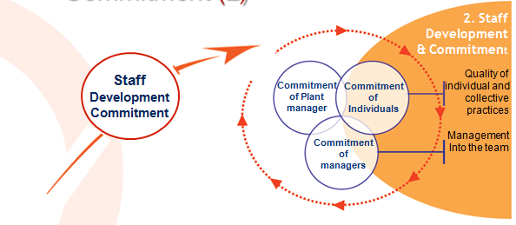
Levers for Staff Development & Commitment
2 Major Elements:
Strong professional skills, including Safety skills and Human
Performance practices
Opportunities for the staff to be committed
to diagnosis and to the building up
of the action plan
2. Staff
Development
& Commitment
>> Human Performance Tools
>> Simulator & operated moke-ups
>>Team Project based
on self-diagnosis, self-assessment
>> Benchmarking
>> Safety Culture Day
V. LAGRANGE
Notes:
Let’s go to our second safety management principle: staff development and commitment.
This principle depends on the interest of each manager to create the conditions of individual and collective success.
This success is expected in two areas:
Conditions for success of daily activities: work organization, skills
The second is linked with the place that everyone find himself, within the organization over time
In this perspective, we think that 2 elements are major in order to progress:
Strong professional skills, including Safety skills and Human Performance practices
Opportunities to the staff to be committed to diagnosis and to the building up of the action plan.

Slide 11
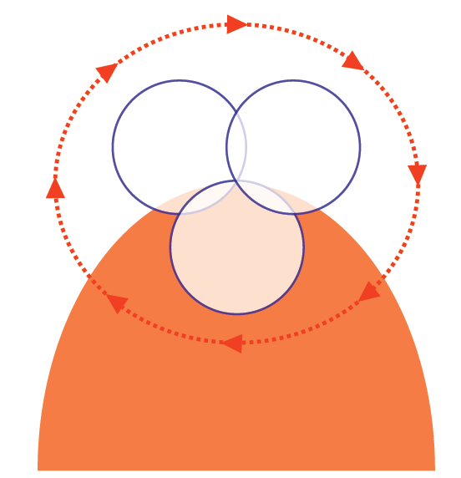
Levers for Control and
Continuous Improvement
>> Safety Process Review
>> In-depth analysis of events
>> Corrective Action Program
>> Low Level Events Approach
>> Safety Perception Questionnaire
>> Annual Safety Report
Commitment
of Plant
manager
Commitment
of
Individuals
Control &
Continuous
Improvement
Commitment
of
managers
3. Leading with Performance,
Processes and
Continuous Improvement
Notes:
Now, our third safety management principle – leading with performance, processes and Continuous improvement.
The management system is organized to provide to nuclear safety the rightful place in the organization. It is based on the functioning of processes and on the principle of continuous improvement.
The performance assessment, the monitoring of the respect of the requirements and moreover the experience feedback are the engines of progress.
We suggest different levers for this principle:
>> Safety Process Review
>> Deep Event Analysis
>> Corrective Action Program
>> Low Level Events Approach
>> Safety Perception Questionnaire
>> Annual Safety Report

Slide 12
How has been deployed our safety management organization?
Lines Management
Processes
Safety First
Projects
Notes:
How has been deployed our safety management disposal?
In relations to - lines management,
- processes
- and, projects.

Slide 13

Implementation on Managements Lines
Safety Management
Guide
Implemented through:
  Training of managers,
  Self-questioning at the 3 levels of management: Plant, Department and First Line managers
Assessed by:
  Annual Safety Report
  Nuclear Inspection,
Notes:
First, how has been it deployed on the lines management?
We described on a Guide, what we consider as practices of excellence on the 3 key-principles of safety management. This Guide is composed of 3 parts: an historical overview of our disposal, which is very important in a period of staff replacement. A second part, on the expectations on each principle, in terms of practices. And, the third part is a self-questionning, very concrete and practical ; in fact, it is a set of thirty questions for each of the 3 levels of management.
We have been deployed this Guide through :
training, at all levels of management
and also, on site, by the top managers, in a local way, means taking into account the results, the context, the history of the site. They have been deployed the Guide inside departments, and also inside the managers networks of the site.
That’s in running today.
What about assessment, which is a lever to reinforce the approach?
At the end of each year, the sites establish their Annual Safety report – it means a diagnosis of safety performance, a root cause analysis and a safety management diagnosis on the 3 principles – of course, at the end, an action plan. It is planned that, at the end of 2013, we will ask a specific report on their deployment of the Guide.

Slide 14
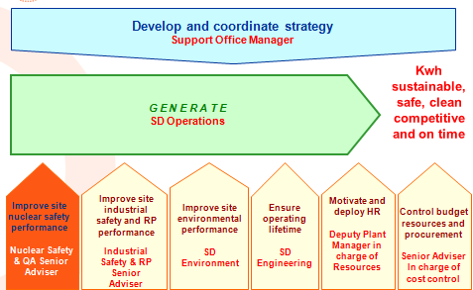
Implementation on Processes (1)
2 major elements:
  A Nuclear Safety Macro-Process (MP)
  A Plant Strategic Review
A Nuclear Safety MP
In order to:
Establish a Diagnosis
Define a action plan
Challenge the other MP to take into account safety
Notes:
Now, what about the deployment on processes?
Today, all the French sites use processes to control, and the majority, have developed an Integrated Management System.
This is an example of the map of the different processes of a French site.
Mapping of the processes splits into 8 macro-processes:
Plant coordination process
Generation process in charge of the site ultimate goal
And 6 support processes: nuclear safety, industrial safety and radiation protection, environment, operating lifetime, Human Resources, and budget resources and procurement.
So, as you see, in EDF we have chosen to get a nuclear safety process separately.
The mission of this process is to establish diagnosis and action plan to improve safety and also, that very important to challenge the other macro-processes to take into account safety.
Our conviction, is that it is very important for us to maintain a such safety process, even if the safety is clearly the responsibility of “generate” process. Because, in order to continuously progress, we need to take advantage of the independence and of the challenge that occurs this safety process.

Slide 15
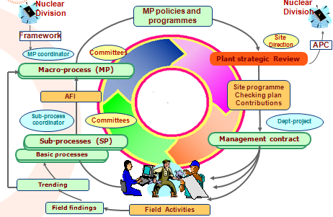
Implementation on Processes (2)
2 major elements:
  A Nuclear Safety Macro-Process (MP)
  A Plant Strategic Review
A Plant Strategic Review
In order to:
Have an overview of all the major risks and actions
Decide what are the priorities by ensuring Safety First
Notes:
Second element of the deployment on processes.
At the end of the year, each macro-process held a review in order to determine areas for improvement, based on its strengths and weaknesses during the year. These areas for improvement are ranked by using a matrix of priority.
After this step, a plant strategic Review is done in order to coordinate all the macro-processes. This plant Review enables the programmes to be compiled, and site priorities to be identified.
Generally, 5 or 6 site priorities are defined, which make up the site commitments for the next year.
Concerning safety, this Plant Strategic Review has a crucial role:
Have an overview of all the major risks, priorities and actions,
Decide what are the priorities in order to ensure Safety First

Slide 16
Implementation on Projects
INSAG 18
Analyze the impacts
– technical, human, organizational –
on safety
Operational
INSAG 18 Analysis
Project Level
Independent Safety Line
INSAG 18 Analysis
Project Level
Confrontation
INSAG 18
Site Level
Confrontation
INSAG 18
Site Level
Notes:
Last mode of governance, the projects; it means programs featured by important change in methods, practices or organization.
In that area, we have been trying to use the INSAG 18, in order to ensure safety first, even in a period of change.
So, in these projects, in a first step, we identify the major impacts - technical, human, organizational one – and, then, we estimate the consequences of these impacts on safety.
In this case of project, we do the same as for daily safety analysis .It means, we use a confrontation between the analysis of the operational line and the analysis of the independent safety line.
The objective is to identify the risks concerning safety, define the counters and assure that the counters are taking into account in the deployment of the project in site.

Slide 17
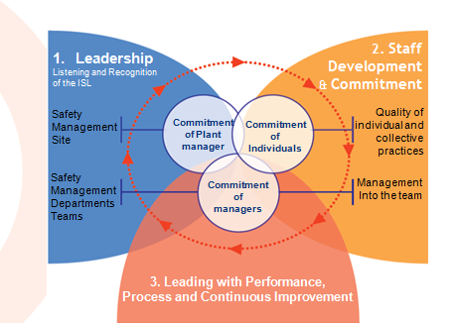
Conclusion & Perspectives
Indicators
of
- Results
- Contribution
- Trend
Safety Management
on 3 key-principles
Safety
Performance
Items
on
Behaviors
Attitudes
Perception
Safety
Culture
We need more “knowledge” on safety culture, particularly on Attitudes and Perception
Notes:
At this step of my talk, I ca say I tried to present to you, not the integrality of our actions in safety, but only the more recent one in safety management.
To conclude, I will talk about our needs and perspectives.
With the time, we have had an effective set of indicators to measure the nuclear safety performance, and we have also, some indicators to evaluate the progress. We talk about indicators of contribution and trends.
We have had with the assessment made by the nuclear inspection, associated with peer review, a certain knowledge of the practices and the behaviors of the managers and the staff.
What we need now, it is more information, more knowledge on the attitudes and the perception of people regarding safety.
That’s why, we are very interested by the SCART from IAEA, and by the technical support mission from Wano Paris.
One of our sites, Cruas, did one TSM last July ; we will encourage others French sites to do the same.
My conviction, is that we are in a very constrained period – lot of requirements following Fukushima, an huge maintenance program, an important staff replacement. We are in a period in which nuclear safety and all the actors concerned must be very strong and powerful.

