Slide 1
The Report of Actions Taken in the Field of Establishing Integrated Management System

Slide 2
Establishment Of Integrated Management System
Since Bushehr Nuclear Power Plant (BNPP) is the first nuclear power plant in the country establishing integrated management system and there is no history with regard to establishing this system in power plant in Iran, several contractors were identified for establishing the system and their experience and competence were assessed and a contract was concluded with qualified consultant for the establishment of integrated management system.
In order to plan and establish the project of management systems of quality, safety and health, and environment in an integrated manner in operating company of BNPP, recognizing current situation, identifying, planning, designing, and reviewing organizational processes based on integrated management system requirements, development and modification of all documentations such as procedures, instructions, and organizational forms needed for integrated management system were carried out.
2

Slide 3
Establishment Of Integrated Management System
In order to specify current situation of the company regarding realizing management systems requirements, at first the situation of existing working processes, equipment, infrastructure, human resource, current management systems, and other resources being used currently, and also work departments was assessed in the form of holding meetings with deputies and managers of the company and the domain of establishing management systems was clarified and agreed upon. Then management system was determined based on the above-mentioned results and the gap between status quo and desirable status based on requirements.
In this regard, “executive committee for planning and establishing integrated management system” and “steering committee for planning and establishing integrated management system” were formed with participation of representatives of all plant departments in a way that all company departments become familiar with key concepts of this system.
3

Slide 4
List of Training Courses Held
Following training courses for familiarizing the staff with concepts of ISO9001, 45001, 14001, and GSR Part2 were hold and representatives from all company departments attended these training courses:
Getting familiar with requirements of quality management system based on ISO9001-2015;
Getting familiar with requirements of occupational health and safety management system, ISO45001-2008;
Getting familiar with requirements of environmental management system, ISO 14001-2015;
Getting familiar with requirements of management system based on GSR Part2;
Getting familiar with process management;
Risk identification and assessment techniques and their aspects;
Getting familiar with risk management based on ISO 31000:2018;
Getting familiar with data analysis and problem solving techniques;
Getting familiar with knowledge management;
Getting familiar with seven basic tools of quality control;
Getting familiar with calibration management and basics;
Getting familiar with configuration management;
Getting familiar with ranking process;
Getting familiar with change management;
Getting familiar with records management based on ISO 30301;
Getting familiar with audit guidance of environmental and quality management systems based on ISO 19011:2011;
Audit workshop;
Professional ethics in audit.
4

Slide 5
Establishment Of Integrated Management System
Processes map of the company was developed and approved based on all company activities, internal and external factors, and stakeholders of the company in order to improve the process and increase communications and documentation. Toward clarifying processes and facilitating decision making in company, the ID of each identified process has been developed in which the activities, input and output of each process, and assessing criteria and the knowledge required for activities of each processes have specified.
Monitoring, measuring, and analyzing the criteria and indicators related to company processes have been carried out in order to identify areas for improvement and also determine appropriate corrective actions for increasing continuous improvement and effectiveness of integrated management system of BNPP operating company.
5

Slide 6
Establishment Of Integrated Management System
BNPP operating company, as a high technology and important from safety point of view company and regarding the importance and necessity of risk management in nuclear activities, has placed risk management at the top of the list of its activities and has considered risks in three areas of quality, health and safety risks, and environmental risks and has planned the issue of risk management in integrated management system and processes map of the company as an organizational capability and has established and implemented it in all plant activities.
Organizational risk management of the company has been planned based on COSO model, ISO31000:2018 and, on the basis of this, risks and opportunities of integrated management system processes and safety risks and environmental aspects has been identified and assessed; and controlling and response actions for activities and hazards that have unacceptable risks have been determined and their effectiveness has been analyzed.
6

Slide 7
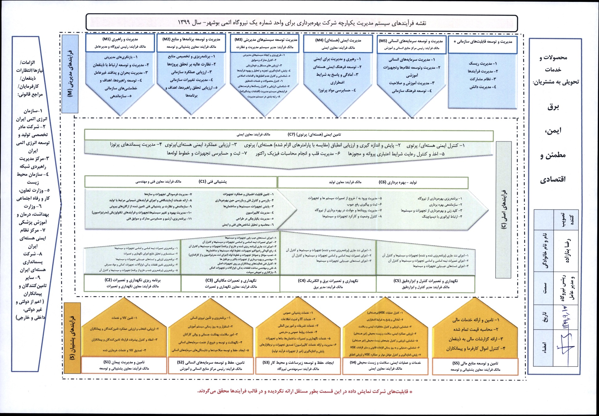
Bushehr Nuclear Power Plant (BNPP) Processes map
7

Slide 8
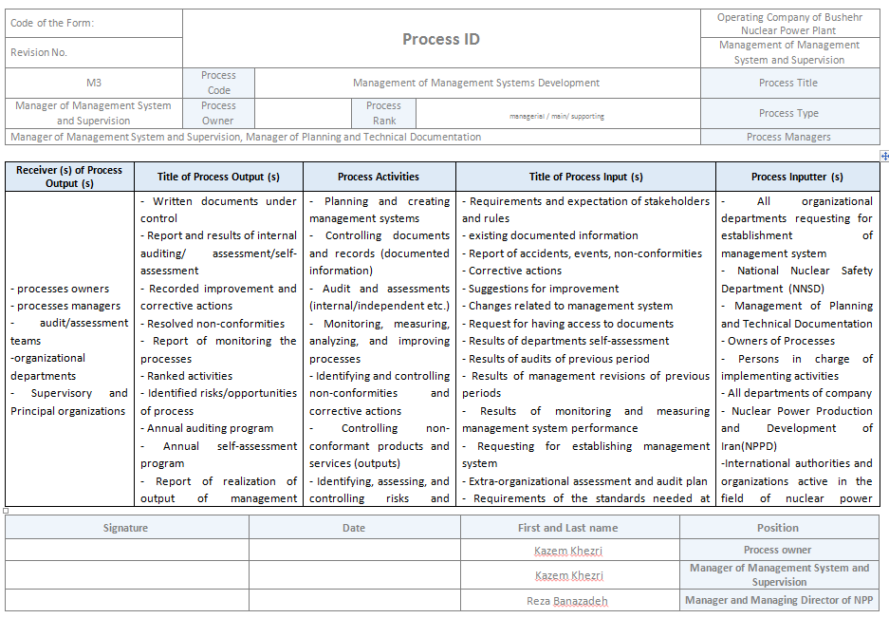
Management of Management Systems Development Process ID
8

Slide 9
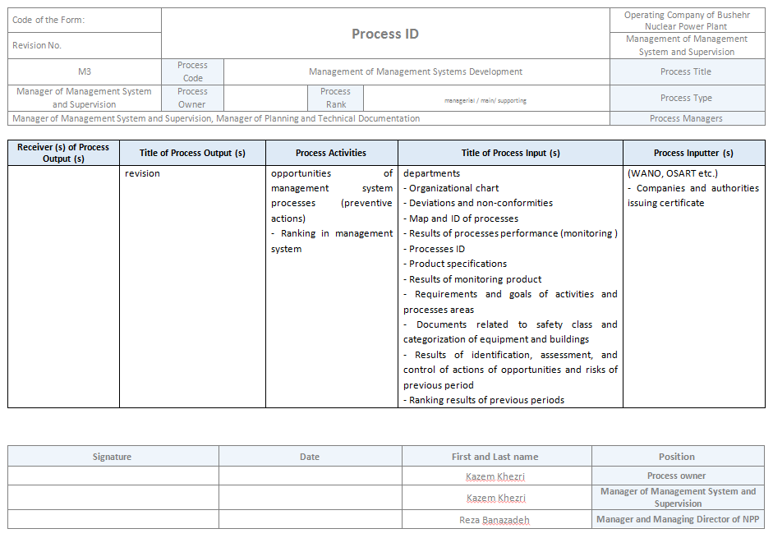
Management of Management Systems Development Process ID
9

Slide 10
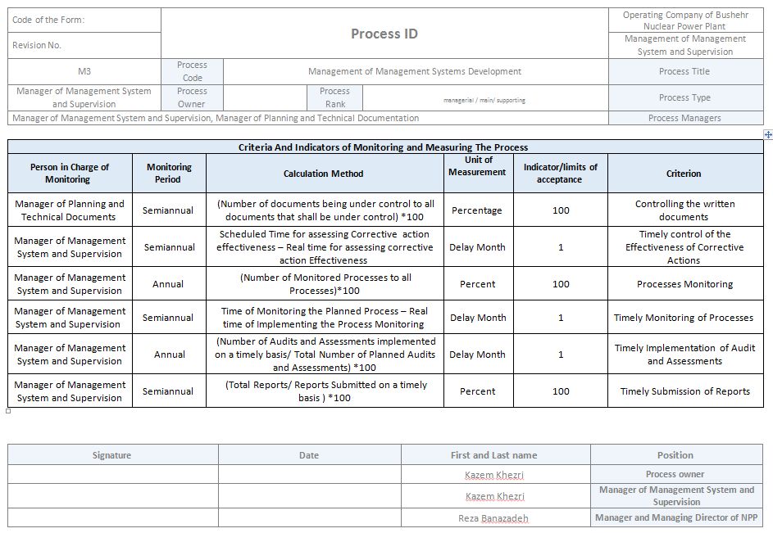
Management of Management Systems Development Process ID
10

Slide 11
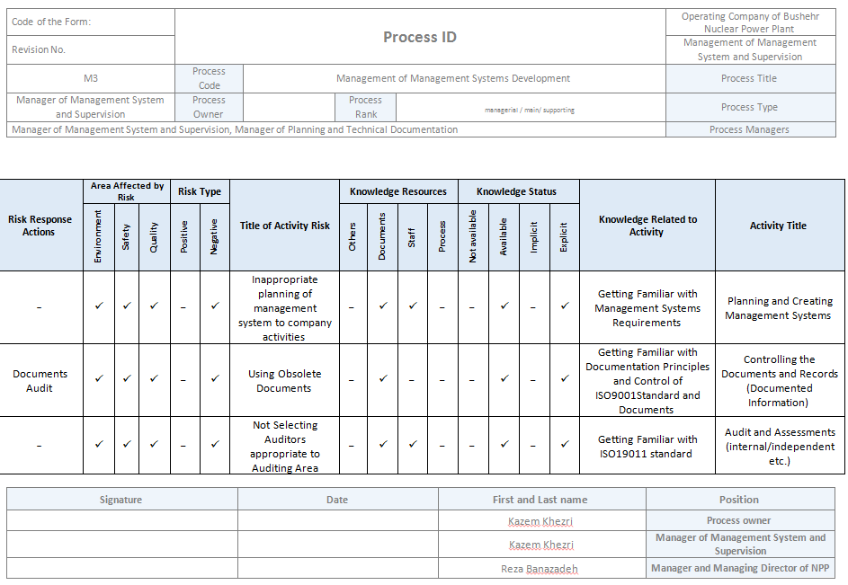
Management of Management Systems Development Process ID
11

Slide 12
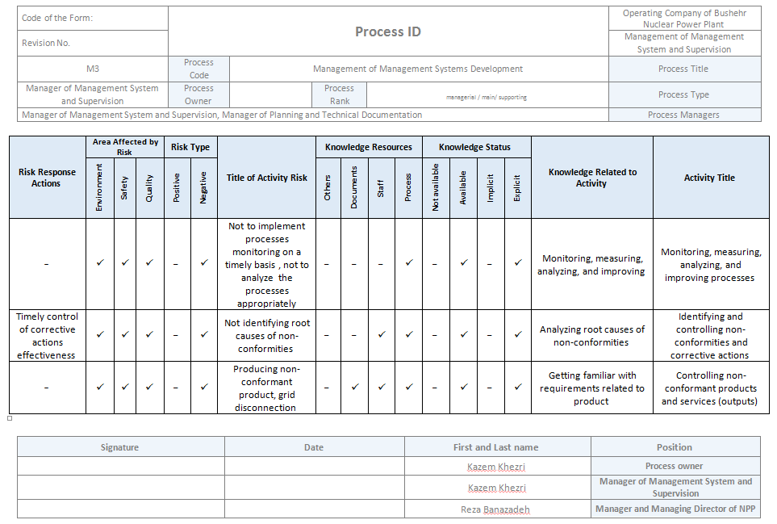
Management of Management Systems Development Process ID
12

Slide 13
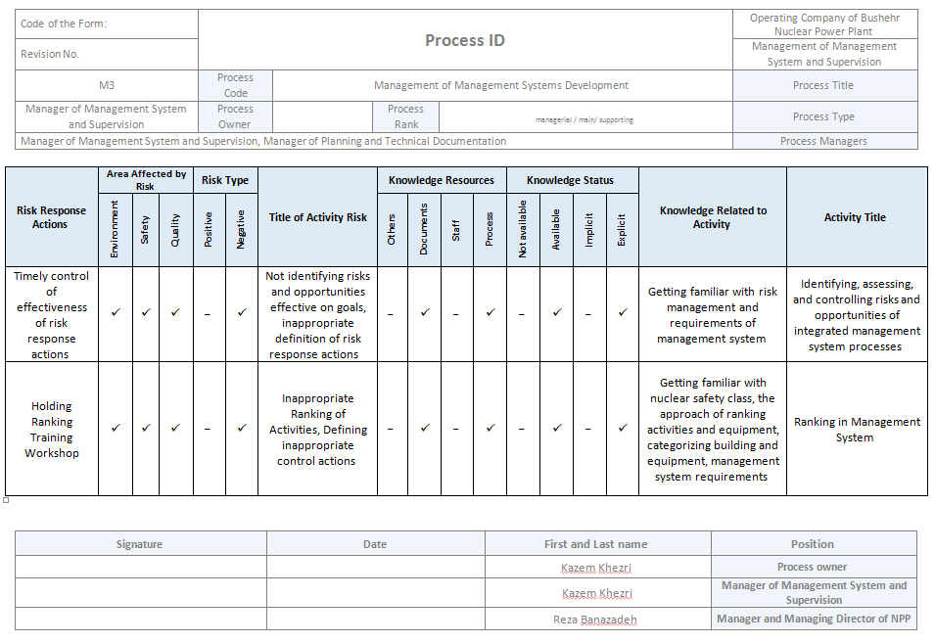
Management of Management Systems Development Process ID
13

Slide 14
Thanks For Your Attention

