Slide 1

Vibration Monitoring System in Bushehr Npp1 introduction & problems
Acquaintance with Methods of Vibration Monitoring of Rotating Machines Including RCP and Turbine-Generator
8 – 11 September 2014
IAEA Headquarters
Vienna, Austria
Provided by:
Adel Derisi
(BNPP Operating Company)
Mohamad Rasti
(BNPP Operating Company)

Slide 2

Vibration Monitoring System in Bushehr Npp1
HISTORY
HISTORY:
Construction of the plant was started in 1975 by German companies (KWU), but the work was stopped in 1979.
We had to assess the damage done to the partially complete plant by the passage of time and by air raids during the Iran–Iraq War.
A contract for finishing the plant was signed between Iran and the Russian Ministry for Atomic Energy in 1995, with Russia's Atomstroyexport named as the main contractor.

Slide 3
Vibration Monitoring System in Bushehr Npp1
Introduction to the Vibration Monitoring system & diagnostic in BNpp1
Introduction to the Vibration Monitoring system & diagnostic in BNpp1
  Organizational structure of Vibration analysis group in Bushehr Npp1
In Bushehr NPP1 vibration condition monitoring & diagnostic is implemented by Vibration analysis group
Chief Engineer
Engineering & Technical Division
System & Equipment Performance, Analysis & modernization
Vibration analysis group

Slide 4
Vibration Monitoring System in Bushehr Npp1
Introduction to the Vibration Monitoring system & diagnostic in BNpp1
Vibration Monitoring system & diagnostic
We use Automatic Vibration Monitoring System(AVMS) in BNPP in RCPs(Reactor Coolant Pump),Turbo-generator and chillers .
The system for doing this monitoring includes sensor located in position and another system located in control room .This system(AVMS) can only perform monitoring but can not perform diagnosis. This is our on-line Vibration Monitoring System. We use portable vibrometr (mobile devices-pocket vibra ultra) for off-line Vibration Monitoring. This set measures the velocity of vibration.
Monitoring
  AVMS(Automatic Vibration Monitoring System)(on-line)
  Mobile devices (pocket vibra ultra)(off-line)
Diagnostic
    Mobile devices (pocket vibra ultra)

Slide 5
Vibration Monitoring System in Bushehr Npp1
Introduction to the Vibration Monitoring system & diagnostic in BNpp1
Vibration Monitoring in BNPP-1
On-line monitoring systems
  RCP(Cooling Reactor Pump) 4 Pump
    DIAPROM Russian system (Displacement & Velocity )
  Turbine & Generator
    ВИБРОБИТ 100 Russian system (Displacement & Velocity )
  Cooling machines - three York (5*10^7 BTU) , four Carrier (10^8 BTU)
    Bently Nevada USA (only Displacement of shaft )
Off-line monitoring systems by mobile devices (pocket vibra ultra)
  Safety system channels (four independent Channels)
    Emergency AC power system 4 * 2 Generator (3100 kw,50Hz,10500v)
    Emergency feed water system 4 * 2 Pump
    Extra borating system 4 * 1 Pump
    Service cooling water system 4 * 1 Pump(450 kw ,vertical, sea water)
    Residual heat removal system 4 * 3 Pump
HISTORY

Slide 6
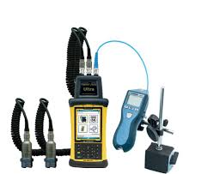
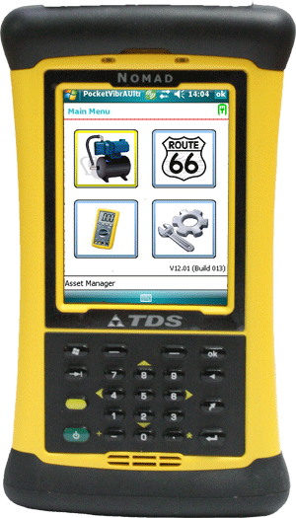
Vibration Monitoring System in Bushehr Npp1
Introduction to the Vibration Monitoring system & diagnostic in BNpp1
Specifications of mobile devices(Pocket Vibra Ultra)
Size 220 mm x 95mm x 45mm
Weight 500g (not including accelerometer)
IP67 sealed against accidental immersion
(1m for 30 min)
Frequency ranges
0 Hz to 1 kHz; 0 Hz to 15 kHz
Frequency Resolution
400, 800, 1600, 3200, 6400, 12800,
25600 or 51200 lines FFT
(0.3 Hz from 0 to 15 kHZ, 0.02 Hz from 0 to 1 kHz)
Input range
+/- 50g with standard 25mV/g C-Cubed
accelerometer
Dynamic range
120 dB +/- 50g to +/- 0.0004g with standard
Accelerometer
Envelope demodulation filters
Fully user selectable high pass and low pass
filter cut-off frequencies
Accelerometer Connection
Standard 10 pin IP67 connected smart
accelerometer with built-in ID and sensitivity
calibration (nominally 25mV/g)

Slide 7
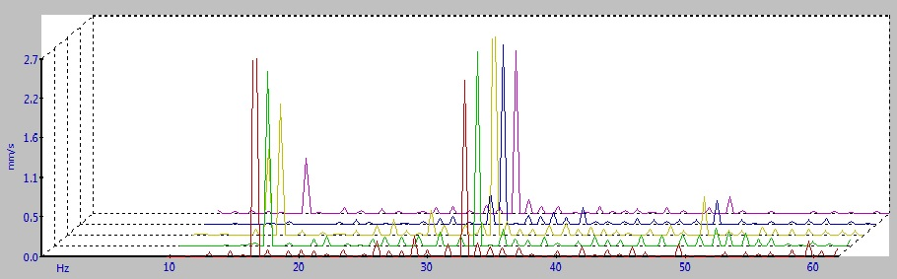
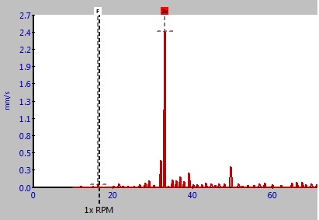
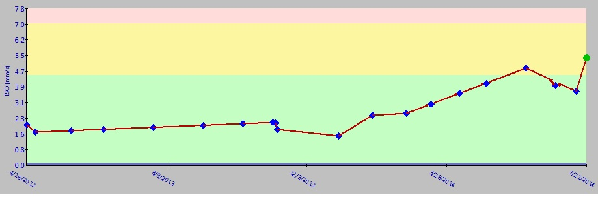
Vibration Monitoring System in Bushehr Npp1
Introduction to the Vibration Monitoring system & diagnostic in BNpp1
“C-Trend “- Vibration Analysis

Slide 8
Vibration Monitoring System in Bushehr Npp1
Problems
Questions
In what section (Repairs & Maintenance or Technical & Engineering) of your structure ,CM(Condition Monitoring) is located?
Is it necessary that CM section be in the same section along with the R&M section(balance ,alignment,…)?
During the periodical repairs of your NPP carried out by the contractor from outside the NPP ,how is acceptance done in terms of vibrations control?
In regard to conditions of our NPP in which some of equipment are old , but have been put recently into operation , what priority is considered for determining the norm of vibration?(Standard , manufacturer or operating conditions – operating organization?)
What kind of methods do exist for measuring the vibration of non-rotary equipment such as valves , pipeline and their supports?
Is AVMS(Automatic Vibration Monitoring System ) in your NPPs able to diagnose? ( in a way other than trend method ) Is it necessary (in terms of standards and also better maintenance ) to do so?

Slide 9
Vibration Monitoring System in Bushehr Npp1
Thanks For Your Attention

