Slide 1
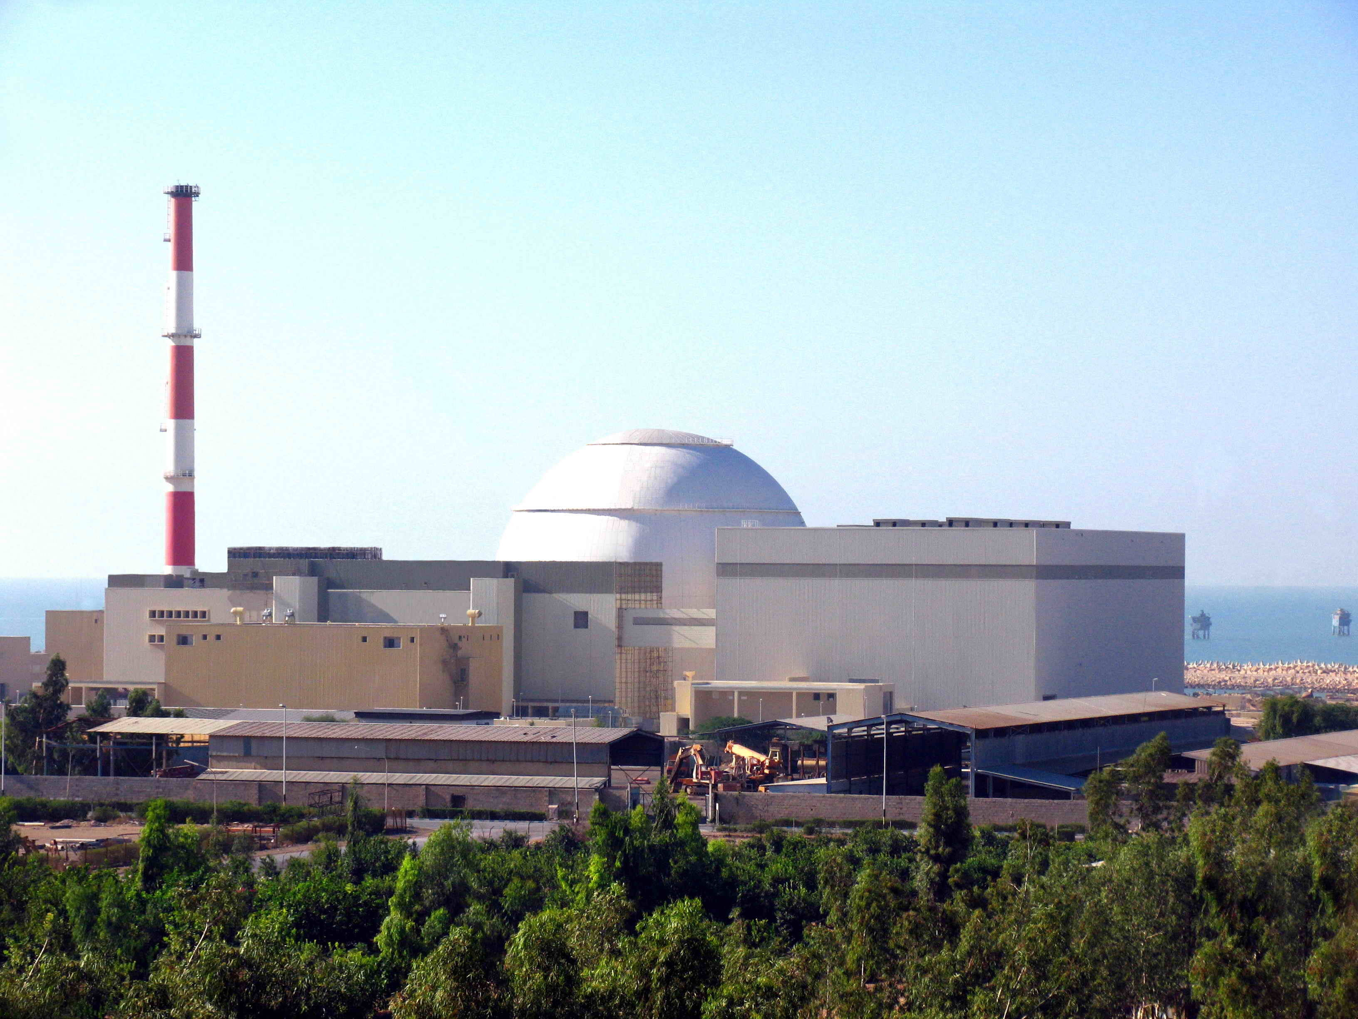


NPPs Safety Development
& Improvement Co.
TAVANA

Slide 2
NPPs Safety Development & Improvement Co.
NPP’s Safety Development & Improvement Company (TAVANA) is responsible for the Technical support of the BNPP-1.
The company was established by the NPPD in 2013.

Slide 3
Organizational Structure
Board of
Directorate
General Director
NPPs Safety Development & Improvement Co.
Office of General Director
Legal & Contractual Management
Quality & Permissions Management
Technical & Engineering Department
Fuel Management Department
Nuclear Engineering Department
Planning & Projects Department
Technical Coordination Department at BNPP-1
Administrative, Financial & Supporting Department
Electrical & Communication Section
In-Core Fuel Management & Reactor Physic Section
Probabilistic Safety Analysis Section (PSA)
Planning & Project Control Section
Electrical Section
Administrative Section
Instrumentation & Control Section
Fuel Procurement Section
Thermal Hydraulic & Accident Analysis Section
Documents & Information Technology Section (IT)
Instrumentation & Control Section
Financial Section
Civil Section
Fuel Engineering Services & Accounting Section
Radiation Protection and Emergency Planning Section
Human Resource & Training Section
Mechanical Section
Supporting Section
Mechanical, Process & Material Section
Waste Management Section
Project Manager 1
Nuclear Section
Simulation and Control Section
Project Manager 2

Slide 4
NNSD
(Regulatory Body)
TSO Interfaces chart
First year
NPPD
(Op. Organization)
REA
(Contractor)
BNPP
(Operation)
Training
Consulting
Reviewing
….
TSO (TAVANA Co.)
Vendors
Research Centers
Working Line
Main Contracting Line
Consultants

Slide 5
TSO Interfaces chart
Second year
NNSD
(Regulatory Body)
NPPD
(Op. Organization)
REA
(Contractor)
TSO (TAVANA Co.)
BNPP
(Op. Organization)
Research Centers
Vendors
Consultants
Working Line
Main Contracting Line

Slide 6
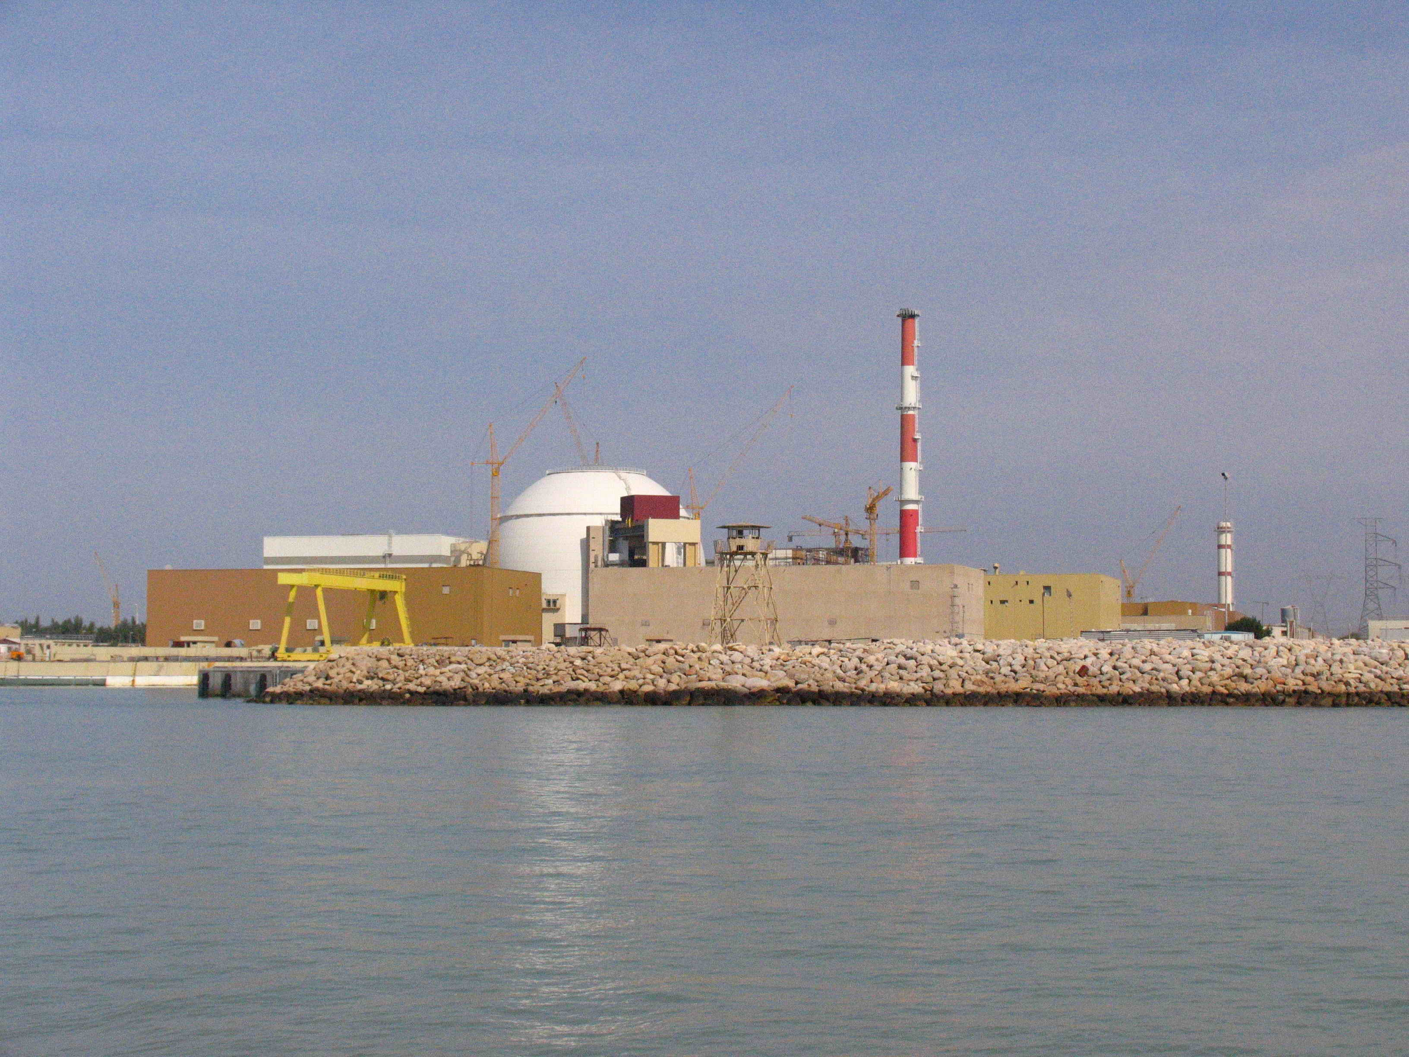
Thanks for Your
Consideration

