Slide 1

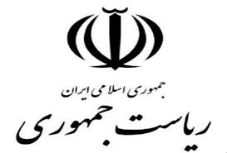
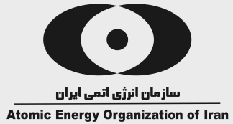
“He initiated you from the earth and settled you there”
Surah Hud,
Verse 61
Nuclear Energy in its way of sustainable development

Slide 2
The Necessity of Nuclear Energy Development
Nuclear And Radioactive Materials
outlines
Radioactive Wastes
Facilities and Radioactive Waste Producers in Iran
Radioactive Waste Management in Iran

Slide 3
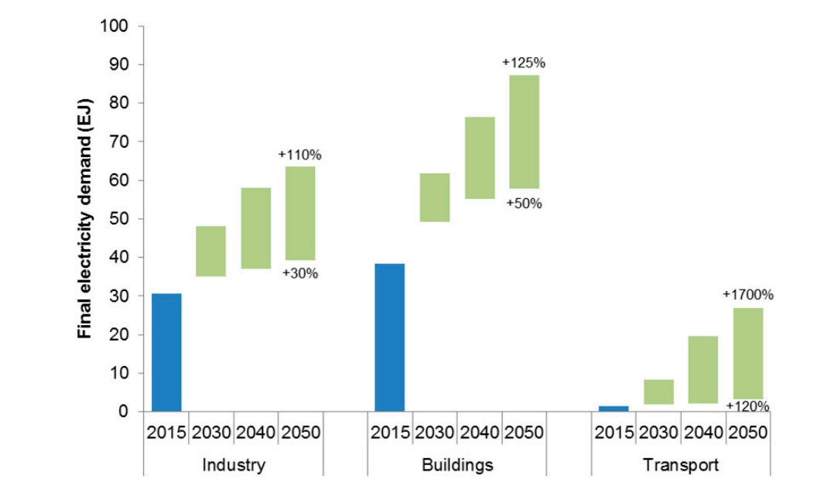
Necessity of nuclear energy development
Increasing demand of electricity in the world
Climate change and nuclear power, IAEA, 2018
One of the main purposes of sustainable development is to obtain clean, safe and cost-effective sources of energy

Slide 4

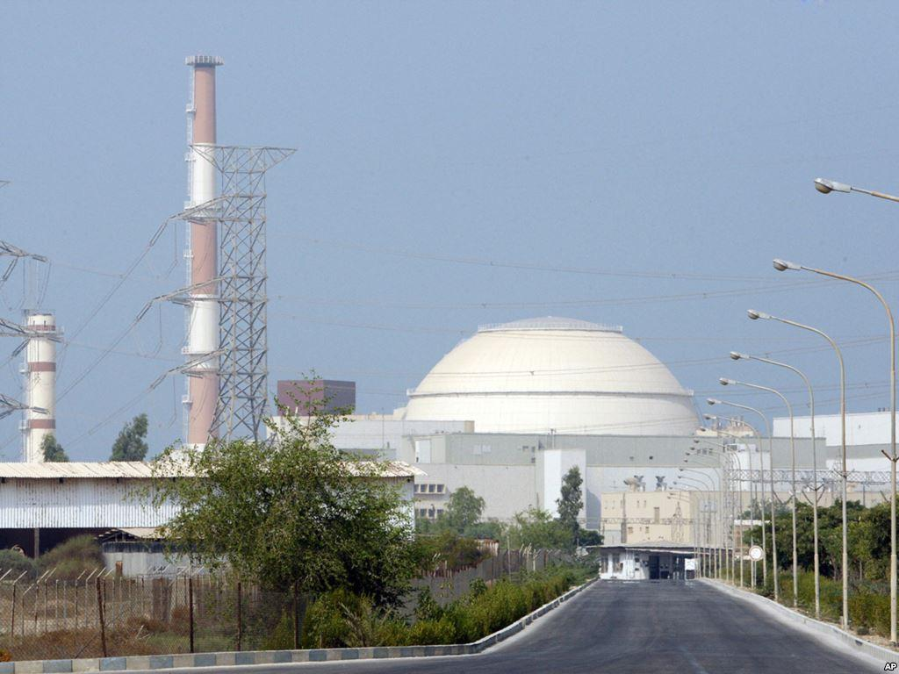
Necessity of nuclear energy development
Advantages of nuclear power plants
Clean
Cost-effective
Safe
Reliable
Notes:
منابع انرژي پاک – نظير انرژي هسته اي، برقابي، بادي، ژئوترمال و خورشيدي – انرژي هاي پاکي هستند که گازهاي گلخانه اي توليد نمي کنند و بنابراين تاثيري در تغيير اقليم ندارند.
انرژي هسته اي يکي از صنايع مهم و استراتژيک در توليد انرژي پاک و بدون کربن مي باشد.
دانشمندان توافق دارند که انرژي هسته اي يکي از انرژي هاي قابل اعتماد است که رهاسازي گازهاي گلخانه اي را به شدت کاهش مي دهد.
استفاده از انرژي هسته اي در حال حاضر در دنيا در حدود 2/5 ميليارد تن دي اکسيد کربن ناشي از سوخت هاي فسيلي را کاهش داده است.
پسماندهاي پرتوزاي حاصل از انرژي هسته اي در حال حاضر بر اساس روش هاي ثابت شده در حال مديريت هستند.

Slide 5
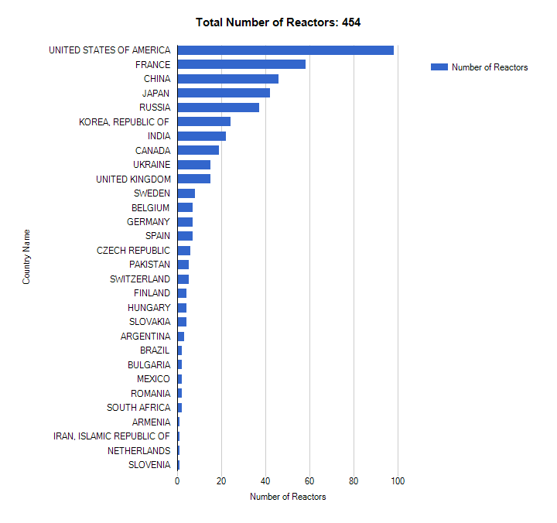
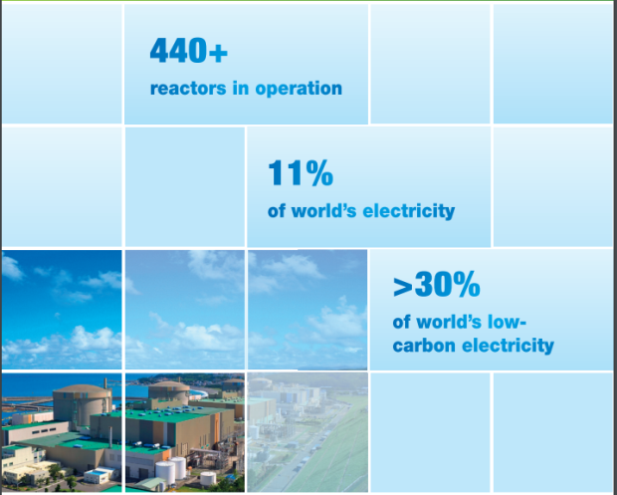
Necessity of nuclear energy development
NPPs in the world
IAEA 2019

Slide 6
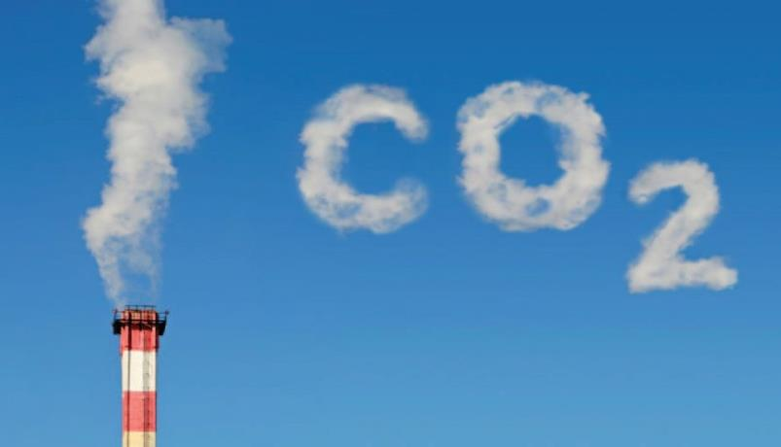
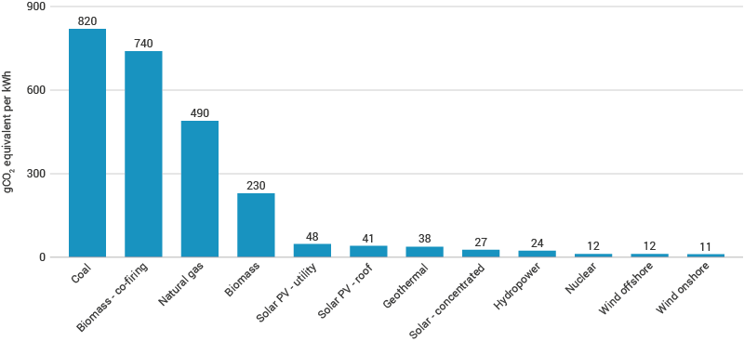
Necessity of nuclear energy development
Comparison of greenhouse gases in different power plants
Nuclear Power for Sustainable Development, IAEA, 2018

Slide 7
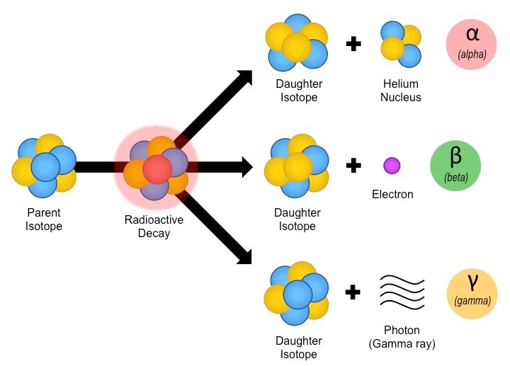
Nuclear and radioactive materials
Radioactive materials are divided into two categories:
Natural radioactive materials
(K-40, U-238)
2. Artificial radioactive materials
(Iodine-131, Cesium-137)
To assure the peaceful application of nuclear technology, there is another definition and classification based on the international nuclear safeguard protocols in which Uranium, Thorium and Plutonium are considered nuclear materials.
Notes:
مواد راديو اكتيو شامل دو دسته هستند، ا- ماده پرتوزاي طبيعي و 2- ماده پرتوزاي مصنوعي
ماده پرتوزاي طبيعي آن دسته از مواد پرتوزا است كه در طبيعت به صورت ذاتي وجود دارند و انسان در به وجود آمدن آن ها هيچ نقشي ندارد.
و ماده پرتوزاي مصنوعي آن دسته از مواد پرتوزا را شامل مي شود كه ساخته دست انسان هستند و براي توليد آن ها، انساني تلاش كرده است.

Slide 8
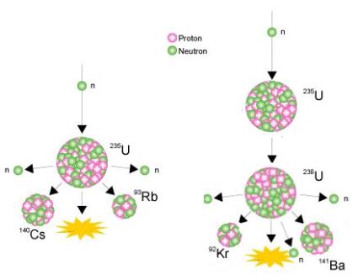
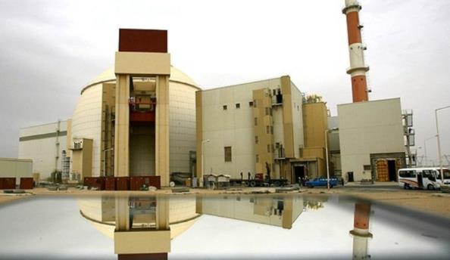
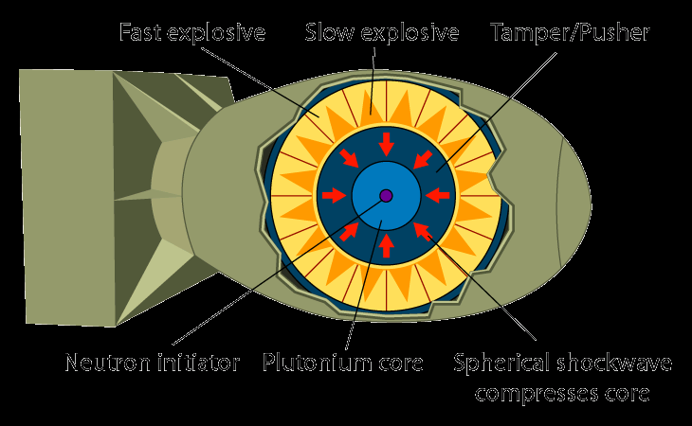
Nuclear and radioactive materials
Dual-use of nuclear materials
Bushehr NPP
Hiroshima and Nagasaki, Japan, 1945

Slide 9
Radioactive wastes
Radioactive waste is the byproduct of a nuclear process which is not usable for any other activities.
Radioactive wastes produced in Iran include:
Solid and liquid wastes of Bushehr NPP and research reactor
Solid and liquid wasted arising from research activities and radiopharmaceuticals production
Radioactively contaminated equipment
Spent radioactive resins from reactors
Spent radioactive sources
Spent nuclear fuels
Wastes containing natural radioactive materials
Medical Radioactive wastes

Slide 10
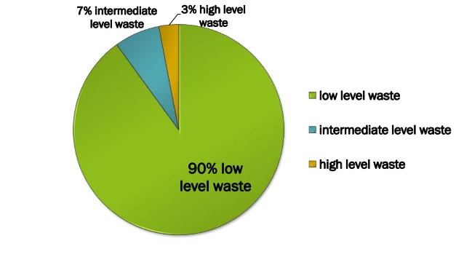
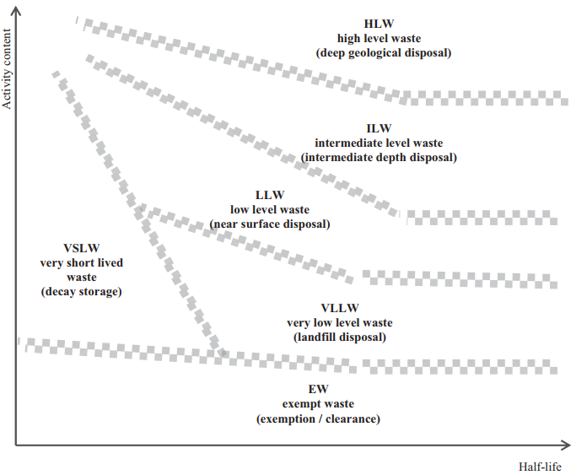
Radioactive wastes
Classification
Radioactive wastes ‘based on their activity and half-life’ are usually classified in three levels : low, intermediate and high level
A large volume of produced wastes in the world are categorized as low and intermediate level.
 | Volume | Activity
High Level waste | 3% | 95%
Intermediate Level waste | 7% | 4%
Low Level waste | 90% | 1%

Slide 11
Facilities And Radioactive Waste Producers In Iran
There are five main radioactive waste producers in Iran:
Bushehr NPPs
Nuclear fuel cycle facilities (NFC), from Uranium mining and milling to enrichment and fuel fabrication
Radioactive research institutes (RRI) in the field of medicine and fundamental particles including laboratories and research reactors
Medical/ industrial institutes (MII) with diagnostic and therapeutic activities, industrial evaluation system and sterilization
Mines and industries producing Naturally Occurring Radioactive Materials (NORM) especially in mining and oil and gas production and refinement

Slide 12
Radioactive waste management in Iran
Management and control of radioactive waste is a global agreement, so establishing, developing and implementing a long term plan in order to manage this kind of waste in a safe and secure manner is the responsibility of the governments.
Iran Radioactive Waste Management Company (IRWA) deals with radioactive wastes management according to the national and international rules, Iran Nuclear Regulatory Body regulations and IAEA standards.
Atomic Energy Organization of Iran is responsible for the items below:
Protecting the environment
Protecting public health
Protecting next generations
Consultancy services about the reduction of radioactive waste production
Improving the nuclear safety level

Slide 13
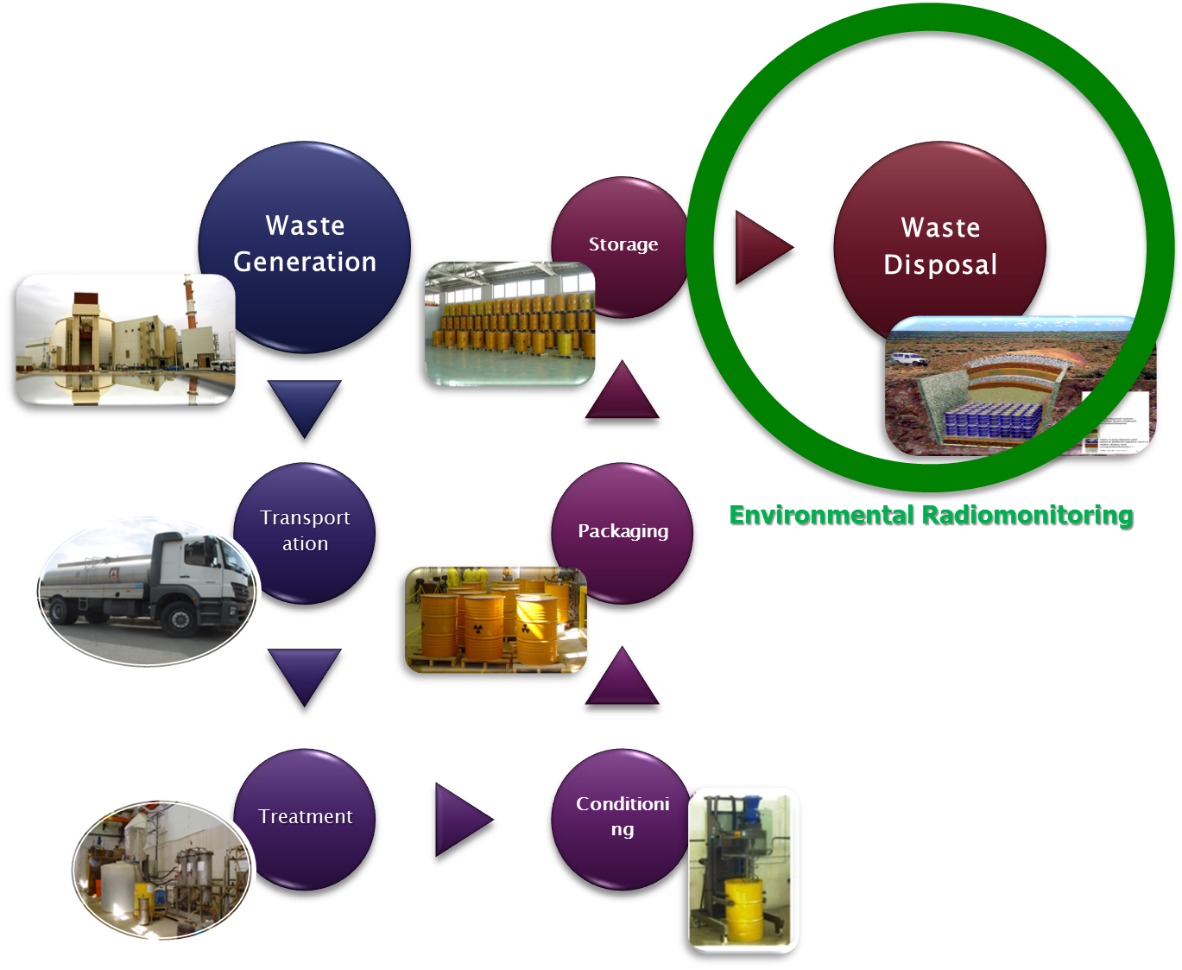
Radioactive waste management in Iran
Waste management from generation to disposal

Slide 14
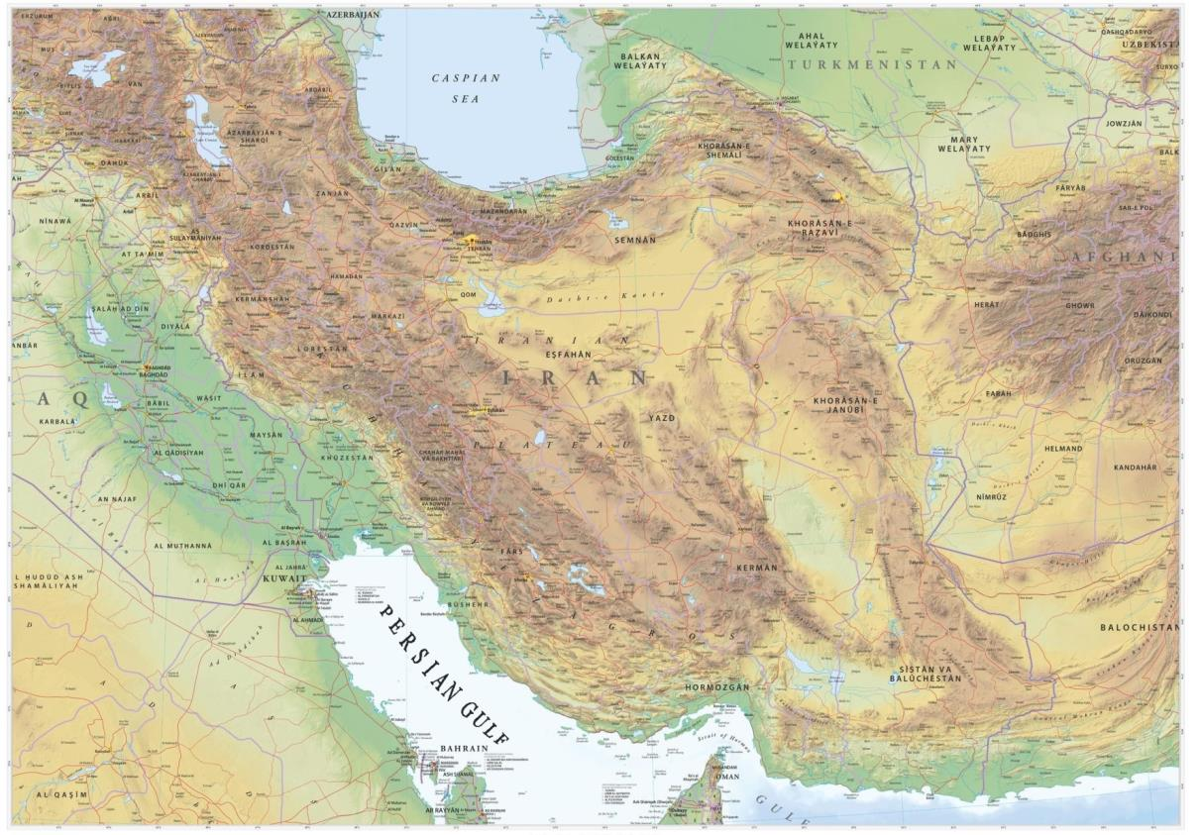
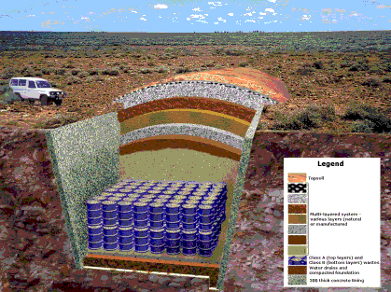
Radioactive waste management in Iran
Location of IRWA facilities
Karaj interim storage
Tehran site
Anarak disposal site

Slide 15
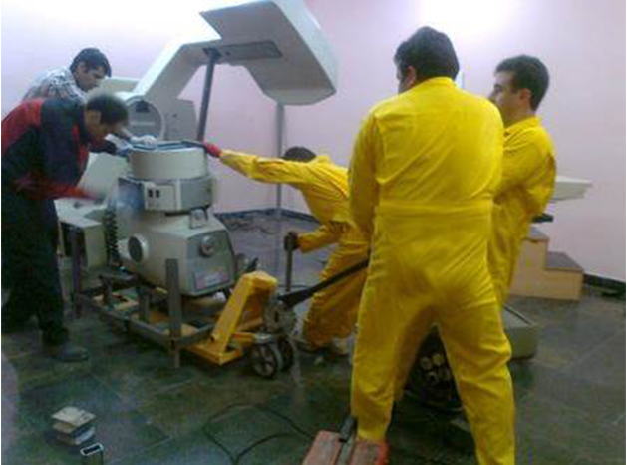
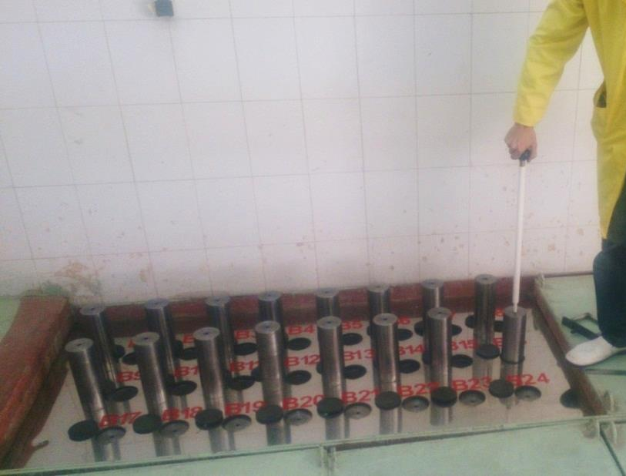
Radioactive waste management in Iran
Disused radioactive sources
location of management: Tehran site
Dismantling, collection, transportation and characterization of radioactive sources
Establishing one of the safest radioactive source storage systems

Slide 16
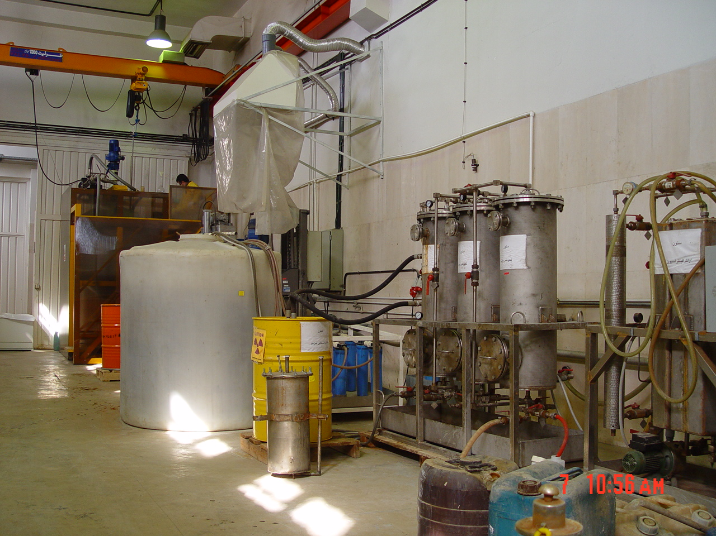
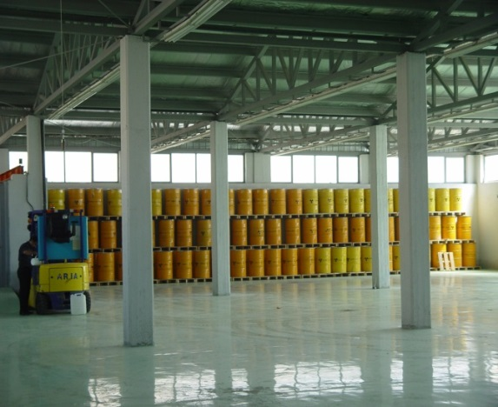
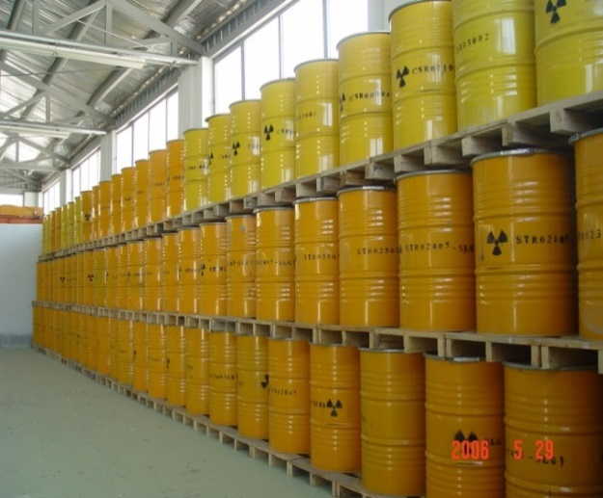
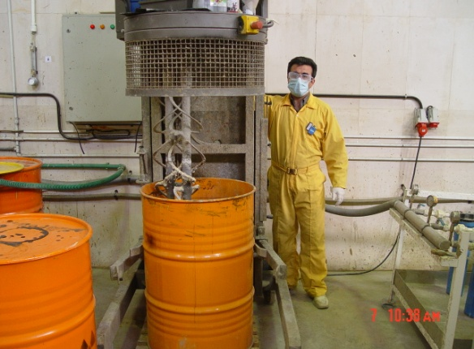
Radioactive waste management in Iran
Treatment, Conditioning and storage of radioactive waste
By the time repository is completed and ready to accept radioactive wastes , they will be stored in storage buildings constructed based on IAEA and Iran Nuclear Regulatory Body standards.
In order to preventing radioactive wastes to release in the environment, the wastes are immobilized in cement.
Tehran site
Karaj interim storage

Slide 17
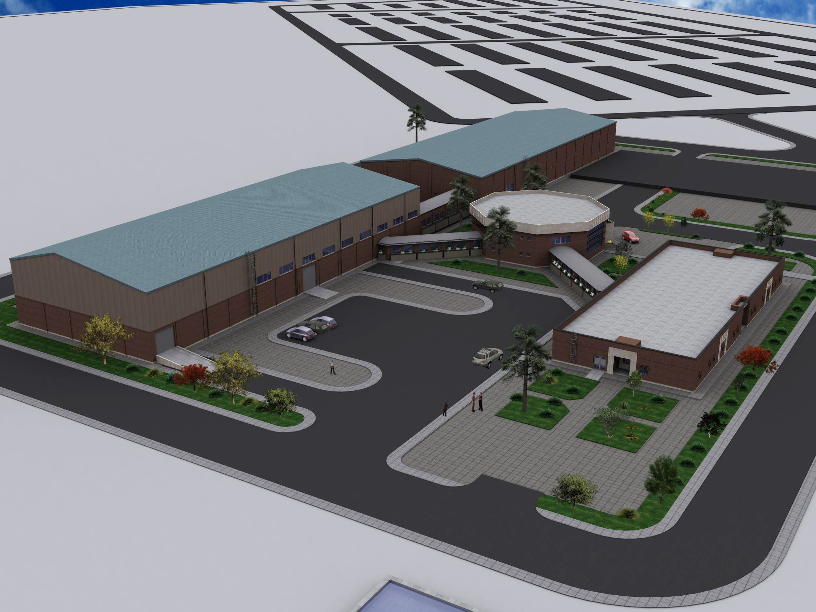
Radioactive waste management in Iran
Final Disposal of Radioactive Waste in Anarak Repository
Waste disposal zone
Storage Building I
Laboratory
Treatment unit
Health physics building

Slide 18
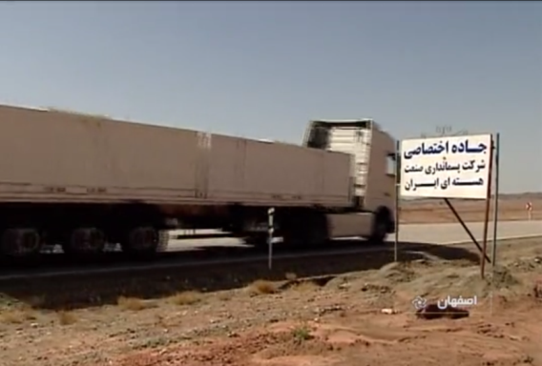
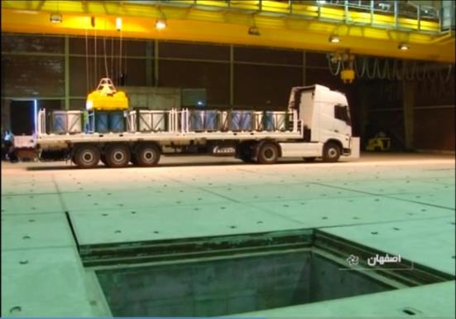
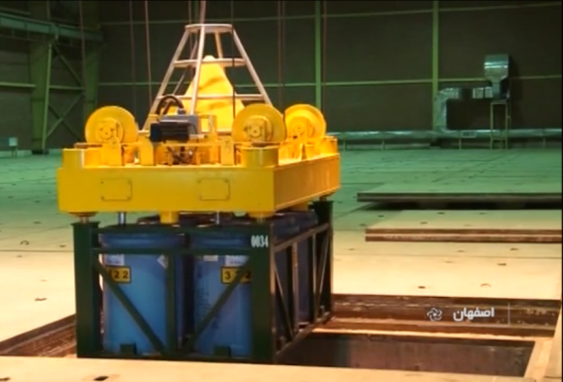
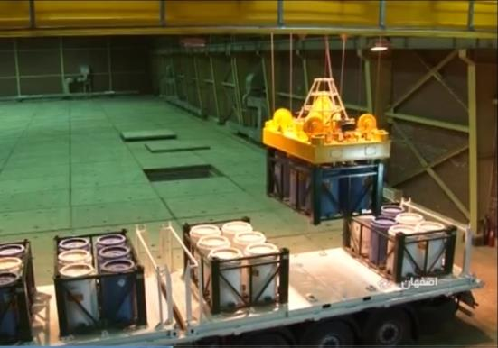
Radioactive waste management in Iran
Transportation of Bushehr NPP radioactive wastes to storage buildings in Anarak

Slide 19

Radioactive waste management Radiation dose
Absorbed dose is a measure of the energy deposited in a medium by ionizing radiation. The SI unit for absorbed dose is Joule of energy absorbed per kilogram of matter and its especial name is gray (Gy). Absorbed dose is used in the calculation of dose uptake in living tissue in both radiation protection (reduction of harmful effects), and radiology (potential beneficial effects for example in cancer treatment). It is also used to directly compare the effect of radiation on inanimate matter.
Equivalent dose is a dose quantity (DE) representing the stochastic health effects of low levels of ionizing radiation on the human body. It is derived from the
physical quantity absorbed dose, but also takes into account the
biological effectiveness of the radiation, which is dependent on
the radiation type and energy. In the SI system of units, the unit
of measure is the Sievert (Sv).
Permitted limit of annual dose for the public is 1 mSv.

Slide 20
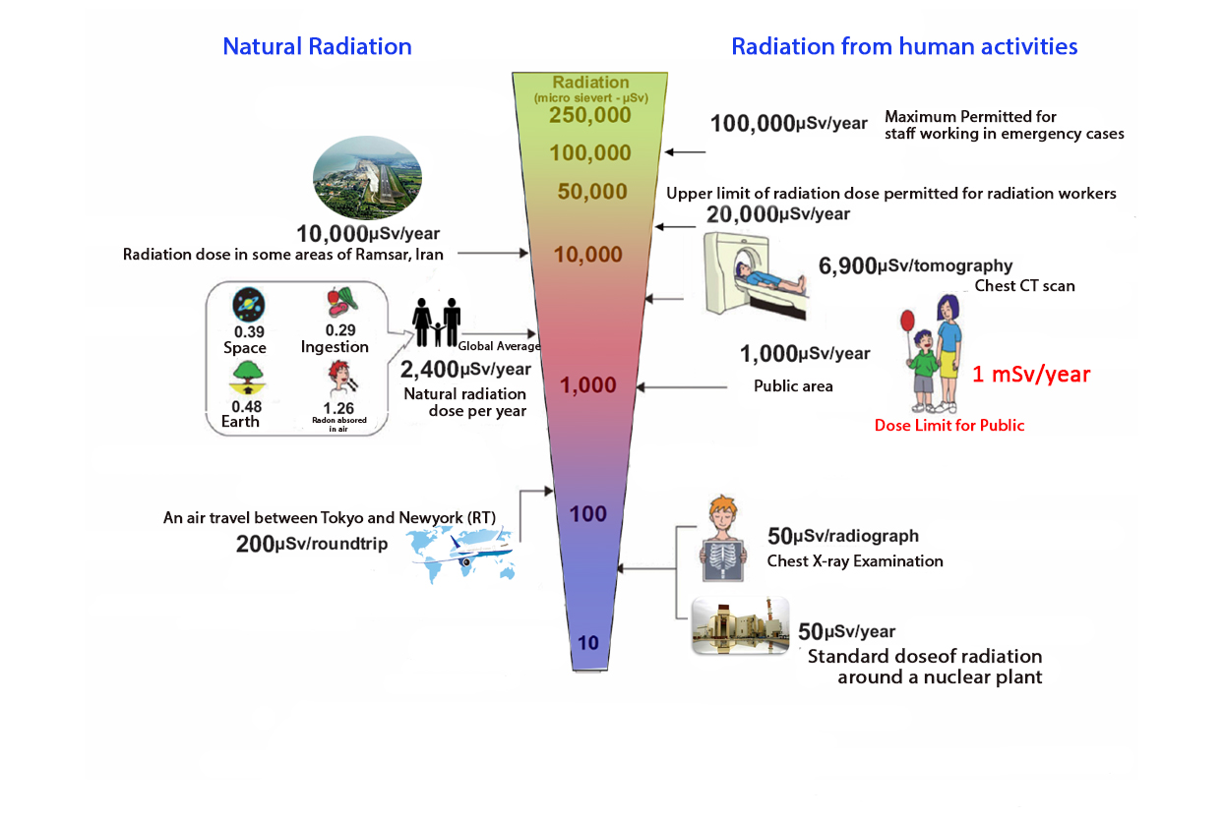
Radioactive waste management
Absorbed Dose

Slide 21
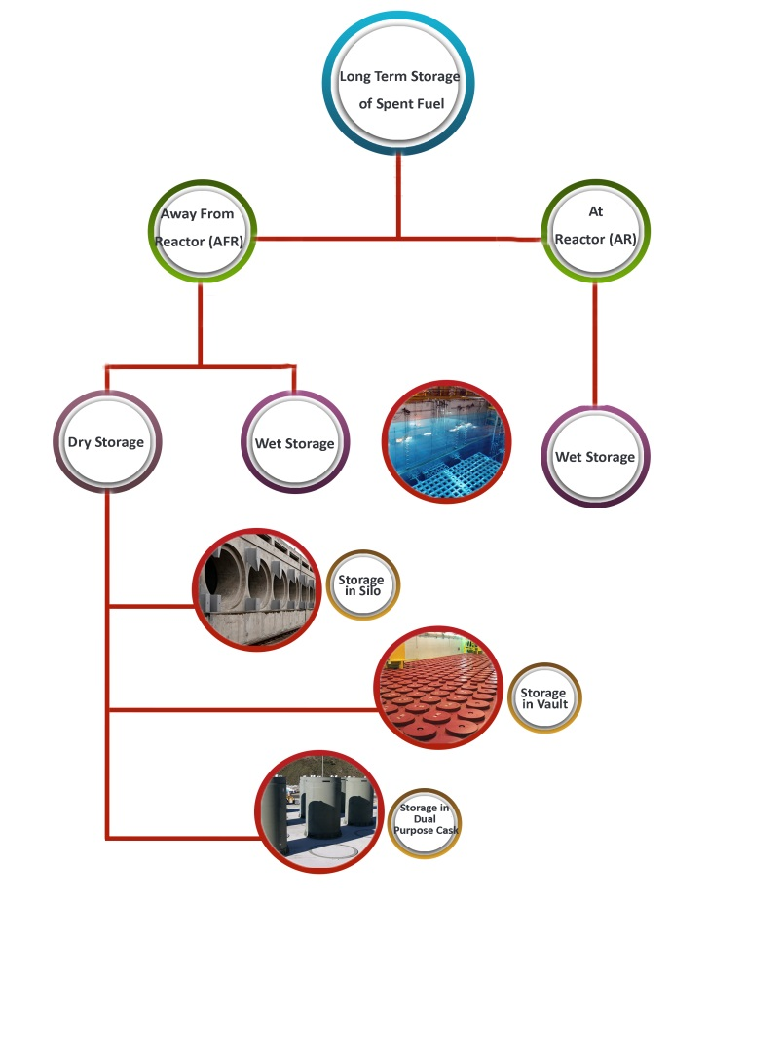
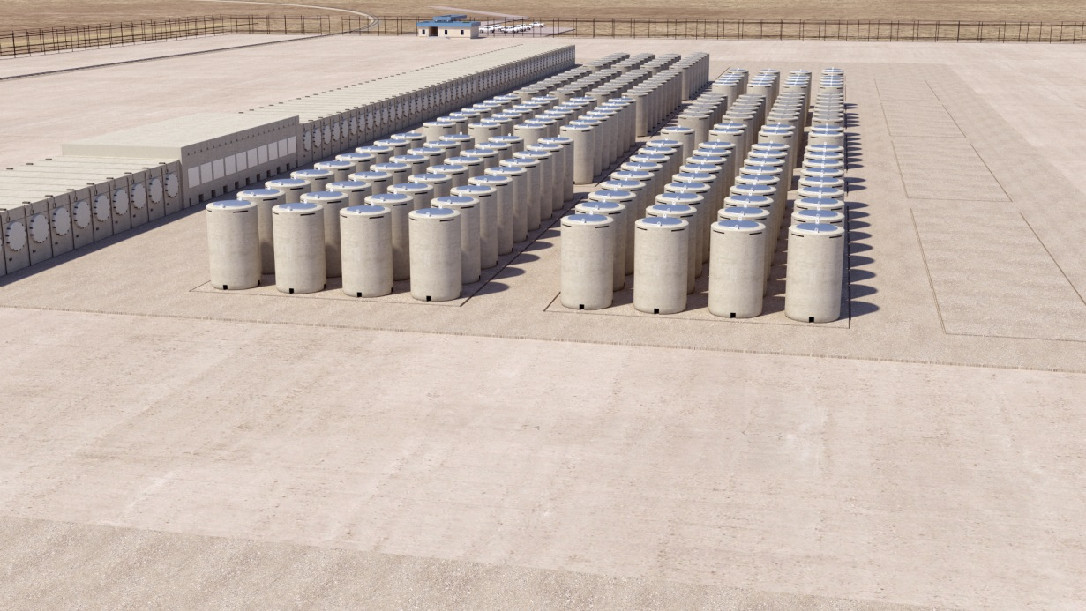
Radioactive waste management Spent Fuel Management
Different methods of spent nuclear fuel long term storage

Slide 22
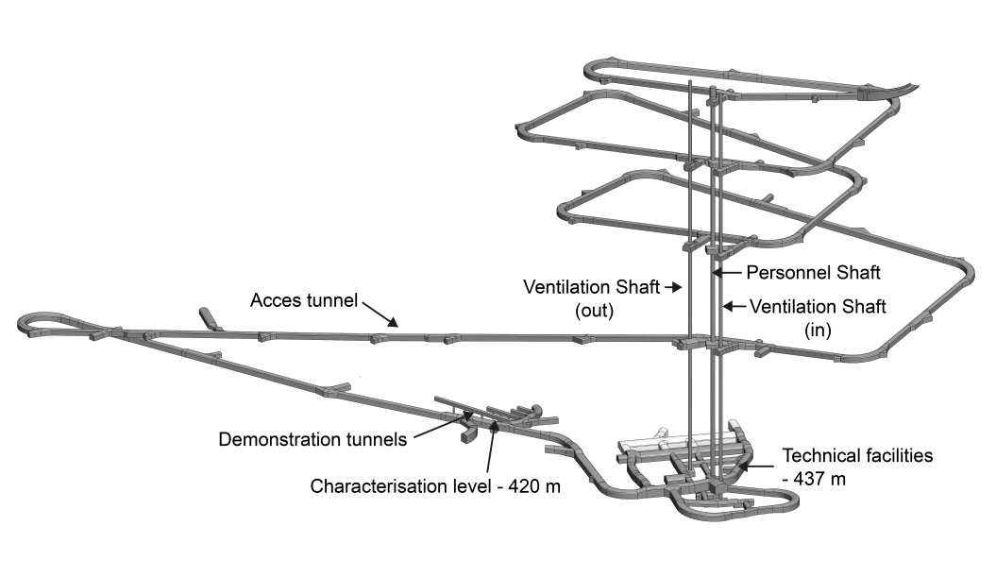
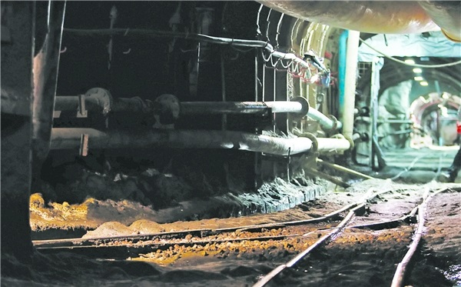
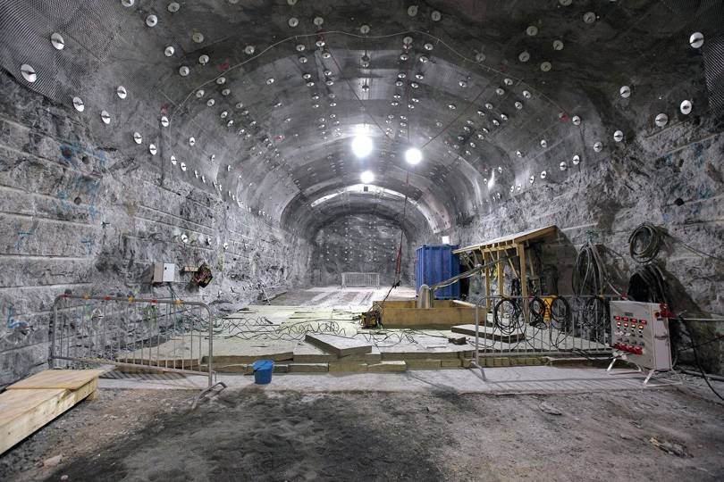
Radioactive waste management
Spent Fuel Management
Considered as one of the options for underground disposal of radioactive wastes, underground Uranium mine of Saghand is under investigation.
ONKALO site in Finland is under construction in the depth of 400 m to final disposal of radioactive wastes.
Notes:
تمامی روش‌های نگهداری بلند مدت سوخت مصرف‌شده اعم از نگهداری درون راکتور یا دور از راکتور، انبارش خشک یا مرطوب، همگی روشی موقت بوده و راه حل نهایی، دفن در سایت دفن دائمی است.
استفاده از پسمانگورهای عمیق (Deep Geological Repository: DGR) از سال‌ها پیش در دستور کار کشورهایی قرار گرفت که روی صنعت هسته‌ای سرمایه‌گذاری کلانی کرده بودند. از جمله این کشورها می‌توان به آرژانتین، بلژیک، کانادا، چین، فنلاند، فرانسه، آلمان، ژاپن، کره، سوئد، سوئیس، بریتانیا و ایالات متحده اشاره کرد که برخی از آن‌ها در مرحله مطالعات اولیه، برخی در مرحله ساخت و برخی دیگر در فاز بهره‌برداری از پسمانگورهای عمیق هستند.
عمق این پسمانگور‌ها معمولا بین 300 تا 1000 متر است.
در مراحل ابتدایی یافتن پسمانگورهای عمیق، عموما مطالعات روی گنبدها و معادن نمکی شروع می‌شود که پس از پایان فعالیت‌های استخراجی، بسته شده‌اند. پسمانگورهای Schacht Asse II و Morsleben در آلمان، نمونه‌هایی از این معادن نمکی هستند.

Slide 23
Radioactive waste management extending environmental services
Developing radio-monitoring programs in industries with the aim of identifying contaminated or probably contaminated areas and determining background radioactivity level
Running active environmental monitoring using portable equipment and establishing environmental radio-monitoring system
Site selection studies, environmental basic studies and contamination diffusion modeling
Laboratory measurements and radiation analysis
Measuring the amount of radioactive materials in water for water organizations around the country
Holding international events subjecting radioactive waste management and environmental protection for the regional countries
Notes:
سازمان انرژي اتمي و شرکت پسمانداري صنعت هسته اي ايران در راستای اهداف و ماموریت‌های خود توسعه خدمات زيست محيطي را به ساير سازمان ها در دستور کار دارد که شامل موارد زير مي شوند:

Slide 24
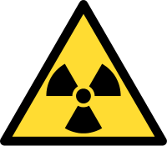

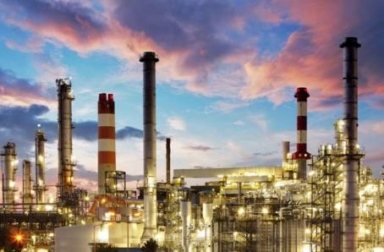
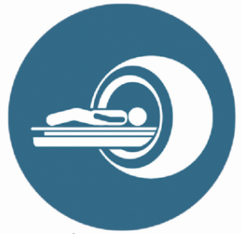

Radioactive waste management
Centers looking for environmental services
Industries dealing with performing radiation activities
Oil and gas industry, phosphate industry, metal mines, etc…, need to manage their NORM wastes. IRWA presents services in related fields from monitoring and measurements to consultation and waste management.
Environment Protection Organization and related companies
In the light of the objective of the Environment Protection Organization in protect and preserve the environment, IRWA is ready to present environmental services with radiation approach to evaluate radionuclides in different media.
Diagnostic and Radio-therapeutic Centers
Radioactive waste management has to be taken into consideration especially in hospitals, diagnostic and radio-therapeutic centers. In this regard, IRWA is ready to present consultation and executive services to such centers.
Universities and Research Centers
IRWA is ready to present radiation analysis services and run joint projects with universities and other research centers based on its experiences and technical capacity.
Notes:
با توجه به طیف وسیع فعالیت‌های سازمان در حوزه خدمات محیطی و آنالیز محیطی، مراکز مختلفی که نیاز به خدمات زیست محیطی، به‌ویژه در زمینه خدمات پرتویی دارند، می‌توانند از خدمات این سازمان و شرکت هاي تابعه بهره‌مند شوند.

Slide 25

Radioactive waste management
future outlook to protect the environment
Providing the necessary equipment such as compactor and incinerator to reduce the volume of radioactive wastes
Using uranium mine of Saghand as a radioactive waste disposal
Extending radiological environmental services to regional countries
Spent nuclear fuel management

Slide 26
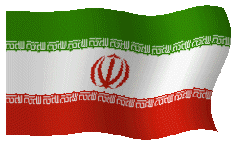

Thanks

Slide 27
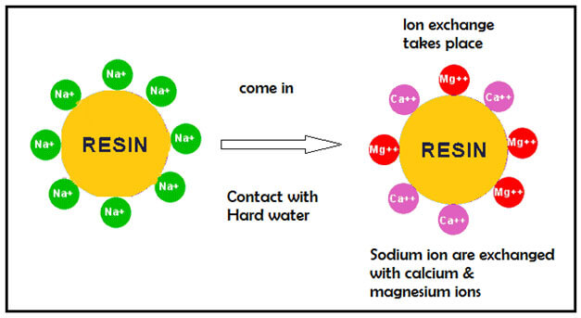
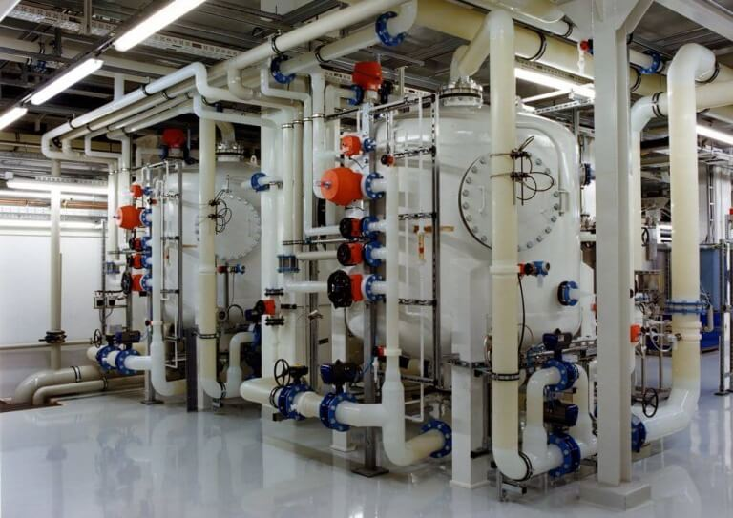
Ion Exchange Resins
An ion-exchange resin or ion-exchange polymer is an insoluble matrix that acts as a medium for absorbing cations and anions. Ion exchange process is used for reduce or completely removal of heavy metals, hardness, soluble solids from water or for producing pure water. In so doing, water and waste are passed through the column containing resins to get purified and deionized. In this process, the ion exchange is done in the water means that ion from liquid phase moves to the resins and the removed ions in the water are replaced with other ions coming from solid phase.
Ion exchange resins are widely used in Nuclear Power Plants to produce deionized water and remove radionuclides from the cooling water as well as in radioactive liquid waste treatment.

Slide 28
Ion Exchange Resins
A special type of resin (commercial name: purolite) is being used in Tehran research reactor and the most commonly used resins in waste treatment are selective for Cesium and Strontium with different commercial names
Ion exchange resins will have to be managed as radioactive wastes after several times wash and reduction
Resins recommended for Bushehr NPP are of AV-17-8-chS type for anion model and KU-2-8chS for cation model. More than 14 m³ radioactive spent resin are yearly produced by a 1,000 MW NPP in operation

Slide 29
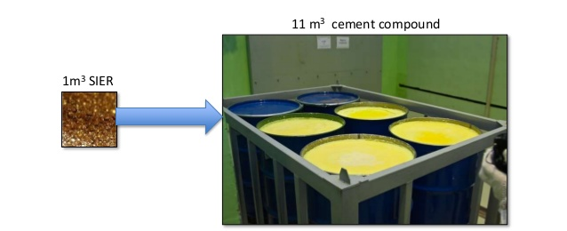
Radioactive Resin Management
These resins have to be managed using different methods such as polymerization, incineration, immobilization in cement or bitumem. Most countries like Iran and in Bushehr NPP, immobilization in cement is the technology used to stabilization the resins.
Because of the organic nature of most of resins, the maximum capacity of loading resins in 200 lit barrel is about 60 kg which is equivalent to 17 percent of final weight although practically less resins will be loaded in the barrel and increases the expenses.

