Slide 1
Institutional Strength in Depth in the Nuclear
Industry to Sustain Operational Excellence
Effective management of External Interfaces
Mike Harrison
17th December 2021

Slide 2
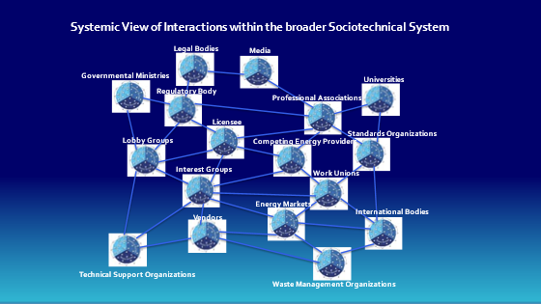
The Licensee operates with in a broader more complex system
The functioning and interaction with these other stakeholder can significantly impact the performance of the licensee
Important to understand:
  Importance
  Influence
  Interactions

Slide 3
Interface With Regulators
The relationship between the licensee and regulator a key factor in determining style and hence type of regulation
Licensee
Operate to Standards which Exceed Compliance Standards
Regulator Enforce Compliance Standards, Rules and Regulations to ensure Safe operation
Prescriptive Regulation
Enabling Regulation
Attributes Enabling Strong relationship
Regulatory Interface protocol
Focus on outcomes rather than process e.g.
  speed of delivery
  economic impact
  Prioritised on risk mitigation
Strong Internal Oversight
Open and transparent relationship
Transparent event reporting
Graded approach to Comms
Support regulator in undertaking their duties

Slide 4
Public Stakeholder Engagement
Improving the balance of information available.
Clear understandable information
Need to prioritise in (particular local communities.)
Updates with community
Local media and local forums
Normal/ Emergency arrangements
AWARENESS
Which channel public get news
KNOWLEDGE
Level of knowledge about nuclear
PERCEPTION
Trust to organization
POINT
OF VIEW
How support nuclear
Leaders must devote significant resources and attention
Listen to and respond openly
Rapid response to requests
Positive pro-active comms
Open door policy
Open reporting
Comms strategies and plans
Trained spokes person
Need to constantly build

Slide 5
Industry Interfaces
Senior leaders within the nuclear industry have the responsibility to collectively come together to:
facilitate the delivery of these industry programmes;
challenge peers who are not effectively participating;
support those who are struggling with implementation;
work with industry interfaces to prioritise and effectively link the various improvement programmes so that the benefits are effectively optimised

Slide 6
Thank you!
Notes:
Thank you!

