Slide 1

In the name of Allah
Department of Energy Engineering
Presentation title:
Implementation of Computer-based Operator Aid Tool (COAT) on
BNPP Full-scale/Compact Simulators
Presenter
Khalil Moshkbar-Bakhshayesh
Supervisor
Mohammed Bagher Ghofrani
Aug. 2016

Slide 2
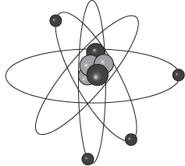
Outlines
Introduction
Conceptual Design and Abilities of the COAT
Implementation Project : Objectives & Scope
Development of graphical user interfaces (GUIs) for BNPP Operators
Requirements for Implementation of the COAT on BNPP Full- scale/Compact Simulators
Area of Cooperation – Discussions

Slide 3

Introduction
Overview Safety levels of D-in-D
Control of abnormal operation and detection of failures
Level number | Objective | Type of transients | Some possible enhancements in G-3 NPPs
Level 1 | Prevention of abnormal operation and failures | NO | Design margins and robustness; response time to faults Simplification Irradiation embrittlement
Level 2 | Control of abnormal operation and detection of failures | AOO | Increased application of digital I&C Separation of control from protection systems
Level 3 | Control of accidents within the design basis | DBA | Digital instrumentation and control for protection systems Passive safety systems
Level 4 | Control of severe plant conditions | BDBA / SA | -
Level 5 | Mitigation of radiological consequences | Emergency plan | -
Grace period
Transient identification and forecasting
Improving grace period
Improving safety

Slide 4
Introduction
Classification of Computer aid support tools for NPP operators:
Transient Identifiers
Model- based
Model- Free
Transient Forecasters
Real- Time
Slower than Real Time
Faster than Real Time
Transient Identifier / Forecaster
Operator Guidelines

Slide 5
Introduction
Model-free computer-aided support tools
Abilities and weaknesses of model-free transient identifiers
Transient identifier |  |  |  | Ability | Weakness | Improvement
ANN | Feed-forward networks |  |  | More efficient at quasi-equilibrium transients | Difficulty in identification of fast transients | By feedback connections among the neurons
 | Recurrent networks |  |  | To deal with temporal data | Hard training of long temporal dependencies | By spectrum analysis methods (i.e. WT, FFT)
 | Unsupervised networks |  | Competitive | Recognition of unlabeled transients | Difficulty in modeling time dependent data | By recurrent networks
 |  |  | Localized |  | 1-Difficulty in modeling time dependent data 2-Too conservative
Fuzzy systems |  |  |  | 1-Unlabeled transient identification 2-Robustness against noisy data | 1-Results should be interpreted 2-Do not cover enough transients | By hybrid neuro-fuzzy systems
Heuristic techniques |  | Biological approaches |  | Transient identification optimization | 1-Difficulty in transient identification in presence of noise 2-Difficulty in identification of large number of transients 3-Difficulty in recognition of unlabeled transients | By quantum computation
 |  | Statistical approaches | HMM | - | 1- Hard training 2- Difficulty in recognition of unlabeled transients | -
 |  |  | SVM | Does not suffer from local minima

Slide 6
Introduction
Model-based computer-aided support tools
Compact simulators
Plant analyzer
Sever accident simulator
Accident management support tool
Abilities and weaknesses of model-based transient identifiers
 | Application | Ability | Weakness
Compact simulator | Simulation of very important systems | Transient identification | Limited simulations
Plant analyzer | Approximately simulation of all systems | Analysis of steady and transient states | Not applicable for real-time systems
Sever accident simulator | Reactor core simulation | SA simulation | Not applied for AOO and DBA transients
Accident management support tool | Accident management | Accident tracking/prediction | Not applied for AOO and DBA transients

Slide 7
Conceptual Design and Abilities of the COAT
COAT: Transient identifier + Transient forecaster + Transient clusterer
General structure of COAT

Slide 8
Conceptual Design and Abilities of the COAT
Transient identifier : Modular EBP based Identifier + ARIMA Method
Schematic view of the proposed structure for identification of NPPs transients

Slide 9
Conceptual Design and Abilities of the COAT
Transient forecaster: Modular EBP based Identifier + ARIMA Method + EBP Algorithm
Schematic view of the proposed structure for prediction of time series of NPPs parameters in transients

Slide 10
Conceptual Design and Abilities of the COAT
Schematic view of the proposed structure for prediction of NPPs parameters in noisy environment

Slide 11
Conceptual Design and Abilities of the COAT
Transient clusterer: Transductive Support Vector Machine
Structure of TSVM
Structure of Identification/Clustering of the COAT

Slide 12
Conceptual Design and Abilities of the COAT
Conceptual design: Description of how a new product will work and meet its performance requirements (what of the solution).
Characteristics of the Conceptual Design :
written in customer’s language
• explaining the observable external characteristics of the system
• contains no technical jargon (If it does, define it.)
• describes the functions of the system - is independent of implementation
• linked to the related documents
Level modularity
Decomposition of each level

Slide 13
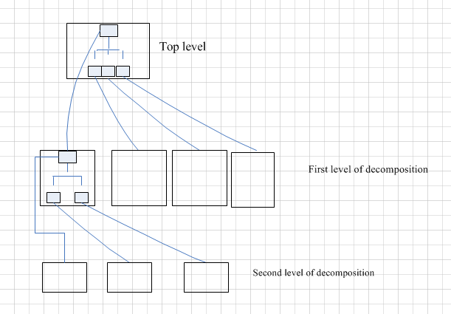
Conceptual Design and Abilities of the COAT
Modularity and decomposition

Slide 14
Conceptual Design and Abilities of the COAT
Modularity:
The results of decomposition form composite parts
Modular: when each activity of the system is performed by exactly one component
Decomposition:
Starting with a high-level depiction of the system’s key elements
Creating lower-level looks at how the system’s features and functions fit together
Methods for Decomposition:
Modular decompositions (assigning functions to components)
Data-oriented decomposition (external data structures)
Event-oriented decomposition (events that the system must handle)
Outside-in design (user’s inputs, to processing, to output)
Object-oriented design (classes of objects and their inter-relationships)

Slide 15
Conceptual Design and Abilities of the COAT
Levels of Conceptual design:
Architecture requirements : system modularity
Programing Modules : algorithms and data structures
Executable Design codes: memory allocation, execution time, code optimizations,... ( Questionable )

Slide 16
Conceptual design of the COAT

Slide 17
Conceptual Design and Abilities of the COAT
Abilities of the COAT :
1) Plant variables for transients training can be selected independent of each other.
2) For transient identification, few number of the plant variables is enough
3) Recognition of transient is based only on the sign of each classifier output.
4) The number of transients identified can be extended without side effect on training.
5) Balance between generalization and memorization is enhanced.
6) Unknown transients is clustered.
7) Transients identification without need for noise filtering.
8) Prediction of the Plant parameters solely dependent to its own signal.
9) Forecasting can be extended to longer time intervals.

Slide 18
Implementation Project : Objectives & Scope
Operator procedures without support system:
Operator procedures in NPPs

Slide 19
Implementation Project : Objectives & Scope
Operator procedures with support system:
Operator operation
(accompany with COAT)
Operator procedures in NPPs accompany with COAT

Slide 20
Implementation Project : Objectives & Scope
Main objectives :
Training/test/improvement/optimization of the programming codes by data of transients extracted from the Plant simulators
Validation of the programing codes by the plant simulators ( Full Scale/ Compact )
Development the software package COAT based on regular standards
Harmonization of the software package COAT by Full scale simulators
20

Slide 21
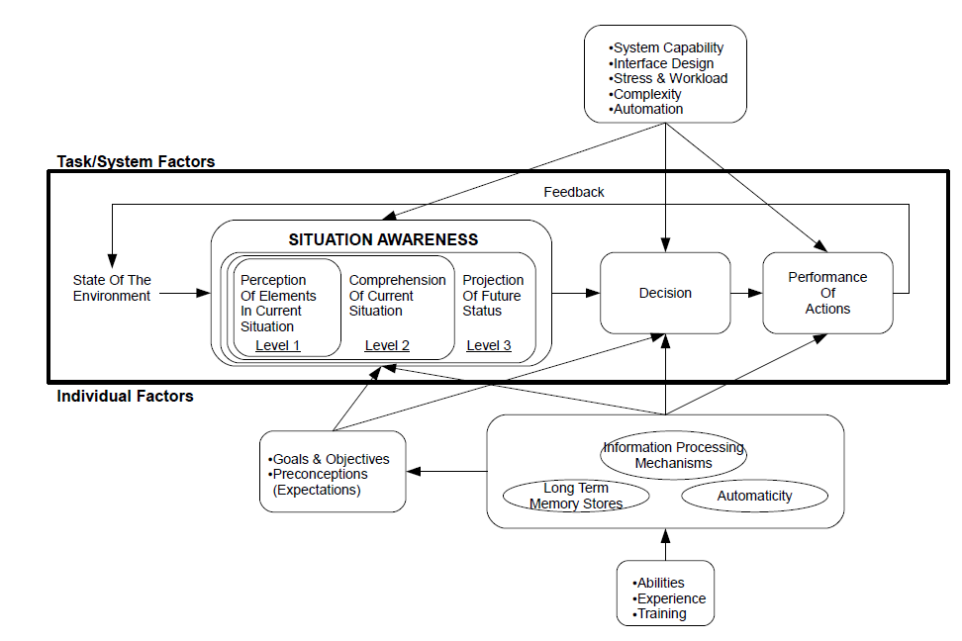
Development of GUIs for BNPP Operators
Model of situation awareness in dynamic decision making

Slide 22
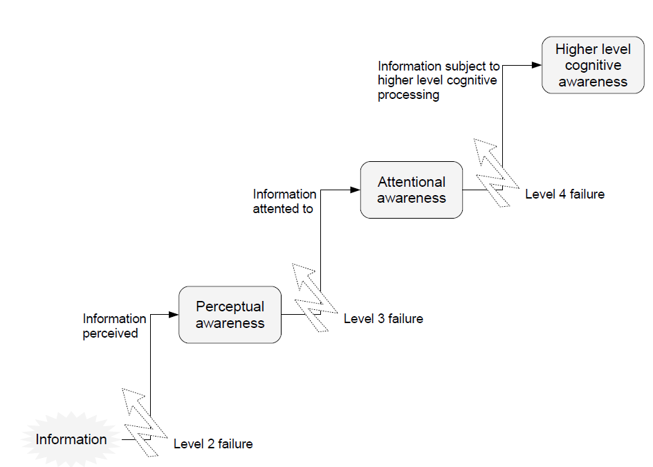
Development of GUIs for BNPP Operators
The levels of awareness

Slide 23
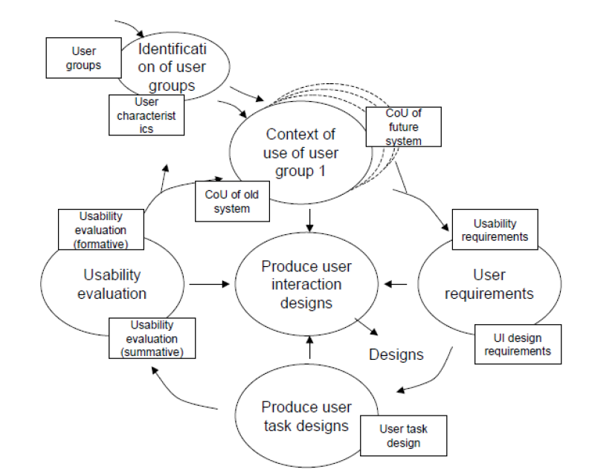
Development of GUIs for BNPP Operators
The process model of user centered design- ISO 13407, ISO 18529

Slide 24
Requirements for Implementation of the COAT on BNPP Full- scale/Compact Simulators
Main requirements:
Definition different types/severities of transients based on FSAR
Training of programing codes based on data extracted from full scale simulator
Programing codes optimization/memory allocation/ improvement execution time
Development software package of the COAT
Validation software package of the COAT
Programing Standards selection & adoption
Harmonization of Software package of the COAT by full scale simulator
Preparation of data acquisition system
Preparation of the COAT user guidelines ( for the plant operators )
Preparation of graphical user interfaces (GUIs)
Preparation hardware requirements (i.e. monitors, actuators, wall panels, operator consoles, maintenance station, technical support center, switches, …)
Basic design of the COAT

Slide 25
Area of Cooperation – Discussions
Software development
  Improvement of EBP /ARIMA/ TSVM programming codes for identification / forecasting , based on data extracted from full scale simulator
  validation / optimization of programing codes
  Software package development
  Considering allocated memory and execution time of the developed software
Programing Standards selection & adoption
  Software package harmonization
  Preparation GUIs
  Preparation user guidelines ( for operators)

Slide 26
Area of Cooperation – Discussions
Hardware development
  Development data acquisition system
  Preparation wall panels/ monitors/ switches/operator consoles
  Development technical support center / maintenance station

Slide 27
Extracted Papers
[1] K. Moshkbar-Bakhshayesh and M. B. Ghofrani, "Conceptual Design of a Computer-based Operator Aid Tool for Transient Identification and Forecasting in NPPs," 2016
[2] K. Moshkbar-Bakhshayesh and M. B. Ghofrani, "Combining Supervised and Semi-Supervised Learning in the Design of a New Identifier for NPPs Transients," IEEE Transactions on Nuclear Science, vol. 63, pp.
1882-1888, 2016.
[3] K. Moshkbar-Bakhshayesh and M. B. Ghofrani, "Development of a New Method for Forecasting Future States
of NPPs Parameters in Transients," IEEE Transactions on Nuclear Science, vol. 61, 2014
[4] K. Moshkbar-Bakhshayesh and M. B. Ghofrani, "Development of a Robust Identifier for NPPs Transients
Combining ARIMA Model and EBP Algorithm," IEEE Transactions on Nuclear Science, vol. 61, pp. 2383-2391, 2014
[5] K. Moshkbar-Bakhshayesh and M. B. Ghofrani, "Development of an Efficient Identifier for Nuclear Power
Plant Transients Based on Latest Advances of Error Back-Propagation Learning Algorithm,"
IEEE Transactions on Nuclear Science, vol. 61, pp. 602-610, 2014
[6] K. Moshkbar-Bakhshayesh and M. B. Ghofrani, "Transient identification in nuclear power plants: A review,“
Progress in Nuclear Energy, vol. 67, pp. 23-32, 2013, first review paper in Nuclear Eng. In IRAN
]7[ خليل مشکبار بخشايش، محمد باقر غفراني، ”توسعه شبکه عصبي MLP بهبود يافته براي تشخيص گذره ها در نيروگاه هسته اي بوشهر
بخش اول: بهبود در نحوه ارايه داده ها، وزن هاي اوليه، و تابع فعال سازي وفقي“، نوزدهمين کنفرانس هسته اي، مشهد ، 2-3 اسفند ماه 1391، (ارايه شفاهي)
]8[ خليل مشکبار بخشايش، محمد باقر غفراني، ”توسعه شبکه عصبي MLP بهبود يافته براي تشخيص گذره ها در نيروگاه هسته اي بوشهر
بخش دوم: انتخاب نوع تابع فعال سازي و تابع هزينه“، نوزدهمين کنفرانس هسته اي، مشهد ، 2-3 اسفند ماه 1391، (ارايه شفاهي)
]9[ خليل مشکبار بخشايش، محمد باقر غفراني، ” تشخيص گذره ها در نيروگاه اتمي بوشهر از طريق پيش بيني مقادير متغيرها به کمک
ترکيب روش آماري ARIMA و شبکه عصبي مصنوعي“، بيستمين کنفرانس هسته اي، رشت ، 7-8 اسفند ماه 1392، (ارايه شفاهي)

Slide 28
THANKS

