Slide 1
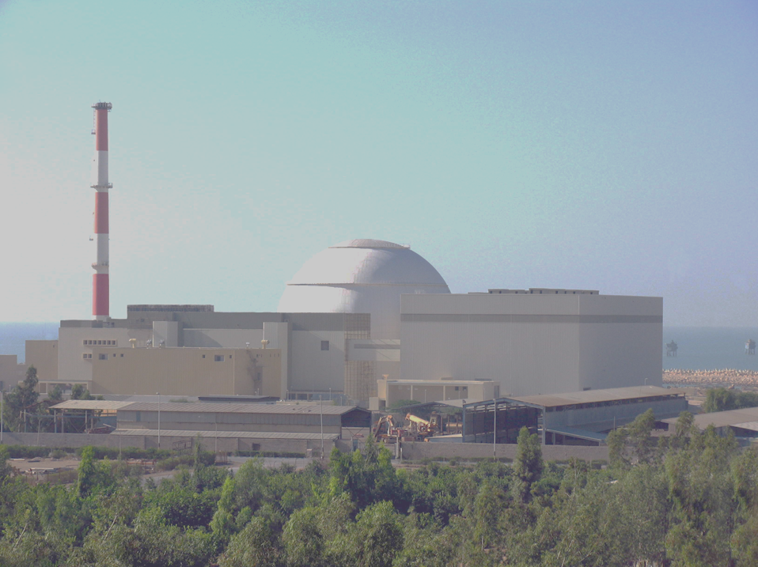



Bushehr Nuclear Power Plant
PSA and LPSA in Bushehr NPP
WANO MC workshop
Probabilistic Safety Assessment at operating NPPs
18-21 May 2021

Slide 2

Outline
LPSA Level-1 in BNPP
Establishment stage
Implementation stage
2
3
4
1
Bushehr Nuclear Power Plant (BNPP)
5
Discution
1/23

Slide 3
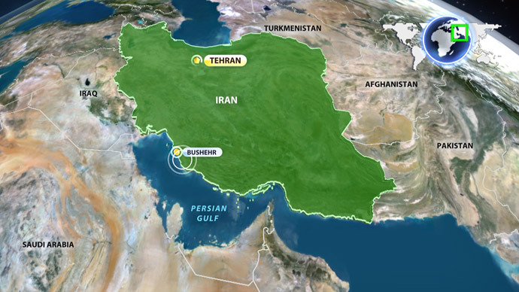
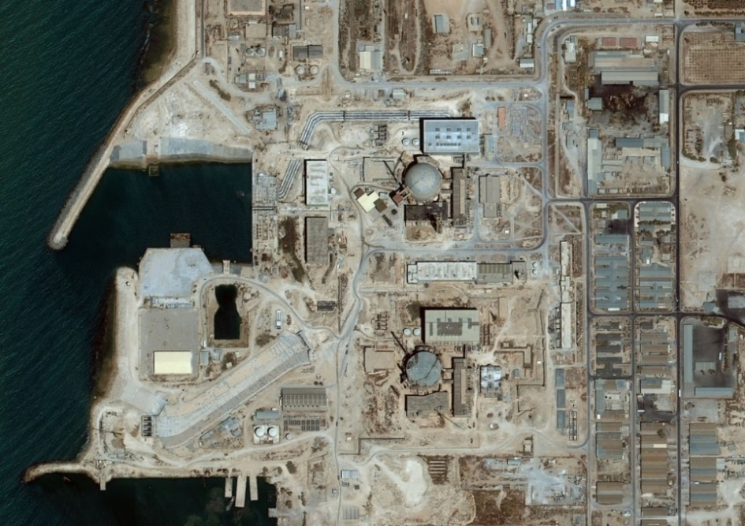
Bushehr Nuclear Power Plant (BNPP-1)
Construction started in 1974, KWU design, 2 PWR units each 1293 MW;
Construction stopped in 1980;
In Jan. 1996 contract was effective with RF to complete the unit-1 based on VVER-1000 type 446 (modified version of 320) with using of KWU available buildings & equipment.
2/23

Slide 4
Bushehr Nuclear Power Plant (BNPP-1)
History of commissioning and operation:
  First criticality achieved in May 2011
  Unit connected to the grid in Sep. 2011
  Unit provisional acceptance in Sep. 2013
  First refueling conducted, Feb. 2013
3/23

Slide 5
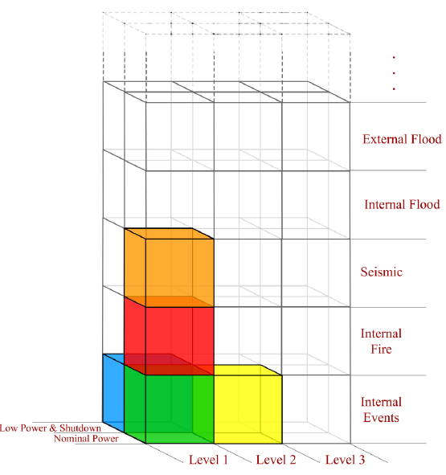
PSA Documents in BNPP
LPSA Level 1 for full power and shutdown modes are being conducted.
4/23

Slide 6
LPSA Level-1 in BNPP
Establishment stage:
  Development of procedures;
  Provide Risk Spectrum;
  Development of Data Management Software (PSA).
Implementation stage:
  DATA gathering and analysis;
  Operating mode and POS analysis;
  Initiating event analysis;
  System analysis;
  Accident sequence analysis;
  Common Cause Failure analysis;
  Human Analysis;
  Thermo-hydraulic Analysis.
5/23

Slide 7
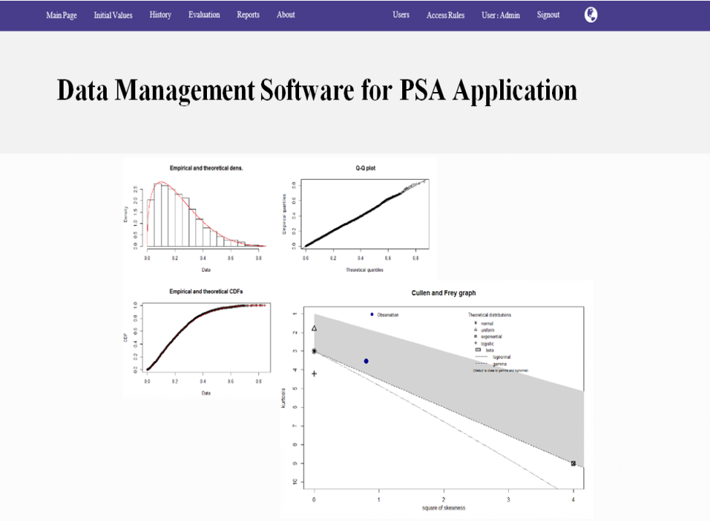
Establishment stage
  Development of Data Management Software (PSA)
  This is a software by which data of PSA could be managed. Furthermore, this software have been coupled with R studio and WINBUGs in order to update the data using classical method and Bayesian analysis.
7/23

Slide 8
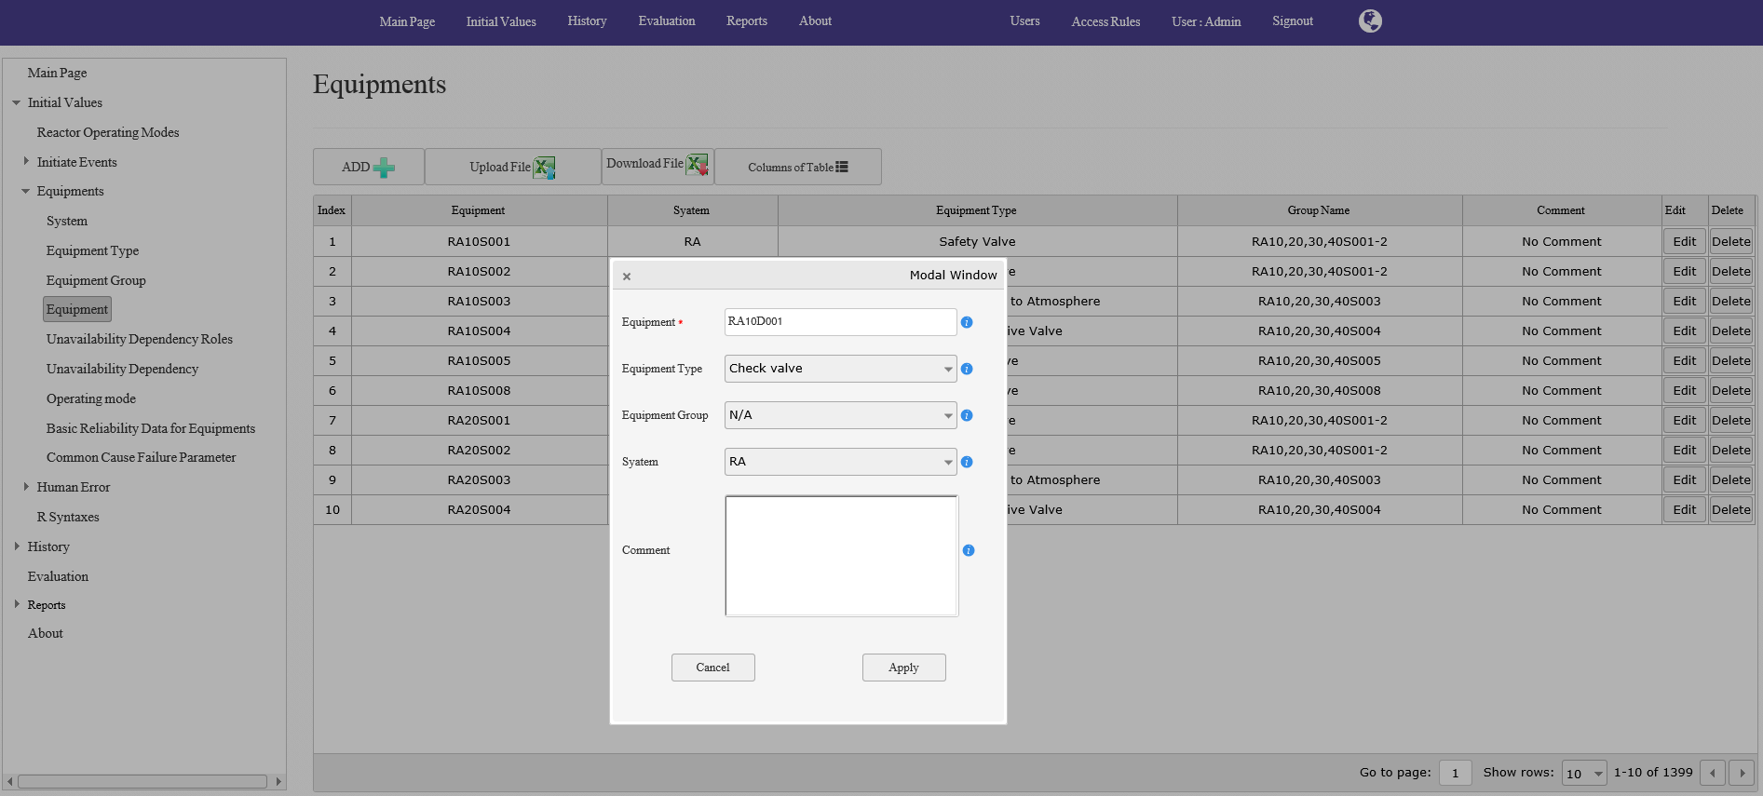
Data Management Software (PSA)
Equipment page: In order to define and add new equipment
8/23

Slide 9
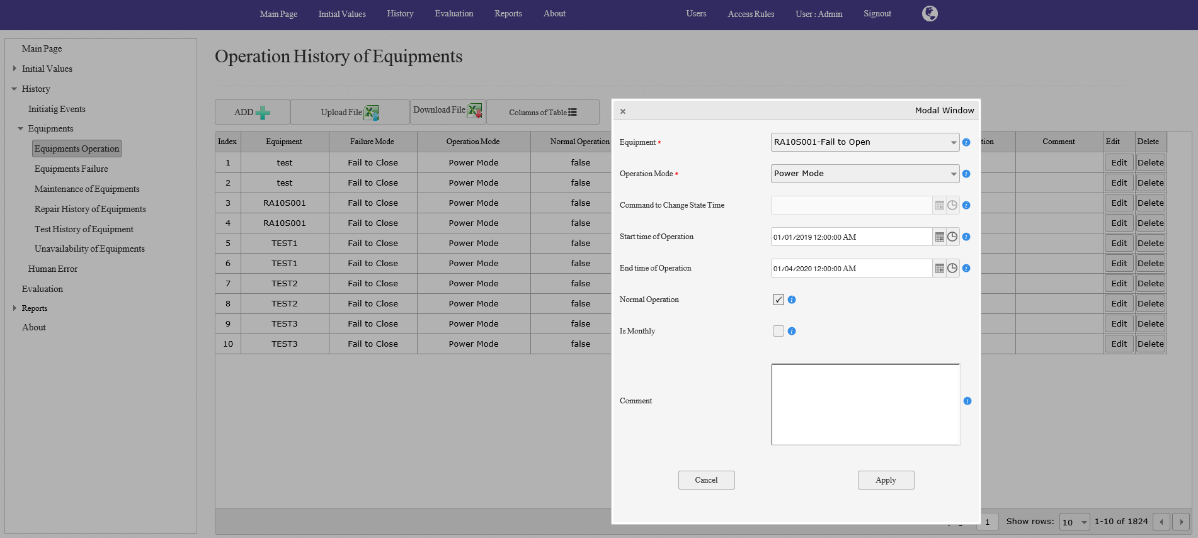
Data Management Software (PSA)
Operation History of Equipment page: In order to define the operation time of equipment
9/23

Slide 10
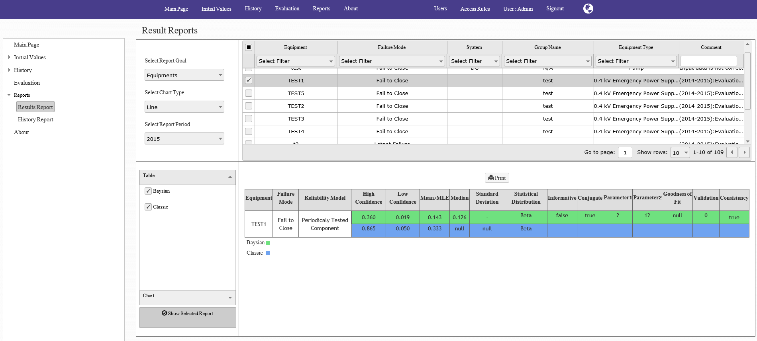
Data Management Software (PSA)
Result page: In order to show and print the calculation results
10/23

Slide 11
DATA gathering and analysis
DATA gathering from 2015 to 2019:
  Gathering of data from working journals;
  Providing computer server to gathering and analysis of working signal;
  Inputting data to Data management software for updating based on classical and Bayesian methods.
11/23

Slide 12
Operating mode and POS analysis
Enhancing of reactor operational modes from three to five.
Correction of POS grouping based on added reactor operational modes and using of second stage hydra-accumulators .
Correction of each of POS duration and frequency based on operational experiences .
12/23

Slide 13
Initiating event analysis:
Correction of IE’s grouping for all of POSs based on:
  Updated POSs
  FSAR analysis
  IAEA general list
  BNPP operational experiences
  Similar NPP experiences within years 2000 to 2019
13/23

Slide 14
System analysis
Correction Checking of working (as built) system flow diagrams and making necessary corrections:
  Remove of conservative assumption as far as possible
  Remove of unacceptable simplification
  Inserting new changes applied in operational duration based on technical decision or modernization programs
Correction of system equipment dependencies especially based on new defined POSs.
Ongoing development of fault trees based on necessary safety functions and above mentioned corrections.
14/23

Slide 15
Accident sequence analysis:
Ongoing check of system safety functions and sequence of applying them in event tree model .
Ongoing development of event tree model .
15/23

Slide 16
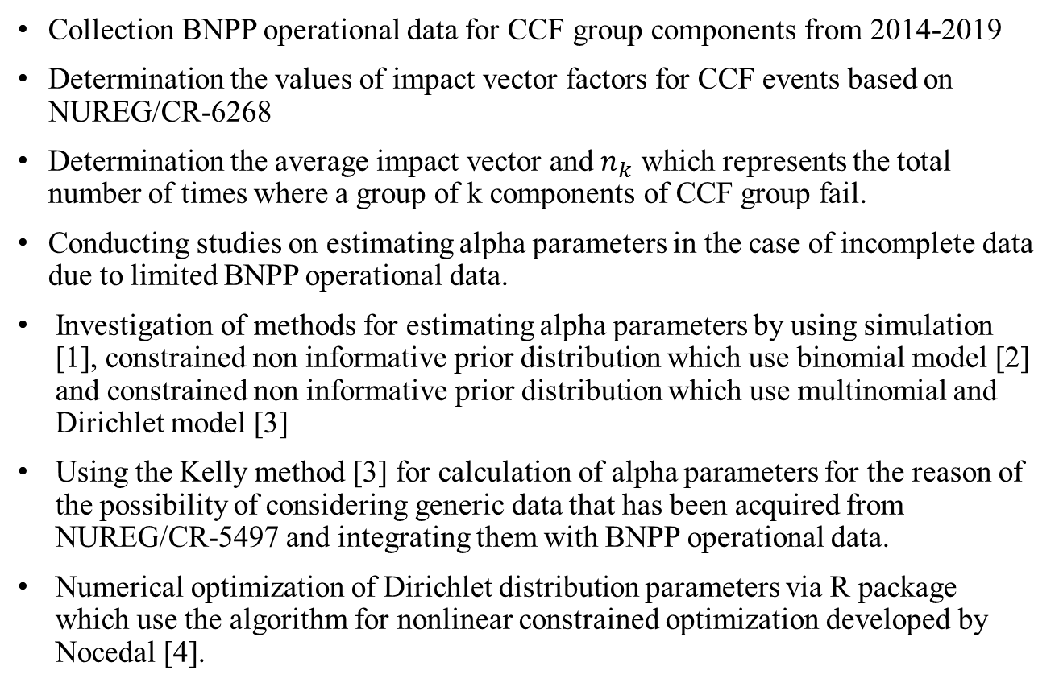
Common Cause Failure:
Updating of CCF parameters
Collection BNPP operational data for CCF group components from 2014-2019
Determination the values of impact vector factors for CCF events based on NUREG/CR-6268
Determination the average impact vector and $n_{k}$ which represents the total number of times where a group of k components of CCF group fail.
Conducting studies on estimating alpha parameters in the case of incomplete data due to limited BNPP operational data.
Investigation of methods for estimating alpha parameters by using simulation [1], constrained non informative prior distribution which use binomial model [2] and constrained non informative prior distribution which use multinomial and Dirichlet model [3]
Using the Kelly method [3] for calculation of alpha parameters for the reason of the possibility of considering generic data that has been acquired from NUREG/CR-5497 and integrating them with BNPP operational data.
Numerical optimization of Dirichlet distribution parameters via R package which use the algorithm for nonlinear constrained optimization developed by Nocedal [4].
16/23

Slide 17
Common Cause Failure:
Updating of CCF parameters
Construction an algorithm to calculate the posterior distribution
Extraction updated alpha parameters value from the posterior distribution
References
[1] T. D. Duy, D. Vasseur, A practical methodology for modeling and estimation of common cause failure parameters in multi-unit nuclear PSA model, Reliability Engineering and System Safety 170 (2018) 159–174
[2] C. L. Atwood, Constrained non-informative priors in risk assessment, Reliability Engineering and System Safety 53 (1996) 37-46.
[3] D. L. Kelly, C. L. Atwood, Finding a minimally informative Dirichlet prior distribution using least squares, Reliability Engineering and System Safety 96 (3) (2011) 398-402.
[4] J. Nocedal and S. J. Wright (2006). Numerical Optimization. Second Edition, Springer Science + Business Media, New York.
Discussion
The main challenge in updating the alpha parameters is the lack of specific power plant operation data due to its short service life.
Another challenge is the incomplete recording of equipment status after fault detection, which makes the determination of the values of impact vector factors uncertain.
17/23

Slide 18
Human Analysis
Correction of quantifying the Pre-accident human error probabilities due to calibration, maintenance and repair by developing dependency effect for actions which of dependency between action executers was not considered, and by selecting the more relevant items from THERP method for probable errors assigned for identified actions;
Adding new Post-accident human error and removing some based on changes resulted from system analysis and safety function definition at power mode;
Enhancing qualitative assessment of Post-accident human error at all modes by describing personnel actions in term of safety functions more specific and unambiguous;
Verification of quantification of Post-accident human error probabilities at power mode by CREAM method;
Redeveloping dependencies between Post-accident human errors at all modes after completion of the PSA model; Correction of Post-accident human error analysis at low power and shutdown modes based on changes in new POS grouping, system analysis, and accident sequence analysis result;
18/23

Slide 19
Human Analysis
Enhancing of human errors entailing initiating;
Reviewing BNPP operational experiences from 2014-2019 to drive human error related event which are important from PSA point of view for updating either post or pre-accident human error probabilities;
Running PSA scenarios containing post-accident human error at power mode in BNPP simulator with main control room personnel to drive the intended data for updating post-accident human error probabilities .
19/23

Slide 20
Human Analysis
Discussion
NPP operational experiences do not help updating human error
However full scope simulator can only provide data for post-accident errors at power mode but still a valuable source for HRA as they allow to produce data of interest as well as to observe operator performance in recreated accident conditions for which there is little, if any, real experience. The challenge in simulator application is that the scenarios should be run in repetitive way for all actions defined in PSA and it may not be possible.
20/23

Slide 21
Human Analysis
Discussion
Several scenarios in low power and shutdown modes, which typically have large water inventories and generally slower dynamics are defined as long time window scenarios. In long time scenario the mission times are on the order of hours, from as little as 4-6 hours up to 24 or 48 hours which makes them impossible to be run in simulator.
Deriving times on hands of operators for implementation of required actions defined in PSA (specially in low power and shutdown modes) is problematic.
Prior probabilities of performance shaping factors considered in decision tree method which is needed in process of human error probability updating is not available.
21/23

Slide 22
Thermo-hydroulic Analysis
Ongoing develop a comprehensive thermo-hydraulic model.
Ongoing perform thermo-hydraulic calculations using computational code (RELAP5) with the following purposes:
Prepare code input for selected scenarios according to event tree;
Preform Thermo-hydraulic analysis for different versions of each scenario;
Determine the final state of the core and maximum fuel cladding temperature for all scenarios’ sequences.
22/23

Slide 23
conclusion
Many of Discussion
the main challenge in updating the alpha parameters is the lack of specific power plant operation data due to its short service life. Another challenge is the incomplete recording of equipment status after fault detection, which makes the determination of the values of impact vector factors uncertain.
full scope simulator can only provide data for post-accident errors at power mode but still a valuable source for HRA as they allow to produce data of interest as well as to observe operator performance in recreated accident conditions for which there is little, if any, real experience. The challenge in simulator application is that the scenarios should be run in repetitive way for all actions defined in PSA and it may not be possible.
Several scenarios in low power and shutdown modes, which typically have large water inventories and generally slower dynamics are defined as long time window scenarios. In long time scenario the mission times are on the order of hours, from as little as 4-6 hours up to 24 or 48 hours which makes them impossible to be run in simulator.
23/23

Slide 24

Thank You For Your Attention

