Slide 1


The Iranian heavy water
program & policies
Behrooz Kamalvandi
Deputy President of The Atomic Energy Organization of
Iran for International, Legal and Parliamentary Affairs
Wednesday, 28 September 2016, from 4.00 p.m. to 6.00 p.m.
60th General Conference IAEA
Vianna

Slide 2

In the name of GOD

Slide 3
Contents
Introduction
History of Iranian Heavy Water and current status
Heavy Water & Joint Comprehensive Plan of Action (JCPoA)
Conclusions

Slide 4
Reference Points before Islamic Revolution
  1957: Start of civil nuclear program .
1959: Academic nuclear education kick off.
1966: Construction and Operation of Tehran Research Reactor.
1970-78:
SRI Study ( Stanford Research Institute) for energy planning: Forecasting for nuclear power sharing: 9000 MW (16%)
Establishment (AEOI) Atomic Energy Organization of IRAN
Conclusion of Bushehr NPPs Contract with KWU (2 reactor)
Darkhowin (Karon) NPPs Contract with Framatom (2Reactor)
Conclusion of agreements for construction of 6 NPP with Germany
Nuclear fuel cycle research and development including airborne uranium exploration (more than a third of country) began.
Research laboratories for nuclear studies constructed.
Esfahan center for nuclear technology was established.

Slide 5
Reference Points after the Islamic Revolution
European countries abandon their engagement with Iran
Conclusion of Agreement with Russia for completion of BNPP-1 in 1992, Signing commercial Contract, 1995
Nuclear fuel cycle technology achievement (1990-2002),
Design and construction of Heavy water production plant,
Designing and construction of IR-40 (Iranian HWRR),
Development of fusion and laser research and non-power nuclear application in medicine, agriculture and industry,
BNPP-1, First grid connection, Sept. 2011,
BNPP-1, Reach to it’s 1000 Mw. Capacity , Aug 2012,
BNPP-1, Provisional Acceptance-Iranian Operator,Sept.2013
First refueling conducted, Feb. 2013
Second refueling, planned Sept. 2015

Slide 6
Non-Power Nuclear applications in Iran
Food and agriculture application: food preservation, increasing genetic variability and crop production and etc.
Medicine application : using radiation and radioisotopes for diagnosis and therapy of various medical conditions, producing radiopharmaceuticals and etc. parts of Isotope production is exported.
Industrial applications: oil and gas exploration, radioactive tracers, road construction and etc.
Seawater desalination

Slide 7
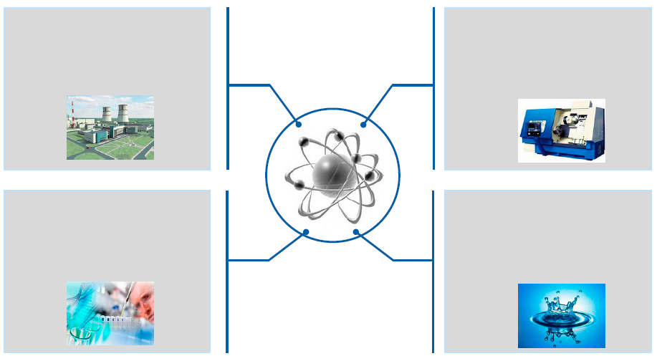
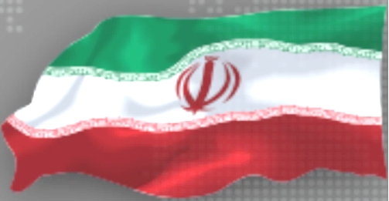
Nuclear power development in IRAN means not only large scale power production, but also additional advantages
nuclear Tecnology applications
Power production
Industry development
New jobs
Creation of manufacturing facilities
Base Load
Science development
R&D
New technologies development
Alternative use
Seawater desalination
Heat generation

Slide 8
Iran Nuclear Agreement (JCPoA)
  The Joint Comprehensive Plan of Action (JCPOA) known commonly as the Iran deal, is an international agreement on the nuclear program of Iran reached in Vienna on 14 July 2015 between Iran, the P5+1*
  *The five permanent members of the United Nations Security Council-China, France, Russia, United Kingdom, United States- plus Germany, and the European Union.

Slide 9
JCPoA (cont'd)
What Iran wants : lifting of sanctions (National , international & multinational), preservation of Nuclear achievement particularly the Fuel Cycle, recognition of it’s right of enrichment , keeping infrastructure of the Nuclear Program, putting an end to the accusation of PMD. Paving the way for international nuclear cooperation.
What (E3/EU+3) want: to have objective guarantee on peacefulness of Iran’s nuc. Program, to limit Iran’s nuclear program, more transparency and verification.

Slide 10
JCPoA (cont'd)
  On January 2016, the parities (E3/EU+3) and Iran after two years of intensive negotiation started to implement JCPOA :
  - Lifting of all nuclear-related sanctions imposed on Iran by EU, UN Security Council and the US.
  -Termination of 6 UNSC Resolutions.
  - Termination of IAEA resolution and Board decesions
  - Adoption of UNSC Resolution 2231.
  - cooperation on Trade, Technology , finance and Energy

Slide 11
JCPoA (cont'd)
  Iran accepted to limit it’s nuclear program in scope, level and size, that would later be gradually developed and intensify based on an agreed timetable
Iran will implement additional protocol with the expectation that IAEA would issue it’s broader conclusion not more than 8 years.
The UNSC Resolution 2231 would automatically be terminated after 10 years.
Certain limits would be removed on years 8 , 10 and all restriction would be automatically removed on year 15.

Slide 12
International cooperation
  Wide range of issues in the Annex 3 of JCPoA.
  Modernization of Arak Heavy Water Reactor.

Slide 13
JCPoA Impact on Iran Nuclear Program
Development of international relations with companies & countries with nuclear technology
enhancing and strengthening of nuclear technology in Iran
Optimization of the nuclear development program with Eco-technical and localization approach

Slide 14
JCPoA Impact on Iran Nuclear Programme
Cooperation field:
Strengthening nuclear safety,
Capacity building in different fields,
Supplying of valid codes, instruments and equipment related to nuclear energy and nuclear safety,
Small Modular Reactor technology development plans,
Other 2 S , Security and Safeguards.

Slide 15

Thank you for your attention

