Slide 1

Review safety analysis report of BNPP
Workshop on Deterministic Safety Analysis and Format and Content of the Safety Analysis Report
IAEA
EVT1805013
Shahram Sheikhi
Shahram@aut.ac.ir
2-6 September 2019, Hangzhou

Slide 2
Table of content
Introduction
General description of the plant
approach on the Review of the Content and Format of BNPP SAR
Format and Content of the Safety Analysis Report OF BNPP
Example of accident analysis
Challenges identified during review
Conclusion & Recommendation

Slide 3
Introduction
SAR for NPP Bushehr is developed for justifying acceptability of adopted concepts ensuring the adequate level of NPP safety wherein radiation effect on personnel, population and environment during normal operation, operational occurrences and design basis accidents does not lead to exceeding anticipated radiation doses for personnel and population, specified values for releases, discharges and content of radioactive substances in the environment and is minimized during beyond design basis accidents.
The project is developed based on requirements of rules and norms on safety in nuclear power engineering of the Russian Federation, INRA and IAEA.
objective
The objective of SAR review is to determine the extent to which the plant conforms to current national and/or international safety standards and operating practices.

Slide 4
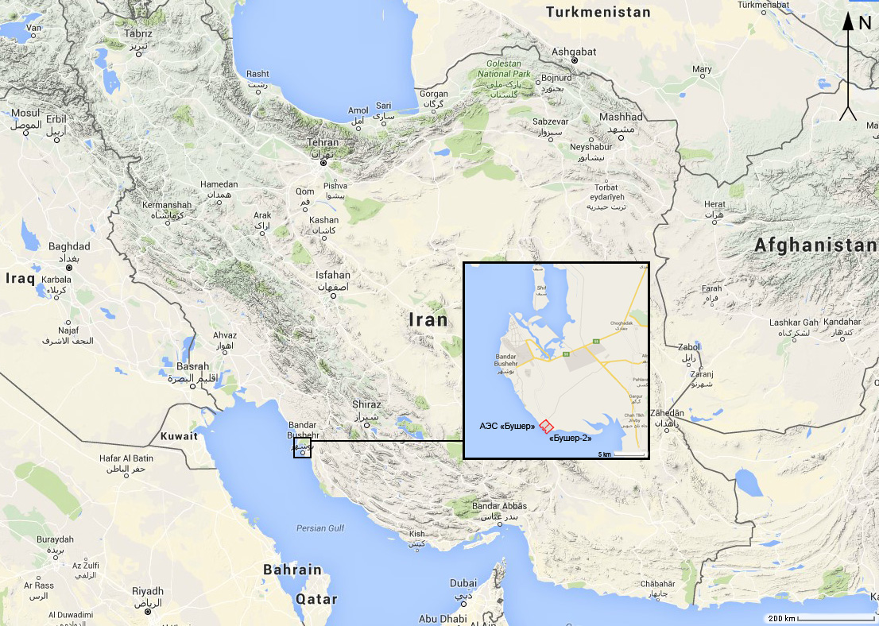
2. General description of the plant
Bushehr NPP is located in the southwest of the Islamic Republic of Iran, on the bank of the Persian Gulf in Bushehr province.

Slide 5
2.General description of the plant
In the design of “Bushehr” NPP the reactor plant is used with WWER-1000 type reactor (model V-446) upgraded on the basis of operation experience of V-320 series plants. This is the four-loop reactor plant with water-cooled water-moderated reactor (WWER).
characteristics | Bushehr NPP
Nominal value of the reactor thermal power, MW | 3000 MW
Parameters of primary system: Reactor coolant outlet pressure, MPa Reactor coolant outlet temperature, ^{о}С Reactor coolant inlet temperature, ^{о}С Coolant flow rate through the reactor, m³/h | 15.7 321 291 84800
Containment type | Double containment: - steel containment; - reinforced concrete containment.

Slide 6
3. Approach on the Review of the Content and Format of BNPP SAR
The principal purpose of the SAR is to inform the Regulator (and public) of:
the nature of the plant (basic design),
the plans for its use, and
the safety evaluations that have been performed to evaluate whether the plant can be constructed and operated without undue risk to the health and safety of the public.
Therefore, the information contained in the SAR should be timely, accurate, complete, and organized in a format
that provides easy access.
• The purpose of the Standard Format and Content of Safety Analysis Reports for Nuclear Power Plants is to indicate the information to be provided in the SAR and to establish a uniform format for
presenting the information.
• Use of this format will:
– help ensure the completeness of the information provided,
– will assist the Regulator's staff and others in locating the information,
and
– will aid in shortening the time needed for the review process.
• SAR content could and should be upgraded if necessary!
Main tool for Review of Safety Margins:
- Regulatory Guides
- Standard Review Plans
- Inspection Manual

Slide 7
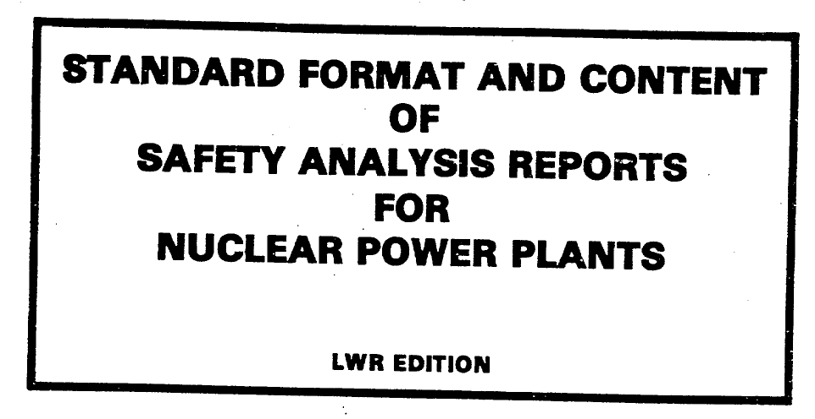
3.Approach on the Review of the Content and Format of BNPP SAR
RG-1.70 rev.3: Standard Format and Content of Safety Analysis Reports for Nuclear Power Plants (LWR Edition) – used for current operating unit (BNPP)
1. INTRODUCTION AND GENERAL DESCRIPTION OF PLANT
2. SITE CHARACTERISTICS
3. GENERAL DESIGN BASES OF STRUCTURES, COMPONENTS,
EQUIPMENT AND SYSTEMS
4. REACTOR
5. REACTOR COOLANT SYSTEM AND CONNECTED SYSTEMS
6. CONTAINMENT AND ENGINEERED SAFETY FEATURES
7. INSTRUMENTATION AND CONTROL
8. ELECTRIC POWER
9. AUXILIARY SYSTEMS
10.STEAM AND POWER CONVERSION SYSTEM
11.RADIOACTIVE WASTE MANAGEMENT
12.RADIATION PROTECTION
13.CONDUCT OF OPERATIONS
14.PLANT COMMISSIONING (initial test program and ITAAC-Design Certification
15.ACCIDENT ANALYSES
16.TECHNICAL SPECIFICATIONS
17.QUALITY ASSURANCE

Slide 8
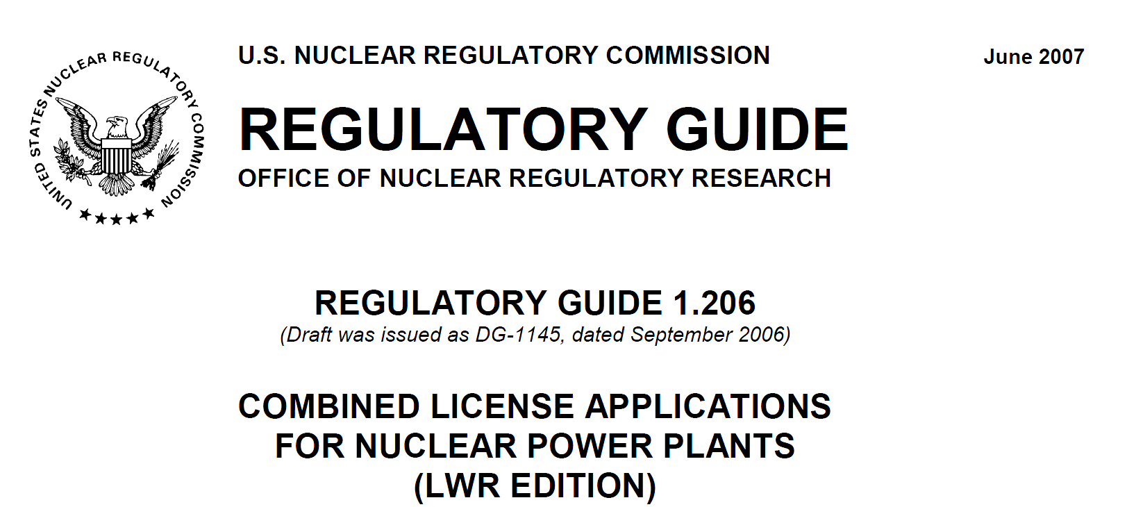
3.Approach on the Review of the Content and Format of BNPP SAR
US NRC Regulatory Guide 1.206 - Combined License Applications for Nuclear Power Plants– used for new units
1. INTRODUCTION AND GENERAL DESCRIPTION OF PLANT
2. SITE CHARACTERISTICS
3. Design of Structures, Systems, Components, and Equipment
4. REACTOR
5. Reactor Coolant and Connecting Systems
6. ENGINEERED SAFETY FEATURES
7. INSTRUMENTATION AND CONTROL
8. ELECTRIC POWER
9. AUXILIARY SYSTEMS
10.STEAM AND POWER CONVERSION SYSTEM
11.RADIOACTIVE WASTE MANAGEMENT
12.RADIATION PROTECTION
13.CONDUCT OF OPERATIONS
14. Verification Programs
15.ACCIDENT ANALYSES
16.TECHNICAL SPECIFICATIONS
17. Quality Assurance and Reliability Assurance
18. Human Factors Engineering
19. Probabilistic Risk Assessment and Severe Accident Evaluation

Slide 9
3.Approach on the Review of the Content and Format of BNPP SAR
US NRC Regulatory Guide 1.206 - Combined License Applications for Nuclear Power Plants– used for new units
This regulatory guide provides guidance regarding the information to be submitted in a COL application for a nuclear power plant. In general a COL applicant is not required to conform to this guidance.
In addition, the Sections C.I.2–C.I.19 correspond to Chapters 2–19 of NUREG-0800.
In contrast, Sections C.I.18 and C.I.19 specify information requirements that are not addressed in RG 1.70.
Sections C.I.2–C.I.17 are based on the existing guidance provided in RG 1.70, “Standard Format and Content of Safety Analysis Reports for Nuclear Power Plants,” issued November 1978, although the NRC staff has updated the guidance in those sections to reflect the current information requirements for COL applications.
Section C.I.1 provides broad generic guidance, although COL applicants have the option not to maintain some of this information in Chapter 1 of the FSAR.

Slide 10
3.Approach on the Review of the Content and Format of BNPP SAR
Regulatory Guide 1.203 – Transient and Accident Analysis Methods
Guidelines described under RG-1.203 are used for evaluating submittals in the following categories:
• Construction permit applications that must meet the design-basis description requirements (e.g. 10 CFR 50.34) and the relationship of the design bases to the principal design criteria described (GDC) (e.g. Appendix A to 10 CFR Part 50).
Chapter 15 of the SRP describes the transients and accidents that the Regulator staff reviews as part of the application, and the criteria of Appendix A that specifically apply to each class of transient and accident. Chapter 15 also states that acceptable EMs should be used to analyze these transients and accidents
• Operating license applications must meet the design-basis description requirements and the relationship of the design bases to the principal design criteria.
• New or modified EMs proposed by vendors or operating reactor licensees that, in accordance with 10 CFR 50.59, require Regulatory review and approval. In such instances, a graded application of the principles of this regulatory guide can be undertaken, based on the nature and extent of the new model or proposed changes.
The two fundamental features of transient and accident analysis methods are:
the evaluation model concept, and
the basic principles important for the development, assessment, and review of those methods.
The evaluation model concept establishes the basis for methods used to analyze a particular event or class of events.
An evaluation model (EM) is the calculational framework for evaluating the behavior of the reactor system (or/and containment) during a postulated transient or design-basis accident.

Slide 11

3.Approach on the Review of the Content and Format of BNPP SAR
NUREG 0800 SRP: Standard Review Plan for Review of Safety Analysis Reports for nuclear power Plants: LWR Edition
1. INTRODUCTION AND GENERAL DESCRIPTION OF PLANT
2. SITE CHARACTERISTICS
3. GENERAL DESIGN BASES OF STRUCTURES, COMPONENTS,
EQUIPMENT AND SYSTEMS
4. REACTOR
5. REACTOR COOLANT SYSTEM AND CONNECTED SYSTEMS
6. ENGINEERED SAFETY FEATURES
7. INSTRUMENTATION AND CONTROL
8. ELECTRIC POWER
9. AUXILIARY SYSTEMS
10.STEAM AND POWER CONVERSION SYSTEM
11.RADIOACTIVE WASTE MANAGEMENT
12.RADIATION PROTECTION
13.CONDUCT OF OPERATIONS
14. initial test program
15.ACCIDENT ANALYSES
16.TECHNICAL SPECIFICATIONS
17.QUALITY ASSURANCE
18. HUMAN FACTORS ENGINEERING

Slide 12
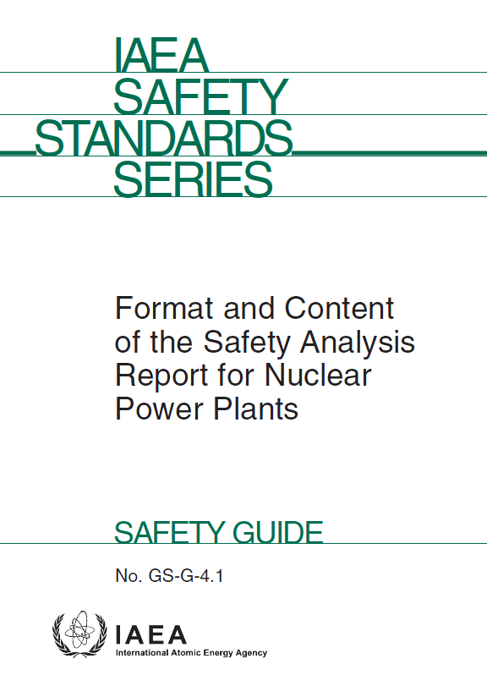
3.Approach on the Review of the Content and Format of BNPP SAR
IAEA GS-G-4.1 - Format and Content of the Safety Analysis Report for Nuclear Power Plants
Chapter I: Introduction
Chapter II: General plant description
Chapter III: Management of safety
Chapter IV: Site evaluation
Chapter V: General design aspects
Chapter VI: Description and conformance to the design of plant systems
Chapter VII: Safety analysis
Chapter VIII: Commissioning
Chapter IX: Operational
Chapter X: Operational limits and conditions
Chapter XI: Radiation protection
Chapter XII: Emergency preparedness
Chapter XIII: Environmental aspects
Chapter XIV: Radioactive waste management
Chapter XV: Decommissioning and end of life aspects

Slide 13
4. PSAR CONTENT of BNPP
CHAPTER 1 | Introduction and NPP general description
CHAPTER 2 | NPP site specification
CHAPTER 3 | Design of structures, components, equipment and systems
CHAPTER 4 | Reactor
CHAPTER 5 | Primary circuit and related systems
CHAPTER 6 | Security equipment
CHAPTER 7 | Instrumentation and control
CHAPTER 8 | Power Supply
CHAPTER 9 | Auxiliary systems
CHAPTER 10 | The conversion system steam and energy
CHAPTER 11 | Radioactive waste handling
CHAPTER 12 | Radiation protection
CHAPTER 13 | Operation
CHAPTER 14 | Initial test program
CHAPTER 15 | Accident analysis
CHAPTER 16 | Safe operation limits and conditions
CHAPTER 17 | Quality assurance
CHAPTER 18 | Human factors
CHAPTER 19 | Severe accident
CHAPTER 20 | Other aspects
CHAPTER 21 | Decommissioning

Slide 14
5.CONTENT OF CHAPTER 15
15.1 | Introduction
15.1.1 | General provisions
15.1.2 | The list and classification of postulated initiating events, acceptance criteria, initial and boundary conditions
15.1.3 | Analysis procedures
15.1.4 | Initial data for calculations
15.2 | Increase in heat removal through the secondary circuit
15.3 | Decrease in heat removal through the secondary circuit
15.4 | Decrease in the primary coolant flow rate
15.5 | Reactivity and power distribution abnormalities
15.6 | Primary coolant inventory increase
15.7 | Primary coolant inventory decrease
15.8 | Leak to the secondary system
15.9 | Disturbances in nuclear fuel handling
15.10 | Release of radioactive media from systems and equipment of other circuits and systems
15.11 | Spurious operation of systems
15.12 | Analysis of beyond design basis accidents
15.13 | Radiological consequences

Slide 15
initiating events of design modes
Groups of initiating events
increase of heat removal by the secondary circuit;
- decrease of the primary circuit coolant flow rate;
- reactivity and power distribution anomalies;
- increase of the primary circuit coolant inventory;
- decrease of the primary coolant inventory;
- leakage into the secondary circuit system;
- disturbances in nuclear fuel handling;
- release of radioactive media from the systems and equipment of other circuits and systems;
- spurious operation of systems.
- decrease of heat removal by the secondary circuit;

Slide 16
Basic Safety Criteria and Design Limits
For design basis conditions of categories 1 and 2 according to norms and rules the operational limit and the safe operation limit of damage of fuel elements are set during operation of the NPP at the following power:
 | admissible number of fuel elements with damages of gas leakiness type | admissible number of fuel elements with direct contact of fuel and the coolant
operation limit | 0.2 % of the total number of fuel elements | 0.02 % of the total number of fuel elements
safe operation limit | 1.0 % of the total number of fuel elements | 0.1 % of the total number of fuel elements

Slide 17
List of the most important initial conditions
- initial parameters of the nuclear power plant:
1) reactor power;
2) coolant temperature at the core inlet;
3) coolant pressure in the primary circuit;
4) coolant flow through the reactor;
5) pressurizer level;
6) steam generator pressure;
7) feed water flow;
8) feed water temperature;
9) steam generator level;
10) fuel pool temperature;
11) fuel pool level;
- power distribution:
1) fuel rod maximum linear load;
2) power density distribution axial profile;
3) radial power peaking factor;
- reactivity coefficients and other physical neutron characteristics of the reactor core:
1) fuel temperature reactivity coefficient;
2) coolant temperature reactivity coefficient;
3) coolant density reactivity coefficient;
4) coolant boric acid content reactivity coefficient;
5) prompt neutron average generation time and delayed neutron share;
- efficiency of absorbing rods of the control and protection system:
1) efficiency of individual CPS CR (ejection and drop);
2) efficiency of CPS CR group;
3) emergency protection efficiency;
- residual heat.

Slide 18
Boundary conditions
Combinations of boundary conditions to be used in a safety analysis are chosen for a certain initial event from the following list:
– Assumption of safety systems operability;
– Operational conditions of functioning systems and equipment (deviations of setpoints and characteristics);
– Actuation delays of functioning systems and equipment;
– Assumption of the operator's action;
– Assumption of power supply availability;
– Allowance for actuation of normal operation systems.

Slide 19
Analysis Methods
codes used for safety justification of Bushehr-1 NPP
Thermohydraulic analyses
TRAP-KS
Containment analyses
ANGAR
Neutronics analyses
Analysis of the radiation safety
KORSAR/GP
ATHLET/BIPR-VVER
SAPFIR-2006
NOSTRA
LEAK3
COTRAN-M
RELWWER-UNI

Slide 20
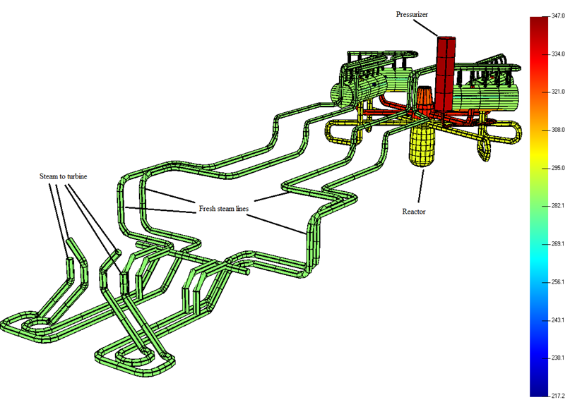
Analysis Methods
Example of Model of the primary and the secondary circuits

Slide 21
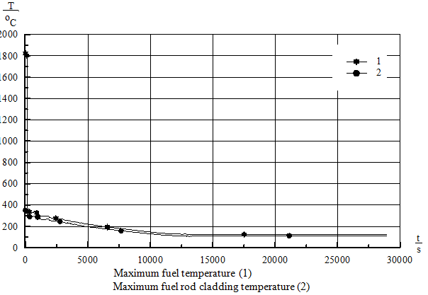
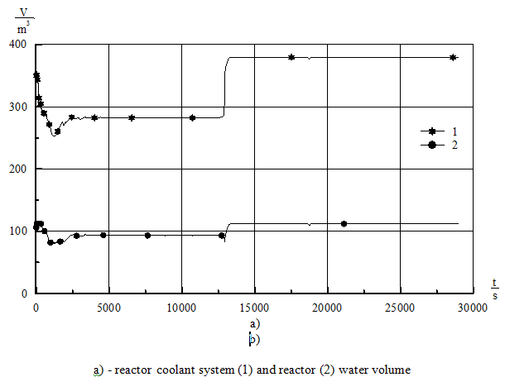
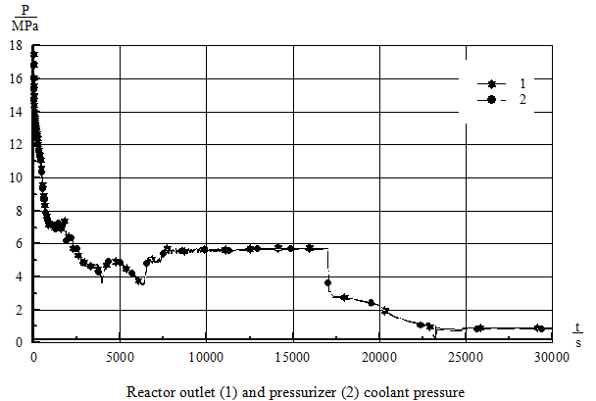
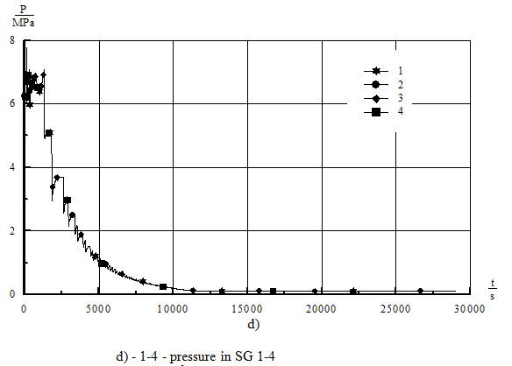
Example of accident analysis results
Small break LOCA of pipeline (DnomЈ100 mm)

Slide 22
Main challenges identified during review
the analysis of uncertainty for BDBA
The manner of selection of representative list of accidents
Relation between the SAR chapters
The thermal-hydraulic analysis regards to Spent fuel pool accidents
The basis document (PSA ,etc.) associated to Classification of initiating events and topical reports
An acceptable methodology for determining uncertainties (from the combined effects of calibration error, drift, instrumentation error, and other factors)
possible deviations (within the tolerances) of the initial conditions
shutdown and low power states of the plant
The criterion for detecting reactor plant controlled state or end of calculation
Reasons evidence for the most conservative version

Slide 23
Main challenges identified during review
The margins between the results of accident analysis as presented and the cliff edge effect
The methodology for determining uncertainties
delay time for signal processing in addition to time for signal generation and for signal transfer in electric circuits
Delay for the start-up due to inertia
Automatically initiate the relevant systems indicative of an ATWS
ensuring that containment design conditions during accident
Assurance of non water-solid condition during accident

Slide 24
Conclusion & Recommendation
the analysis of uncertainty for BDBA is not required. This issue need to be taken into account in the new requirements.
A new section need to be considered to describe an acceptable methodology for determining uncertainties (from the combined effects of calibration error, drift, instrumentation error, and other factors)
recommendation and requirement regarding to accident in the SFP needed to be clarified with more details.
The necessity of the providing related topical reports and any other basis document (PSA ,etc.) associated to safety analysis need to be emphasized.
To ensure conservatism of the safety analyses, possible deviations (within the tolerances) of the initial conditions need to be taken into consideration. Some special part need to be considered to address any source of deviations.
Consideration should be given to analyze accidents for test conditions and low power states of the plant
The criterion for detecting reactor plant controlled state or end of calculation should be introduced in reference documentation.

Slide 25
Conclusion & Recommendation
ensuring that containment design conditions following any accident that deposits reactor coolant in the containment need to be addressed in reference documentation.
New upgrades need to be considered for the content of the SAR regarding to post fukushima lesson learned and ageing management.
The margins between the results of accident analysis as presented and any abrupt changes for the worse in those results as conditions vary (the cliff edge effect) need to be discussed.
Consideration should be given to delay time for signal processing in addition to time for signal generation and for signal transfer in electric circuits.
The assumptions used for analyses should be provided in summary table with one column for assumptions used in the design-basis analysis and one column for assumptions used in the realistic analysis.
Delay for the start-up due to inertia need to be mentioned in assumptions.
measures to automatically initiate the relevant systems under conditions indicative of an ATWS need to be considered. This equipment shall be independent and diverse from the reactor trip system from sensor output to the final actuation device.
Assurance that the pressurizer does not reach a water-solid condition shall be provided.

Slide 26
References
NS-R-1, Safety of Nuclear Power Plants: Design, IAEA, 2000
IAEA-TECDOC-1335, Configuration management in nuclear power plants, IAEA, 2003
SSG-2, Deterministic Safety Analysis for Nuclear Power Plants, IAEA, VIENNA, IAEA, 2009
WENRA, WENRA Safety Reference Levels for Existing Reactors: Update in relation to lessons learned from TEPCO Fukushima Dai-chi accident, 2014.
JSC “ATOMENERGOPROEKT”, 49.BU.1 0.0.ОО.FSAR.RDR001, Final safety analysis report Revision 2, Moscow (2015)
Regulatory Guide 1.70 - Standard Format and Content of Safety Analysis Reports for Nuclear Power Plants (LWR Edition)
Regulatory Guide 1.206 - Combined License Applications for Nuclear Power Plants
Regulatory Guide 1.203 – Transient and Accident Analysis Methods
IAEA GS-G-4.1 - Format and Content of the Safety Analysis Report for Nuclear Power Plants
IAEA, Safety Reports Series No.23 accident analysis for nuclear power plants, Vienna (2002).

Slide 27
THANK YOU
Comments?
Questions?

