Slide 1


The Iranian nuclear Power
program policies
Behrooz Kamalvandi
Deputy President of The Atomic Energy Organization of
Iran for International, Legal and Parliamentary Affairs
Turkey-MENA Nuclear Industry Congress
2016 May 12-13, Istanbul

Slide 2

In the name of GOD

Slide 3
Contents
Introduction
Perspective of the world nuclear energy development
Resources, production and consumption of energy in IRAN
Why nuclear energy development program in I.R.IRAN
History of nuclear development of IRAN and current status
Joint Comprehensive Plan of Action (JCPoA)
JCPoA Impact on Iran’s Nuclear Programme
Nuclear development as an economic advantage of Iran
Conclusions

Slide 4
Introduction
  Energy is the most important factor in socio-economic development
  It plays a vital role in development of industrial infrastructures, in economic development and in improving life styles and standards of the countries
  The world need will greatly increase for energy supply in the next 20 years, especially cleanly-generated electricity.
  Nuclear power is the most environmentally benign way of producing electricity on a large scale.
  Iran have to use energy mix option and especially developing the nuclear power plants as a necessary part of energy mix in long term programs.

Slide 5
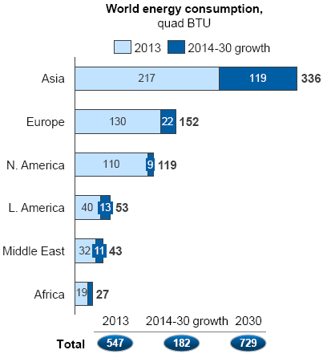
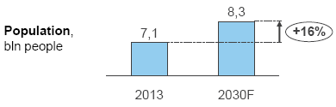
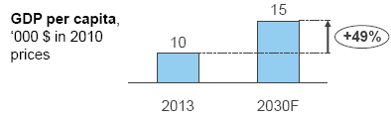
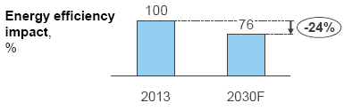
Perspective of developing the nuclear energy in the world
  Over the next few decades, population and income growth are expected to create new demands for energy
Key drivers for energy demand
54%

Slide 6
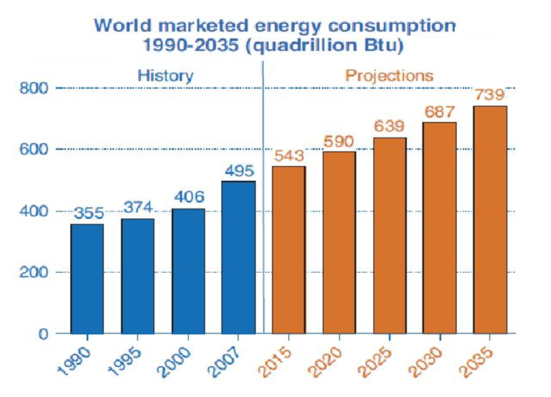
world energy demand
  From 2000 to 2010 total world primary energy demand grew by 26%.
  From 2010 to 2035 it is projected to grow by 45%.

Slide 7
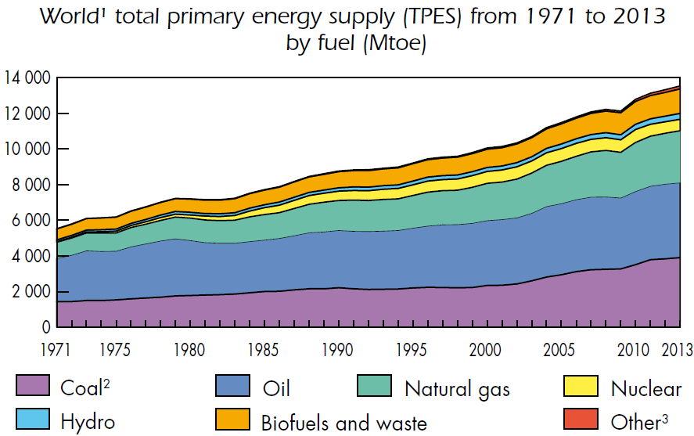
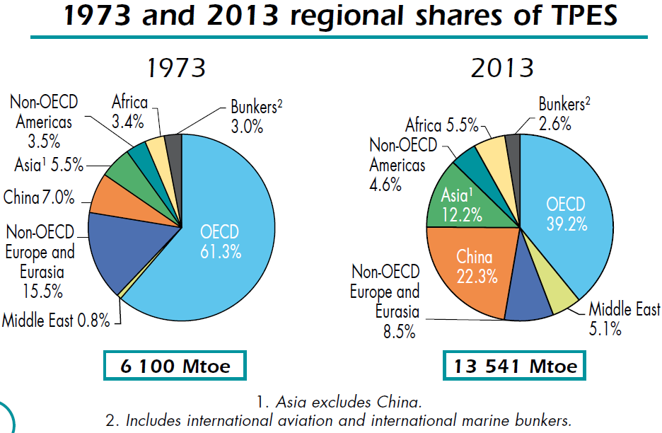
World total primary energy supply (TPES)

Slide 8
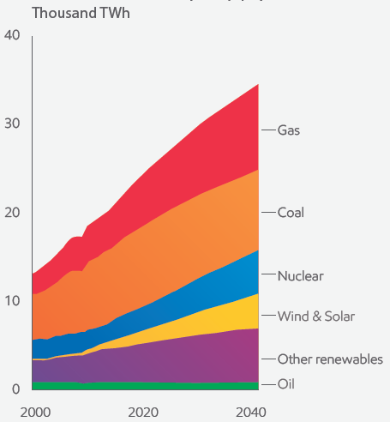
Outlook for Global electricity supply
ExxonMobil: By 2040, natural gas, nuclear and renewables are expected to deliver more than 70 percent of the world’s electricity.
Source: 2015- The Outlook for Energy : A View to 2040 (By ExxonMobil)

Slide 9
  Although wind and solar energy are expected to exceed global nuclear capacity by 2040, installed capacity alone does not indicate actual generation of electricity
  Nuclear energy is “base load”, with 80- 85% efficiency
  Wind and solar, however, have low efficiency because they are intermittent sources
  As a result, even by 2040, wind and solar each will meet far less electricity demand than nuclear power.

Slide 10
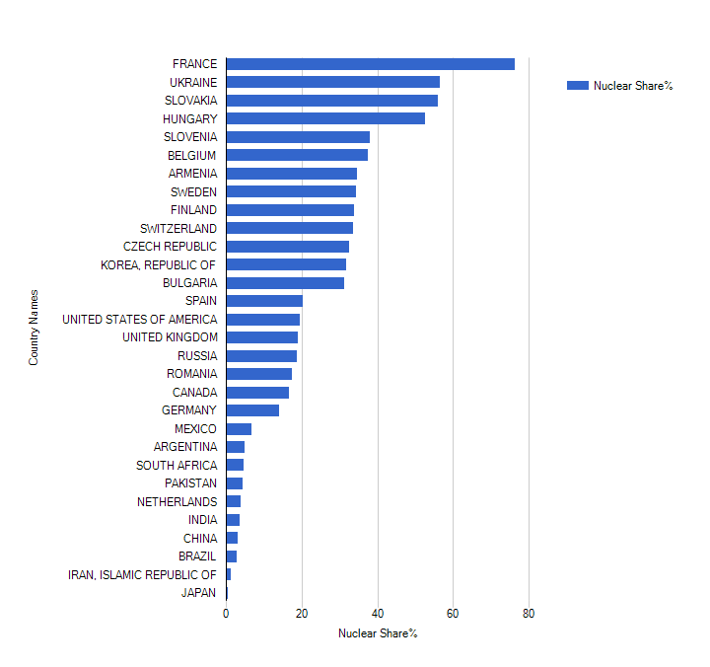
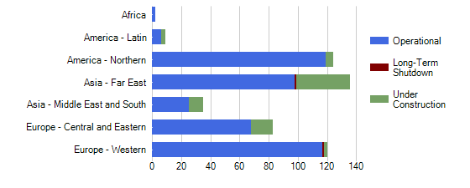
Demand for the Nuclear Energy
  Nuclear power provides about 11% of the world’s electricity, and 21% of electricity in OECD countries
  444 Reactor operational
  64 Reactor under construction( 42 in Asia)
[IAEA,PRIS]

Slide 11
Resources
energy in IRAN
  Total reserve of accessible crude oil and gas liquidities is about 11.4 % of world known reserves.
  About 98 % of primary energy production is providing from oil and natural gas resources.
  Natural gas, with a reserve of 13.18 trillion cubic meters forms about 15.5 % of world natural gas reserve

Slide 12
Electric Power generation
energy in IRAN
  Nominal capacity of power plants reached the record of 73152 MW in 2014
  Rate of electricity demand is about 8%
  Share of N.Gas on electricity generation 30%
  Challenges of growing demand, efficiency, Environmental impact and fossil resources.

Slide 13
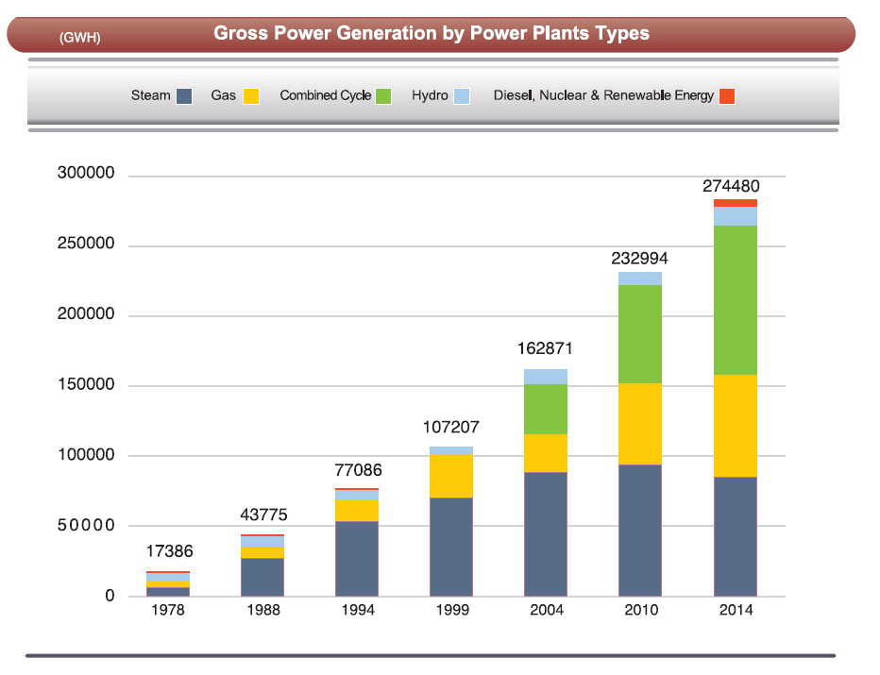
Electric Power generation by power plant types
energy in IRAN

Slide 14
energy in IRAN
In mid-2015 generating capacity was 74 GWe. Iran plans to boost generating capacity to 122 GWe by 2022, with substantial export potential.
Iran trades electricity with Afghanistan, Armenia, Azerbaijan, Iraq, Pakistan, Syria, Turkmenistan and Turkey. Net export is about 6 TWh/yr. turkey and Iraq account for 90% of exports.

Slide 15
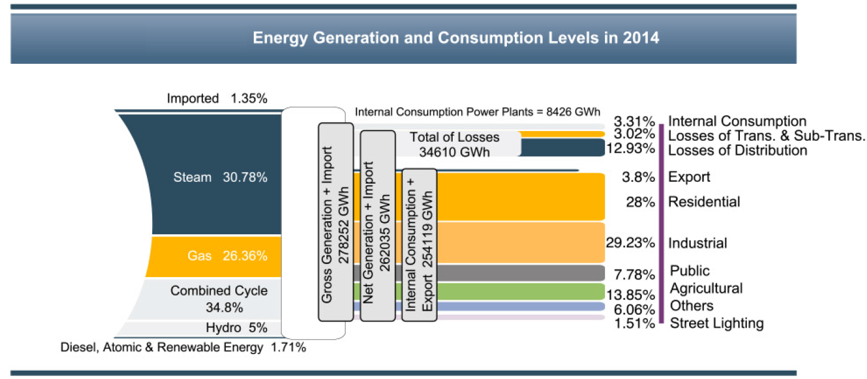
Electricity generation leveling
energy in IRAN
In 2014, Electric energy consumption has been increasing by 8.1% comparing with it in the previous year, reaching 219653 GWh.

Slide 16
Needs of Country's developing programs for energy
Why nuclear energy development program in I.R.IRAN
  Based on the 20yrs. Vision document and 5yrs. developing programs, Iran target a high, sustained and fast economical growth rate of 8%
  According to the country vision document, on 2025, Islamic Republic of Iran shall occupy the first place in nuclear technology among countries of the region
  Parallel with GDP growth, the electricity need will rise to about 123000 MWe by the year 2025

Slide 17
The Energy security point of view
  Fossil resources alone can not guarantee a secured supply of energy in long term.
  Supplying energy by hydro-electric power on great extension didn't succeed. Because Iran is an arid land with vast deserts.
  Renewable energy sources such as wind, solar, geothermal because of their technical limitations and uncompetitive price in comparison to other sources can not have a big share in producing the primary energy.
  The potential capacity of power plant construction on the mentioned sources (hydro & renewable energy) in 2025 are low in comparison with total need of the country

Slide 18
Environmental consideration/Sustainable development
The fossil fuels are considered as the main resources of energy and petrochemical industry in Iran and at the same time they play the main role in climate change and environmental contaminations
Techno-economic advantages
Low fuel and social cost of NPPs, longer lifetime , capability for supplying base load energy and by-products of nuclear power plants can be considered as some techno-economic advantages.
Nuclear technology is multidisciplinary and interrelated of different science & technologies.

Slide 19
Legal and National Objectives
In Strategic Energy Plan of the country, one of Iran's pillars in energy section is related to nuclear energy: “Effort to achieve nuclear science & Technology and construct nuclear power plants to supply part of Iran's energy and training fields is necessary”.
Iran's Atomic Energy Council approval: Construction of nuclear power plants to generate 10 to 20% of country's needed electricity is one of Iran Government's principal goals and policies

Slide 20
Reference Points before Islamic Revolution
  1957: Start of civil nuclear program .
1959: Academic nuclear education kick off.
1966: Construction and Operation of Tehran Research Reactor.
1970-78:
SRI Study ( Stanford Research Institute) for energy planning: Forecasting for nuclear power sharing: 9000 MW (16%)
Establishment (AEOI) Atomic Energy Organization of IRAN
Conclusion of Bushehr NPPs Contract with KWU (2 reactor)
Darkhowin (Karon) NPPs Contract with Framatom (2Reactor)
Conclusion of agreements for construction of 6 NPP with Germany
Nuclear fuel cycle research and development including airborne uranium exploration (more than a third of country) began.
Research laboratories for nuclear studies constructed.
Esfahan center for nuclear technology was established.

Slide 21
Reference Points after the Islamic Revolution
European countries abandon their engagement with Iran
Conclusion of Agreement with Russia for completion of BNPP-1 in 1992, Signing commercial Contract, 1995
Nuclear fuel cycle technology achievement (1990-2002),
Design and construction of Heavy water production plant,
Designing and construction of IR-40 (Iranian HWRR),
Development of fusion and laser research and non-power nuclear application in medicine, agriculture and industry,
BNPP-1, First grid connection, Sept. 2011,
BNPP-1, Reach to it’s 1000 Mw. Capacity , Aug 2012,
BNPP-1, Provisional Acceptance-Iranian Operator,Sept.2013
First refueling conducted, Feb. 2013
Second refueling, planned Sept. 2015

Slide 22
History of the first unit of Bushehr Nuclear Power Plant(BNPP1)
 | Type | MWe gross, net | Construction start | Commercial operation
Bushehr 1 | VVER-1000/446 | 1000,915 | 1975, 1994 | Sept 2013
Total (1) | 915 MWe net
  Bushehr 1
  In 1957 a civil nuclear program was established under the US Atoms for Peace programme.
  In 1974 a target of 23,000 MWe of nuclear capacity to free up oil and gas for export. Preliminary agreements with Siemens KWU and Framatome for 4 NPPTs signed.

Slide 23
History of the first unit of Bushehr Nuclear Power Plant(BNPP1)
  1975 construction of two 1,293 MW - PWR units was started 18 km south of Bushehr in Bushehr province on the Persian Gulf by Siemens KWU, based on the Biblis B reactor in Germany.
  After the Islamic revolution, work was abandoned early in 1979 with unit 1 substantially complete and unit two about half complete. The plant was damaged by Iraqi air strikes in 1984-88.

Slide 24
History of the first unit of Bushehr Nuclear Power Plant(BNPP1)
  In 1992, the governments of the Islamic Republic of Iran and the Russian Federation signed a bilateral agreement on the completion of unit one of BNPP.
  A 1000 (MW) VVER type nuclear power reactor is operating in Iran, after many years construction, and a second is planned.
  The 7 TWh/yr from the Bushehr reactor frees up about 1.6 million tones of oil (11 million brs) or 1800 million cubic meters of gas per year, which can be exported .

Slide 25
Current status of nuclear energy in IRAN
Share of nuclear power in the country’s electricity capacity (73000 MW) in 2014, was about 1.4 percent.
The total electricity produced by the BNPP1 in 2011-2015 was about 13563 GWh.
During the four years operation of BNPP1(2011-2014), the total amounts of fossil fuels that have been saved is equivalent to 22 million barrels of crude oil.
Furthermore, during this period, the emission of 13 million tons of pollutants has been prevented.
SUM | 2015 | 2014 | 2013 | 2012-2011 | year
13563.7 | 3546.7 | 4140.1 | 4268.3 | 1608.8 | BNPP-1 Production (GWh)

Slide 26
Current status of nuclear energy in IRAN
International Cooperation
- Considering the continues improvement of the Bushehr Nuclear Power Plant safety performance indicators, benefits have been gained through close cooperation with International organizations, IAEA and WANO.
Continues collaboration and close cooperation in nuclear aspects with IAEA,
1st WANO Peer Review was Conducted in BNPP-1 0n 2011 and its follow-up on 2013,
2nd WANO Peer Review held in BNNP-1 on June, 2015,
First WANO Cooperate Peer Review Conducted in NPPD Co. on Sept., 2015,
Pre-OSART is planned for end of 2016 and OSART is expected to be conducted in 2017.

Slide 27
Non-Power Nuclear applications in Iran
Food and agriculture application: food preservation, increasing genetic variability and crop production and etc.
Medicine application : using radiation and radioisotopes for diagnosis and therapy of various medical conditions, producing radiopharmaceuticals and etc. parts of Isotope production is exported.
Industrial applications: oil and gas exploration, radioactive tracers, road construction and etc.
Seawater desalination

Slide 28
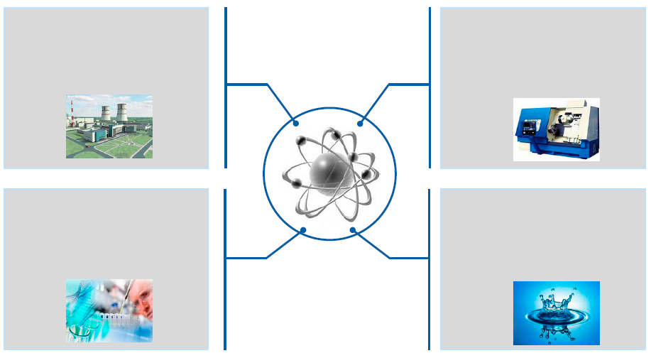

Nuclear power development in IRAN means not only large scale power production, but also additional advantages
nuclear Tecnology applications
Power production
Industry development
New jobs
Creation of manufacturing facilities
Base Load
Science development
R&D
New technologies development
Alternative use
Seawater desalination
Heat generation

Slide 29
Nuclear Power Development program
  Construction of two more units of the Bushehr nuclear power plant (BNPP-1,2) are due to start in the near future. The BNPP-1,2 are the VVER-1000,AES92 type with 1057 MWe output.
  Iran is planning to develop Small Modular Reactor and are negotiating with china on construction of SMRs.
  The Darkhowin Nuclear Power Plant (IR-360) is a planned nuclear power plant located about 70 kilometers south of Ahvaz, Iran at the Karun river. The plant detailed design is under preparation.
  Development of fuel cycle and fuel fabrication for different types of reactors in the country.

Slide 30
Iran Nuclear Agreement (JCPoA)
  The Joint Comprehensive Plan of Action (JCPOA) known commonly as the Iran deal, is an international agreement on the nuclear program of Iran reached in Vienna on 14 July 2015 between Iran, the P5+1*
  *The five permanent members of the United Nations Security Council-China, France, Russia, United Kingdom, United States- plus Germany, and the European Union.

Slide 31
JCPoA (cont'd)
What Iran wants : lifting of sanctions (National , international & multinational), preservation of Nuclear achievement particularly the Fuel Cycle, recognition of it’s right of enrichment , keeping infrastructure of the Nuclear Program, putting an end to the accusation of PMD. Paving the way for international nuclear cooperation.
What (E3/EU+3) want: to have objective guarantee on peacefulness of Iran’s nuc. Program, to limit Iran’s nuclear program, more transparency and verification.

Slide 32
JCPoA (cont'd)
  On January 2016, the parities (E3/EU+3) and Iran after two years of intensive negotiation started to implement JCPOA :
  - Lifting of all nuclear-related sanctions imposed on Iran by EU, UN Security Council and the US.
  -Termination of 6 UNSC Resolutions.
  - Termination of IAEA resolution and Board decesions
  - Adoption of UNSC Resolution 2231.
  - cooperation on Trade, Technology , finance and Energy

Slide 33
JCPoA (cont'd)
  Iran accepted to limit it’s nuclear program in scope, level and size, that would later be gradually developed and intensify based on an agreed timetable
Iran will implement additional protocol with the expectation that IAEA would issue it’s broader conclusion not more than 8 years.
The UNSC Resolution 2231 would automatically be terminated after 10 years.
Certain limits would be removed on years 8 , 10 and all restriction would be automatically removed on year 15.

Slide 34
International cooperation
  Wide range of issues in the Annex 3 of JCPoA.
  Modernization of Arak Heavy Water Reactor.
  nuclear Asian states such as Japan, China and South Korea are expected to cooperate with Iran to enhance its nuclear energy capacities.
  Cooperation with European countries such as Switzerland, Sweden , Norway ,Czech Republic, Slovak .Spain, Bulgaria ,Poland….

Slide 35
JCPoA Impact on Iran Nuclear Program
Development of international relations with companies & countries with nuclear technology
enhancing and strengthening of nuclear technology in Iran
Optimization of the nuclear development program with Eco-technical and localization approach

Slide 36
JCPoA Impact on Iran Nuclear Programme
Cooperation field:
Strengthening nuclear safety,
Capacity building in different fields,
Supplying of valid codes, instruments and equipment related to nuclear energy and nuclear safety,
Small Modular Reactor technology development plans,
Other 2 S , Security and Safeguards.

Slide 37
IRAN’s advantages in nuclear energy applications development
  IRAN sees 8 percent growth/year under post sanctions, and Depending on GDP growth, Iran plans to boost generating capacity to 122 GWe by 2022.
Iran has a young and educated population which need job. Nuclear energy development can play an important role in job creation and economic growth in Iran.
Iran has a good human resource in nuclear sector. There are several universities that training human resource in nuclear physics, nuclear medicine and reactor and fuel cycle engineering and etc.

Slide 38
Reason for nuclear energy applications development
Water shortage in Iran reaches critical levels. Nuclear desalination is generally very cost-competitive with using fossil fuels and can paly an important role in desalinating needs in Iran.
Iran has gained public awareness and acceptance of nuclear energy.
Nuclear energy has became source of national pride for Iranian people.
Iran has gained engineering and management experiences in nuclear energy.

Slide 39
Conclusion
Iran plans to boost generating capacity to 122 GWe by 2022, to properly respond to the huge rate of energy demand, thus nuclear power will paly an important role in electricity generation.
In view of the decreasing trend of fossil fuel resources in Iran, and various economic and environmental peculiarities, nuclear power is believed to play an important role. Thus, for the coming decades Iran plans to expand utilization of its nuclear power capacity as one of the most reliable and safe source of its energy supply.

Slide 40
Conclusion
Nuclear power technology is considered as multidisciplinary, and Influential on the development of other sectors.
Having more than 50 years of experiences, ample human resources and proper infrastructures, Iran welcomes bilateral, regional and international cooperation on different fields and applications of nuclear technology in areas such as nuclear safety, security, safeguards, capacity building and any other field.

Slide 41

Thank you for your attention

