Slide 1
Operating Company of Bushehr NPP
Ghaffari - Hossein
Bushehr NPP Manager & Managing Director

Slide 2
1. General information
2. Current status
3. Design-informed peer reviews in WANO-MC
4. Nuclear Safety Culture assessment during peer reviews
Notes:
Миссии технической поддержки (МТП) входят в программу ВАО АЭС «Техническая поддержка и обмен».

Slide 3
General BNPP Information
Bushehr NPP location;
Construction of the Bushehr NPP;
Commissioning;
Provisional Acceptance Agreement.

Slide 4
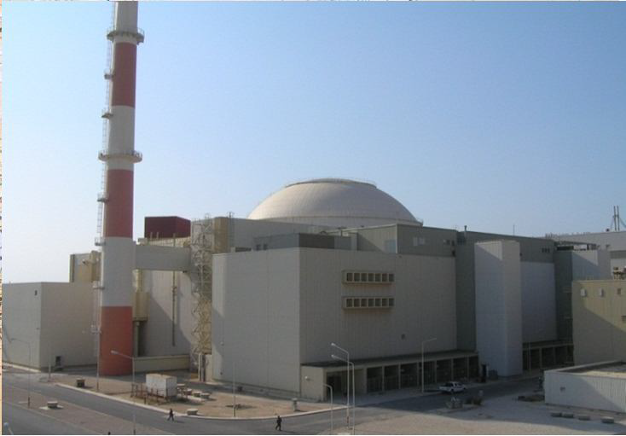
General BNPP Information
Unit number | Type/Design | Installed capacity | Commissioning date | Operation termination date
Bushehr-1 | PWR / WWER | Thermal power -3000 MW Electrical Power-1000 MW | 23.09.2013 | -
Notes:
Миссии технической поддержки (МТП) входят в программу ВАО АЭС «Техническая поддержка и обмен».

Slide 5
General information
2. Current status
3. Design-informed peer reviews in WANO-MC
4. Nuclear Safety Culture assessment during peer reviews
Notes:
Миссии технической поддержки (МТП) входят в программу ВАО АЭС «Техническая поддержка и обмен».

Slide 6
Current Status
    Current status of Plant
    Currently, Bushehr NPP is working in accordance with the requirements of the national and international standards.
    Unit 1 – 3000 MWt; 1000 MWe (nominal)
    All systems are operating in standard mode. All works are carried out as per the schedule.

Slide 7
Current Status
WANO Performance Indicators
No. | Indicator | Q4-2014 | Q1-2015 | Q2-2015 | Q3-2015
1 | FLR | 8.40% | 18.74% | 4.52% | 4.16%
2 | CRE | 0.39 man-sievert | 0.33 man-sievert | 0.25 man-sievert | 0.24 man-sievert
3 | ISA2 | - | - | 0.31 | 0.31
4 | SSPI | 0.0093 | 0.0094 | 0.0081 | 0.007
5 | SP5 | 0.0247 | 0.0255 | 0.022 | 0.0202

Slide 8
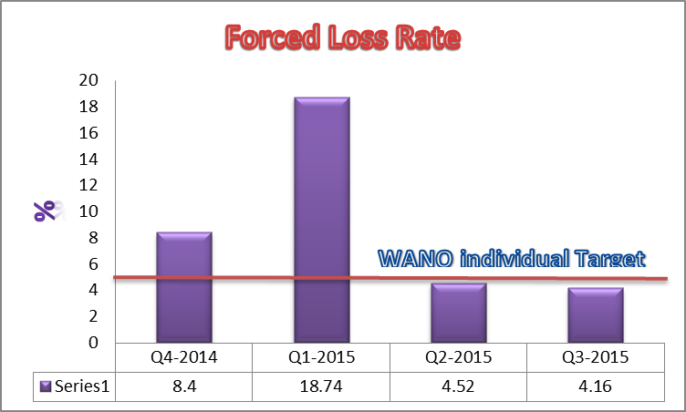
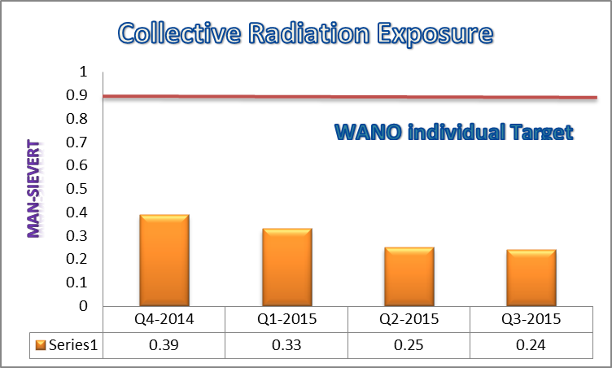
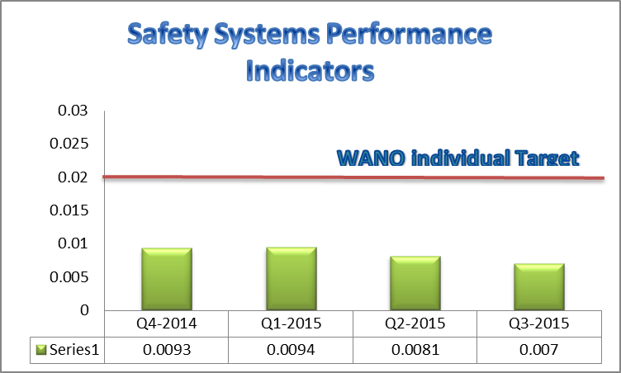
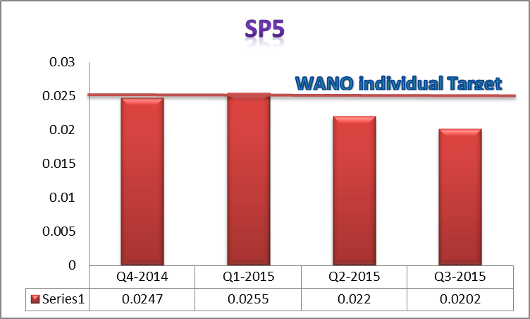
Current Status

Slide 9
WANO Peer Review
First WANO Peer Review of BNPP-1 was completed on June 2015.
In June 2015 the Moscow Centre of the World Association of Nuclear Operators (WANO-MC) conducted the first full scope peer review of the Bushehr nuclear power plant (BNPP) in Iran.
During WANO Peer Review, 3 good practices and 14 Areas For Improvement (AFI) were identified.
Action Plan to address each AFI was made.
Program of Corrective Actions was sent to WANO-MC.
Corporate Peer Review in operating company was completed on 2015.

Slide 10
WANO Peer Review Results
AFIs
№ | Areas for improvement | Field | Status of CM
1. | AFI LF.1-1: In some instances, station has not used a formal process to justify continuing operation. | in the field of Management and Leadership | 30 CM were developed
2. | AFI ОР.2-1 Operational switching and operation carrying out carefully, cautiously and in a controlled manner. | in the field of Operation | 33 CM were developed
3. | AFI OF.1-1 : At the station, there is no clear plan for the integrated identification and elimination of shortcomings of the system parameters and information on the operation of the equipment for MCR operators. | in the field of Operation | 45 CM were developed
4. | AFI OP.1-1 : In the implementation of some the abnormal and emergency situations in the simulation on FSS ,some shortcomings in the basic principles of the operators led to human errors and deterioration of the unit. | in the field of Operation | 54 CM were developed
5. | AFI MA.2-1 : Repair procedures and documentation are not always technically correct and do not contain the necessary instructions. | in the field of M&R | 32 CM were developed
6. | AFI EN.1-1 : System engineers have not always closely examined equipment conditions, trended key operating parameters for early identification and correction of negative trends. | in the Technical Support and Engineering area | 16 CM were developed
7. | AFI CM.3-1 : In some instances, modifications have been implemented without formal and timely evaluation. |  | 10 CM were developed

Slide 11
WANO Peer Review Results
AFIs
№ | Areas for improvement | Field | Status of CM
8. | AFI CY.1-1 : There are shortcomings in the implementation of the chemical monitoring of water chemistry regime. | in the field of Chemistry | 21 CM were developed
9. | AFI EP.2-1 : The absence of the "Guidelines for the management of severe accidents" (GSAM) and part of the necessities for the staff involved in the elimination of severe accidents leads to not fully ensuring the readiness for emergency response. | in the Field of Emergency Planning | 15 CM were developed
10. | AFI PI.2-1 : In investigating the events and planning the corrective measures , a consistent and balanced approach are not always applied. | in the field of Performance Improvement | 13 CM were developed
11. | RP.3-1 : Measures to control and non-proliferation of radioactive contamination are not always sufficient and effective. | in the field of Radiation Safety | 22 CM were developed
12. | RP.4-1 : Planned and executed work does not always minimize the generation of solid waste. | in the field of Radiation Safety | 8 CM were developed
13. | HU.1-1 : Employees of nuclear power do not always use effectively methods to prevent human error and eliminate repetition of the events. | in the field of Human Resources and Training | 14 CM were developed
14. | TR.1-1 : inconsistencies in the reality of the full-scale simulator (FSS). |  | 1 CM were developed

Slide 12
WANO Peer Review Results
GPs
No. | Good Practice | Subject | Field
1 | GP MA.1-1 | Application of automated accounting system tool, equipment and devices | M&R
2 | GP ER.4-1 | Laboratory for materials analysis, equipped with the means to fulfil both non-destructive and destructive methods of control provides immediate failure analysis of mechanical equipment. This allows you to determine causes and to issue recommendations for corrective action to prevent recurrence of similar failures in the future | Technical & Engineering
3 | GP RP. 4-1 | Bushehr nuclear power plant was created and introduced automated complex certification packages for radioactive waste | Radiation Protection

Slide 13
WANO Peer Review Results
SOERs
Level | Status | Quantity | Percent (%)
SAT | Implemented satisfactorily | 165 | 73
AI | Waiting to be implemented | 43 | 19
FAR | Further actions required | 9 | 4
NP | Not relevant to NPP | 2 | 1
NR | Not reviewed during PR | 7 | 3
Total | - | 226 | 100%

Slide 14
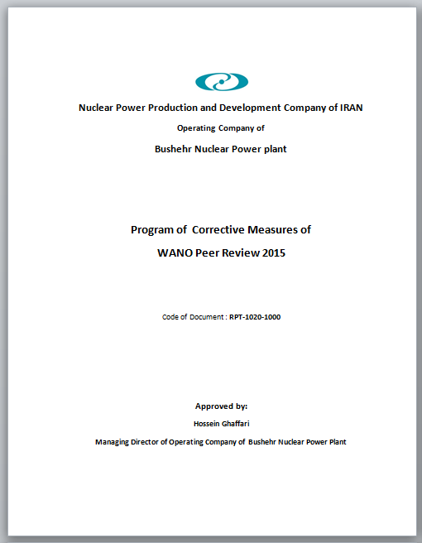
Action Plan for WANO PR AFIs
Action Plan to address each AFI was made.
Program of Corrective Actions was sent to WANO-MC.
This corrective measures plan has been developed in 14 parts commensurate with each area.
This program includes 194 separate corrective measures for all AFIs.
The corrective measures plan was reviewed by WANO-MC experts and their comments were included in this plan.

Slide 15
Interaction Plan between Bushehr NPP and WANO-MC, 2016-17
  On the basis of results of WANO Peer Review and agreement with WANO-MC, a bilateral interactions plan with WANO-MC has been developed.
  This plan includes the corrective measures with WANO cooperation which encompasses specific measures for each area.
  For each area, the following measures have been taken into account:
  Implementing one or more TSMs for each area;
  Participating Bushehr NPP personnel in the different WANO events related to each AFI;
  Implementing numerous self-assessments in each area based on the WANO Guide documents by BNPP;
  Implementing the target observations by WANO-MC Representative in BNPP for each area

Slide 16
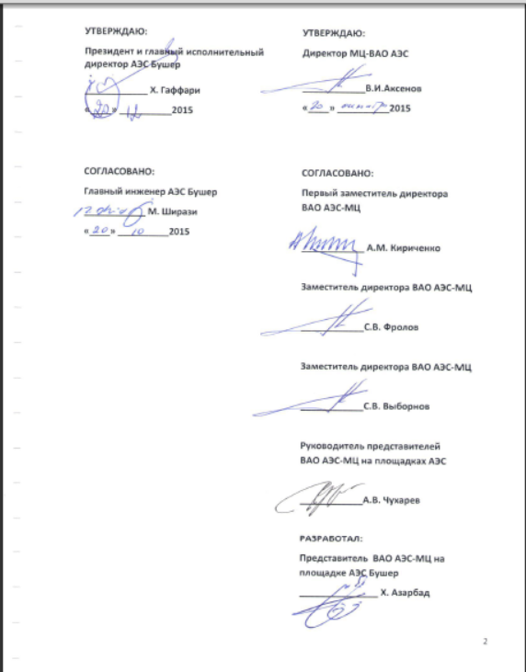
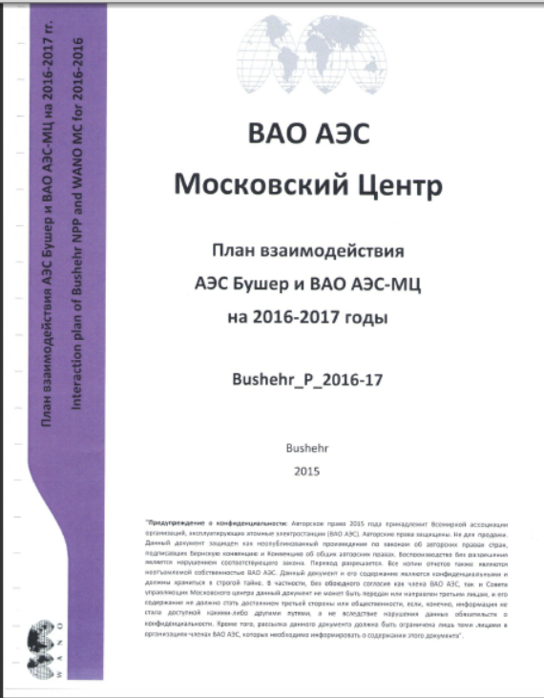
Interaction Plan between Bushehr NPP and WANO-MC, 2016-17

Slide 17
An example of measures taken for each AFI
  During Peer Review 2015 at BNPP, AFI identified in the Technical Support and Engineering area.
  47 Corrective Measures were developed by NPP in this area which will be implemented in 2016-17.
  3 Expert Technical Support Missions (2 TSM + 1 Benchmarking Visit in 2016):
  - TSM on topic “Configuration management - temporary and permanent modifications of equipment”; 06-09 February 2016
  - TSM on topic “The system performance measurement of the equipment and the assessment of its condition”; 27 February -02 March 2016
  - Benchmarking Visit on “Technical Support Engineering System”; 1-5 August 2016
  Implementing numerous self-assessments in this area based on the WANO Guide documents by BNPP;
  PL 2015-1 Principles for Design Basis Management
  GL 2001-05 (Rev-1) Guidelines for Conduct of Engineering Support Activities at Nuclear Power Plants
  Implementing the target observations by WANO-MC Representative in BNPP for this area

Slide 18
Participation in WANO Activities - 2015
Preliminary Visit (Pre-Visit) of WANO Peer Review; January 24-28, 2015
Technical Support Mission (TSM) on “Workshop & Non-workshop NPP organizational Structure”; March 01-04, 2015
TSM on “Management System of QA Records”; April 23-29, 2015
Preliminary Visit (Pre-Visit) of WANO Corporate Peer Review (CPR); May 04-06, 2015
WANO Peer Review of Bushehr NPP; June 01-18, 2015
WANO Corporate Peer Review (CPR); October 15-23, 2015
Attendance of Deputy director of WANO-MC (Mr. Frolov) concerning the contract of WANO-MC Representative at BNPP-1; November 07-08, 2015
Technical Support Mission (TSM) on “The Effectiveness of Radiation Protection at NPPs”; December 03-09, 2015
WANO-MC Representatives Exchange Visit; December 20-22, 2015

Slide 19
WANO TSMs in Bushehr NPP - 2015
Technical Support Missions 2015
No. | AREA / SCOPE
1 | TSM : Workshop and non-workshop organizational structure of NPP
2 | TSM : NPP self-assessment
3 | TSM : Operations and Maintenance Procedures and Documentation (Система управления записями по качеству)
4 | TSM (BM) : Benchmarking Visit to PAKS NPP on Work Management (WM.1-1)
5 | TSM : Radiation Protection Effectiveness
Postponed to 2016 | Benchmarking visit on SAM & EP
Postponed to 2016 | TSM : NPP self assessment (preparation for OSART)

Slide 20
Number of NPP/organization employees involved in WANO-MC activity in 2015
а) Held on-site/in the Bushehr NPP site; Each TSM, at Least 30 Persons Involved in WANO Activity
b) As PR experts at other NPPs; 4 Persons (2 Groups)
- 2 Experts (Reviewer) ; “Balakova NPP Peer Review" (Russia) from May 14 to 29, 2015
- 2 Experts (Reviewer) ; “WANO Pre-Start up Peer Review of the Novovoronezh NPP" from August, 29 to September, 11, 2015
c) As participants of seminars held at other NPPs, including WANO-MC office; Workshops, Seminars (18 Persons)
d) As participants of other WANO-MC activities. Contact Persons’ Meeting, , Benchmarking, GB Meeting, WANO Representatives Meeting (17 Persons)

Slide 21
TSMs planned and held in BNPP on 2016
No. | Subject | Type | Area | Date
1 | Benchmarking Bushehr NPP to Tianwan NPP on SAM&EP | BM planned for 2015 | EP | 2016 held 11-16 Jan.
2 | TSM on topic “NPP Self assessment (OSART)” | EXM | OA , LF | 30 January – 03 February 2016
3 | TSM on topic “Configuration management - temporary and permanent modifications of equipment” | EXM | EN.1-1 | 06-09 February 2016
4 | TSM on topic “The system performance measurement of the equipment and the assessment of its condition” | EXM | EN.1-1 | 27 February -02 March 2016
5 | TSM on topic “The effectiveness operational decision-making” | EXM | LF.1-1 | 23-26 April 2016
6 | TSM on topic “Nuclear safety culture” | EXM |  | 01-04 Oct. 2016
7 | TSM on topic “Operating procedures” | AV + EXM | OP.1-1 | 05-08 Nov. 2016
8 | TSM on topic “The basic principles of the operators” | EXM | OP.2-1 | Q4 2016
9 | BM “Establishing of technical support engineering system” | BM | EN.1-1 | 1-5 August 2016
10 | Seminar on preparing the operator staff of MCR/RCR | Seminar | OP-2-1 | Q4 2016

Slide 22
Participation in WANO Activities 2010 -2016
All the WANO Operating Experience information is used by BNPP’s specialists.
In the period 2013-2015, BUSHEHR NPP have submitted 12 reports to WANO-MC.
11 experts of BNPP took part in WANO peer reviews in the period 2010-2015.
95 experts of BNPP took part in WANO Programs (Seminars, Workshops, .. in the period 2010-2015;

Slide 23
General information
2. Current status
3. Design-informed peer reviews in WANO-MC
4. Nuclear Safety Culture assessment during peer reviews
Notes:
Миссии технической поддержки (МТП) входят в программу ВАО АЭС «Техническая поддержка и обмен».

Slide 24
Design-informed peer reviews in WANO-MC
Design is a most important factor (or key-factor) in the nuclear safety of a nuclear power plant.
Bushehr NPP design is a unique design compared to other NPPs, because it is especial design of German – Russian one.
Getting more knowledge on advantages and shortages of NPP design and its effects on NPP operators and personnel performance is one the main priorities of Bushehr NPP.
Bushehr NPP welcomes WANO activities in this field and will take part in WANO events.

Slide 25
Design-informed peer reviews in WANO-MC
BNPP has taken the following measures for familiarization with the design-informed WANO Peer Review (DIPR) through following steps:
Familiarization with organizational and methodological basis of DIPR:
Familiarization with data preparation for DIPR including fundamental safety function analysis
Reviewing the WANO documents and methodological procedures in DIPR area.
In this line, we participated in a seminar on “ Design-Information Peer Review” held by WANO-MC in December 2015.
We are interested to participate in the other DIPRs that are performed in NPPs which are the same type with Bushehr NPP.
Based on the coordination with WANO-MC, we want to reach a readiness by training the staff so that we can hold a self-assessment in this area.
Notes:
Миссии технической поддержки (МТП) входят в программу ВАО АЭС «Техническая поддержка и обмен».

Slide 26
General information
2. Current status
3. Design-informed peer reviews in WANO-MC
4. Nuclear Safety Culture assessment during peer reviews
Notes:
Миссии технической поддержки (МТП) входят в программу ВАО АЭС «Техническая поддержка и обмен».

Slide 27
Nuclear Safety Culture Assessment during Peer Reviews
In relation to the Safety Culture in Bushehr NPP, measures were taken and meetings were held.
Since, the managers’ behavior is a model for personnel in maintaining and promoting the safety culture. Last year, an emphasis was made on increasing the managers’ knowledge about nuclear safety culture and regular meetings and discussions were held through making use of WANO and IAEA experiences as well as the documents related to nuclear safety culture. These discussions were given with presence of senior and middle managers of NPP.
In the current year, one of the NPP objectives is to promote the level of nuclear safety culture.
Promoting the level of nuclear safety culture entails determining the level in NPP. For this purpose, conducting safety culture self-assessment and developing a corrective measures plan based on the results of self-assessment are taken into account for promoting the safety culture in NPP.
Based on this, in WANO Bilateral Interaction Plan for 2016, a TSM (TSM on “Nuclear safety culture” at Bushehr NPP, October 01-04, 2016) is planned during which the self-assessment results and the method applied are examined.

Slide 28
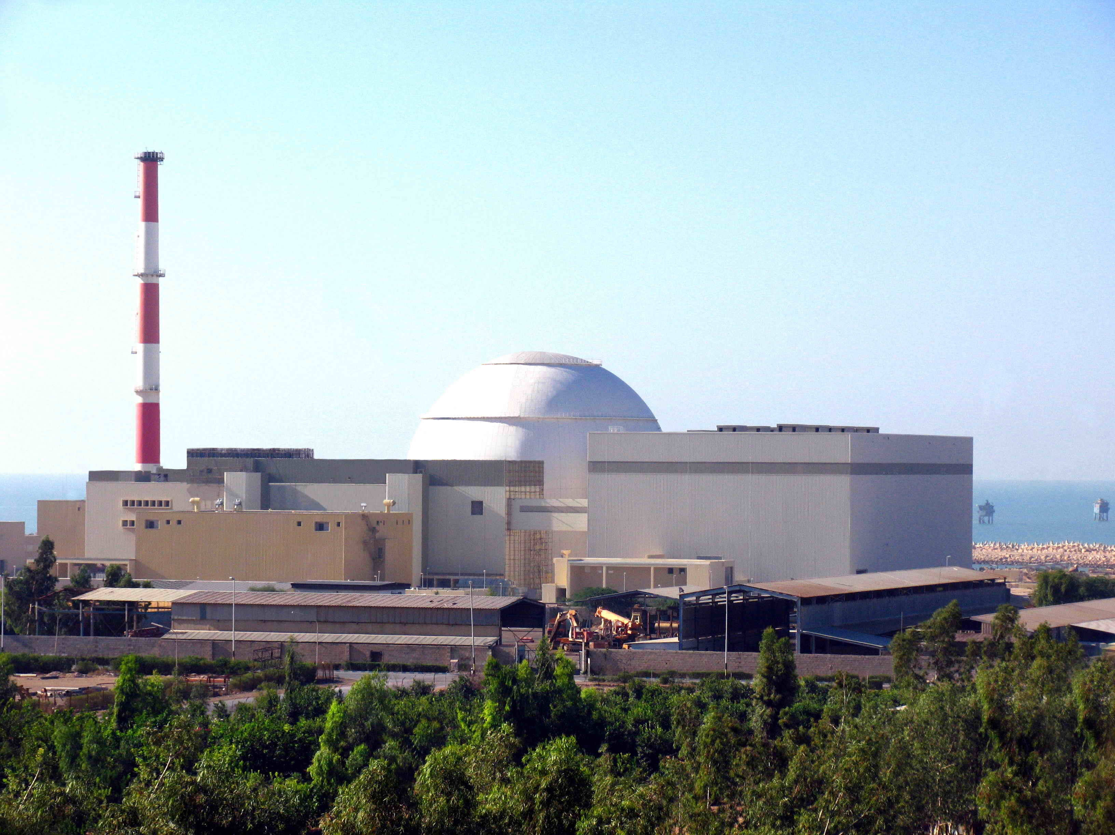
Thanks for Your Attention!
Notes:
Миссии технической поддержки (МТП) входят в программу ВАО АЭС «Техническая поддержка и обмен».

