Slide 2
WANO – MC CORPORATE PEER REVIEW OF NPPD
WANO – MC CPR Pre-Visit
19-20 October 2021
NPPD

Slide 3
PR programme challenges
The global pandemic has led to major restrictions to international and domestic travel and has impacted PR programme over the past year, resulting in delays to established activities at all regional centres.
There are a number of challenges that the PR programme are facing during the pandemic like maintaining the PR cycle and having qualified reviewers in each area, for example.
In response to this challenge, it was agreed with the Management of the NPPD that Pre-visit would be conducted in remote mode.

Slide 4
WANO Criteria
Best practices (WANO criteria)
IAEA standards
Operating organization requirements
Regulator requirements

Slide 5
WANO Criteria
The PR programme represents one of the most integral and essential commitments of WANO as it provides a clear, objective and independent view of plant and corporate performance relative to the latest version of the WANO Performance Objectives and Criteria
The basis for identifying Areas For Improvement is not compliance with the minimum requirements of the standards, rules and regulations, but it with the examples of the best international practice.

Slide 6
CPR Objectives and Goals
Review corporate management, oversight, and support of nuclear station, in order to achieve the highest levels of nuclear safety and reliability possible.
Identify some areas for improvement at the level of the corporate organization that represent the most important gaps to international best practices
Identify the causes and contributors of the problems
Identify strengths (good practices) that may be useful to other nuclear utilities worldwide
Provide feedback to a company that is worthwhile and helpful

Slide 7
Benefits for the company
Comparison with the best international practices in the performance of corporate organization
Independent assessment of the effectiveness of corporate strategies, policies, decisions, oversight
Feedback on how corporate expectations are understood and followed in plant practices
Feedback to what extent corporate support meets the needs of the plants
Company supervision usually focuses on regulatory compliance. The conclusions of the CPR are based on the results of many companies, that is, global best
The result of the CPR is the conclusions of an independent team of experts and gives a “vision from the outside”

Slide 8
Benefits for Reviewers and WANO Members
Identify different approaches and processes for addressing issues
Throughout the review and discussions, reviewers get a better understanding of “excellence”
Networking for the future
Distribution of strengths to WANO members

Slide 9
What is new in the process?
The Corporate Peer Review will be conducted in accordance with the WANO Performance Objectives and Criteria, 2019-1, Section 7 - Corporate areas.
The new PO&C 2019-1 is using on all plants and companies from June 2020.

Slide 10
Objectives of the CPR Pre-Visit
Brief the company staff on the corporate peer review (CPR) process
Review the scope of the CPR, including WANO PO&Cs
Understand the company organization. Meetings (interviews) with Company & Plant High Level Executives & Managers
Identify potential focus areas
Define advance information package for CPR
Discuss logistical arrangements, including CPR Minutes

Slide 11
CPR stages
Preliminary visit (October 19 - 20, 2021)
CPR (May 15 – 26, 2022)
A Final report is handed over to company leadership on final meeting two month after CPR has been finished
Follow-up CPR (after 2,5-3 years)

Slide 12
CPR Pre-Visit TEAM COMPOSITION
WANO – MC CPR Pre-Visit
VYBORNOV Sergiy | MC Deputy Director – Team Leader
SHISHKIN Sergey | MC CPR Manager – CPR Expert
FALLER Sergey | MC Adviser – CPR Expert

Slide 13
CPR Pre-Visit Programme Time-Frame
 | TUESDAY 19 October | WEDNESDAY 20 October
 | 10:00 Opening meeting with the Bushehr NPP (BNPP) managers 10:30 Interview (1) with the BNPP General Director 11:30 Interview (2) with the BNPP Chief Engineer | 10:00 Entrance meeting with NPPD Leaders. Pre-visit Goals. Information about the current situation in the NPPD 11:00 Interview (CPR TL) with Vice President and Managing Director of NPPD 12:00 Interview (2) with Deputy DG for Technical Engineering of NPPD
 | 12:45 – lunch | 13:00 – lunch
 | 13:30 Interview (3) with BNPP Engineering & Technical Division Manager 14:30 Interview (4) with BNPP HR Management & Training Center Manager 16:00 – 16:30 Debriefing with the BNPP management | 13:30 Interview (3) with Supervision & Technical Inspection Manager of NPPD 14:30 Interview (4) with Nuclear Safety Manager of NPPD 16:00 – 16:30 Debriefing with the NPPD management on the Pre-visit results

Slide 14
CPR team composition
Team Leader
6-7 Experts (including from WANO PC)
Host Peer
Coordinator
Industry Adviser

Slide 15
First round of CPR`s completed
Since April 2011, 12 CPRs have been held at the WANO MC
Developed 48 AFIs
Formulated 34 Strengths
The process of preparing and conducting the CPR allows the company to re-evaluate its role and interaction with NPP
Company executives are involved in the process and highly value CPR results

Slide 16
CPR`s First round Results
(All RC)

Slide 17
Brief conclusions
What MC companies received or learned new:
Unexpected finds for most companies when compared to WANO standards
The CPR preparation process and communication during the review stimulate a reassessment of activities.
Understanding the priority of nuclear safety, the importance of participation and understanding of nuclear activities
Some companies went on to restructure and introduce new processes

Slide 18
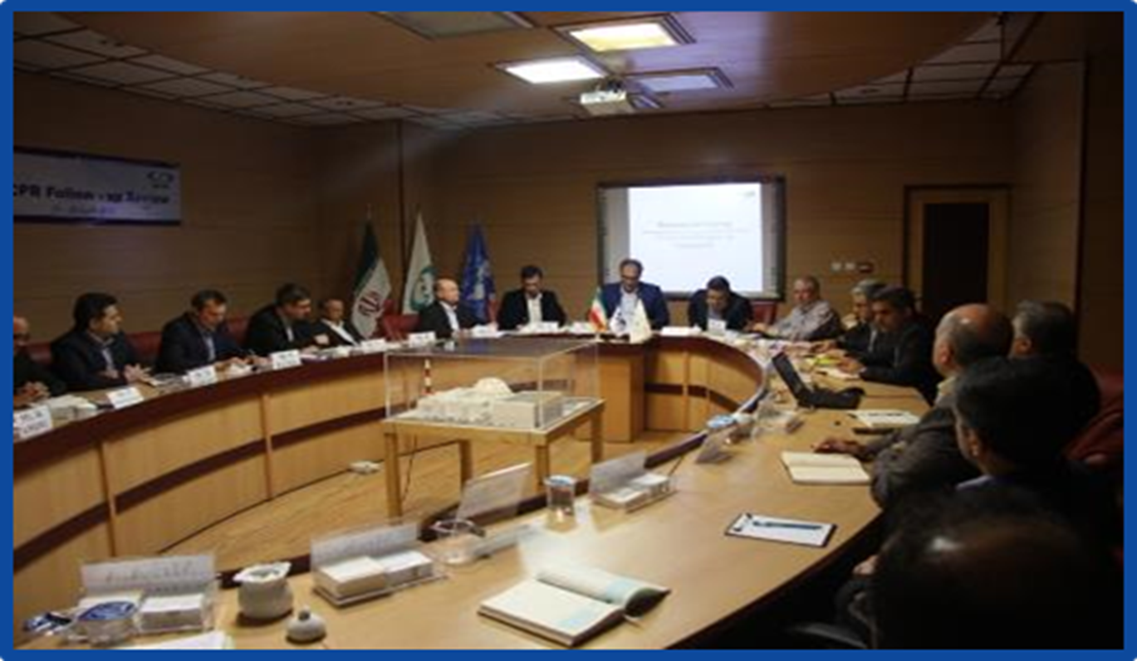
CPR - FU April, 2018

