Slide 2
Compass
WANO Long Term Plan 2015÷2019
WANO Restricted Distribution

Slide 3
Compass
Focus Areas
Continue to support and set the standards of high performance of the world’s existing nuclear fleet.
Build and maintain a highly-trained professional workforce in WANO and provide nuclear leadership training for our members.

Slide 4
Compass
Focus Areas
Forge a stronger WANO through more consistent, credible products and programmes.
Instil superior standards among new industry entrants and maintain them for plants approaching end-of-life, life extensions and decommissioning.

Slide 5
Compass
Focus Areas
Focus Area 1
Ensure continuous, high performance of the world’s existing fleet.

Slide 6
Compass
Focus Area 1
WANO’s mission is to maximise the safety and reliability of the world’s operating reactors, and this remains our most important focus area and the foundation from which all other initiatives are built.
What will we do?

Slide 7
Compass
Focus Area 1
Problems in nuclear industry:
Ageing fleet in some parts of the world.
Rapid expansion in others.
WANO must never compromise on issues that may diminish nuclear safety.

Slide 8

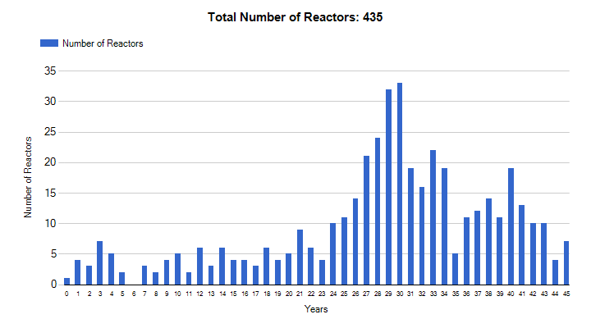
Reactor fleet approaching end of life*
* Source IAEA
WANO Restricted Distribution

Slide 9
Reference Case Capacity
Net GWe (2013 to 2030)
operating
serious
emerging
WANO Restricted Distribution
Notes:
9
Updated: September 2011
Serious: Iran, UAE, Turkey, Vietnam, Jordan, Saudi Arabia, Belarus
Other: Indonesia, Iran, Malaysia, Pakistan, Poland, South Africa, Turkey
Asia: Japan, S. Korea, Taiwan, UAE, Vietnam
E. Europe: Armenia, Belarus, Ukraine
Looking at where the big growth areas are, you can see that China and Asia are expected to be the leaders in nuclear growth.
China previously had a target of 40 gigawatts of generating capacity by 2020 but this has been revised upward, with some reports as high as 86 gigawatts. As such we have assumed that China reaches 50 gigawatts by 2020 and then 94 gigawatts by 2030 in our reference scenario.
China is actively pursing the construction of new reactors and by the end of 2009 there could be as many as 20 reactors under construction at various sites.
Also of note is increases in Indian nuclear capacity, included in the Other grouping. India has stated its goal is to have nuclear capacity rise to 20 gigawatts by 2020 and 63 gigawatts by 2032. We were a bit more conservative in our forecast, assuming India has 16 gigawatts by 2020 and 31 gigawatts by 2030 in the reference case. (Current = 4 GWe)
New to nuclear generation this year is the addition of 7 currently non nuclear countries where we have included a total of 10 new reactors by 2030 (Belarus, Indonesia, Iran, Malaysia, Saudi Arabia, Turkey, and the United Arab Emirates)

Slide 10
Compass
Focus Area 1
We are expected to critically review performance and enforce high standards of excellence in nuclear safety and reliability.
Identifying areas where members do not meet these expectations and taking appropriate actions in response to these areas is a fundamental requirement.

Slide 11
Compass
Focus Area 1
How will we do it?
Complete the 12 Post-Fukushima Commission projects and report on their progress, impact and effectiveness to the General Assembly at the 2015 BGM in Toronto.
Focus WANO’s resources and attention where they are most
needed by improving the way we measure and identify plants in need of special attention to improve performance.

Slide 12
Compass
Focus Areas
Focus Area 2
Build and maintain a highly-trained professional workforce in WANO and provide nuclear leadership training for our members.

Slide 13
Compass
Focus Area 2
What will we do?
Problems:
unprecedented exodus of experienced workers
growing chorus of nations wanting to introduce nuclear energy to their supply mix

Slide 14
Compass
Focus Area 2
WANO has a role to play on both sides of this crossroads. Over the life of this plan, we will need to assist in effectively transferring the collective knowledge and standards from our industry retiring nuclear professionals to an emerging nuclear workforce new to the concept of a strong nuclear safety culture.

Slide 15
Compass
Focus Area 2
How will we do it?
Develop a multi-year programme to ensure consistent training is available and delivered to WANO professionals in order to support effective delivery of WANO programmes to all members.
Examine resource implications to expand leadership training for key station positions.

Slide 16
Compass
Focus Area 2
How will we do it?
Engage with the new generation of nuclear leaders, operators, technicians and engineers to help instil a commitment to safety and an affinity for high standards.

Slide 17
Compass
Focus Area 2
How will we do it?
Link with other Focus Area 4 initiatives to develop a strong nuclear safety culture and commitment to high standards within the nuclear workforce and supply chain.
Conduct a detailed, WANO-wide assessment of human resource policies and practices used in the London Office and regional centres to determine if a common approach should be adopted to drive alignment and efficiencies.

Slide 18
Compass
Focus areas
Focus area 3
Forge a stronger WANO through more consistent, credible products and programmes

Slide 19
Compass
Focus area 3
What will we do?
We are One WANO and one industry, with a high degree of interdependency required to achieve success. We are committed to common goals, principles and standards. While these common items may have minor differences based on regional traits, our first commitment is to WANO as a whole, hence independent or autonomous approaches do not improve overall nuclear safety and reliability.

Slide 20
Compass
Focus area 3
How will we do it?
Adjust all regional centre and London Office action plans to close all outstanding AFIs identified during the mid-term assessments by the 2015 BGM.
Work collectively as ‘One WANO’ to address the common themes, or cross-cutting issues that the assessment teams found impact all of WANO.

Slide 21
Compass
Focus area 3
How will we do it?
Develop metrics to accurately measure WANO programme effectiveness and methods for members to offer constructive feedback on how programmes are being delivered.
Continue to build effective relationships with like-minded organizations to leverage resources in support of nuclear safety and reliability.

Slide 22
Compass
Focus area 3
How will we do it?
Improve the linkages between the main and regional governing boards, ensuring strategic directions are aligned and information is shared in an open and timely manner.
Undertake a study on the current regional structure of WANO to determine if the requirement for another centre will be needed to better address the changing nuclear landscape and how best to capitalize this opportunity for the overall benefit of WANO and its members.

Slide 23
Compass
Focus areas
Focus area 4
Instil superior standards among new industry entrants and maintain them for plants approaching end-of-life, safe shutdown and decommissioning.

Slide 24
WANO
WANO Members
  35 countries
  118 utilities
  210 plants
  540 units (in operation, undergoing construction or decommissioning)
Changes in Nuclear Industry
  69 units under construction
  More than 50 countries show interest in building nuclear plants

Slide 25
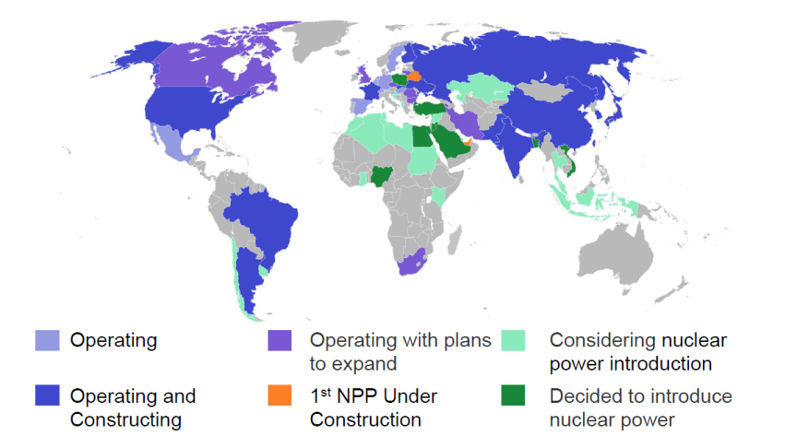
NPP landscape worldwide*
* Source IAEA, January 2014

Slide 26
Compass
Focus area 4
What will we do?
To meet the needs of members on both ends of the nuclear life cycle, WANO will need to expand its current suite of products and services and adapt to this new nuclear landscape. WANO will need to insert itself earlier into the new build process to instil the high standards of safety and performance a growing membership requires.

Slide 27
Compass
Focus area 4
How will we do it?
Engage new entrant companies and countries early in the planning and construction phase to foster a commitment to worldwide nuclear safety.
Strengthen its cooperation with IAEA towards all new entrant countries.

Slide 28
Compass
Focus area 4
How will we do it?
Expand WANO’s Operating Experience database to include information from plants under construction, refurbishment or decommissioning.
Understand and monitor the changing energy policy, financial and geopolitical landscape and its effect on nuclear safety.

Slide 29
Compass
Focus area 4
How will we do it?
Facilitate workshops and seminars, share operating experience for those members who are facing plant extensions, refurbishments and/or decommissioning.

