Slide 2
SIGNIFICANT EVENT REPORT SER 2020-01
SER 2020-01, Water Hammer Events
Click here to access the report>>
DISTRIBUTION CLASSIFICATION:
LIMITED

Slide 3
Objectives
Discuss aspects of one significant event caused by water hammer (WH) including:
    Consequences
    Causes and contributing factors of the event
Discuss the important lessons learnt associated with WH events and general WH phenomena.

Slide 4
What is Water Hammer?
General Phenomena
WH is a long-standing safety issue not only in the nuclear power industry, but also in other power generation and process industries.
WH is the change in the pressure of a fluid in a closed conduit caused by a rapid change in the fluid velocity. This pressure change is the result of the conversion of kinetic energy into pressure (compression waves) or the conversion of pressure into kinetic energy.
Three WH mechanisms occurring in power plants can be identified, the first two also known as condensation-induced WH.
High-speed condensate slamming into steam-filled lines
Sudden condensation of steam in a steam line
Voiding in normally water-filled lines, in particular in standby systems
Note: A lot of demonstration & training videos and pictures can be found on Internet

Slide 5
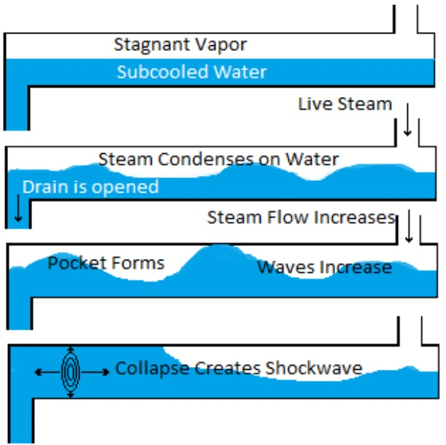
What is Water Hammer
Description of the Condensation-Induced WH Mechanism
(Source: Heysham A event report analysis).
      Steam is allowed to flow over an accumulation of cooled condensate
      The hot steam collapses on contact with the subcooled condensate which draws more steam into the line.
      Enough flow occurs to form a wave in the condensate that contacts the top of the pipe, isolating a pocket of steam.
      The trapped steam pocket rapidly condenses causing the bubble to collapse and creating a pressure wave due to the surrounding condensate filling the low pressure void.
      This change in momentum of the incompressible condensate is converted to overpressure.
      The resulting force created by the WH can be substantial and certainly has the potential to lead to catastrophic component failure

Slide 6
What happened?
WER PAR 19-0101 Catastrophic Failure of Auxiliary Steam Isolation Valve
Unit 1 of Heysham A station was in steady operation, and the auxiliary steam supply for the reactor building heating and ventilating system (HVAC) was being returned to service.
During operation of a manual isolation valve, the valve body circumferentially fractured due to WH.
This was caused by a significant volume of condensate accumulated in the steam supply pipework as a result of degradation of the system equipment.
It was followed by a significant steam leak and resulted in serious burns and serious injuries to three workers.

Slide 7
Significant Aspects of the Event
Significant aspects of the event are key reasons (including consequences and essential gaps) why the event is classified as Significant
They can be identified in four areas
Significant aspects of the event
Serious injury of three workers
System degradation leading to catastrophic equipment damage
Understanding water hammer, knowledge
Leaders / managers / professional behaviour
Industrial safety
Leadership, safety culture
Equipment reliability programme
Operational focus
Training system

Slide 8
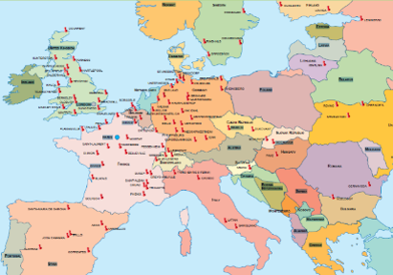
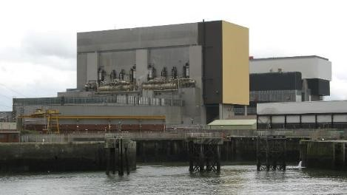
Plant description
Four units in operation, with two AGR reactors at both Heysham A and Heysham B stations
The auxiliary steam supply is a complex system used for steam supply to several systems of both units, including HVAC systems, CO2 plant vaporisers, reactor pressure vessel heating plant, and several other
Parameters – saturated steam, nominal pressure 6.2 to 6.9 bars, temperature approximately 170°C

Slide 9
Heysham A Event Description
On 19 November 2018 the plant was in steady operation.
The auxiliary steam supply system and the reactor building HVAC system were being returned to service.
To warm up the system pipework, the return to service (RTS) form outlined a requirement for a gradual warming of the system through gradual opening of the manually operated isolation valve SA/738 to reduce potential for ‘banging and crashing’ of pipework.
Stiff operation of the valve was foreseen and discussed during a pre-job briefing.
The activity was commenced at about 18:00. The effort of two operations technicians was necessary to crack open the valve between 1 and 1.5 turns using a spanner.
The system was then left to warm through.

Slide 10
Heysham A Event Description
During the shift hand-over at 19:30, the RTS form was passed to the night-shift operation technicians.
An operations technician attempted to open the SA/738 valve further at about 22:15, but it was not possible.
Two other operations technicians were called to help to operate the valve. At approximately 22:30, two separate 1/8 turns open were achieved on the SA/738 valve.
Following the second 1/8 turn an initial bang was heard, followed by a louder second bang and the release of steam from the SA/738 valve body due to a circumferential fracture.
This exposed all three technicians to a significant release of steam causing severe burn injuries.
They exited the elevated platform as quickly as possible to escape the steam release with further injuries (broken bones) as a result.

Slide 11
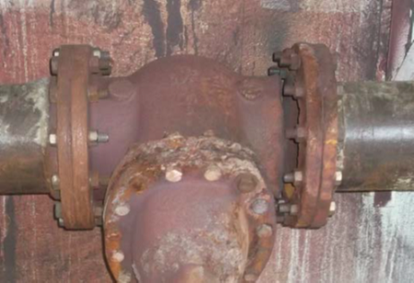
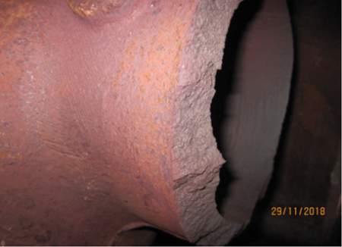
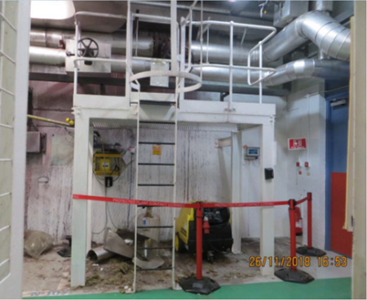
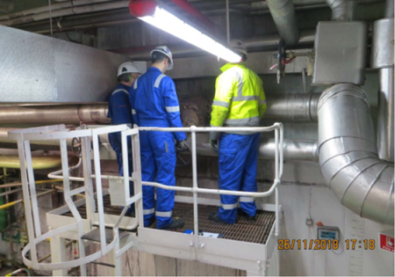
Heysham A Event Description
Fractured SA/738 cast iron isolation valve body
Valve SA/738 access platform and three personnel sited on the platform

Slide 12
Heysham A Event Description
Fire alarms were initiated in the central control room and reported over the radio system for immediate investigation. No fire was confirmed.
A first aider provided the first aid to all three injured personnel within a few minutes and then they were transported to the local hospital.
An operational alert was declared at 22:57 and the emergency control centre was established at 23:40 to provide support.
The operational alert was stood down and a transition into event recovery was made at 16:25 the following day.

Slide 13
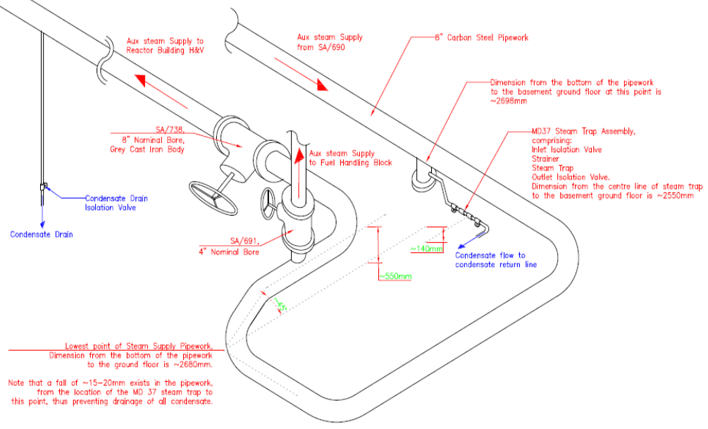
Heysham A Event Description
Fractured valve
Missing steam trap
The pipework arrangement associated with the valves SA/738 and SA/691

Slide 14
Causes and Contributing Factors
A significant volume of condensate accumulated in the auxiliary steam supply pipework due to inadequate condensate drainage. The condensate induced WH which led to the circumferential fracture of the valve body.
Steam traps in the auxiliary steam supply were not given adequate priority for the performance of maintenance, inspection and testing. The equipment classification was not commensurate with the industrial safety hazard posed by the system, resulting in inadequate maintenance prioritisation.
Although the system was designed with the use of flake graphite cast iron valves, it was fit for purpose. But the system configuration was not maintained as expected (steam traps inoperable and material condition of some equipment deteriorated). This resulted in the condensation induced WH generating forces exceeding the component strength and leading to destruction of the valve body.

Slide 15
Causes and Contributing Factors
There was a lack of knowledge and training regarding WH. This created conditions where risk associated with personnel and plant safety were tolerated and not understood. As a result, the plant lost the capability to assess the WH risk accurately. It was therefore unable to either recognise the risk that the degraded plant state posed, or take straightforward actions that could have prevented plant damage and injuries.
The organisation did not learn from or act on fleet and industry operating experience that was available in this area; as it was not appropriately screened, categorised, reviewed and disseminated. As a result, the opportunity to implement effective barriers to the valve failure was missed.

Slide 16
Causes and Contributing Factors
Tolerance of auxiliary steam supply degradation was enabled by governance arrangements within the station engineering function. The existing processes, including the corrective action programme, work management and equipment reliability programme, were not effectively used to identify, prioritise and address equipment issues and to ensure adequate system configuration and reliability.
Procedures used for operation of the auxiliary steam supply did not highlight system derived hazards and did not identify the requirements to ensure safe and reliable operation. For example, stiff operation of valve SA/738 could have been caused by flawed return to service operations leading to the creation of high differential pressure between upstream and downstream pipework.

Slide 17
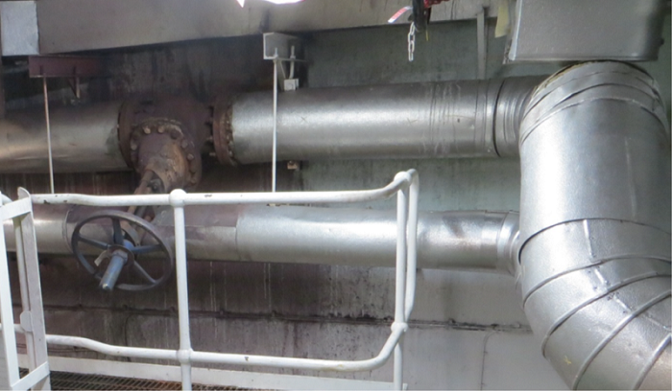
Causes and Contributing Factors
Another reason for the stiff valve operation could have been a design flaw, as the valve spindle was about 30 degrees below horizontal, causing condensate accumulation in the valve bonnet and body and leading to hydraulic valve locking.

Slide 18
Industry Operating Experience
45 WH-related events reported to WANO between Jan 2016 – Dec 2019.
One Significant (SIG), six Noteworthy (NOT), 24 Trending (TRE) and 14 Other (OTH) WANO Event Reports (WERs).
Several NOT and TRE are briefly described further on.

Slide 19
Industry Operating Experience
During normal operation and while performing a reactor protection safety injection (SI) system logic test, a weld on a pipe connecting the high-pressure and low-pressure (LP) SI systems failed, rendering the LP system inoperable. The cause was that gas accumulation induced a WH after pump start, resulting in high vibrations and weld cracking. WER TYO 19-0230
During normal operation in commissioning stage, excessive vibration of main pipeline from steam and water separator drain tank to high pressure drain expander caused breaking of a sampling pipe on the main pipe. This resulted in leakage of water, requiring reactor shutdown for repairs. The causes were WH due to large differential pressure across the drain valve. WER TYO 17-0019
During an outage, safety valve lift testing on the start-up feed heater relief valve was being performed. When pressure was applied to the start-up feed heater system, pipework connecting the exhaust of the discharge valve catastrophically failed due to WH, releasing hot water and steam into the building. WER PAR 19-0512

Slide 20
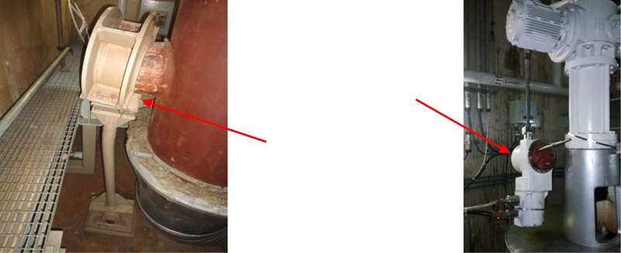
Industry Operating Experience
At the beginning of refuelling outage, with the plant in hot standby, three actuators and pipe supports were damaged while carrying out the main steam relief control valve test. It was caused by WH due to a high volume of water accumulation in the discharge lines due to a clogged drain line. A limiting condition of operation was entered requiring forced unit cooldown. WER PAR 18-0504
Damaged actuator &
main steam line supports

Slide 21
Industry Operating Experience
During power ascension after an outage, and while attempting to place a heater drain tank in service, a flow control valve malfunctioned resulting in a WH to the pipeline pumping heater condensate into the turbine condensate system. The cause was an incorrectly selected flow control valve actuator due to an inadequately conceived design change. The power had to be held at 46% for several days to develop and implement a design change to replace the valve actuator. WER ATL 17-1193
While operating at 80% power, a steam leak was observed from the flow transmitter impulse line in the feedwater reheater drain system pump discharge path. The unit was shut down for four days for repair. The cause was a failed weld joint due to WH induced by inadequate pipe warm up and insufficient water drainage. Incorrect installation of pipe routes and an inadequate weld quality were contributors. WER MOW 16-0076

Slide 22
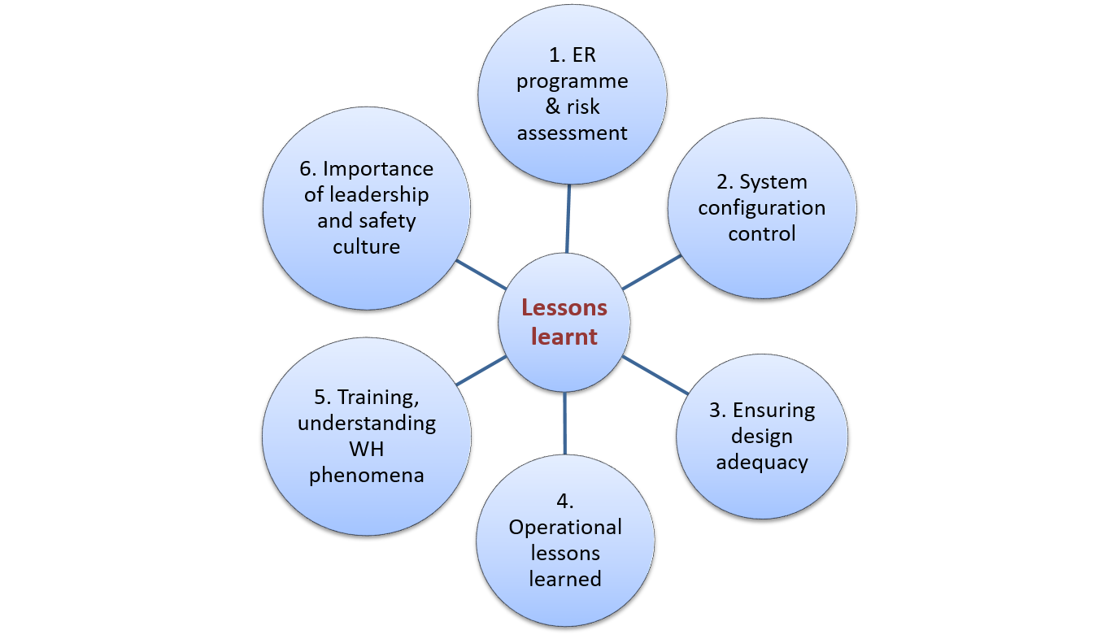
Lessons Learnt
Lessons, particularly from Significant and Noteworthy WH related events, can be categorised in six different areas

Slide 23
Lessons Learnt
1. Equipment reliability programme and risk assessment
Ensure that scoping and identification of component criticality, including steam traps, takes into account consequences of their failure, including industrial safety hazards posed by the system.
Assess WH risks and set due operational priorities for resolution of related equipment deficiencies.
Cumulative risk assessment has to be considered when equipment of the same or associated system are unavailable or impaired.
Adequate risk assessment during design reviews and when proposing corrective actions of operational issues must be performed to guarantee operational conditions do not unacceptably deteriorate during the fuel cycle or between two preventive maintenance works.
Recommendations in SOER 2015-2, Risk Management Challenges, are also broadly applicable for managing risks associated with WH.

Slide 24
Lessons Learnt
2. System configuration control
Maintaining design configuration of systems is essential in order to avoid WH-related events. Appropriate risk assessment and prioritisation of equipment defects should be performed.
Ensure adequate performance monitoring techniques are used to make sure that component degradation is detected early, analysed, communicated and measures are taken to ensure operational configuration is maintained.

Slide 25
Lessons Learnt
3. Ensuring design adequacy
Original design
Ensure possible original design vulnerabilities of systems sensitive to WH, particularly steam and condensate systems, are identified.
Internal and industry operating experience is one of the useful means to be used to identify possible design vulnerabilities.
Design changes
Ensure system design basis is maintained during equipment modifications.
Ensure the design phase identifies and considers all credible operational conditions of the modified system, including dynamic loading induced by WH, which may occur during postulated plant conditions.
When the implementation time of proposed equipment modifications is long or implementation of measures is delayed, make sure additional risk assessment is performed and bridging or additional mitigation strategies are implemented.

Slide 26
Lessons Learnt
4. Operational lessons learnt
Steam systems must be returned to service and operated so that condensate build-up or steam and condensate mixing is prevented.
Attention is to be paid when returning water systems to service, as well as stand-by systems, to ensure they are water solid and ready to operate without WH.
Highlighting possible WH hazards in relevant procedures and during pre-job briefings are examples of organisational measures which can prevent WH.

Slide 27
Lessons Learnt
5. Training and understanding WH phenomena
Ensure station staff involved in operation, maintenance, work management and other programmes and processes are knowledgeable of WH phenomena and hazards.
Suitable initial and ongoing training tailored to various target groups is essential for maintaining site knowledge regarding WH. This knowledge and skill should ensure that circumstances which would contribute to event occurrence, due to underestimation or misunderstanding of WH risks, should be avoided.

Slide 28
Lessons Learnt
6. Importance of leadership and safety culture
Several leadership attributes and safety culture traits, if understood and exhibited, could have helped prevent WH issues. In particular in relation to the following programmes:
Equipment reliability – ensure system health reports highlight important equipment issues and receive appropriate attention from equipment reliability review panels or equivalent management boards.
Operating experience (OE) – require that OE related to WH is identified and effectively internalised.
Work management – emphasise adequate risk assessment is performed to identify and effectively mitigate all risks related to planned work, including industrial safety risks.
Training – require reviews of training programmes, including those related to maintaining WH awareness, are regularly performed to make sure gaps are timely identified and training tailored to actual needs.

Slide 29
Prevent Events
Prevent events is intended for use particularly by front line workers, technicians, supervisors, engineers and other staff during beginning of shift meetings, pre-job briefings and work meetings to communicate key industry experience and increase awareness of WH phenomena.
Examples of practical actions which may help prevent or mitigate the problems associated with WH are gathered into four areas.
  Operations
  Equipment reliability and system configuration control
  Risk management
  Design considerations

Slide 30
Prevent Events
1. Operations
Ensure that downstream steam lines are fully drained before return to service activities commence.
Be aware of and verify actual equipment conditions, including steam traps. Verify they are operating and draining condensate correctly.
When condensate is present in steam supply pipework, do not use ‘cracking open’ of the isolation valve to avoid condensation induced WH.
If subcooled condensate is suspected in a steam line, isolate the steam supply and then drain the condensate (attempting to drain the condensate first could trigger a WH event).
If the system pipework is fragmented, do not allow subcooled condensate to be pushed or drawn into a steam-filled line. Instead, drain the condensate off.
If a steam line drain line is opened and the line vibrates, or hammers, close the drain and shut the steam off. Allow any condensate to drain before proceeding.
When returning a confirmed drained line to service, warm slowly and ensure downstream drain point(s) remain open until the line reaches the system temperature and pressure.
When isolating a system, ensure sufficient time is given for cool down.
Ensure stand-by water systems and water systems being returned to service are adequately vented and primed.
Highlight possible WH hazards during pre-job briefings.

Slide 31
Prevent Events
2. Equipment reliability and system configuration control
Identify components such as cast iron or other brittle components, with possible WH-related failure mechanisms which are important to maintain plant safety, personnel safety and reliability. Correct scoping and identification of components is essential for ensuring adequate preventive maintenance as well as for sound prioritisation of corrective maintenance.
Ensure preventive maintenance strategies for components important to prevention of WH events, such as steam traps, are developed.
Ensure failures and adverse conditions of this equipment are identified, reported, screened, prioritised and corrected commensurate with the requirements of their desired maintenance strategy or performance criteria.
Ensure design configuration by maintaining equipment in good condition, in particular steam traps and valves, drain lines, flow restrictors and dry deluge pipework free of debris or corrosion products.

Slide 32
Prevent Events
3. Risk management
Identify, assess and minimise all risks prior to conducting operations and maintenance activities, including industrial safety risks and possibility of WH. Identified risks should be discussed during pre-job briefs.

Slide 33
Prevent Events
4. Design considerations
Consider the following during design reviews and equipment modifications of steam and condensate systems:
      Sufficient and appropriately placed venting lines, drains and steam traps, especially in horizontal sections and where condensate can accumulate, as these pose the greatest risk from WH.
      Adequate pipework slope in the direction of the steam flow.
      Excluding cast iron valve use within steam systems and consideration of their replacement to improve resistance to brittle fracture.
      Spindle orientation of isolation valves used on steam systems is verified to minimise the potential for ‘hydraulic locking’ and WH due to non-vertical orientation.
      Need for a small bypass line installation around steam isolation valves to enable gradual warming of steam systems.

Slide 34
Applicability to your Plant?
Lessons learnt are applicable for preventing similar events at any type of reactor.
This SER highlights how lack of understanding, knowledge and training on WH phenomena can lead to inadequately maintained, configured or operated systems, bring about WH events and result in equipment damage or injuries.
Events demonstrate how flawed organisational defences and barriers (e.g. procedures, training, work processes or programmes) in conjunction with gaps in effective leadership can inhibit the organisational effectiveness and its capability for avoiding events with significant safety consequences.

