Slide 1
Project INSC IRN3.01/16 Lot 2
“Support in the Stress Test Exercise”
NPP Prospect for Future Activities
NPPs Safety Development and Improvement Co. (TAVANA)
December 2020

Slide 2
Content
Briefing the Project Status and Milestones
Review of Tentative Time-table of Future Activities
NPP Prospect

Slide 3
Briefing the Project Status and Milestones
Launched in May 2018
TASK 0
TASK 1
1St Workshop in June 2018
TASK 1
Kick-off meeting
Inception Report
TASK 1
1St Technical Visit in Sep 2018
2nd Workshop in Nov 2018
TASK 2
Data Collection
Gap Analysis
1st and 2nd Technical Meetings in May-June 2019
TASK 2
Technical Visit Report
3rd Technical Meeting in Dec 2019
TASK 3
Self-assessment Methodology
SAST report drafting plan
Submission of SAST Report to INRA in May 2020
SAST Report Draft
Safety improvement Recommendations
EC comments incorporated
SAST Report Finalization

Slide 4
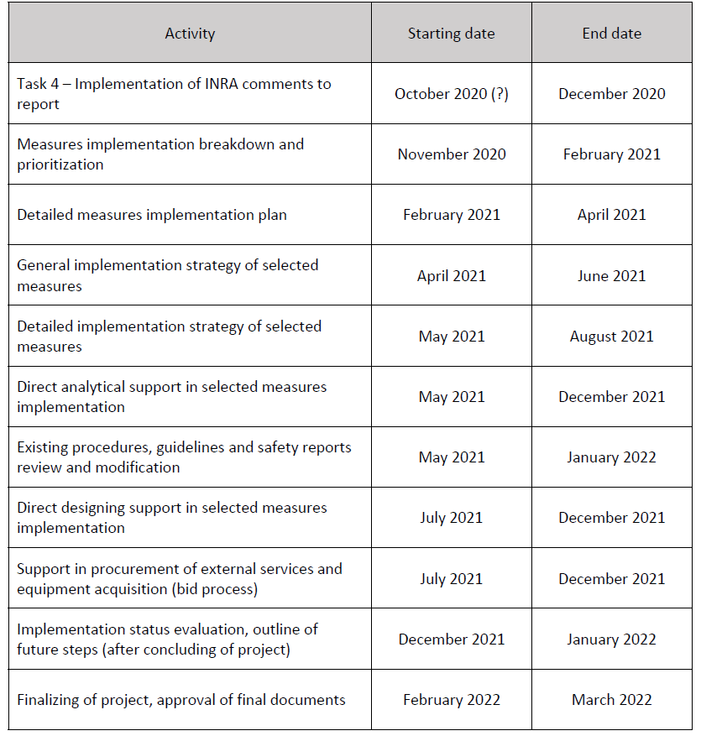
Review of Tentative Time-table of Future Activities
Remaining tasks (4, 5) of the project are well covered.
Implementation of INRA comments is expected to take longer if new recommendations are proposed by INRA.
According to ToR, Encourage/Support NPP in presentation of SAST report in international conferences should be considered as an activity in near future.
According to ToR, Technical Visit to EU power plants should be considered as an activity in near future. .
Bring “Direct analytical/designing support” activity forward according to End-user needs so that the end-user will be able to benefit from UJV support from now on.

Slide 5
NPP Prospect
Mutual cooperation with EC/UJV in the framework of the project proved to be a successful example which could be adopted for future NPP technical support activities.
Project Extension provides valuable opportunity for further mutual cooperation. Receiving technical support for implementation of safety recommendations is of great importance for the End-user.
Most important task of the project (task 5), including general and detailed technical support for addressing selected safety recommendations is expected to be performed within the extended time. Hence next stage of the project requires specific attention on behalf of the End-user and the Contractor.
As COVID-19 pandemic limitations are still in place, effective cooperation during the extended time should be carefully planned in advance.

Slide 6
NPP Prospect
It is recommended that more important Safety recommendations, implementation of which needs technical/analytical support from UJV be identified by the End-user.
If done, it is expected that the identified safety recommendations fall into the following categorization:
  Mobile Equipment Implementation/Procurement
  Newly developed symptom-based AM instructions
  Analysis of radiological consequences of accidents and relevant issues
New EOP, SAMG
Radiological Analysis
Mobile Equipment

Slide 7
NPP Prospect
Example of safety recommendations requiring support from UJV
New EOP, SAMG
Radiological Analysis
Mobile Equipment
Quality & consistency with plant safety upgrading
Independent Review of AM documentation
Training programme
Safety Parameters display system
I&C functioning under severe condition
Accidents in SFP
Primary depressurization, CF venting, CF sub-atmospheric,
…
Optimum use of MDGs
Connection points
Procedures
DC load optimization
Water supply
…
Post Accident Conditions
On-line assessment of radiological conditions
Control places habitability
Links between EP and AM
…

Slide 8
NPP Prospect
The End-user expects to receive technical support from UJV in the identified areas through various means where applicable:
Development of detailed implementation plan for selected safety recommendations
Technical/Scientific Visit to EU power plants
In-depth Review of relevant documents (e.g. EOP & SAMG) developed by Russian Vendor
Review of relevant documents (i.e. design for connection of mobile equipment to plant systems, instructions,…) developed by TAVANA
Delivery of useful reports on implementation of similar safety upgrading measures in EU power plants or indicating relevant international experiences
Performing independent calculations
Supply Computer Codes for Safety analyses of Plant.
….

Slide 9

Thank You!

