Slide 1
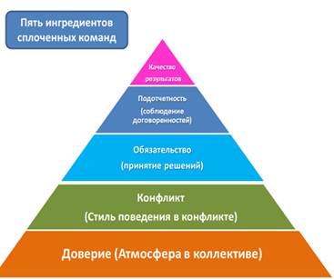
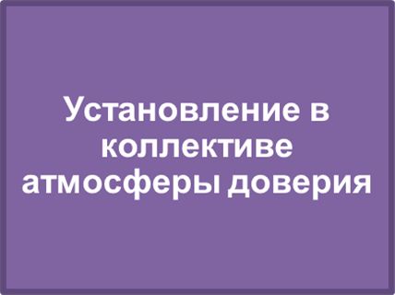
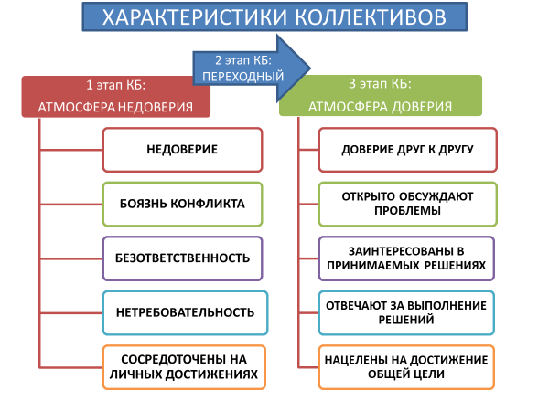
Establishing an atmosphere of trust in the team

Slide 2


«ATMOSPHERE OF TRUST IN THE TEAM»
Define the concept of «atmosphere of trust in the team»
Present the results to all participants
TRUST

Slide 3

WHAT IS TRUST?
Trust is process of relationship and interaction, which aims at defining and sharing the goals.
Trust is the main element in the relationship between people and their leaders.
Trust is a sense of security and comfort in interpersonal relationships, which is necessary to create a healthy, open climate in the organization.
The belief that others will behave according to your expectations.
(Concise dictionary of psychology)
Confidence in someone's honesty, sincerity, in the correctness of something.
(S. Ozhegov)
Trust is like paper. Once it’s crumpled it can’t be perfect againе

Slide 4

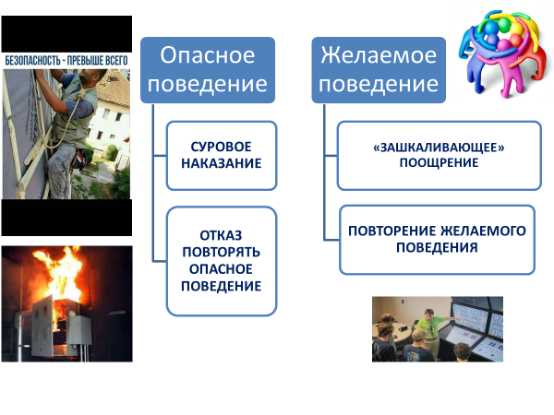
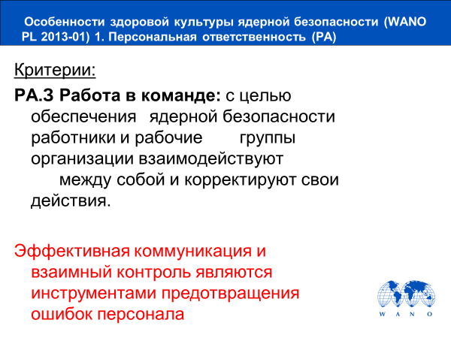
ОСОБЕННОСТИ ВНЕШНЕЙ СРЕДЫ ОРГАНИЗАЦИИ
Creating an atmosphere of intolerance to violations by personnel of the established safety requirements
АТМОСФЕРА НЕТЕРПИМОСТИ К НАРУШЕНИЯМ
ATMOSPHERE OF TRUST
Establishment by the leaders of all levels an atmosphere of trust and such approaches to collective work that form the internal need for a positive attitude towards security

Slide 5

THREE LEADER TOOLS FOR CREATION
ATMOSPHERE OF TRUST
RESPECT
INTEGRITY
Get rid of the desire to control every little thing, allow employees to be more independent. A great way to show respect is to make high demands. Explain to people that you believe in their abilities and expect a lot from them. Let your subordinates learn to take responsibility and make decisions. When discussing a problem with an employee, talk about it and how to solve it. Never get personal. Even if you are in a bad mood, it is not permissible to insult other people.
If you want your subordinates to always be honest with you and with each other, not to hide important information, then you need to start with yourself. Honesty doesn't just mean you have to tell the truth. It is necessary to be ethical always and in everything. Every leader has temptations, for example, to forge a report, to shift responsibility off.
It is important that you do not succumb to these temptations and behave honestly, even when they are sure that the truth will not be revealed.
OPENNESS
Allow employees to Express their opinions and share bad news, while taking it easy («green zone»).
Be prepared to listen to everyone. Tell employees that it is their responsibility to express their opinions, if they disagree with something, see a problem or have an alternative point of view. However, it is important to explain to people: the last word is yours, you should not immediately agree with everything you are told.

Slide 6
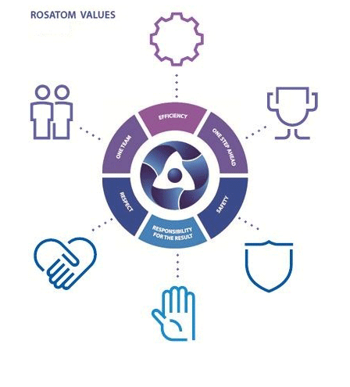
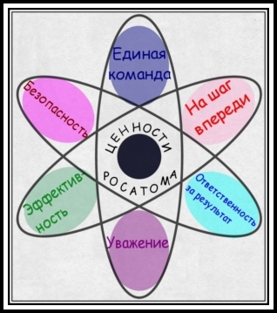
HONESTY: It is necessary to be ethical always and in everything
What are the values ​​of different personnel generations focused on the values ​​of Rosatom?
GENERATION VALUES
GENERATION OF BABY-BOOMERS (1944-1963) | GENERATION Х (1964-1983) | GENERATION Y (1984-2003)
Cult of youth; Responsibility Orientation on personal growth, the desire to be the best; The importance of personal reward and status; Collectivism, team spirit. | Pragmatism; Competitiveness; Individualism; Focus on achieving goals and objectives; Orientation to work in the project team of professionals; Ready for change; Global awareness; Technical and computer competence; Lifelong learning. | Individualism; Subordination; Interesting work and comfort; Computer addiction; Immediate reward; Training; Competitiveness.

Slide 7
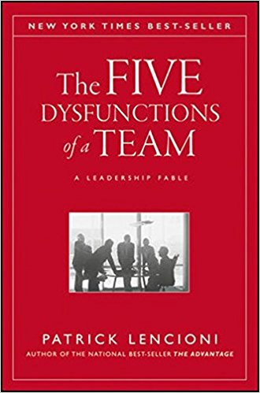
Establishing an atmosphere of trust in the team
Team members who trust each other on a basic and emotional level feel comfortable being vulnerable to each other regarding their mistakes, fears, and behaviors. They participate in the conflict, make decisions and control each other, tend to ignore their individual needs and programs and focus on achieving team goals. They are not tempted to put their subordinate units or career aspirations ahead of the collective results that determine the success of the team.

Slide 8



Component №1: Trust (The atmosphere in the team)
Team members trust each other on a basic and emotional level, they are comfortable being vulnerable to each other regarding their weaknesses, mistakes, fears and behaviors.
Team members who lack trust are often unwilling to admit their mistakes, admit their weaknesses, or ask for help.
Without a certain level of comfort among team members, it is impossible to create an atmosphere of trust.
Teams that lack trust often exhibit the following behavior
Team members who have a high level of trust
hide their weaknesses and mistakes from each other;
hesitate to ask for help or give constructive feedback;
do not offer assistance to people outside their own areas of responsibility;
draw conclusions about the intentions and abilities of others, without trying to clarify them;
do not recognize or use each other's skills and experience;
spend time and energy managing their behavior to impress;
hide discontent;
find reasons not to spend time together.
admit their mistakes;
recognize their shortcomings;
ask for help without thinking;
ask each other for advice on their areas of responsibility;
recognize and apply each other’s experience and knowledge;
voluntarily apologize to each other;
open and sincere with each other;
easily can discuss their private life with each other.

Slide 9
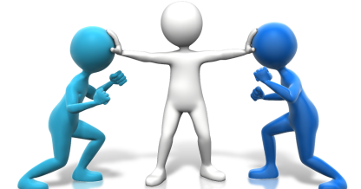
Component №2: Conflict (Style of behavior in conflict)
Teams whose members trust each other are not afraid to engage in emotional dialogue around issues and decisions that are key to the success of an organization.
They do not hesitate to disagree, challenge and ask each other questions, all in the spirit of finding the best answers, discovering the truth and making excellent decisions.
Trust is crucial because without it, team members are unlikely to engage in honest discussions on key issues.
Teams that are afraid of conflict
When teams accept conflict
hold uninteresting for most meetings;
create an atmosphere dominated by the secret transfer of information and ad hominem arguments;
ignore controversial topics critical to team success;
do not use all opinions and perspectives of team members;
spend time and energy on posturing and interpersonal risk management.
team members feel free during the discussion and participate in it with great enthusiasm;
team members are interesting and convincing;
the most important and complex issues are discussed during the meetings;
team members voice their opinions without fear of confrontation;
during the discussions, team members understand how they came to certain conclusions and beliefs;
team members ask each other's opinions during meetings;
team members share unpopular opinions with the group;
if a conflict arises, the team does not dodge a problem, but resolves it before moving on to another topic.

Slide 10

Component №3: Commitment (Decision-making)
Teams that are involved in a conflict can achieve genuine agreement around important decisions, even if different team members initially disagree.
They ensure that all opinions and ideas are considered, giving team members confidence that their ideas are taken into account.
Without conflicts, it is extremely difficult for team members to make decisions because they do not feel that they are part of the solution. This creates an environment of ambiguity and confusion in the organization, which leads to frustration among employees, especially the best performers..
Team that can not fulfill the obligation
When there is a strong commitment to the decision
creates uncertainty among team members regarding direction and priorities;
does not see existing features due to excessive analysis and unnecessary delay;
fosters insecurity and fear of failure;
returns to discussion and decision-making again and again;
encourages doubt, speculation among team members.
team members leave the meeting with a feeling of confidence that everyone is involved in the decisions agreed upon at the meeting;
team members conclude discussions with clear and concrete decisions and calls for action;
the team is clearly aware of the direction of its activities and primary tasks;
the team is focused on common goals;
the team is decisive even when accurate data is missing;
the team does not retreat from their decisions;
team members support group decisions, even if at first they did not agree.

Slide 11

Component №4: Accountability (Compliance with the agreements)
Team members who are committed to decisions and performance standards do not hesitate to monitor each other in compliance with these decisions and standards.
They do not rely on the group leader as the main source of accountability, they go directly to their colleagues.
When team members do not commit themselves to a clear action plan, the results suffer.
Teams that do not support each other
When there is a high level of accountability
create discontent among team members who have different performance indicators;
encourage mediocrity;
violate deadlines and key tasks;
impose on the team leader an unnecessary burden of the only responsible person for discipline.
team members point to each other's unproductive behavioral patterns;
team members are free to discuss with colleagues the problems arising in their area of responsibility;
team members ask each other about the approaches and methods they are using at the moment;
the team ensures that less efficient employees feel pressured and know that they are expected to get better results;
all team members adhere to the same high standards;
Team does not retreat from the decisions;
team members offer each other constructive criticism.
11

Slide 12

Component №5: Results (Quality of Results)
Teams that trust each other, participate in conflict, make decisions and control each other, tend to ignore their individual needs and programs, and focus on achieving team goals.
They resist the temptation to put their subordinate units or career aspirations ahead of the collective results that determine the success of the team.
When a team can't focus on results, they
With strong attention to the results
rarely beat their competitors;
lose results-oriented employees;
encourage team members to focus on their own careers and personal goals;
easily distracted;
inert and do not develop
team members quickly point to the contributions and achievements of colleagues;
the team has a reputation as a highly effective team;
when a team fails to achieve common goals, each team member takes personal responsibility for making the team more effective;
team members are willing to voluntarily donate something for the benefit of the team;
team members do not aim to find recognition for their contribution;
the team consistently achieves its goals;
team members value collective success more than personal achievements;
team members attach little importance to position and status.

Slide 13
FIVE INGREDIENTS OF NON-ABSOLUTED TEAMS
ATTITUDE TO THE RESULTS
When team members do not consider themselves accountable to each other, they increase the likelihood that individual achievements will become more important than the results of teamwork.
ACCOUNTABILITY (FAILURE TO COMPLY WITH AGREEMENTS)
When team members fail to commit to a clear action plan, results suffer
ATMOSPHERE IN COLLECTIVE
Team members do not want to be vulnerable to each other and therefore do not want to admit their mistakes, freely express their security concerns.
CONFLICT BEHAVIOR STYLE
Trust is crucial because without it, teams are unlikely to engage in honest discussions and constructive conflicts on key security issues.
COMMITMENT (DECISION MAKING)
Without conflicts, it is extremely difficult for team members to make decisions, and to be responsible for them, because they do not feel that they are part of this decision.

Slide 14
CHARACTERISTICS OF COLLECTIVES
2 phase SC:
TRANSIENT
1 phase SC:
ATMOSPHERE OF MISTRUST
DISTRUST
FEAR OF CONFLICT
3 phase SC:
ATMOSPHERE OF TRUST
TRUST TO EACH OTHER
OPENLY DISCUSSING THE PROBLEM
FOCUS ON PERSONAL ACHIEVEMENTS
IRRESPONSIBILITY
INDISCRIMINATENESS
AIMED AT ACHIEVING A COMMON GOAL
INTERESTED IN DECISIONS TO BE MADE
RESPONSIBLE FOR IMPLEMENTATION OF DECISIONS

