Slide 2
May 2020
Operating Experience Programme
WANO-MC
Summary of significant events
at NPPs
of WANO AC, PC and TC
LIMITED DISTRIBUTION

Slide 3
May 2020
Number of Units (according to WANO)
Regional Centre | Construction | Decommissioned | Operational | Total
Atlanta | 10 | 21 | 124 | 155
Moscow | 12 | 20 | 80 (77+2FlU+1AF) | 112
Paris | 8 | 54 | 151 | 213
Tokyo | 17 | 26 | 107 | 150
Total | 47 | 121 | 462 | 630
Number of Submitted Reports (01-31.05.2020)
Regional Centre | Signifi- cant | Note- worthy | Trending | Other | Not Evaluated | Total
Atlanta | 0 | 3 | 38 | 60 | 0 | 101
Moscow | 1 | 0 | 28 | 11 | 0 | 40
Paris | 2 | 2 | 45 | 23 | 0 | 72
Tokyo | 0 | 0 | 33 | 40 | 0 | 73
Total | 3 | 5 | 144 | 134 | 0 | 286

Slide 4
List of Events to Review (1)
(S) WER PAR 19-0902 29.11.2019 Forsmark-2 NPP (Sweden)
Unplanned High Dose to 5 People due to Faulty Telescoping Radiation Monitoring Instrument
(S) WER PAR 18-0765 04.08.2018 Borssele-1 NPP (Netherlands)
Reactor Protection System Failure Led to Scram and Major Degradation
of RCP Pump
(N) WER ATL 20-0256 30.11.2019 Diablo Canyon-2 NPP (USA)
Both Trains of Containment Spray Removed from Service in Error Prior
to Mode Change
(S) – Significant; (N) – Noteworthy; (T) – Trending; (O) – Other

Slide 5
List of Events to Review (2)
(N) WER ATL 20-0226 15.01.2020 Point Lepreau-1 NPP (Canada)
Electrical Contractor Performed Maintenance on the Wrong Exhaust Fan
(N) WER PAR 20-0209 31.10.2019 Civaux-1 NPP (France)
Generic Event Relating to Compliance of Diesel Generator Sets with Internal Electrical Sources and 1,300 MW and N4 Series 6.6 kV Emergency Diesel Generator Sets
(N) WER PAR 20-0251 24.05.2019 Cattenom-3 NPP (France)
Shutdown for 18 Days to Repair Leak from Internal and External Vessel Gaskets due to Maintenance Quality Failure
(S) – Significant; (N) – Noteworthy; (T) – Trending; (O) – Other

Slide 6
List of Events to Review (3)
(T) WER ATL 20-0281 10.02.2020 Sequoyah-1 NPP (USA)
Unplanned Internal Dose during Reactor Cavity Decontamination
(T) WER PAR 20-0156 03.08.2019 Nogent-1 NPP (France)
Accident Subsequent to the Ejection of a Main Steam Line Plug from a Steam Generator
(See detailed information on these events in the original WERs)
(S) – Significant; (N) – Noteworthy; (T) – Trending; (O) – Other

Slide 7
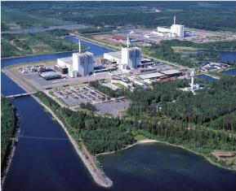
Event at Forsmark-2 NPP
Forsmark NPP (Sweden):
3 units
Reactor type - BWR
Power:
Unit 1 - 1022 MWe
Unit 2 - 1156 MWe
Unit 3 - 1195 MWe
Event date: 29.11.2019
Unit: Forsmark-2
Unplanned High Dose to 5 People due to Faulty Telescoping Radiation Monitoring Instrument
Event report: WER PAR 19-0902

Slide 8
Event at Forsmark-2 NPP
Short description:
On 29/11/2019 with unit 2 at full power, five workers were exposed to high dose rates (1.73 Sv/h). The highest dose received by one of the worker was 1.7 mSv. Two reactor hall mechanics, two radiation protection technicians and one cleaning staff were replacing the pool remediation filter, using a telescope radiologic detector showing an incorrect lower dose rate value. The team stopped the activity when personal dosimeters and reactor building dose rate alarm were triggered.
The direct cause was that the defective detector did not alert about the high-dose rate. The high dose probe has not been functionally checked, as there was no high-dose source to test it.

Slide 9
Event at Forsmark-2 NPP
Contributor were stressful environment and lack of HU tools use.
Corrective actions were adaptation of local alarms to on-going job, and shortening of the telescope detector calibration interval.
INES 1 event.

Slide 10
Event at Forsmark-2 NPP
Description:
On November 29, 2019 after pool cleaning, the filter in the pool remediation equipment was to be replaced. A total of five people, two reactor hall mechanics, two radiation protection technicians and one cleaning staff participated. Everyone has approved radiation protection training and a PJB was conducted before the work was started. The area was clearly closed off and two radiation protection technicians were present throughout the work so that no unauthorized persons could be in the area. All personnel had electronic dosimeters with preset alarm levels.

Slide 11
Event at Forsmark-2 NPP
When lifting the filter, the electronic dosimeter began to alarm for the individual who handled the filter, the activity alarm in the ceiling of the reactor building began to alarm shortly afterwards. The electronic dosimeter to one of the radiation protection technician also began to alarm. These alarms safely interrupted the work. The individual who handled the filter received a dose of 1.7 mSv and was exposed to a dose rate of 1.73 Sv/h, the radiation protection technician closest to the filter received a dose of 0.3 mSv and was exposed to a dose rate of 20 mSv/h, the cleaner received a dose of 0.075 mSv and was exposed to a dose rate of 8.4 mSv/h.

Slide 12
Event at Forsmark-2 NPP
Analysis and comments:
When considering the number of independent safety barriers, it is necessary to consider the number of alarms and how the staff reacted to the alarms separately. In this case, there were four independent safety barriers:
Personal electronic dosimeters with preset alarm levels. These worked as expected.
Installed gamma alarm in Reactor Hall ceiling. This worked and alarmed functioning as expected.

Slide 13
Event at Forsmark-2 NPP
Portable air monitoring. This did not alarm because it was too far away from the filter.
Radiation protection technician with radiation protection instruments. The instrument malfunctioned and showed an incorrect measurement value.
The two alarms that worked require staff to respond to the alarm. The work was safely interrupted as soon as possible when the alarms were triggered.
There were a total of five people present, including two radiation protection technicians. The likelihood that all individuals would ignore an alarm is extremely small. Therefore, it is judged that two independent safety barriers existed.

Slide 14
Event at Forsmark-2 NPP
According to Chapter 6.2.3.1 Table 11 in "The International Nuclear and Radiological Event Scale User’s Manual, 2008 Edition", with two independent safety barriers and the maximum consequence level 3, the initial INES classification becomes level 1.
Direct cause:
When changing filters to Luxembourgers, a malfunctioning measuring instrument of the model teletechtor was used by radiation protection personnel. The fact that this was a mistake was not known to radiation protection personnel.

Slide 15
Event at Forsmark-2 NPP
Underlying cause:
Procedural deficiencies – Teletechtors have not been functionally checked with respect to the high dose probe, despite the fact that all other radiation protection instruments are functionally tested before use. This is due to the lack of high-dose material available for the functional control of the high dose probe. Shortcomings in safety culture – It is clear from interviews with staff involved that the working environment has been stressed and error prevention methods have not been applied.

Slide 16
Event at Forsmark-2 NPP
Actions:
- Risk assessment of high-dose jobs.
- More frequent calibration interval for the teletechtor.
- Redundancy through independent measurements when working with a high dose rate.
- Diversification by adapting alarms on fixed equipment to current work.
- Targeted instrument training for radiation protection personnel
Investigation interviews with staff involved.
- Event verification.

Slide 17
Event at Forsmark-2 NPP
- Human, Technology, Organisation investigation and investigation within the HP department initiated to identify long-term measures.

Slide 18
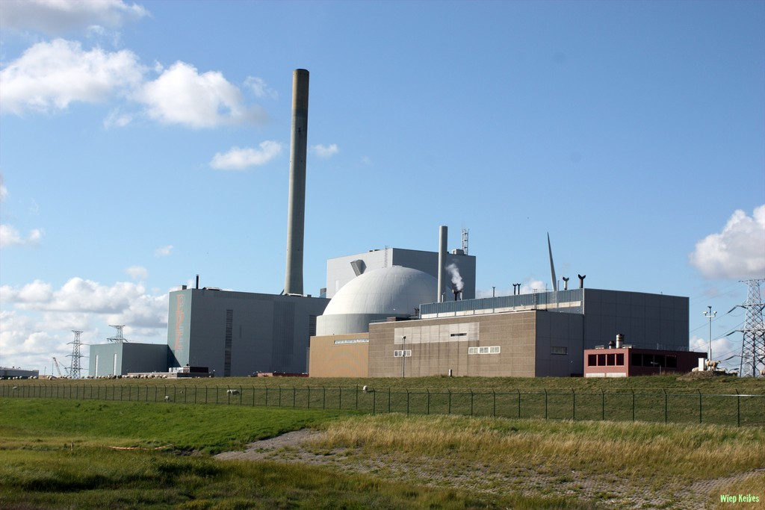
Event at Borssele-1 NPP
Borssele NPP (Netherlands):
1 unit
Reactor type - PWR
Power:
Unit 1 - 515 MWe
Event date: 04.08.2018
Unit: Borssele-1
Reactor Protection System Failure Led to Scram and Major Degradation of RCP Pump
Event report: WER PAR 18-0765

Slide 19
Event at Borssele-1 NPP
Short description:
On 04/08/2018 with unit 1 at power steady operation, an interruption of the reactor protection system (RPS) pulse train lasting less than 150 milliseconds resulted in an automatic reactor SCRAM. Reactor coolant pump 2 (RCP) failed to stop, causing significant damage to its bearings and sealing gland due to lack of lubrication and 150 m3 of borated water went in the reactor sump. The root cause of the RPS interruption was a design weakness on an electronic card (Siemens type BSX46-16 RTG module K110), identified and accepted with a low (random) failure probability during a modification in 1997.

Slide 20
Event at Borssele-1 NPP
The risk of damage to the RCP pump after pulse train failure was known and had been accepted. An unplanned outage of 42 days occurred to repair the pump. A further planned outage in 02/2019 was also undertaken to replace all other RPS pulse train modules. INES classification – level 1.
Illustrations for this event are shown on the following slides.

Slide 21
Event at Borssele-1 NPP
Description:
On the 4th of august 2018 14:27, at Borssele NPP (KCB) during normal operation, reactor at 100 % a short interruption of about 30 msec of the A-impulse of the Reactor Protection System pulse train resulted (as designed) in the activation of several automatic actions that are designed to control design-basis-accidents. Short interruptions occurred in total 4 times at 4th, 5th and 6th of August where only at the 4th and 6th of August the interruption was long enough to activate automatic actions by the Reactor Protection System.
Timeline 04 August of the high impact events:
14:27:25 Activation of 32 RPS-signals in redundancy 1. No activation of RPS-signals in redundancy 2.

Slide 22
Event at Borssele-1 NPP
14:28:08 Opening of one containment sump suction valve, open connection between 2 Refueling Water Storage Tanks (RWST) and the containment sump.
14:28:30 Closure of the main steam isolation valve (by RPS).
14:28:40 Reactor Scram on high steam pressure loop 1.
14:31:25 Containment isolation of Reactor Coolant Pumps. Isolation of seal water and lubrication oil for both RCPs.
Reactor Coolant Pump loop 1 stopped by pump protection.
Reactor Coolant Pump loop 2 kept running (pump protection and manual commands from control room were blocked).

Slide 23
Event at Borssele-1 NPP
14:33:30 Activation of the Level Indication alarm in the containment sump.
14:38:52 Manual isolation from control room of the boric water flow from the RWST to the containment sump.
14:40:31 Manual power off Reactor Coolant Pump loop 2, locally at the power supply switchboard.
14:42 Start resetting RPS-signals and stabilizing unit at operating status warm-subcritical.
23:30 Start cool down to cold-subcritical by natural circulation.

Slide 24
Event at Borssele-1 NPP
After stabilizing the installation in operating status warm-subcritical with both Reactor Coolant Pumps unavailable the reactor is taken to operating status cold subcritical by natural circulation. During this period recurrence of short interruptions (msec) of the PRS pulse train has occurred three times.
On the 4th of August at 22:34:00 Interruption too short to activate RPS signals, only thresholds are activated.
On the 5th of August at 22:54:48 Interruption too short to activate RPS signals, only thresholds are activated.
On the 6th of August at 10:51:02 RPS-signals activated (cold shutdown) Interruption time approx. 30 msec.

Slide 25
Event at Borssele-1 NPP
Resulting in:
- Stopping the Residual Heat Removal pumps. Quickly identified and solved by the control room, the disposal of decay heat was restored.
- Loss of power of one emergency power supply rail, resulting in starting and coupling one of the Station Blackout Diesel Generators.

Slide 26
Event at Borssele-1 NPP
Analysis and comments:
Direct Cause:
Short interruption of the A-impulse of the Reactor Protection System pulse train module K110.
Technical Root Cause 1 (equipment fabrication):
Whisker formation on end-transistors RTG modules K110.
Loose whisker found on mounting-pad can explain the brief and repeated failure.
-- Type: BSX46-16
-- Manufacturer: Siemens
-- Production period: early ’80’s.

Slide 27
Event at Borssele-1 NPP
Root Cause 2 (design / design change):
A design weakness was introduced with the modification of the RPS in 97’.
This was partially recognized in the review process and accepted because it was perceived as not being safety significant.
Contributing Cause:
Risk awareness. The risk of damage to RCP after pulse train failure was identified but seen as economic with a low (random) failure probability.

Slide 28
Event at Borssele-1 NPP
RPS design

Slide 29
Event at Borssele-1 NPP
Failure impulse generator

Slide 30
Event at Borssele-1 NPP
Findings impulse generator К110

Slide 31
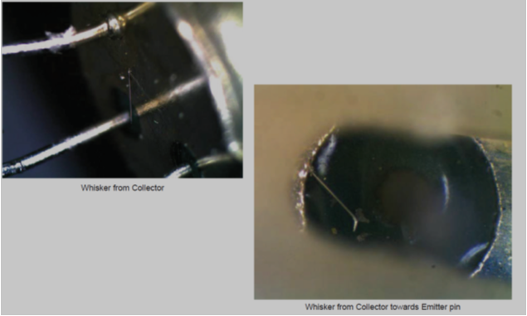
Event at Borssele-1 NPP
Findings impulse generator К120

Slide 32
Event at Borssele-1 NPP
Actions:
Action 1: Design weakness with Reactor coolant pumps was fixed.
Action 2: In an ODM it was decided to replace all modules with end transistors of the type in which whisker formation was found during an additional short outage.
Action 3: An additional internal (complete) and external investigation of failure modes of brief failure of modules within impulse trains.
Action 4: Review maintenance strategies of modules.
Action 5: Improve risk review process of modification portfolio.

Slide 33
Event at Borssele-1 NPP
Action on Operations:
Action 1: Several procedural actions to quickly diagnose and take actions to prevent unwanted effects of pulse train failure.

Slide 34
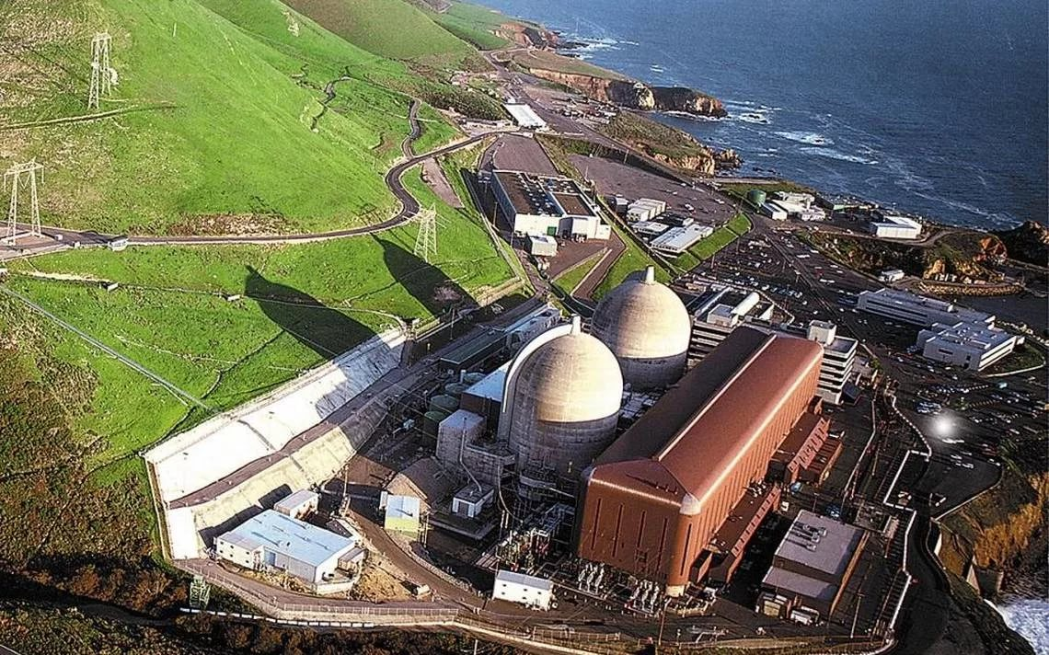
Event at Diablo Canyon-2 NPP
Diablo Canyon NPP (USA):
2 units
Reactor type - PWR
Power:
Units 1-2 - 1197 MWe each
Event date: 30.11.2019
Unit: Diablo Canyon-2
Both Trains of Containment Spray Removed from Service in Error Prior to Mode Change
Event report: WER ATL 20-0256

Slide 35
Event at Diablo Canyon-2 NPP
Short description:
With the unit in Mode 4 (Hot Shutdown) following a refueling outage, both trains of containment spray were removed from service as part of preparations for a planned return to Mode 5 (Cold Shutdown). The containment spray pumps are required to be operable (along with the containment fan cooler units) in Modes 1 through 4 in accordance with Technical Specification requirements. The cause was determined to be a human performance error.

Slide 36
Event at Diablo Canyon-2 NPP
Description:
During the evening of November 29, 2019, while the unit was nearing the end of a refueling outage, with the unit in Mode 4 (Hot Shutdown), an operational decision was made to return to Mode 5 (Cold Shutdown) due to concerns about running reactor coolant pump (RCP) 2-2 at low reactor coolant system (RCS) temperatures and heating up the secondary plant with ongoing maintenance and testing on the Main Turbine Generator. Operations prepared for Mode 5 entry by writing necessary clearances, preparing procedures, and hanging configuration control tags.

Slide 37
Event at Diablo Canyon-2 NPP
One such action was to disable the containment spray pumps by opening their associated DC control power knife switches. This action, which should have been performed following entry into Mode 5, was completed at approximately 0237 hours on November 30, 2019, with the unit still in Mode 4. The DC control power was removed from the containment spray pumps as a result of human error. At 1100, the next operating crew (day shift) recognized the error and immediately entered the appropriate Technical Specification (TS) action, due to two trains of containment spray being inoperable.

Slide 38
Event at Diablo Canyon-2 NPP
Technical Specifications require both trains of Containment Spray to be Operable in Modes 1-4. Both pumps were restored to operable status on November 30, 2019, at 1125, and the TS was exited.

Slide 39
Event at Diablo Canyon-2 NPP
Analysis and comments:
The cause of this event was determined to be an unintended human performance error made by a Senior Reactor Operator. Direction to non-licensed operators to remove both trains of containment spray from service was given before plant conditions were appropriate for the action.

Slide 40
Event at Diablo Canyon-2 NPP
Actions:
The containment spray pumps were promptly restored to operable status upon identification of the error. Qualifications for the SRO directing the work were removed, and a remediation plan was completed. The event was declared a Station Level Event (SLE) and communicated to the station.

Slide 41
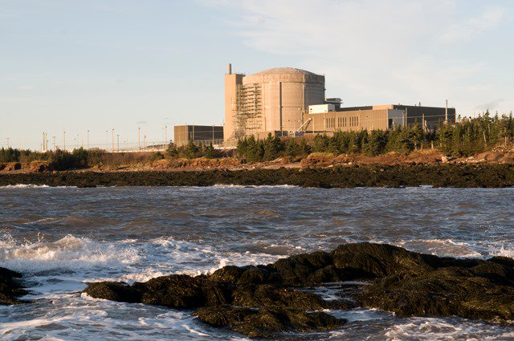
Event at Point Lepreau-1 NPP
Point Lepreau NPP (Canada):
1 unit
Reactor type - PHWR
Power:
Unit 1 - 705 MWe
Event date: 15.01.2020
Unit: Point Lepreau-1
Electrical Contractor Performed Maintenance on the Wrong Exhaust Fan
Event report: WER ATL 20-0226

Slide 42
Event at Point Lepreau-1 NPP
Short description:
Point Lepreau Nuclear Generating Station (PLNGS) consists of a single unit Pressurized Heavy Water Reactor.
There are four (4) exhaust fans located on the roof of the office building which draw air from various areas of the office building and exhaust it through the roof via the exhaust fans.
On January 15th, 2020 at Point Lepreau Nuclear Generating Station (PLNGS), an electrical contractor performed maintenance on the wrong office building six hundred (600) Volt Exhaust Fan (EF) that could have resulted in serious injury as the fan was not electrically isolated.

Slide 43
Event at Point Lepreau-1 NPP
The contractor was given the task of installing a new fan motor on EF-4. The old fan motor had been taken off approximately two (2) weeks prior by other electricians.
The contractor completed a verbal Pre-task / Pre-Job with the contractor foreman and then proceeded to walk down and verify the Lock-out Tag-out (LOTO) isolations. The contractor proceeded to the rooftop of the office building, incorrectly identified the fan to be worked on and replaced the fan motor and switch on EF-3.

Slide 44
Event at Point Lepreau-1 NPP
After the maintenance was complete, the contractor notified the contractor foreman that the incorrect unit was worked on who then contacted the PLNGS Supervisor overseeing the work.
No voltage was present at EF-3 as the overload protection was tripped at the motor starter.

Slide 45
Event at Point Lepreau-1 NPP
A stand-down was immediately completed with the workgroup to discuss the event and review the Station Departmental Procedure on Locking and Tagging for Non-power Block Equipment.
The new fan motor was removed from EF-3 and installed on EF-4 as per the original plan. The motor originally on EF-3 was re-installed on the fan.

Slide 46
Event at Point Lepreau-1 NPP
Analysis and comments:
The direct cause of the event was the contractor not effectively using Human Performance (HU) Tools, specifically Correct Component Verification and Knowing when to Stop. Rather than using prescribed verification techniques to verify the correct component, they listened to see which fan was shut down and verified with a potential check.
With the overload tripped for EF-3 and the fan not running, the contractor assumed they were on the correct component.

Slide 47
Event at Point Lepreau-1 NPP
Contributing causes to the event were the job was perceived as routine/low risk by the contractor, the exhaust fans are not adequately identified in the field and the Station Departmental Procedure for Locking and Tagging Non-Power Block Equipment was not followed as written.
The evaluation for this event determined the Human Performance issue was specific to this individual contractor and is not an organizational issue.

Slide 48
Event at Point Lepreau-1 NPP
Lessons Learned:
- Procedural adherence and effective use of HU Tools are crucial for every task, every time, to prevent HU related events from occurring.
- The same level of rigor must be applied to tasks perceived as routine/low risk as those that are complex and/or high risk.

Slide 49
Event at Point Lepreau-1 NPP
Actions:
- A stand-down was immediately completed with the workgroup to discuss the event and review the Station Departmental Procedure on Locking and Tagging for Non-power Block Equipment.
- Increased Observation and Coaching has been initiated for the Electrical Non-Power Block work group with a specific focus around the LOTO process.

Slide 50
Event at Point Lepreau-1 NPP
- Station Departmental Procedure for Locking and Tagging Non-Power Block Equipment revised to better align the process with Occupational Health and Safety Act 91-191, make the work flow more efficient, recognize current business practices and give it clearer accountabilities.
- HU Guide was revised to remove the verbal Pre-Job Brief criteria for LOTO in Non-Power Block work and ensure it is a written Pre-Job Brief.

Slide 51
Event at Point Lepreau-1 NPP
- A Training Needs Analysis (TNA) was performed in regards to the LOTO process and an action is underway to develop LOTO refresher training with a requalification frequency of every three (3) years to address a gap identified in the TNA.
- A “Toolbox Talk” for the event was developed and delivered to the appropriate employees.

Slide 52
Event at Point Lepreau-1 NPP
- Station Departmental Procedure for Locking and Tagging Non-Power Block Equipment changes rolled-out to work groups who, in addition to the Electrical Non-Power Block group, may be required to work under that process.

Slide 53
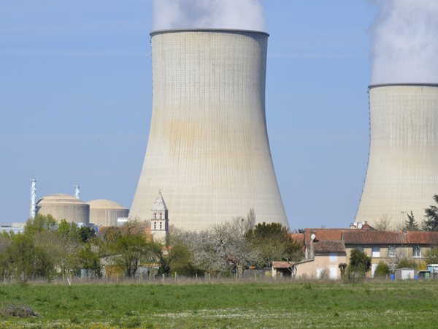
Event at Civaux-1 NPP
Civaux NPP (France):
2 units
Reactor type - PWR
Power:
Units 1-2 - 1561 MWe each
Event date: 31.10.2019
Unit: Civaux-1
Generic Event Relating to Compliance of Diesel Generator Sets with Internal Electrical Sources and 1,300 MW and N4 Series 6.6 kV Emergency Diesel Generator Sets
Event report: WER PAR 20-0209

Slide 54
Event at Civaux-1 NPP
Short description:
This problem also affects the following nuclear power plant units in France: Belleville-1, Paluel-1,2,3,4, Flamanville-1,2, Cattenom-1,3, Nogent-1, Penly-1,2, Chooz-B2.
On 19 February 2019 the regulator required that a review of the internal electrical sources be conducted on the 1,300 MW and N4 series diesel generator sets. This was conducted in September 2019 and a report provided to the regulator on 31 October 2019. The investigation revealed situations for which the earthquake resistance of certain equipment had not been properly demonstrated, and which therefore constitute deviations in compliance.

Slide 55
Event at Civaux-1 NPP
Faults were found with elastomer expansion joint assemblies on 11 reactors; with corrosion on pipework and supports, and with FASTON terminal connectors in the electrical cabinets on 8 reactors. Due to accumulation of maintenance equipment faults and poor maintenance quality which had not been picked up by post maintenance testing due to inadequate test acceptance criteria. The deviations affecting seven diesel generator sets could have led to potential loss of the emergency generating unit in question in the event of an earthquake. The inspections carried out on the redundant diesel generator set did not reveal any deviations. The deviations have been resolved in all reactors.

Slide 56
Event at Civaux-1 NPP
Consequences:
Actual:
None, no significant earthquake has affected these installations
Potential:
Functional consequences by type of deviation.
1. Faults with elastomer expansion joint assembly (Manchons Compensateurs en Élastomère - MCEs).
The MCE assembly faults cover geometric faults and inappropriate MCE types that are likely to adversely affect operation of the diesel generator set in question, in relation to its load cases.

Slide 57
Event at Civaux-1 NPP
2. Corrosion of certain portions of pipes or their supports.
Thin sections observed in certain sections of pipe or on certain supports are likely to adversely affect the pipes' earthquake qualification.
3. FASTON connector faults in the electrical cabinets.
The deviations identified are varied in nature and could, in the event of an earthquake, adversely affect the assignment, either of the auxiliaries for the diesel generator set that are needed for its proper operation, or of the electrical equipment supplied by the diesel generator set during the load shedding and reloading sequences.

Slide 58
Event at Civaux-1 NPP
Analysis and comments:
The causes of these deviations are the accumulation of maintenance equipment quality defects and corrosion.

Slide 59
Event at Civaux-1 NPP
Actions:
- Rapid feedback report (RER) sent to other sites and to the Nuclear Corporate Engineering and Maintenance Support Units.
- The palliative actions taken were proportionate to the faults discovered on the sites.
- The faults were corrected as quickly as possible and according to the basic maintenance programme, except for Flamanville 2, which is in the process of being brought into line as this report is being written.

Slide 60
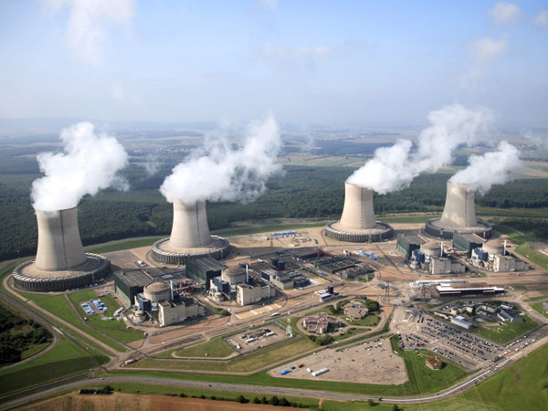
Event at Cattenom-3 NPP
Cattenom NPP (France):
4 units
Reactor type - PWR
Power:
Units 1-4 - 1362 MWe each
Event date: 24.05.2019
Unit: Cattenom-3
Shutdown for 18 Days to Repair Leak from Internal and External Vessel Gaskets due to Maintenance Quality Failure
Event report: WER PAR 20-0251

Slide 61
Event at Cattenom-3 NPP
Short description:
On 24/05/2019 with unit 3 at full power, an alarm representative of a leak from the inner gasket of the vessel cover triggered. In the event of a vessel gasket leak, Technical Specifications require placing the reactor in cold shutdown within 15 days if the leak remains less than 20 l/h or immediately if the outer gasket in turn starts to leak and shut down was started. Three days later, the outer gasket began to leak at 30 l/h and the unit was immediately shut down. Due to failed cleaning and gasket surface preparation and lack of visual inspection prior to assembly. The leak remained confined between the two gaskets, which did not lead to a second containment barrier breach. Led to the loss of 18 equivalent days of full production.

Slide 62
Event at Cattenom-3 NPP
Description:
On 24/05, the “Vessel gasket leak high temperature” alarm appeared in the control room. The detection of this alarm comes from a temperature sensor located on the line for collecting vessel inter-gasket leaks. The change in the temperature is representative of a leak inside the vessel cover.
The “Operation with a leak at the vessel gaskets” setpoint is implemented as per Technical Specifications and requires shutdown of the installation in cold shutdown mode (API) as soon as a leak from the inner gasket reaches 20 L/h.

Slide 63
Event at Cattenom-3 NPP
If the inner gasket flow rate is less than 20 L/h, shutdown in API within 15 days is requested.
If the outer gasket in turn starts to leak, the installation must immediately fall back in API.
On 25/05, the increased leak was quantified at 4 L/h, thus lower than the 20 L/h threshold.
Until 26/05, the leak was stable at around 4 L/h. Preparation for a cold shutdown was begun.
On 26/05, the temperature of the line collecting inter-gasket leaks dropped. This is representative of recovery of the inner gasket sealing or failure of the outer gasket sealing.

Slide 64
Event at Cattenom-3 NPP
On 27/05, a change in the value of the containment air aerosol activity measuring channel was observed from 0 Bq/m3 to 100 Bq/m3 without any alarm appearing.
The level of the chemical drainage sump in the Reactor Building increased.
The leak recovered in the sump was estimated at 30 L/h.
A periodic test carried out found a non-quantified leak rate of 83 L/h, but it remained compliant with the spec tech.
After analysis of the elements, it appeared that the integrity of the outer gasket was compromised.

Slide 65
Event at Cattenom-3 NPP
Given the risk of fast deterioration of gaskets, it was decided to immediately place the unit in Hot Standby under residual heat removal system conditions.
At this first step, one of the aims is to observe the behaviour of the leak at the gaskets.
On 02/06, Unit 3 went into cold shutdown.
Analysis and comments:
The causes of this are poor preparation and cleaning of the gasket surfaces and a failure of the visual inspection before assembly.

Slide 66
Event at Cattenom-3 NPP
Actions:
- Rapid feedback report sent to other sites and to the Nuclear Corporate Engineering and Maintenance Support Units.
- To restore the safety level, the unit was placed in fallback within 15 days following discovery of the leak at the inner gasket, less than 20 L/h.
- Immediate fallback of the unit in hot standby under residual heat removal system connection conditions as soon as the leak from the outer gasket was detected.
- Switch to API was carried out according to the usual schedule for a Corrective Outage.

Slide 67
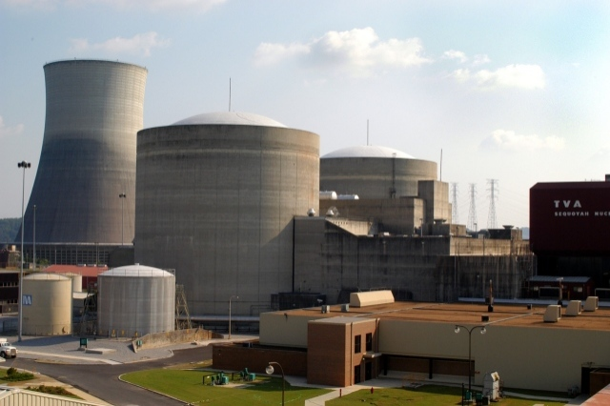
Event at Sequoyah-1 NPP
Sequoyah NPP (USA):
2 units
Reactor type - PWR
Power:
Unit 1 - 1221 MWe
Unit 2 - 1200 MWe
Event date: 10.02.2020
Unit: Sequoyah-1
Unplanned Internal Dose during Reactor Cavity Decontamination
Event report: WER ATL 20-0281

Slide 68
Event at Sequoyah-1 NPP
Short description:
During initial reactor cavity decontamination following reactor head set on 10/28/2019, two radiation protection laborers received intakes of radioactive material. Subsequent analysis of the intakes completed on 02/10/2020, determined that one of the workers received internal dose of 12 mrem. The cause was procedural guidance for as low as reasonably achievable planning (ALARA) had not been followed during preparation.

Slide 69
Event at Sequoyah-1 NPP
Description:
During initial reactor cavity decontamination following reactor head set on 10/28/2019, two radiation protection laborers received intakes of radioactive material. Subsequent analysis of the intakes completed on 02/10/2020, determined that one of the workers received internal dose of 12 millirem (mrem). During preparation, procedural guidance for as low as reasonably achievable (ALARA) planning had not been followed.

Slide 70
Event at Sequoyah-1 NPP
Lessons learned included that rigorous adherence to ALARA planning guidance would have prevented the event and that there is an increased potential for airborne radioactivity when using rotating head surface cleaning attachments on pressure washers. This event occurred because, during the preparation for this activity, RP technicians and leaders did not recognize and mitigate the radiological risk created by use of a different tool and additional scope for upper cavity decontamination.

Slide 71
Event at Sequoyah-1 NPP
This decontamination had traditionally been performed using the same pressure washers and detergents that were used during this activity. However during this evolution, a rotating head surface cleaning attachment was used and additional focus was given to decontaminating the cavity walls. These two factors created a elevated concentration of respirable radioactive aerosols that had not previously been experienced during this evolution.

Slide 72
Event at Sequoyah-1 NPP
During preparation, an opportunity to identify and mitigate the risk was missed because field operations RP personnel inappropriately assumed that a TEDE ALARA Evaluation had been performed on the task. However, procedural guidance for ALARA planning had not been followed. In preparation for the cavity decontamination activity, a TEDE ALARA Evaluation had not been completed because this activity had historically been preformed without creating airborne radioactivity.

Slide 73
Event at Sequoyah-1 NPP
The decision to not perform the TEDE ALARA Evaluation was based on a flawed interpretation of the fleet ALARA planning procedure which requires completion of an evaluation when respiratory protection or work will be performed in an Airborne Radioactivity Area (ARA). The procedure also requires these evaluations for more subjective situations such as when ‘work may create an ARA’.

Slide 74
Event at Sequoyah-1 NPP
Investigation revealed, that as in this case, the procedure had often been misinterpreted to only require TEDE ALARA Evaluations when respiratory protection was worn or ARA conditions were anticipated. More subjective guidance, directing performing the evaluation when ARA ‘could’ occur, had been inappropriately rationalized as not applicable because past performance had not created airborne conditions.

Slide 75
Event at Sequoyah-1 NPP
Subsequent analysis determined that had a TEDE ALARA Evaluation been completed, it would have correctly predicted the radiological conditions created by the work activity. This event and subsequent use of the rotating head surface cleaning tool, when appropriate controls were in place, revealed that while the device was very effective at decontamination it increases the potential for airborne radioactivity to occur.

Slide 76
Event at Sequoyah-1 NPP
Analysis and comments:
This event occurred because, during the preparation for this activity, RP technicians and leaders did not recognize and mitigate the radiological risk created by use of a different tool and additional scope for upper cavity decontamination.

Slide 77
Event at Sequoyah-1 NPP
Actions:
The following immediate actions were implemented during the refueling outage:
- TEDE ALARA Forms created for all activities such as decontamination that had potential for airborne radioactivity.
- Respiratory protection and enhanced engineering controls required for future use of the rotating head surface cleaner.
The following actions were completed following outage:
- This event, its contributors, and corrective actions have been incorporated in RP technician JITT for upcoming outage.

Slide 78
Event at Sequoyah-1 NPP
- Lessons learned regarding flawed assumptions and radiological risk recognition and mitigation have been incorporated into upcoming outage JITT and department focus area.
- Enhanced software was implemented to improve the efficiency and effectiveness of the TEDE ALARA Evaluation process.
- Outage and online RP work planning process revised to require RP field operations and ALARA personnel to align on all process changes and assumptions made when establishing radiological work controls and protective measures.

Slide 79
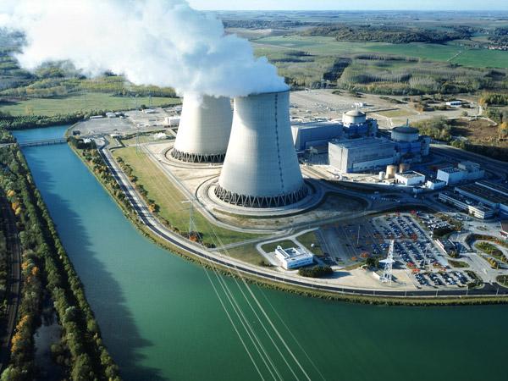
Event at Nogent-1 NPP
Nogent NPP (France):
2 units
Reactor type - PWR
Power:
Units 1-2 - 1363 MWe each
Event date: 03.08.2019
Unit: Nogent-1
Accident Subsequent to the Ejection of a Main Steam Line Plug from a Steam Generator
Event report: WER PAR 20-0156

Slide 80
Event at Nogent-1 NPP
Short description:
On 03/08/2019 with unit 1 shut down for refuelling two workers were struck by an ejected plug they were dismantling during work on the secondary part of a steam generator to remove plugs installed at the main steam line inlet. Due to the unexpected presence of pressure inside the piping. Due to lack of a work procedure, no available operating experience from past work, inadequate implementation of the corporate baseline stipulating conditions for maintenance and usage of the plugs, and the unavailability of all the main steam system pressure sensors due to an ongoing modification preventing any detection at the time of rising pressure in the pipes. The physical consequences for both workers were benign and there was no injury requiring medical attention.

Slide 81
Event at Nogent-1 NPP
Description:
From 11/06 to 14/06/2019, in order to achieve steam generator steam saturation during hydrotesting of the primary circuit, followed by air and helium leak tests, plugs were installed on the secondary side of the steam generators, at the main steam piping inlet (7 per steam generator). These plugs had previously been used at Paluel NPP, and had been checked before dispatch to Nogent. A contractor company fitted the plugs to the steam generators without using a procedure. None of the plugs was found to be defective during installation.
From 28/06 to 06/07/2019, primary circuit hydrotesting was completed, and the plug elastomer was not replaced.

Slide 82
Event at Nogent-1 NPP
From 24 to 30/07/2019, helium leak testing of the steam generators was performed.
On 02/08/2019, steam generator 44 was depressurised. The main steam piping downstream of the steam generator was not vented to equalise pressure.
On 03/08/2019, two contractor workers entered steam generator 44 and began removing the first plug. It was ejected and struck the two workers, who were then forced back against the scaffold deck for a few seconds by the gas escaping from the main steam line. The medical centre took charge of the two workers.
The pressure inside the main steam line downstream of steam generator 41 was then checked, and was measured at approximately 1 bar.

Slide 83
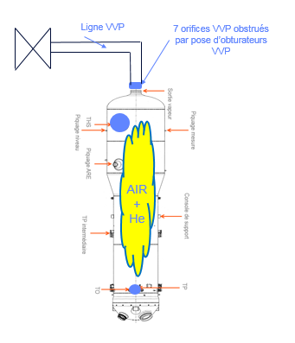
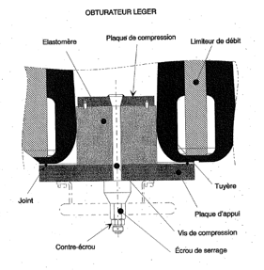
Event at Nogent-1 NPP
Operating diagramme of the SG
(VVP = Main Steam System)
Plug used

Slide 84
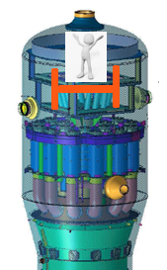
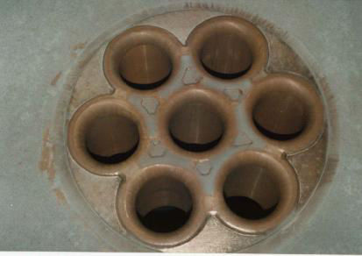
Event at Nogent-1 NPP
Representation of the worker inside the SG
Steam outlet nozzles, inner face of the SG secondary side

Slide 85
Event at Nogent-1 NPP
Analysis and comments:
The following root causes were identified:
- The workers did not have a procedure for the installation and removal of the plugs.
- The corporate baseline specifying the conditions for usage, management and maintenance of the plugs had not been correctly implemented on site. In particular, the baseline stipulated that if the plugs were being used for primary circuit hydrotesting, then the elastomer should systematically be replaced.
- There was no formal operating experience available in corporate databases for plug removal and installation activities.

Slide 86
Event at Nogent-1 NPP
- The requalification tests performed during most of July, subsequent to the refurbishment of the digital part of the reactor protection system, meant that all the pressure sensors for the main steam system were unavailable, thereby preventing the detection at the time of rising pressure in the main steam line piping.

Slide 87
Event at Nogent-1 NPP
Actions:
- Rapid feedback report (RER) sent to other sites and to the Nuclear Corporate Engineering and Maintenance Support Units.
- Verification of the pressure in the steam pipes of the remaining steam generators still fitted with a plug.
- Amendment of the risk assessment for installation/removal of main steam line plugs by adding the ‘risk of pressure’.
- Amendment of the tagging permits used for restoring the steam generators to compliance status after helium leak tests, by adding details of the valves to be opened in the steam piping, as well as an instruction to check the absence of pressure on the sensors fitted to these pipes.

Slide 88
Event at Nogent-1 NPP
- Creation of a procedure for the installation/removal of main steam system plugs.
- Implementation of the corporate baseline specifying the conditions for using, managing and maintaining the plugs.
- Replacement of the elastomer in the main steam line plugs after their use during the coming unit 2 outage.
- Amendment of helium leak test work permits, by adding a verification of the pressure in piping downstream of the main steam system plugs.

Slide 89
Information prepared by
WANO-MC OE Group staff

