Slide 1

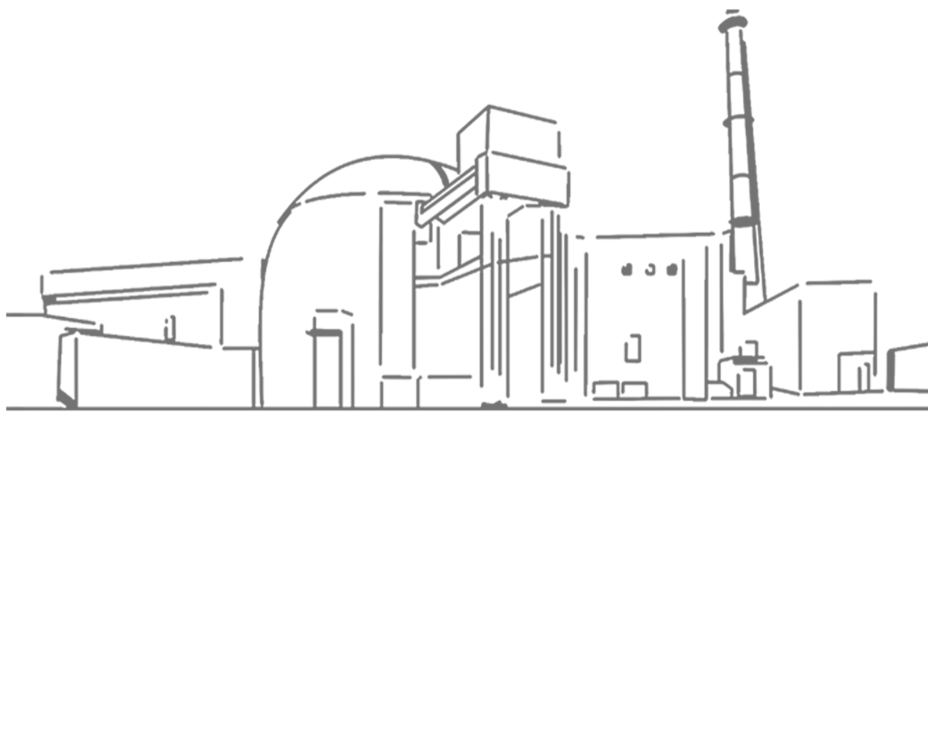
Bushehr NPP Operating Company
Bushehr Nuclear Power Plant
August 2021
Bushehr NPP

Slide 2


Reduction the outage duration with a focus on improving safety and quality of M&R activities

Slide 3
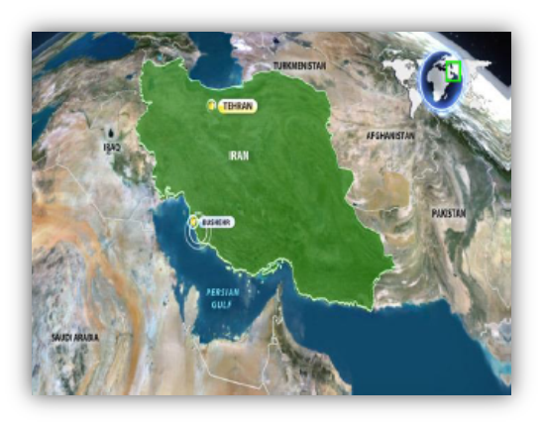
introduction
1
Bushehr NPP is located in southern Iran at the coast of Persian Gulf . Specifications of the Unit 1 is as follows:
VVER-1000 | Reactor type
3000 MW | Thermal power
1000 MW | Electrical power
KWU (German Company) -1979 | Initial design
Atomstroyexport (ASE)-1995 | Design completion
2013 | Start of operation

Slide 4
2
Outsourcing the M&R activities of the Unit in the outage period
Considering the special conditions and unique structure of Bushehr NPP, its M&R activities are performed by TAPNA Company (main contractor of M&R) and domestic and overseas companies.
One of the achievement of Bushehr NPP in the area of human resources management is the creation of a common technical language and formation of conditions for multilateral cooperation amongst the domestic and overseas companies in spite of differences in work culture, social culture , diverse biological climates of the people, etc. For example, the statistics of the manpower participating in the M&R 2017 is shown in the following table:
*Number of Iranian and Overseas Contractor's staff represent in the peak of M&R activities
Total | Staff of Iranian Contractor | Overseas contractor staff | Number of TAPNA staff | M&R manpower | Total volume | Unplanned volumes | Work volume | Outage statistics 2017
1027 | 480 | 240 | 307 |  | 6594 | 1428 | 5166

Slide 5
3
Process of changing the outage duration from 2017 to 2020

Slide 6
4
Factors which have impact on the outage duration of the Unit
Studying the process of the outage duration from 2017 to 2019 indicates decrease in the outage duration in a way that the actual outage duration in 2019 became shorter than the planned outage duration.
From the beginning of 2020, due to the outbreak of covid-19 and application of quarantine conditions and the limitations which were a serous challenge for the presence of Iranian and overseas contractors , all the outage activities of the Unit and time schedules underwent changes.
International limitations related to Covid-19 pandemic all over the world made the foreign contractor unable to opportunely dispatch the M&R staff , spare parts and consumables on a timely basis in spite of the prior contractual agreements.

Slide 7
5
Actions taken in order to reduce the outage duration
Technological actions:
Implementation of the modernization of the refueling machine including a set of decisions and corrective and complementary actions such as installation of SIPPING system
Preparing and developing the requirements for modernization of refueling machine in the areas of mechanics, electricity, I&C and related cameras according to the modern standards of the similar nuclear industries
Planning and organizing in order to supply blocker and the SG tubes drying machine
Preparing and developing the program for detecting the defects and correcting and removing the shortcomings of the polar crane in order to reduce the outages resulting from its defects
Updating and restoring the capability of the machine which controls the SGs tubes and machine which inspects and controls reactor vessel
Planning and organizing for manufacturing the stand of repairing the separable part of the RCPs
Planning and organizing for constructing the repair workshop of the Controlled Radiation Area

Slide 8
6
Actions taken in order to reduce the outage duration
Organizational actions:
Effective establishment of repairs dispatching system
Maintaining and improving the qualification of the staff, training the new methods of repairs via holding the training courses by the foreign contractor
Establishment of the online report-taking system from the process of the doing all the repair activities.
Drawing up the 4-year schedule for the calibration of the sensors and measuring channels according to the repairs 4-year schedule.
Predicting and identifying the areas in need of modernization in the new contract with the Russian contractor
Establishing a Tool Identification System for all the main and general tools
Planning for establishing the repair identification system for improving skills and reducing the repair duration of the main and important equipment which have impact on the critical path
Preparing the training films (Demonstration) of repairing the equipment and analyzing the performance of operative repair staff in order to improve the work safety and repair quality.

Slide 9
7
Establishment of tools Identification system
Tool Identification System allocates a 13-digit code to every tool or instrument and engraves it on it so that this will allows the possibility of controlling, tracking, determining the work area ( radiation controlled area or radiation non-controlled area) and developing different kinds of reports. One of most important objectives for launching the so-called Tool Identification System is to satisfy the FME requirements , to improve safety and quality of executing the M&R activities. Other capabilities of this system are as follows:
Tracking the tools found in the site and in the location of open equipment and extracting the records of their rotation amongst the staff
Controlling the deadline for testing and calibrating the tools and sending them to be tested and calibrated
Expediting and documenting the cycle of the requests and electronic turnover of storehouse
This system was introduced to WANO for the first time in 2015 and was reviewed in 2017. It could be assessed as a good practice in the OSART peer review in 2018.

Slide 10
8
Preparing the training films (Demonstration) of repairing the equipment
These films are prepared in order to train the operative staff of repair by group observation, drill, and simulation of actual conditions of work. When films are played, non-conformities with regulations and instructions are identified and necessary training is given to the staff. One of the most important objectives of this program is to improve safety and quality of M&R activities with a focus on the following issues:
How to properly fill the work permit
Meeting the safety requirements at work and using personal protective equipment
Observing the principle of STAR
Using checklists and documents related to equipment repair
Communication of repair team and apportion of duties
Using appropriate tool
How to perform repair activity and cleaning the work location after repair , handing over the equipment.
This method was assessed as a good practice in the OSART peer review in 2018.

Slide 11
9
Challenges and problems
Some of the most important challenges for reducing the outage duration are as follows:
Architectural limitations of the reactor central hall and also not allocating a special repair for refueling machine if necessary during refueling activities
Lack of enough space for the establishment of repair workshops commensurate with repair requirements between outages and during outage
Limitations resulting from the location of storing the fresh fuel and needing to implement additional activities while transferring fresh fuel to reactor
Hydraulic nut-runner for sealing the reactor main cap is old and an alternative reliable one is not available
Lack of similar NPP Units for the preparing the refueling machine staff and shortcomings of the available simulator
Metallurgy laboratory equipment are old and they have been operating for a long time

Slide 12
10
Conclusion
What was presented indicates the falling slope of outage duration at Bushehr NPP, actions planned for continuation of the reduction of the mentioned period and measures taken for improving the safety level and quality of the M&R activities. Falling slope of the he Unit outage duration in the time span of 2017-2019, lack of investigation reports about falling of bodies into open (unassembled) equipment ( as a result of successful implementation of Tool Identification System), repair documentation, simulation, and implementation of repair drills and other measures indicate the serious resolve of Bushehr NPP in order to reduce outage duration while maintaining and promoting safety level.
The objective for holding this workshop is to use the experiences of other WANO-member NPPs and to get familiar with methods used in other NPPs in order to reduce outage duration with a focus on maintaining and promoting the safety.

Slide 13
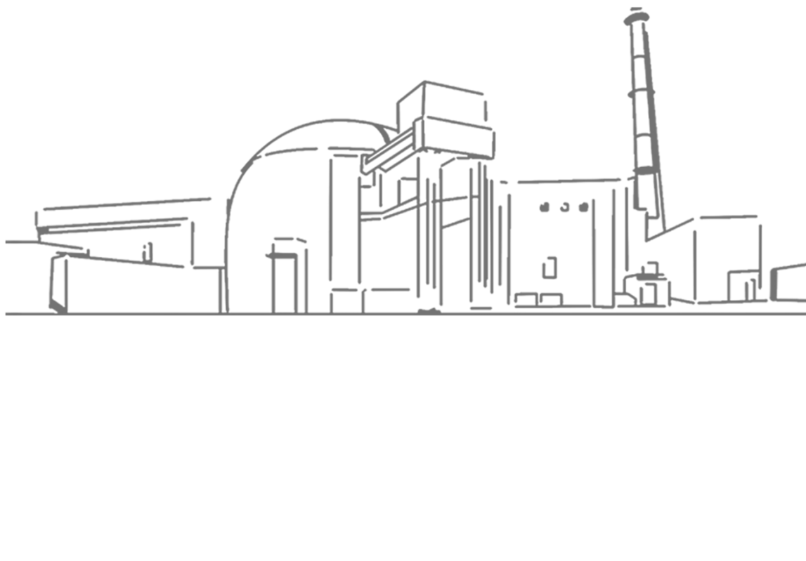


Thank you for your attention
August 2021

