Slide 1
Vadim Tarykin
April 2015
Siofok, Hungary
WANO-MC Youth Movement
'WANO Young Generation'

Slide 2
Achievements
Formalized standards
Youth Movement Database
Actual participation in WANO Programmes
Website Information (Special web section)
Regular video conferences with working group members
The number of YM units is growing
Active interaction with London Office on YM issues

Slide 3
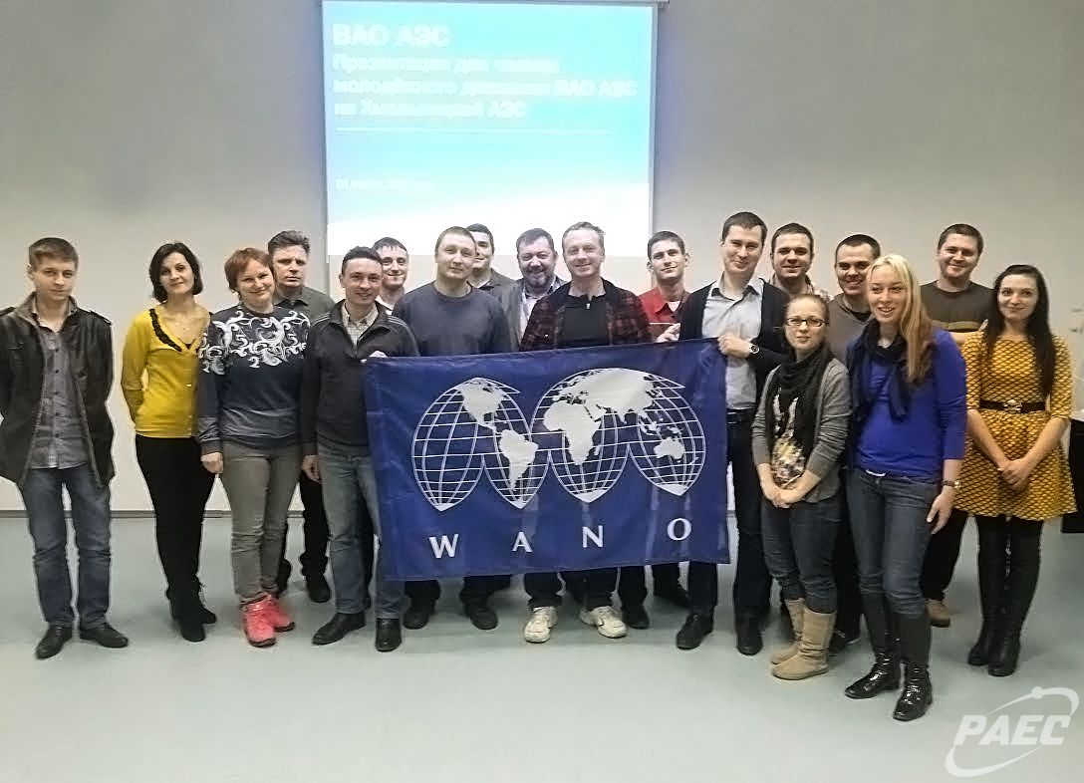
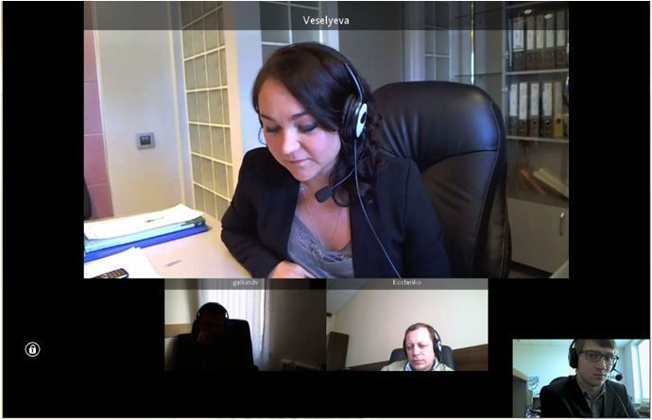
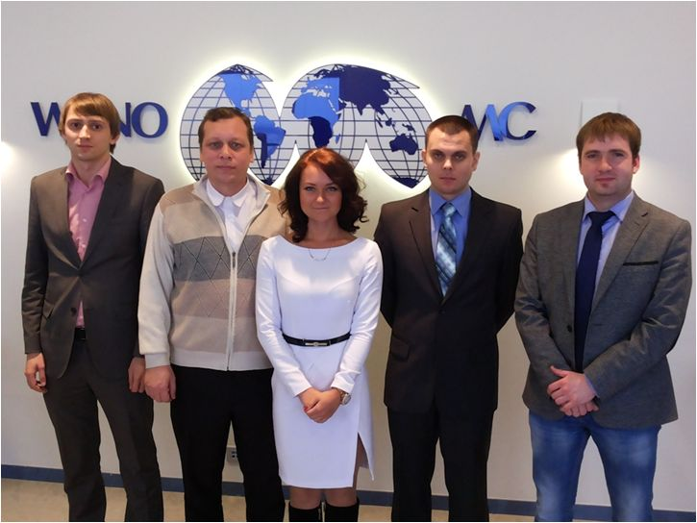

Slide 4
Participation in WANO Programmes
A Follow-up Peer Review Visit to Rovno NPP (27 – 31 October 2014)
A TSM to Kozloduy NPP (23 – 27 February 2015)
A workshop at Novovoronezh NPP (2-6 March 2015)
A TSM to Kursk NPP (23 – 26 March 2015)
Translation of Guidelines and Good Practices (on a regular basis)
Distributing information on WANO Business at plant sites

Slide 5
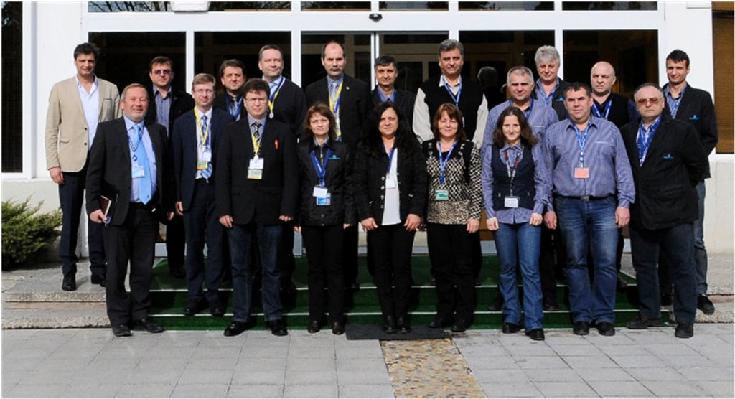
A TSM to Kozloduy NPP from 23-27 February

Slide 6
Future Activities
A TSM to Khmelnitsky NPP (20 – 23 April 2015)
A workshop at Smolensk NPP (28 – 29 April 2015)
A Peer Review Visit to Balakovo NPP (14 – 29 May 2015)
A Pre-startup Peer Review Visit to Novovoronezh NPP (August 2015)
A meeting in WANO-MC Ofice to sum up year-end results (May 2015)
WANO Programme MethodologyTraining
Preparations for Toronto BGM
and other activities…

Slide 7
Proposals for the Memorandum
Each WANO-MC member plant to provide support to YM
Each plant to issue policy documents governing plant administration / YM member relationship according to WANO-MC Youth Movement / WANO-MC Member Plant Interaction Regulations with due accont of local plant specifics.
Promote maximum YM member involvement in WANO Programmes

Slide 8

Thank You for Your Attention!

