Slide 1


Development of Bushehr NPP Stress Test Self-Assessment Report
&
Bushehr NPP OSART Mission(29 Sep.-16 Oct.2018)
Abbaspour. H
Brussels Nov.2018

Slide 2
Part 1
Development of Bushehr NPP Stress Test Self-Assessment Report

Slide 3

EU – Iran Cooperation
  "Based on Annex III.D.8 of the JCPOA that covers nuclear safety aspects "
  Support to INRA
  Support for the Stress test in BNPP
  Training & Tutoring

Slide 4
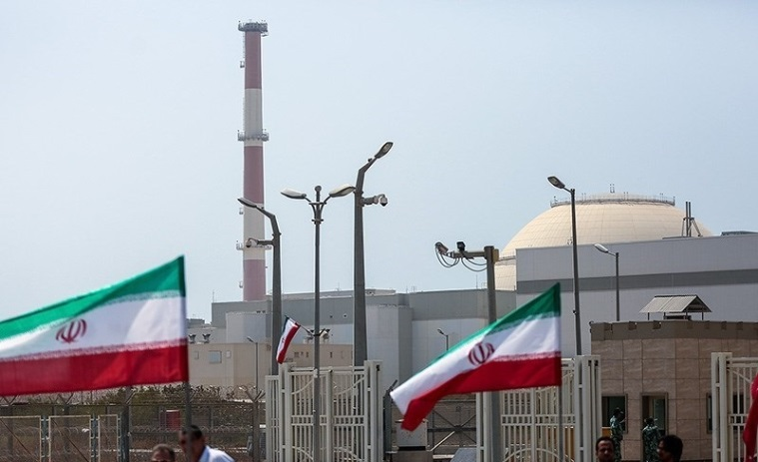
  Support for the Stress test in BNPP
Support to the Bushehr NPP operator
to perform the stress tests exercise
Contractor: UJV Rez
Duration: 3 years
Starting Date: 1st May 2018
  Task 1 Development of the detailed methodology for the Stress Test
  Task 2 Support in preparation of the Self-Assessment Stress Test report
  Task 3 Support to NPPD in presentation of the Self-Assessment Stress Test report to INRA
  Task 4 Support in the development of the final Self-Assessment Stress Test report
  Task 5 Support in designing safety improvement measures resulting from the stress test (including mobile equipment)

Slide 5
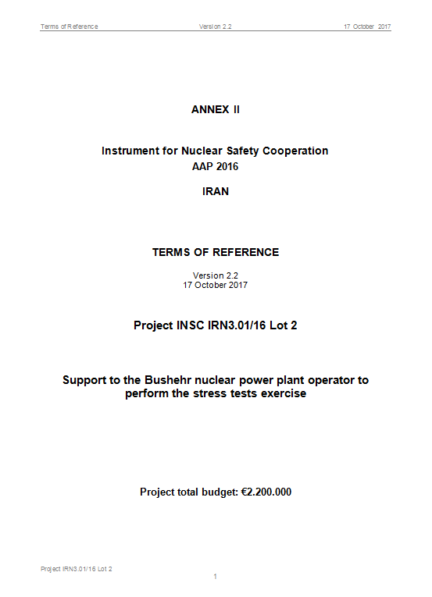
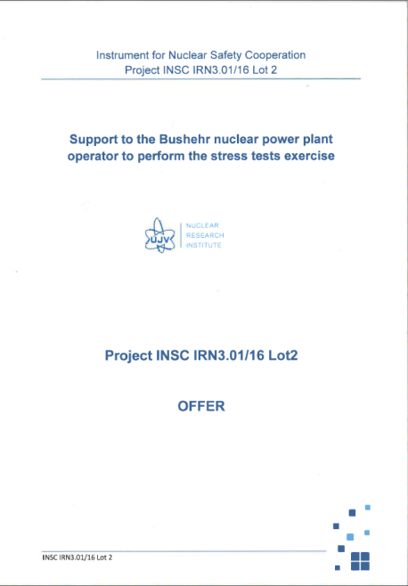
  Activities Performed in relation to Development of Stress Test Self-Assessment Report
  2017-2018
  Finalization of Terms of reference (ToR)
  Finalization of Project INSC IRN3.01/16 Lot 2 offer by UJV
  Review and consideration on INRA requirements for stress tests of NPPs

Slide 6
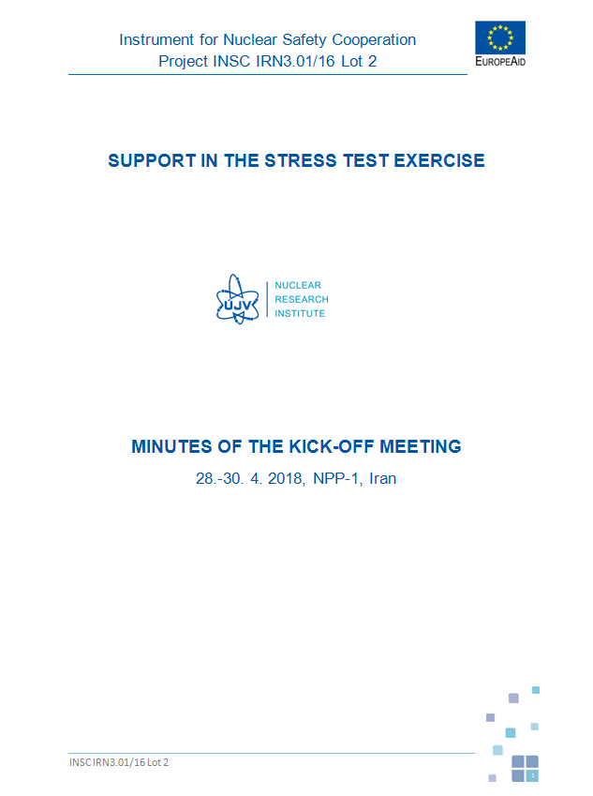
  Activities Performed in relation to Development of Stress Test Self-Assessment Report
  May 2018
  Held the Kick-off meeting of the project in BNPP
  Outcomes:
  Finalization of WGs members (TAVANA, BNPP, UJV)
  Development of overall work plan of the project
  Planning workshops and Technical visits to EU countries

Slide 7
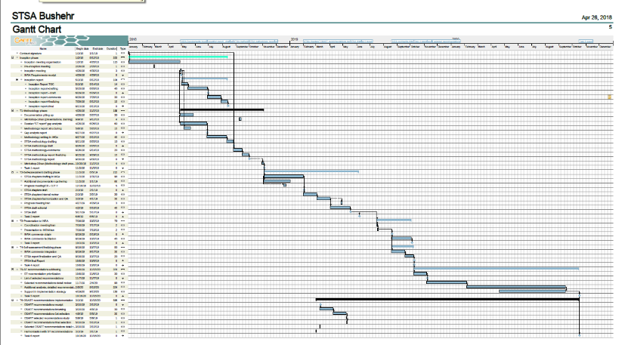
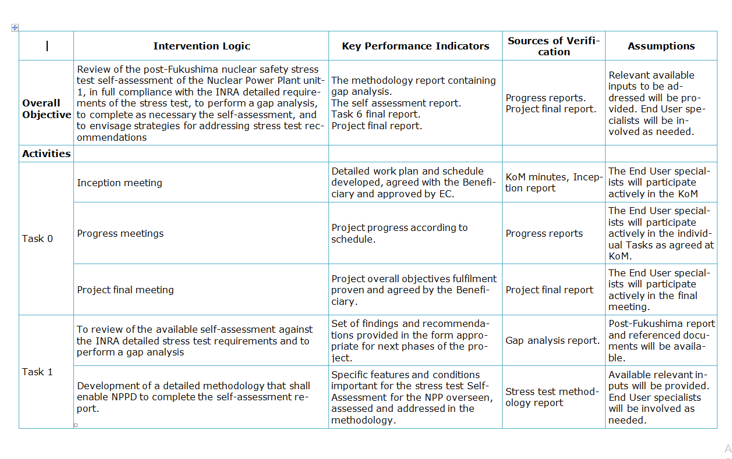
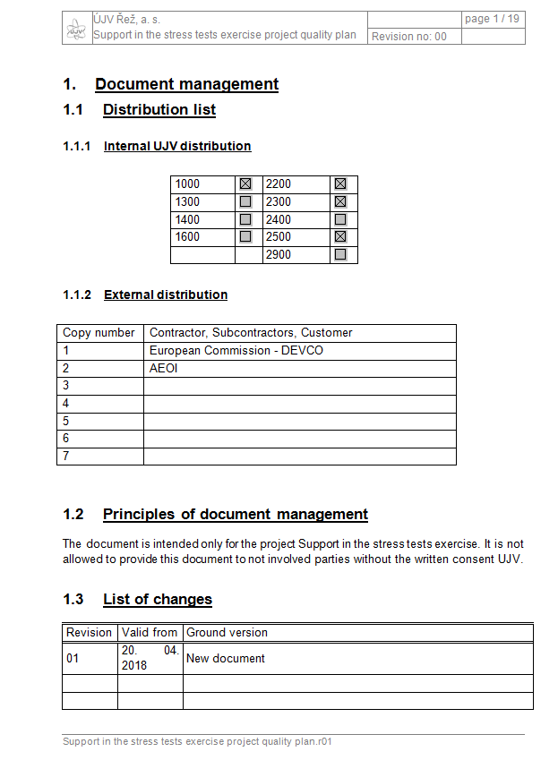
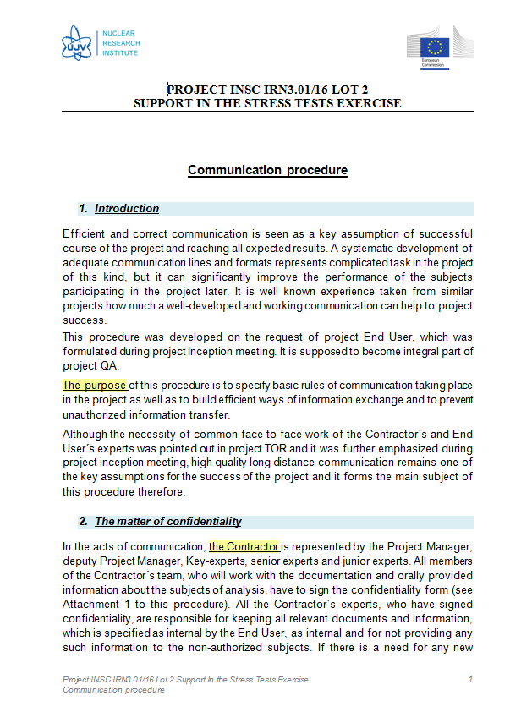
  Activities Performed in relation to Development of Stress Test Self-Assessment Report
  May-June 2018
  Finalization of project schedule
  Finalization of QAP and communication procedure of the Project

Slide 8
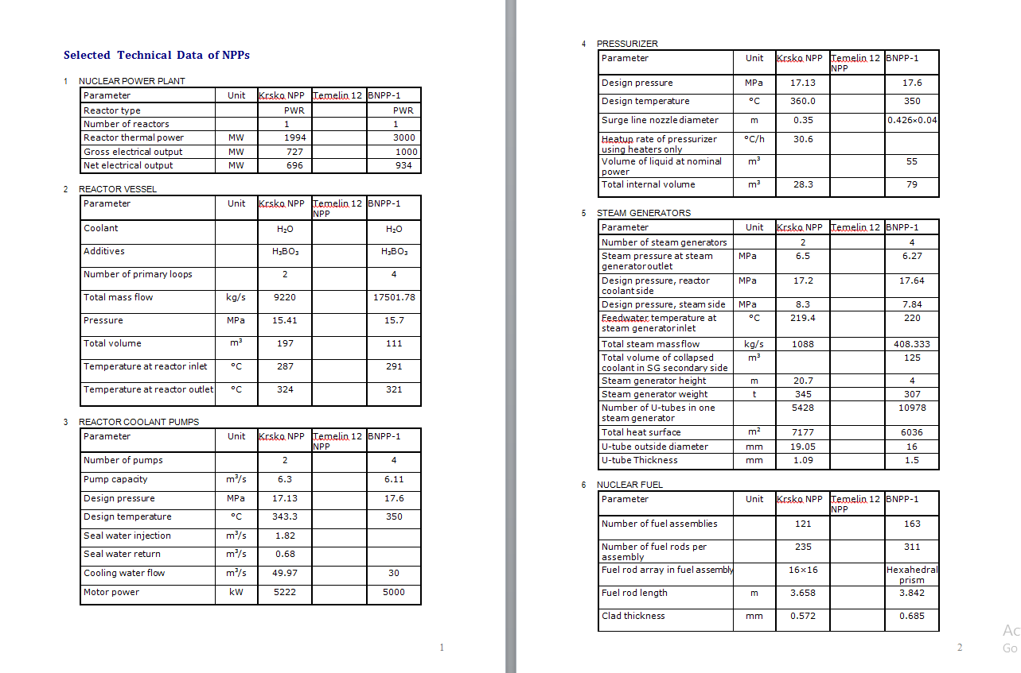
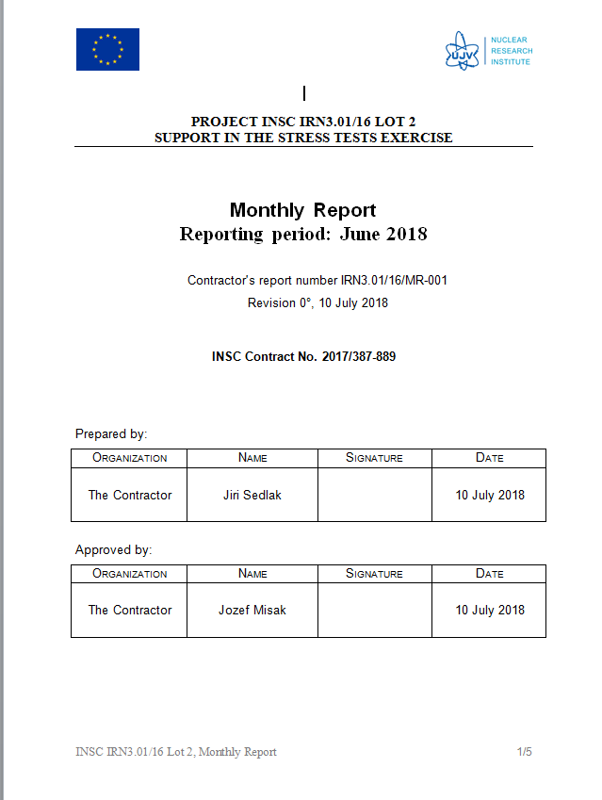
  Activities Performed in relation to Development of Stress Test Self-Assessment Report
  June 2018
  Preparation of the plant data relevant for the stress test
  Submission of information to UJV

Slide 9
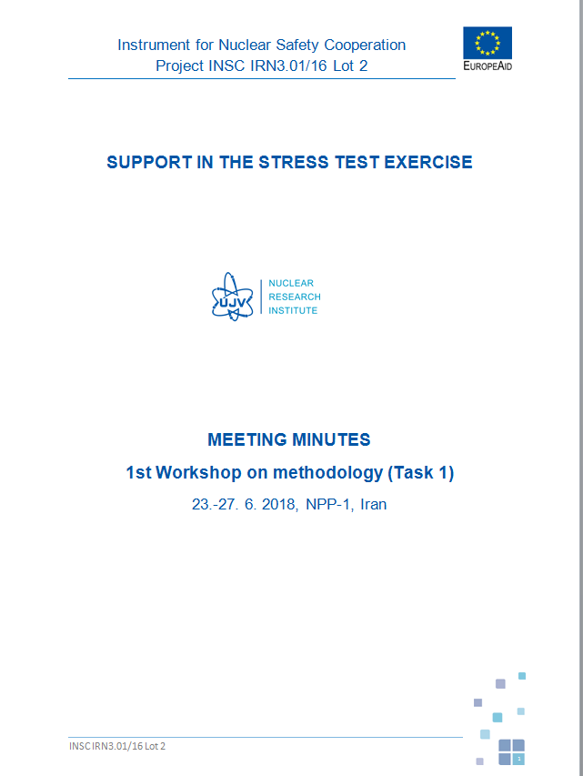
  Activities Performed in relation to Development of Stress Test Self-Assessment Report
  June 2018
  Holding the 1st workshop of the project:
  Outcomes
  Preliminary gap analysis developed by individual working groups
  Development of draft agenda of the 2nd workshop

Slide 10
  Activities Performed in relation to Development of Stress Test Self-Assessment Report
  Sep 2018
  Technical visit of BNPP members (2 persons) to Czech Republic and Slovakia:
  UJV research center and Lab.
  Test Facility of Core Melting
  Material Lab
  LOCA test facility
  HV cabling test Lab
  Non destructive Lab

Slide 11
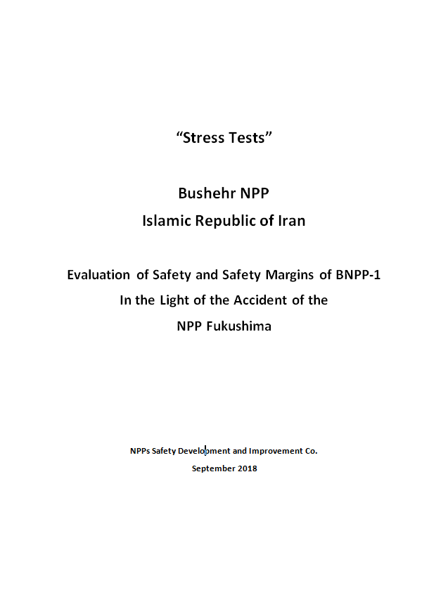
  Activities Performed in relation to Development of Stress Test Self-Assessment Report
  Jul-Sep 2018
  Drafting Chapter 1 of self-assessment stress test report entitled
  “General Data about the site and nuclear power plant”

Slide 12
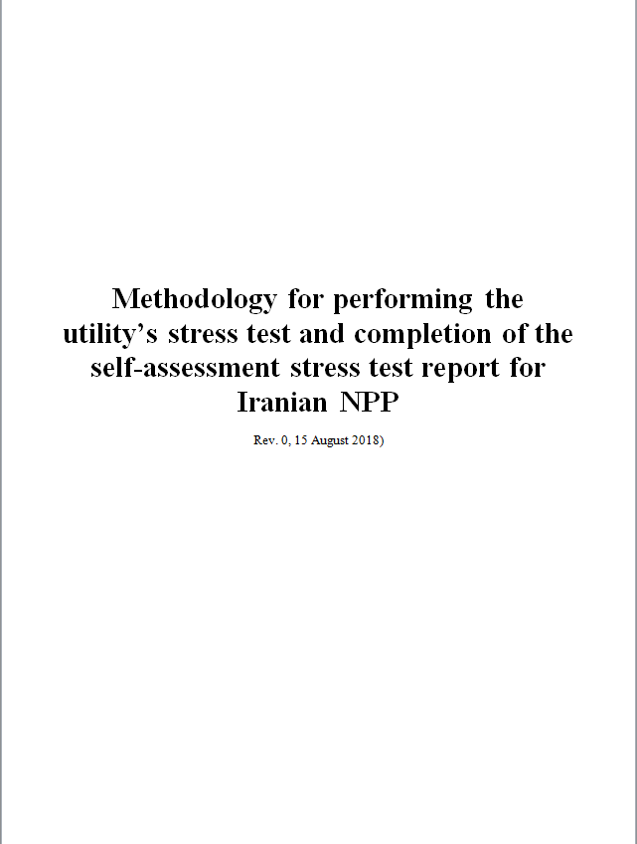
  Activities Performed in relation to Development of Stress Test Self-Assessment Report
  Sep-Nov 2018
  Review and comment on draft Methodology for performing the utility’s stress test and completion of the self-assessment stress test report for Iranian NPP.
  Making arrangements for technical meetings in UJV premises for finalization of Chapter 1 of SAST report.

Slide 13
  Activities Performed in relation to Development of Stress Test Self-Assessment Report
  Nov 2018
  Holding the 2nd workshop of the project
  Outcomes:
  Finalization of the methodology through discussions in working groups
  Development and finalization of detailed work plan to prepare Chapters 2, 3 , 4 , 5 , 6 of SAST report
  Preparation for presentation of methodology to INRA
  Preparation for project progress meeting

Slide 14
  Activities to be performed:
  Development of Chapter 2,3,4,5,6 of SAST report
  Technical meeting at UJV premises to finalize Chapter 1 of SAST report
  Technical meeting in Feb 2019 to draft the SAST report at BNPP
  Technical meeting at UJV premises to finalize activities of SAST report preparation
  Technical meeting in May 2019 (Tehran) to discuss the proposed safety improvement measures

Slide 15
Part 2
Bushehr NPP OSART Mission (29 Sep.-16 Oct.2018)

Slide 16
Introduction
BNPP short description
Conducting Preparatory Meeting
BNPP getting prepared for OSART
Conducting Assist Visit
Performing OSART mission

Slide 17
BNPP description
The Bushehr Nuclear Power Plant is located in Bushehr County, 17 kilometers southeast of Bushehr city
Construction started in May 1975
Initial criticality was achieved in May 2011,
commercial operation began in September 2013

Slide 18
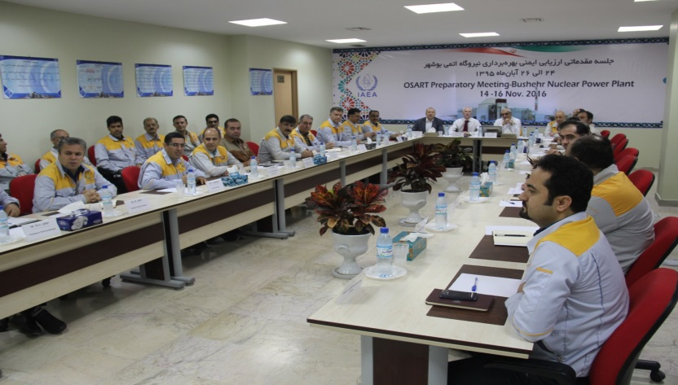
Preparatory Meeting
Preparatory Meeting (14-16 Nov. 2016)
Determining the areas for review
Setting date of conducting OSART mission
Signing a protocol on details of the program

Slide 19
Areas for Review
Leadership and Management for Safety (LM)
Operations (OPS)
Training and Qualification (TQ)
Maintenance (MA)
Technical support (TS)
Operating Experience Feedback (OPEX)
Radiation Protection (RP)
Chemistry (CH)
Emergency Preparedness and Response (EPR)
Accident Management (AM)

Slide 20
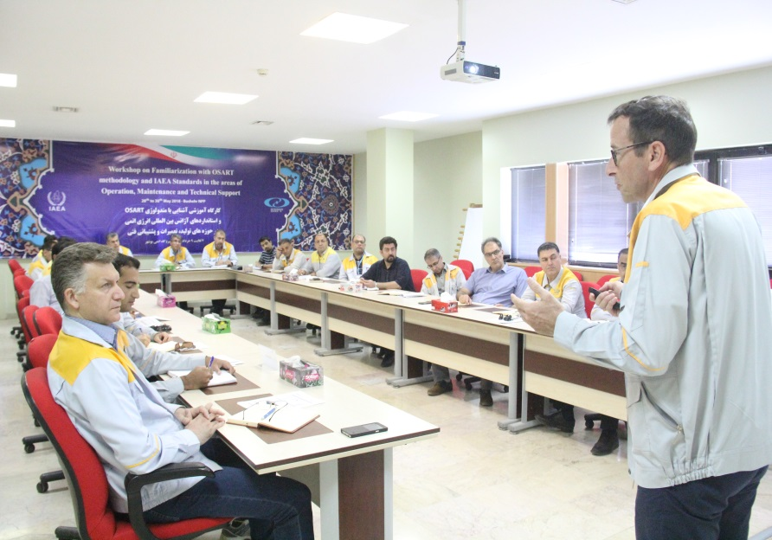
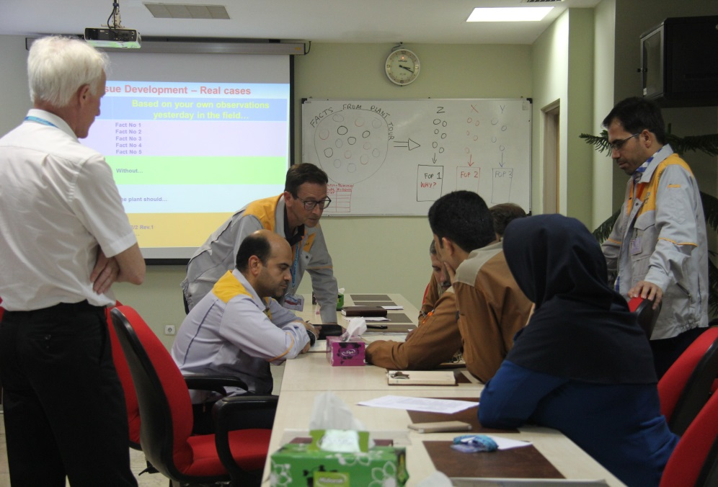
BNPP getting prepared for OSART
Performing Self-Assessment based on IAEA Standards
Preparing and implementing the corrective actions plan
Conducting Assist Visit (Workshop)
Getting familiar with OSART methodology and IAEA Standards in the areas of Operation, Maintenance and Technical Support

Slide 21
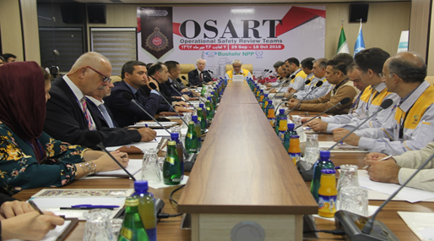
Conducting OSART at BNPP
Date of Implementation: 29 Sep – 16 Oct. 2018
Duration: 18 days
Team Composition: 14 Experts from 10 Countries (France, England, China, Sweden, Belgium, Slovenia, Romania, Slovakia, Hungry, Armenia)

Slide 22
OSART Conclusion
Main BNPP OSART Mission Conclusions
4
Good Practices
6
Suggestions
6
Recommendations
28
Good Performances

Slide 23
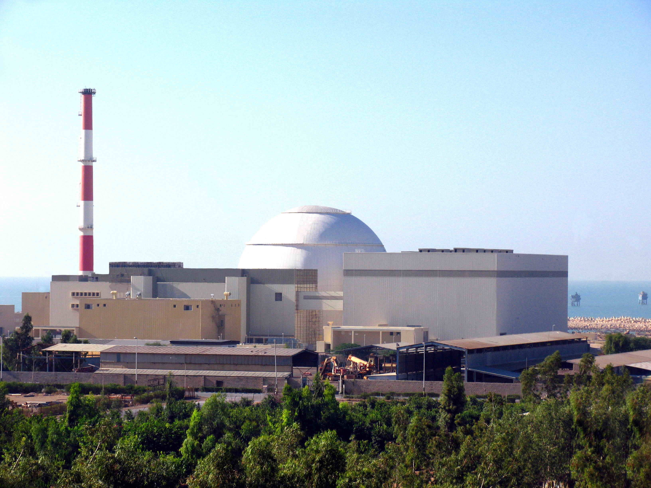
Thank you for your Attention

