Slide 1



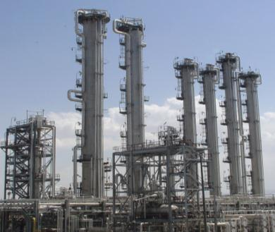
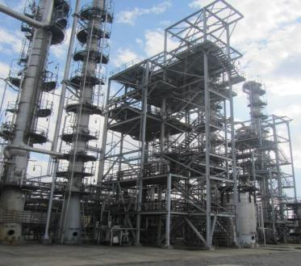
Heavy Water: Global Prospect, Growing Peaceful Demand (Iran Case Study) by the Islamic Republic of Iran
Heavy water and deuterium Production
and It’s applications
Wednesday, 28 September 2016, from 4.00 p.m. to 6.00 p.m.
Conference Room M4, M building, ground floor

Slide 2

Table of Content
1
Introduction
2
Heavy water production
3
Heavy water and deuterium applications

Slide 3
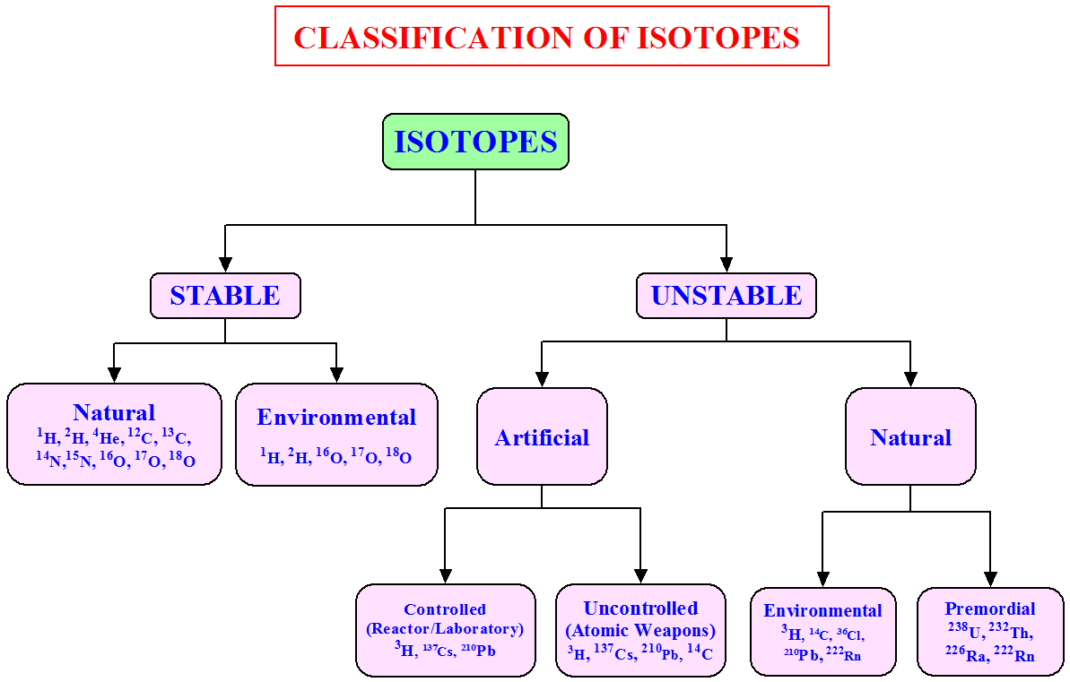
Introduction
Isotopes are variants of a particular chemical element that have the same number of protons in each atom, but differ in neutron number.

Slide 4
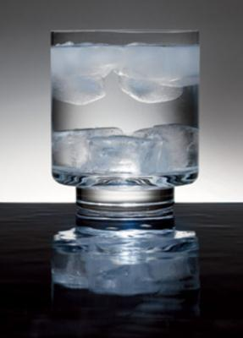
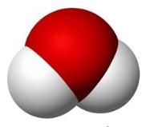
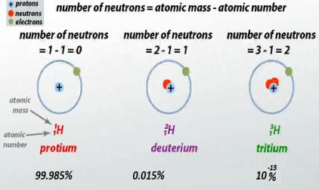
Introduction
Hydrogen Isotopes
Property | D₂O (Heavy water) | H₂O (Natural water)
Freezing point | 3.82 °C | 0.0 °C
Boiling point | 101.4 °C | 100.0 °C
Density at STP (g/mL) | 1.1056 | 0.9982
Temp. of maximum density | 11.6 | 4.0
Dynamic viscosity (at 20 °C, mPa·s) | 1.2467 | 1.0016
Surface tension (at 25 °C, N/m) | 0.07187 | 0.07198
Heat of fusion (cal/mol) | 1,515 | 1,436
Heat of vaporisation (cal/mol) | 10,864 | 10,515
pH (at 25 °C) | 7.43 | 6.9996
Refractive index (at 20 °C) | 1.32844 | 1.33335
O
H
H
Natural Water
O
D
D
Heavy Water

Slide 5
History
Urey, Brickwedde, and Murphy
reported spectroscopic evidence for heavy hydrogen(1931)
G. N. Lewis and R. T. MacDonald: (1933)
scaled up the production of 99% D₂O
György de Hevesy & Hofer: (1934)
First biological tracer experiment
Urey awarded the Nobel Prize for his discovery in 1934

Slide 6
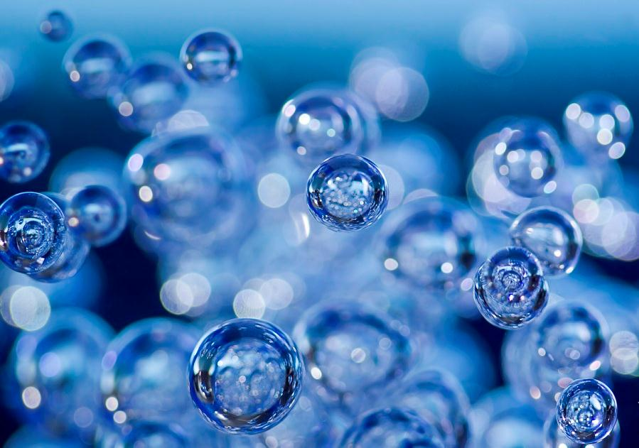
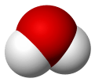
Heavy Water Production Methods
Distillation
Distillation of hydrogen
Distillation of water
Chemical Exchange
Bithermal exchange between (H₂S – HDO)
Chemical exchange between (NH₃ – HD)
Hydrogen – water (H₂O - HD) exchang
Electrolysis of water

Slide 7








Heavy Water Producer
In 1934, Norway built the first commercial heavy water plant, with a capacity of 12 tons per year
Production was started in 1948, five plants were constructed, with an annual production of 20 tons.
In 1953, the United States began using heavy water in nuclear reactors at the Savannah River Site
Pakistan succeeded in acquiring a tritium purification and storage plant and deuterium and tritium precursor materials.
The Bruce Heavy Water Plant was the world's largest heavy water production plant with a capacity of 700 tons per year.
Argentina is a producer of heavy water, using an ammonia/hydrogen exchange based plant supplied by Switzerland's Sulzer company.
India is the world's largest producer of heavy water and use variety of technologies for production of heavy water
Romania produces heavy water at the Drobeta Girdler sulfide plant and exports it occasionally.
China is another producer of heavy water but information about its company is very limited

Slide 8


Since2002 a plant for production of heavy water was being constructed at Arak city.
The heavy-water plant was inaugurated in 2006.
The nominal capacity is 16 tons per year.

Slide 9
Heavy water and deuterium applications
Nuclear Applications
Non-nuclear Application

Slide 10
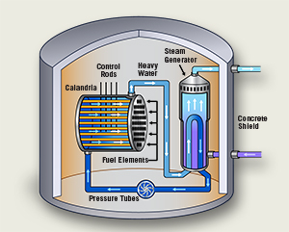
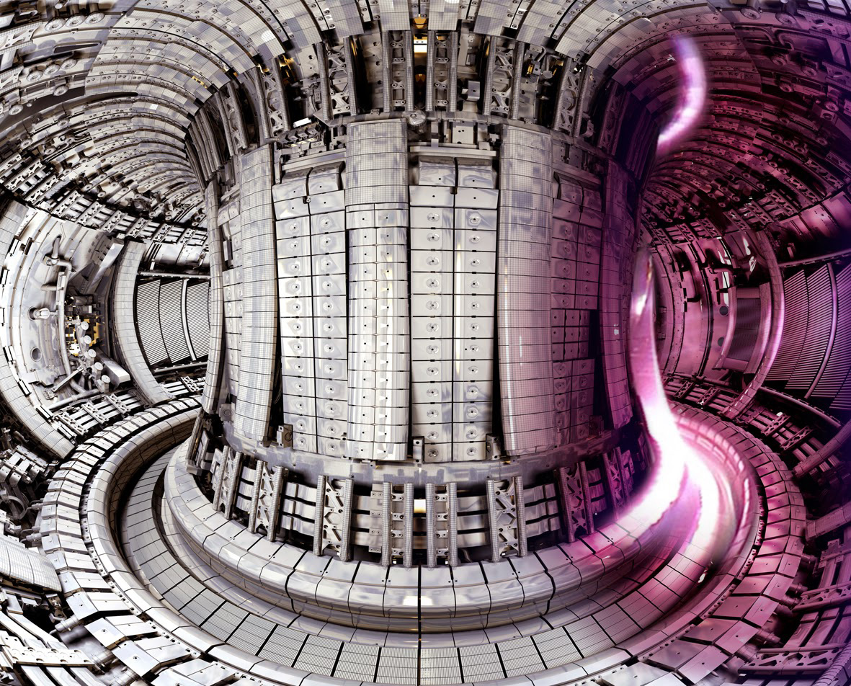
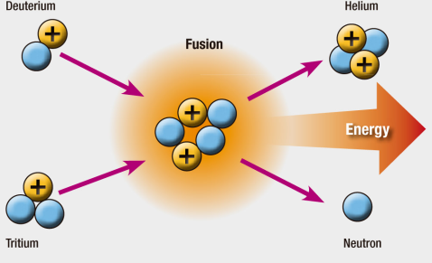
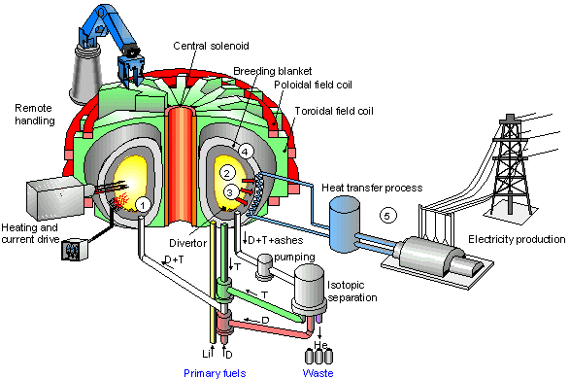
Heavy water and deuterium applications
Nuclear Applications
Heavy Water Reactor
Fusion Reactor

Slide 11
Non-nuclear application of heavy water and deuterium

Slide 12





Research and patents in
Heavy water application field

Slide 13

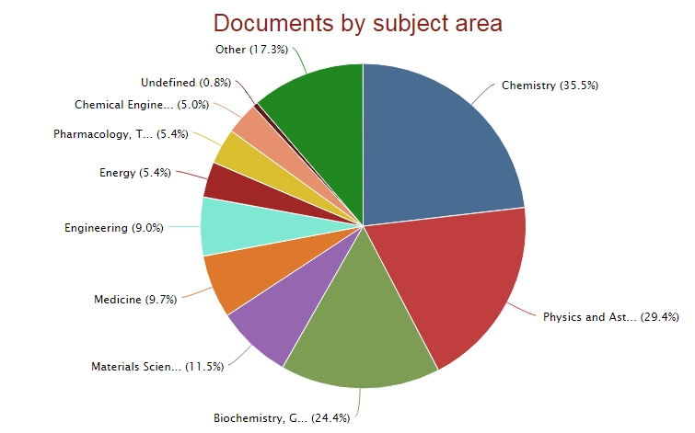
Research and patents in Heavy water application field

Slide 14
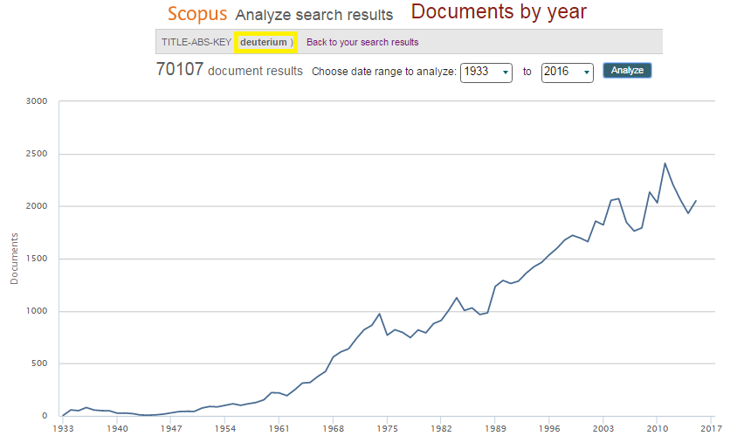
Research and patents in Heavy water application field
Paper Trends: Deuterium
Number of paper published during 1933-2016 (Reference: Scopus)

Slide 15
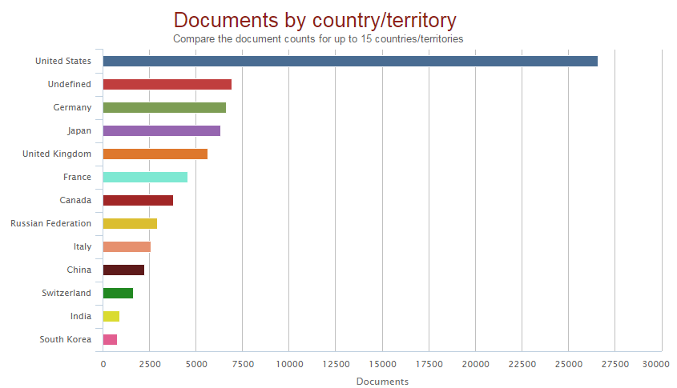
Research and patents in Heavy water application field
Paper Trends: Deuterium
Number of paper published by countries (Reference: Scopus)

Slide 16
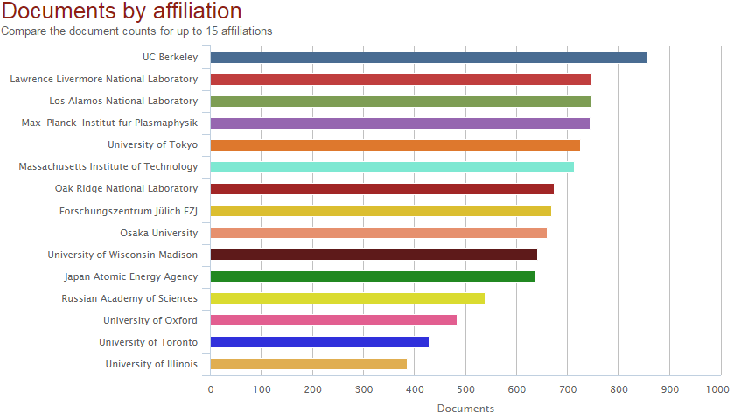
Research and patents in Heavy water application field
Paper Trends: Deuterium
Number of paper published by affiliation (Reference: Scopus)

Slide 17
Research and patents in Heavy water application field
Patent Trends: Deuterium
Number of Patents during 1957-2015

Slide 18
Research and patents in Heavy water application field
Patenting Countries: Deuterium
Number of Patents produced by countries

Slide 19
Research and patents in Heavy water application field

Slide 20
Research and patents in Heavy water application field
Patent Fields: Deuterium

Slide 21
Research and patents in Heavy water application field
Patent Fields: Deuterium

Slide 22
Non-nuclear Application of Heavy water and Deuterium
Medicine & Biology
Nutrition
Pharmaceutical
Chemistry
Electronic
Oil and gas industry
Hydrology

Slide 23
Non-nuclear Application of Heavy water and Deuterium
Medicine & Biology
Diagnostic Applications
Enzyme activity measurements
Cancer therapy
Quantum tunneling

Slide 24
Non-nuclear Application of Heavy water and Deuterium
DIAGNOSTICS
If substances such as natural fatty acids, amino acids, etc., are administered to an animal, we lose track of them the moment they enter the body, since they are mixed with the same substances already present.
The solution of these problems will be possible only when direct methods for tracing such substances are available.
One of this method is labeling. A possibility for such a label is the use of an isotope. As the chemical properties of the various isotopes of an element are almost identical, it is to be expected that the properties of an organic molecule will remain unaltered if one or even several of its atoms are replaced by their isotopes.
As the isotope labeled compound is processed by the body, the presence of deuterium tells the physician how the patient is metabolizing the deuterium.
The physician can then use the results to determine if disease is present and the need for future evaluations or treatment
Arch Dis Child 2001;84:444-448 doi:10.1136/adc.84.5.444
The Journal of Biological Chemistry, Vol 111, No 1.

Slide 25

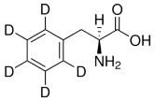
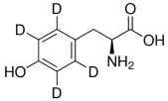
Enzyme activity measurements
Non-nuclear Application of Heavy water and Deuterium
Phenylalanine hydoxylase
L-phenylalanine
L-Tirosine

Slide 26
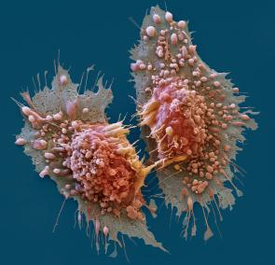
Non-nuclear Application of Heavy water and Deuterium
Cancer therapy
Inhibition of cell proliferation
The growth inhibitory and the inhibition of colony formation of tumor cells
Help in the chemotherapeutic treatment of human tumors

Slide 27
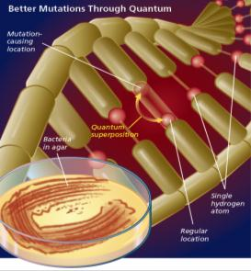

Non-nuclear Application of Heavy water and Deuterium
Medicine & Biology
Quantum tunneling in biology
DNA mutations via proton quantum tunnelling
Proton quantum tunneling
the canonical form of nucleic base
tautomeric form
It doesn't bind to the initial base pair partner, it can bind to a different base
mutation
Enzyme catalytic mechanism

Slide 28
Non-nuclear Application of Heavy water and Deuterium
Nutrition
How Deuterium Isotope Help Nutrition ?
Assessment of Total Energy Expenditure
Assessment of Breastfeeding Practices
Assessment of Vitamin A Body Stores
Determining the amount of fat in the human body

Slide 29

Assessment of Total Energy Expenditure
Non-nuclear Application of Heavy water and Deuterium
Nutrition
Doubly labeled water is water in which both the hydrogen and the oxygen have been partly or completely replaced for tracing purposes
²H₂¹⁸O loading dose
C¹⁸O₂
²H₂¹⁸O
C¹⁸O₂
Doubly Labeled Water
10 atom% D
10 atom% ¹⁸O
Isotopic exchange
ln (enrichment)
²H₂¹⁸O
²H
¹⁸O
Time, d
DLW is traceable hydrogen (deuterium), and traceable oxygen (¹⁸O).
The ¹⁸O leaves the body in two ways: (i) exhaled CO₂, and (ii) water loss in urine, sweat, & breath.
Metabolism can be calculated from oxygen-in/CO₂-out.

Slide 30

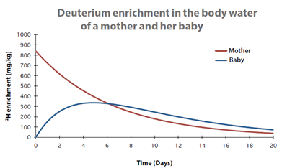
Non-nuclear Application of Heavy water and Deuterium
Nutritions
Assessment of Breastfeeding Practices
D2O
The mother consumes deuterium oxide. The deuterium mixes with water in her body including the milk the baby drinks
Over a period of 14 days, the saliva of both the mother and child is enriched with deuterium
Revealing the changes in isotope concentration with a sensitive method
This gives insight into the baby’s intake of human milk and whether the baby has consumed water from other sources, as well as the body composition of the mother

Slide 31
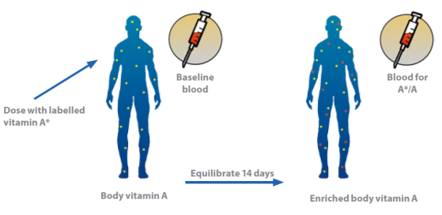
Non-nuclear Application of Heavy water and Deuterium
Nutrition
Assessment of Vitamin A Body Stores
a dose of vitamin A labelled with Deuterium
analysis by mass spectrometry
From measured dose of isotope labelled vitamin A, it is possible to calculate the total quantity of exchangeable vitamin A in the body.

Slide 32
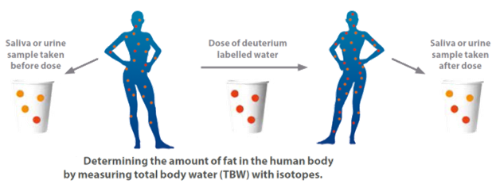
Non-nuclear Application of Heavy water and Deuterium
Nutrition
Determining the amount of fat in the human body
fat mass
No water
fat-free mass
73–80% water
hydration factor.
total body water measurement
amount of fat

Slide 33
Non-nuclear Application of Heavy water and Deuterium
pharmaceutical
Pharmaceutical
Deuterated drugs
Deuterated Internal Standard
Thermo-stabilization of biomolecules

Slide 34

Non-nuclear Application of Heavy water and Deuterium
pharmaceutical
Deuterated drugs
Since deuterium and protium have very similar chemical properties, deuterium can substitute for protium in the manufacture of certain drugs and deuterium does not materially alter the drug’s therapeutic benefits.
The Deuterium atom (D) can slow the rate at which the body metabolizes drugs and allows for longer effective benefit, smaller frequent doses and fewer side effects of the drug.

Slide 35
Non-nuclear Application of Heavy water and Deuterium
pharmaceutical
Patent Trends: Deuterated Drugs
Number of Patents during 1971-2014

Slide 36
Non-nuclear Application of Heavy water and Deuterium
pharmaceutical
Patenting Countries: Deuterated Drugs
Number of Patents produced by countries

Slide 37
Non-nuclear Application of Heavy water and Deuterium
pharmaceutical
Leading Assignees: Deuterated Drugs
Number of Patents produced by organizations/companies

Slide 38
Non-nuclear Application of Heavy water and Deuterium
pharmaceutical
Therapeutic Patents: Deuterated Drugs
Top 10 therapeutic patents related to deuterated Drugs

Slide 39
Non-nuclear Application of Heavy water and Deuterium
pharmaceutical
Metabolism Switching
Haloethane is a volatile anesthetic, is known to cause hepatoxicity

Slide 40
Non-nuclear Application of Heavy water and Deuterium
pharmaceutical
D6-NIFEDIPINE
It is a medication used to manage angina, high blood pressure, Raynaud's phenomenon, and premature labor.
One of the goal of deuteration was to increase the half-life, patient compliance and hence both efficacy and safety indirectly. Longer half-life should lead to decreased “withdrawal effects” in many agents, again a safety improvement. D6-NIFEDIPINE, deuterated nifedipine gave rise to a 34% increase in efficacy in rodents.

Slide 41
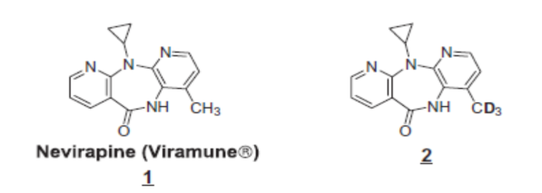
Non-nuclear Application of Heavy water and Deuterium
pharmaceutical
NEVIRAPINE
Nevirapine is a non-nucleoside reverse transcriptase inhibitor for the treatment of HIV infection. Its metabolism causes skin rash and hepatotoxicity due to the metabolism produces a radical intermediate.
Deuterated Nevirapine reduces covalent binding to hepatic proteins, and produce less hydroxy-metabolite which reduced the incidence and severity of the rashes in both mouse and rat models.

Slide 42

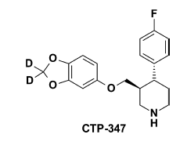
Non-nuclear Application of Heavy water and Deuterium
pharmaceutical
Paroxetine, is an antidepressant of the selective serotonin reuptake inhibitor (SSRI) class. It is used to treat major depressive disorder, obsessive-compulsive disorder, social anxiety disorder, panic disorder, posttraumatic stress disorder, generalized anxiety disorder and premenstrual dysphoric disorder.
CTP-347: Deuterium Modification of Paroxetine
CTP-347, a selectively deuterated analogue of paroxetine.
CTP-347 was designed to eliminate the irreversible inhibition of the metabolizing enzyme (CYP2D6)

Slide 43
Non-nuclear Application of Heavy water and Deuterium
Deuterated Internal Standards
Deuterated Internal Standards
An internal standard is used when performing bioanalysis with mass spectrometry detection.
The best internal standard for bio-analysis is an isotopically labeled version of the molecule you want to quantify.
The stable labeled isotopes available to incorporate in a given molecule (drug or drug metabolite) are deuterium (²H or D), ¹³C and ¹⁵N.
Generally, because of the abundance of hydrogen in organic molecules, the use of deuterium is preferred compared to ¹³C and ¹⁵N, which are generally more expensive solutions for stable labeled internal standards.
Nowadays deuterium labeled compounds are commercially available and widely used in day to day practice in laboratories.

Slide 44

Thermo-stabilization of biomolecule by heavy water
Non-nuclear Application of Heavy water and Deuterium
pharmaceutical
  Live virus vaccine
Plasmid DNA, plasmid vaccines, recombinant protein, antigens and synthetic peptides
Archiving of blood, serum and plasma
Archiving of tissues for histopathology, immomohistochemistry, in situ PCR and in situ hybridization
Cryopreservation of semen, embryos and cell lines
http://dae.nic.in/?q=node/201

Slide 45
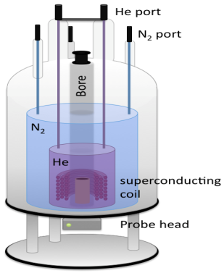
Non-nuclear Application of Heavy water and Deuterium
Chemistry
Characterization of synthesized materials
NMR Solvent
Most NMR spectra are recorded for compounds dissolved in a solvent. Therefore, signals will be observed for the solvent and this must be accounted for in solving spectral problems. To avoid spectra dominated by the solvent signal, most ¹H NMR spectra are recorded in a deuterated solvent

Slide 46
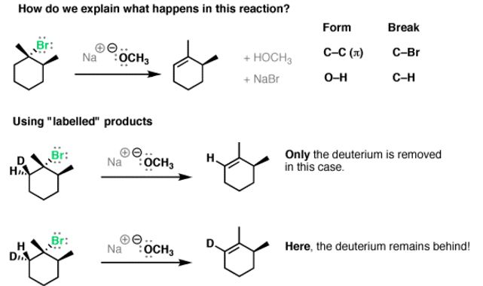
Non-nuclear Application of Heavy water and Deuterium
Chemistry
Chemical mechanism determination
Kinetic isotope effect is considered as a tool for the study of reaction mechanisms.
For example kinetic isotope effects can be used to reveal whether an elimination reaction follows a one step (bimolecular); E2 or two step (One molecule); E1 pathway.

Slide 47

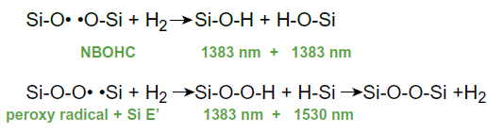
Non-nuclear Application of Heavy water and Deuterium
Electronic
Fiber Optics
In ordinary optical fiber optical loss could occur over time due to chemical reactions between the atomic defects in fibers and the trace amounts of molecular hydrogen inevitably present in/or around optical cables.
1383 nm and 1530 nm peak are very harmful and decrease optical fiber efficiency

Slide 48

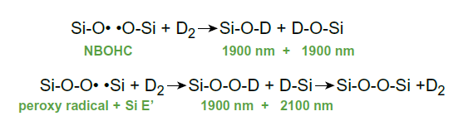
Non-nuclear Application of Heavy water and Deuterium
Electronic
Fiber Optics-Deuterated
Deuterium replaces some of the protium on the fibre cables, which reduces the chemical reaction rate leading to deterioration of the light transmission and extends the life of the cable
O-D and D-Si absorption occur at much longer wavelengths, therefore are not harmful and are outside the normal operating wavelength windows.

Slide 49


Semi- conductor
Non-nuclear Application of Heavy water and Deuterium
Electronic
Deuterium gas (²H_{2;} D₂) is used in the manufacture of silicon semiconductors and microchips in circuit boards
Prevents deterioration of the chip circuitry from chemical attack
It significantly extends and improves the life cycle of semi-conductors and microchips
It allows chips to be made smaller, have high circuit densities.
It can improve the life of a device by up to 50 times

Slide 50
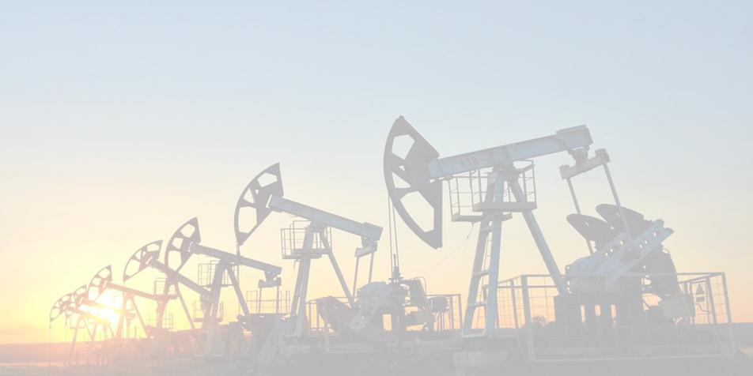
Non-nuclear Application of Heavy water and Deuterium
Oil and gas industry
Using deuterium oxide as a mud tracer in coring operation helps obtain the saturation levels and residual oil saturation.
Procedure:
Introducing a drilling fluid having a known concentrations of deuterium oxide into a well
Obtaining a sample of the fluid from the formation at a location adjacent to the well
Determining the concentrations of the deuterium oxide in the sample
Calculating the deuterium oxide concentration within the formation based on the known and determined concentrations of the deuterium oxide in the drilling fluid and in the sample.

Slide 51
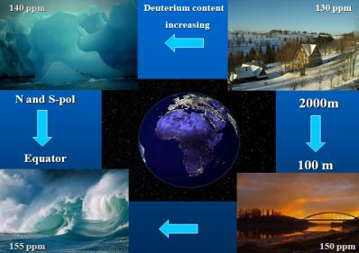

Non-nuclear Application of Heavy water and Deuterium
Hydrology
Give direct insight into the movement and distribution of groundwater within the aquifer.
Follow its movement and therefore providing key information on how and where water is following (groundwater hydrology)
Hydrology using deuterium as a tracer is applied in environmental studies, water and waste-water mapping
Its hydrology applications cause no environmental hazards

Slide 52

Peace cannot be kept by force;
it can only be achieved by understanding.
Albert Einstein

Slide 53

Thank you for your attention

