Slide 1
Institutional Strength in Depth in the Nuclear
Industry to Sustain Operational Excellence
Mike Harrison
15th December 2021

Slide 2
Institutional Strength In Depth – Whole System
Linkages between sub-systems need to be robust
(open responsive dialogue)
Industry
Institutional strength in depth as well as Technical and Engineering strength in depth important to improve safety
Regulator
Stakeholders
Influence of regulators and stakeholders can also have a significant impact on industry

Slide 3
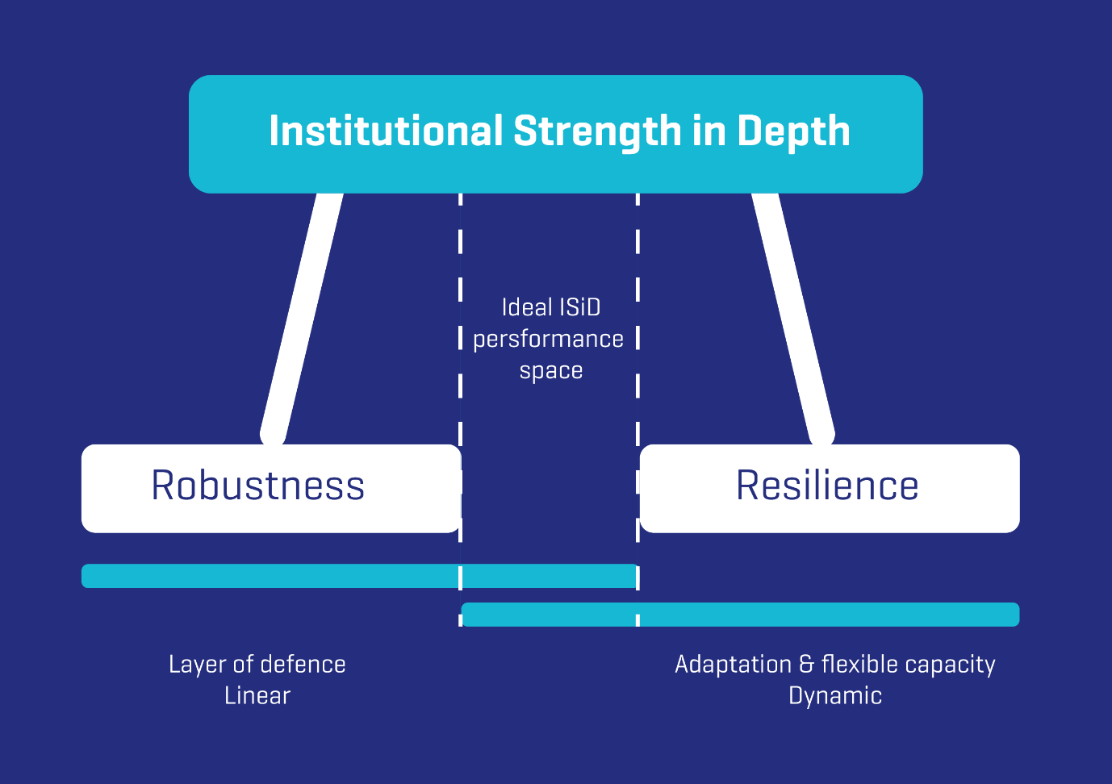
Robust and Resilient Nuclear Safety System
Layers of defence to manage safety against know risks
Embraces the complexity between human, technical and organisational factors to manage unexpected situations

Slide 4
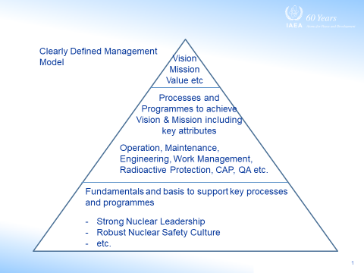
The Foundation of All High Performing Nuclear Organisations
Preserve core nuclear attributes whilst responding to external challenges
Integrated Management System
+
Healthy Nuclear Safety Culture
+
Effective Nuclear leadership
The rigorous development, clear communication and effective deployment key success factor
Preserve the core nuclear safety attributes whilst evolving a vibrant leadership and culture for safety
(Drive for results, be humble, Learn continuously, personal and collective responsibility, Open inclusive and collaborative relationships, Engaged thinking

Slide 5
Governance – Implementation of the Fundamentals
Specific focus on governance and oversight of nuclear safety
Resilient
(Adaptive and Flexible)
+
Robust
Breadth Depth
Diversity Separation Strength
Effective Integrated Management System
Strong leadership and Culture for safety
Effective governance
Robust Oversight
Technical competence
Effective Decision making
Organisational Resilience
Risk management

Slide 6
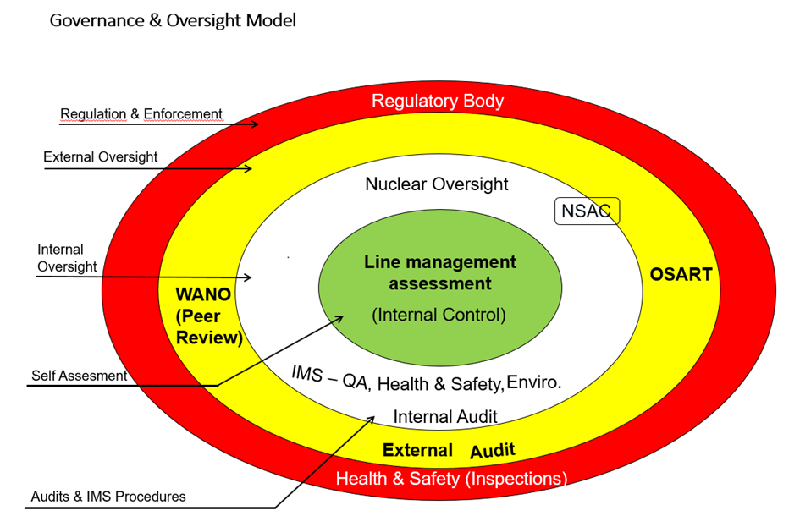
Examples
Governance and Oversight model
Operational risk management
Structural Framework
Diversity, defence in depth, clarity of purpose, clarity of roles and responsibilities, integrated, independence, visibility of performance and gaps etc

Slide 7
Thank you!
Notes:
Thank you!

