Slide 1



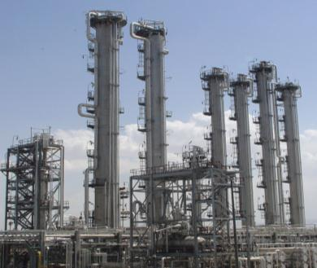
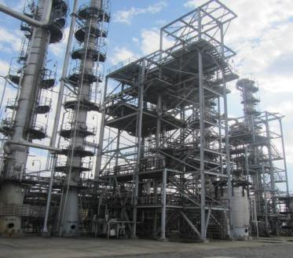
I.R.IRAN’s Heavy Water program
Heavy Water: Global Prospect, Growing Peaceful Demand (Iran Case Study)
by the Islamic Republic of Iran
Wednesday, 28 September 2016, from 4.00 p.m. to 6.00 p.m.
Conference Room M4, M building, ground floor

Slide 2

Table of Content
1
Introduction
Iran’s heavy water program
Conclusion
4
Heavy water supply and demand
3
2

Slide 3
Introduction
Iran and 5+1 nuclear deal agreement and its effect on heavy water production in Iran
All excess heavy water which is beyond Iran's needs will be made available for export to the international market.
Iran will inform the IAEA about the inventory and the production of the HWP and will allow the IAEA to monitor the quantities of the heavy water stocks and the amount of heavy water produced, including through IAEA visits, as requested, to the HWPP.

Slide 4
Iran's heavy water program

Slide 5
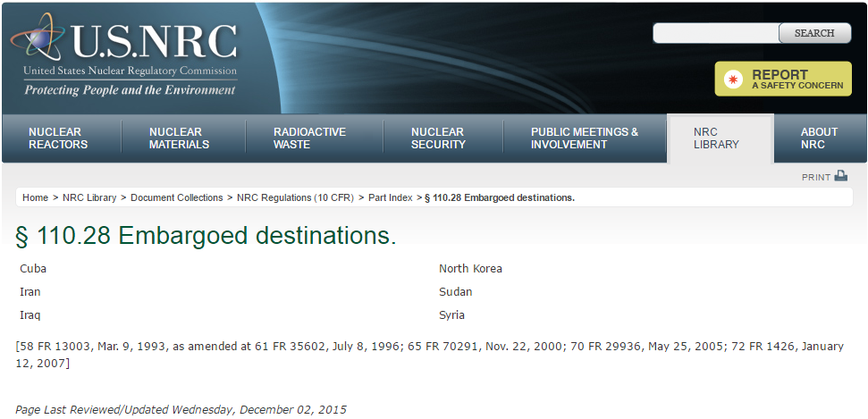
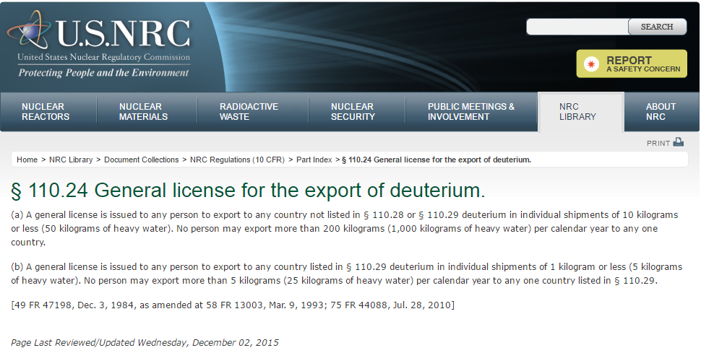
Iran's heavy water program
Iran needed heavy water for IR-40 heavy water reactor but no countries were allowed to export heavy water to Iran

Slide 6
Steps and stages of the organization development
Iran's heavy water program
1-Project executive to production oriented company
2- Technology based company
3- Market oriented company

Slide 7
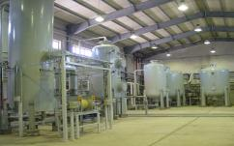

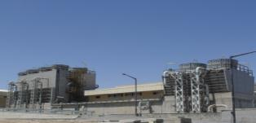
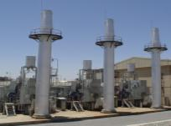
Iran's heavy water program
Heavy water production was started in 2006 with 16 tons/year nominal capacity using GS method

Slide 8
Problems and difficulties at the first stage
Iran's heavy water program
Engineering: New knowledge and technology (License / Basic design)
Procurement and construction: Time constraint
Transferring from project management to production plant ownership phase
Operation: Process problems (for instance foaming problem , corrosion problem)

Slide 9
Iran's heavy water program
The second stage: Technology oriented company
During the second stage, heavy water production plant company moved toward being technology oriented company
Principal on this stage was “ Moving based on the technology based strategies”

Slide 10
Implement the strategic planning by balanced score card method
Iran's heavy water program
Defining Core purposes , core values , mission and vision
Caring about the importance of interested parties role(Customer, Supplier , New entrance and probabilistic substituting producer)
Executing strategic planning process
Determining strategic objectives

Slide 11
The tasks that have been done in the strategic plan
Iran's heavy water program
Changing the organization chart ( complexity between vertical and horizontal foundation and the differences between their culture)
Producing and increasing the quantity of the main product
Improving the quality of the main product( beyond the nuclear grade heavy water)
New products
Meeting the standard requirements
Launching to certify the laboratory
Make the great credit for human resource management system

Slide 12
The results of the second stage
Iran's heavy water program
Cost reducing
Increasing the income
Creating the effective relation with the interested parties
Improving the internal processes in the organization
Retention of the main staff and promote their KSA ( Knowledge , Skill and Ability)
Keeping the information capital
Recognizing the opportunities in the business

Slide 13
The third stage : Market oriented structure
Iran's heavy water program
Setting sales management system
Analyzing the market ( appraising feasible demand )
towards which business ?
towards which technology ?
Using technology and innovation system
Researching about the new application of our products and encourage the internal industries to take the advantage of them
Setting the precise priority to assign the budget by using technology innovation system

Slide 14
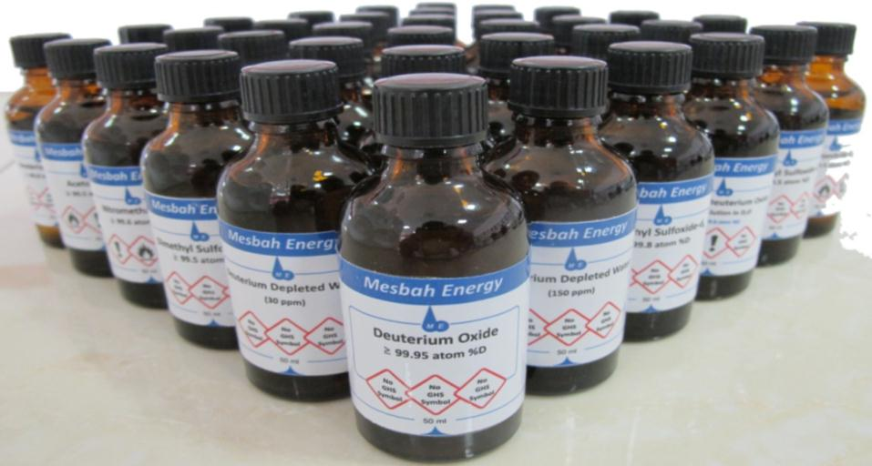
Iran's heavy water program
NMR solvent and deuterated products
Supplying more than 40 deuterated and deuterium labeled compounds
Widely used NMR solvents
Deuterated Acids and Base
Widely used NMR solvents | No.
Acetone-d₆ ≥ 99.5 atom %D | 1
Chloroform-d ≥ 99.5 atom %D _{(stabilized with Ag)} | 2
Acetonitrile-d₃ ≥ 99.5 atom %D | 3
Deuterium Oxide ≥ 99.8 atom %D | 4
Dimethylsulfoxide-d₆ ≥ 99.5 atom %D | 5
Dichloromethane-d₂ ≥ 99.5 atom %D | 6
Methanol-d₁ ≥ 99.5 atom %D | 7
1,2,4-Trichlorobenzene-d₃ ≥ 99.5 atom %D | 8
Mesitylene-d₁₂ ≥ 99 atom % D | 9
Toluene-d₈ ≥ 99 atom % D | 10
Isopropanol-d₆ ≥ 97 atom %D | 11
Dimethylsulfoxide-d₆ ≥ 99.8 atom %D | 12
Deuterium Oxide ≥ 99.95 atom %D | 13
Deuterated Organic acids
Deuterated Acids and Bases | No.
Sodium Deuterium Oxide 30% Solution in D₂O ≥ 99.8 atom %D | 14
Sodium Deuterium Oxide 1.0 M in D₂O ≥ 99.8 atom %D | 15
Sodium Deuterium Oxide 0.1 M in D₂O ≥ 99.8 atom %D | 16
Deuterium Chloride 20% Solution in D₂O ≥ 99.8 atom %D | 17
Deuterium Chloride 1M in D₂O ≥ 99.8 atom %D | 18
Deuterium Chloride 0.1M in D₂O ≥ 99.8 atom %D | 19
Potassium Deuterium Oxide 30% Solution in D₂O ≥ 99.0 atom %D | 20
Phosphoric Acid-d₃ 85% Solution in D₂O ≥ 99.0 atom % D | 21
Sulfuric Acid-d₂ 98% Solution in D₂O ≥ 98.5 atom %D | 22
Deuterated Organic acids | No.
Acetic Acid-d₄ ≥ 99.5 atom %D | 23
Trifluoroacetic Acid-d ≥ 99.5 atom % D | 24
Oxalic Acid-d₂ ≥ 99 atom %D | 25
Boric Acid-d₃ ≥ 98 atom %D | 26
Malonic Acid-d₄ ≥ 99 atom % D | 27
Deuterated organic reagents
Deuterated biologic compounds
Deuterated organic reagents | No.
Iodoform-d ≥ 99 atom %D | 28
Urea-d₄ ≥ 98 atom %D | 29
Thiourea-d₄ ≥ 98 atom %D | 30
Deuterium Peroxide 25% Solution in D₂O ≥ 99 atom % D | 31
Nitromethane-d3 ≥ 99.6 atom %D | 32
Upcoming Deuterated compounds
Deuterated biologic compounds | No.
Glycine-d₅ ≥ 98 atom %D | 33
Glycine-d₂ ≥ 98 atom %D | 34
Alanine-d₇ ≥ 97 atom %D | 35
Alanine-d₄ ≥ 97 atom %D | 36
Picolinic Acid-d1≥ 97 atom %D | 37
Water, Deuterium-depleted (30 ppm) | 38
Water, Deuterium-depleted (105 ppm) | 39
Double Labeled Water (D₂¹⁸O) 10 atom% D, ¹⁸O | 40
Upcoming Deuterated compounds
Benzene-d₆
Sodium borodeuteride
Potassium borodeuteride
Labeled methformine

Slide 15
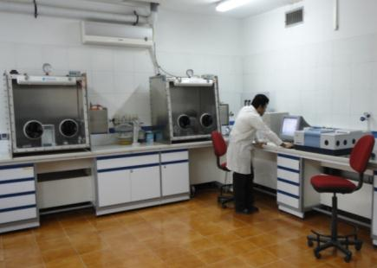
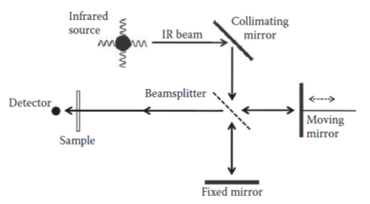
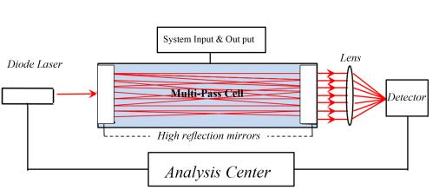
Stable isotope analysis services
Iran's heavy water program
Establishment of Stable Isotope Analysis Laboratory
Design and Development of Stable Isotope Analysis Instruments
Laser Spectroscopy Techniques
High Resolution Fourier Transform Infra Red

Slide 16
Iran's heavy water program
After Nuclear Agreement, new window was opened for sale and marketing activities.
Stablishing sales and marketing management
Selling heavy water to USA and Russia
Improving the enrichment of heavy water to 99.95%
Creating the capability to increase the capacity to 25 tons/years in near future

Slide 17
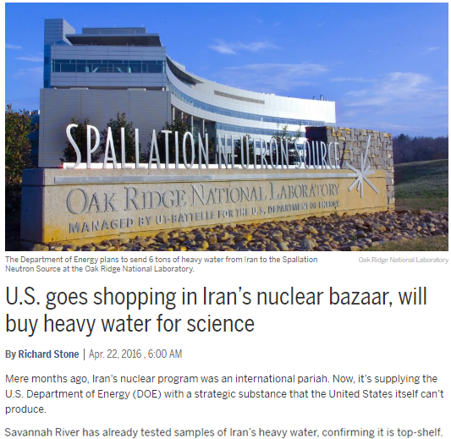
Iran's heavy water program

Slide 18
Future objectives
Iran's heavy water program
Production of H₂¹⁸O
Production of other stable isotopes
Extending stable isotope analysis infrastructures
Running common project with academic and research institute in this field
Extending our stable isotope labeled compound

Slide 19
Heavy water supply and demand

Slide 20





Heavy water supply and demand
Active Heavy Water suppliers
India
Canada
Argentina
Romania
Iran

Slide 21
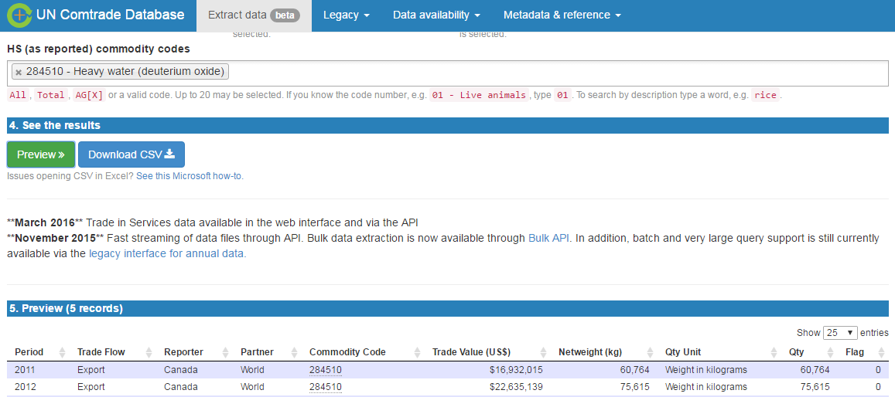
Heavy water supply and demand
UN COMTRADE: United Nations Commodity Trade Statistics Database

Slide 22
Heavy water supply and demand
Heavy water Export by Canada: Reference: http://comtrade.un.org/data
Period | Reporter | Partner | Trade Value (US$) | Netweight (kg)
2000 | Canada | World | 8,935,757 | 55,831
2001 | Canada | World | 103,289,277 | 0
2002 | Canada | World | 70,417,789 | 355,828
2003 | Canada | World | 5,418,146 | 23,134
2004 | Canada | World | 8,931,870 | 83,024
2005 | Canada | World | 8,023,694 | 32,482
2006 | Canada | World | 12,548,412 | 40,800
2007 | Canada | World | 14,542,764 | 58,106
2008 | Canada | World | 13,082,125 | 139,211
2009 | Canada | World | 9,985,228 | 35,255
2010 | Canada | World | 12,528,459 | 45,252
2011 | Canada | World | 16,932,015 | 60,764
2012 | Canada | World | 22,635,139 | 75,615
2013 | Canada | World | 18,409,139 | 46,478
2014 | Canada | World | 12,114,130 | 41,526
2015 | Canada | World | 25,419,846 | 99,679
/

Slide 23
Heavy water supply and demand
Heavy water Export by India: Reference: http://comtrade.un.org/data
Period | Reporter | Partner | Trade Value (US$) | Netweight (kg)
2000 | India | World | 3,151,702 | 16,000
2003 | India | World | 863,576 | 8,840
2004 | India | World | 2,721 | 1
2005 | India | World | 198 | 2
2007 | India | World | 6,459 | 6
2008 | India | World | 6,581,978 | 30,959
2009 | India | World | 3,834,931 | 17,017
2010 | India | World | 2,561,777 | 0
2011 | India | World | 467 | 180
2012 | India | World | 2,828,296 | 12,000
2013 | India | World | 15,962,652 | 50,404
2014 | India | World | 10,586,558 | 32,000
2015 | India | World | 1,528,382 | 4,308

Slide 24
Heavy water Export by Argentina: Reference: http://comtrade.un.org/data
Heavy water supply and demand
Period | Reporter | Partner | Trade Value (US$) | Netweight (kg)
2000 | Argentina | World | 11,996,263 | 55,315
2001 | Argentina | World | 234,716 | 1,375
2003 | Argentina | World | 113 | 1
2004 | Argentina | World | 155,777 | 901
2005 | Argentina | World | 5,349,481 | 20,150
2006 | Argentina | World | 1,584,059 | 7,601
2008 | Argentina | World | 3,618,410 | 9,802

Slide 25
Heavy water supply and demand
Heavy water Export by Argentina: Reference: http://comtrade.un.org/data
Period | Reporter | Partner | Trade Value (US$) | Netweight (kg)
2008 | Romania | World | 201 | 1
2012 | Romania | World | 126,723 | 200

Slide 26
Heavy supplier (low scale)
Heavy water supply and demand
Country | Brand | No.
USA | Sigma Aldrich | 1
USA | Cambridge isotope laboratories (CIL) | 2
Canada | Isowater | 3
Germany | Deutero | 4
Switzerland | Armar | 5
The price for heavy water based on its isotopic enrichment, chemical purity, quantity and brand, ranged from 600 to 2000 US$/ kg.

Slide 27
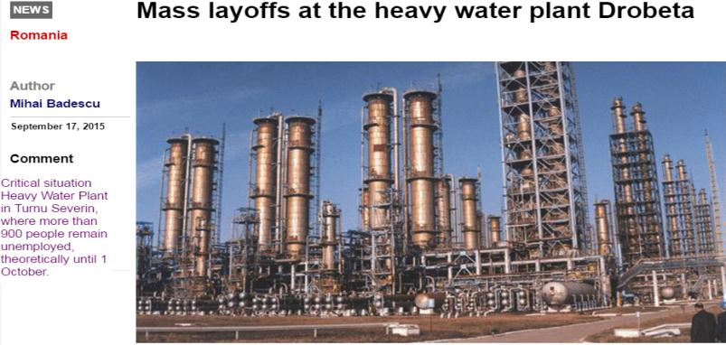
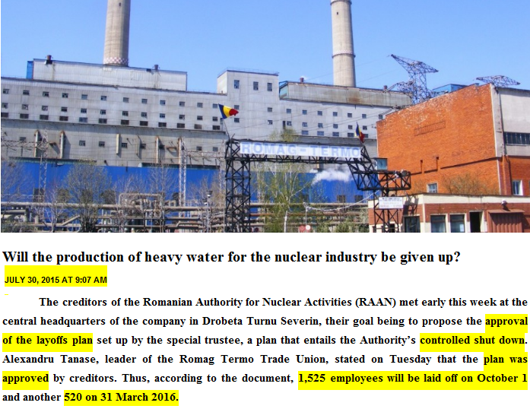
Heavy water supply and demand
Heavy water industry news
Romania heavy water layoffs most of its employees and in near future may be shut down completely.
http://www.nineoclock.ro/will-the-production-of-heavy-water-for-the-nuclear-industry-be-given-up/
http://www.romania-actualitati.ro/disponibilizari_in_masa_la_uzina_de_apa_grea_din_drobeta_turnu_severin-80726

Slide 28
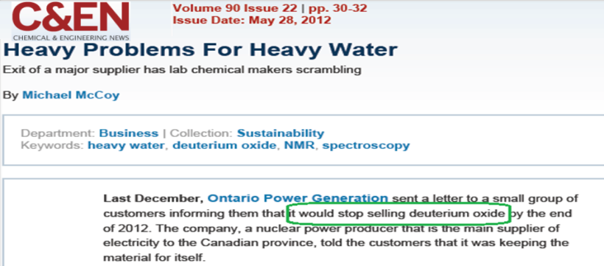
Heavy water industry news
Heavy water supply and demand

Slide 29
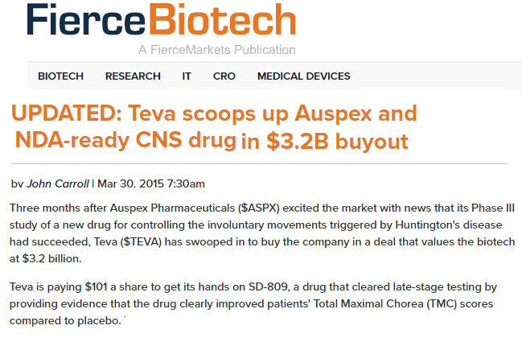


Heavy water supply and demand
Future Demand forecasting
Economist magazine paper related to deuterated drugs
29
http://www.fiercebiotech.com/biotech/updated-teva-scoops-up-auspex-and-nda-ready-cns-drug-3-2b-buyout

Slide 30
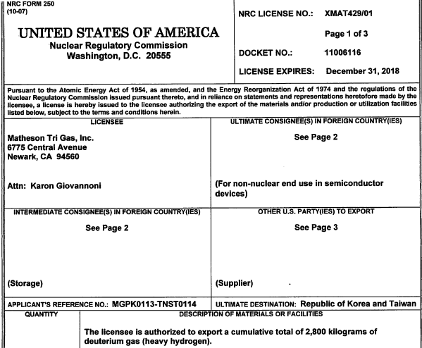
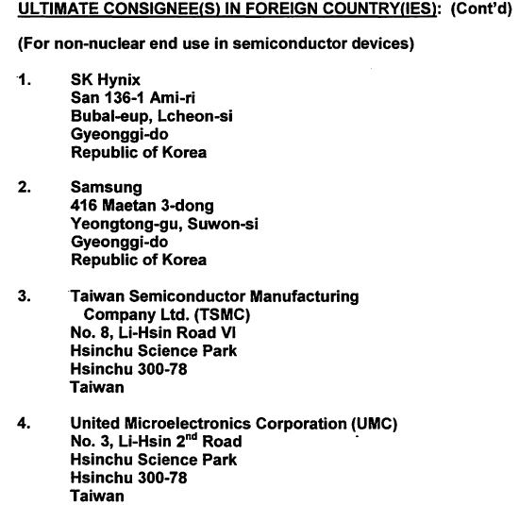
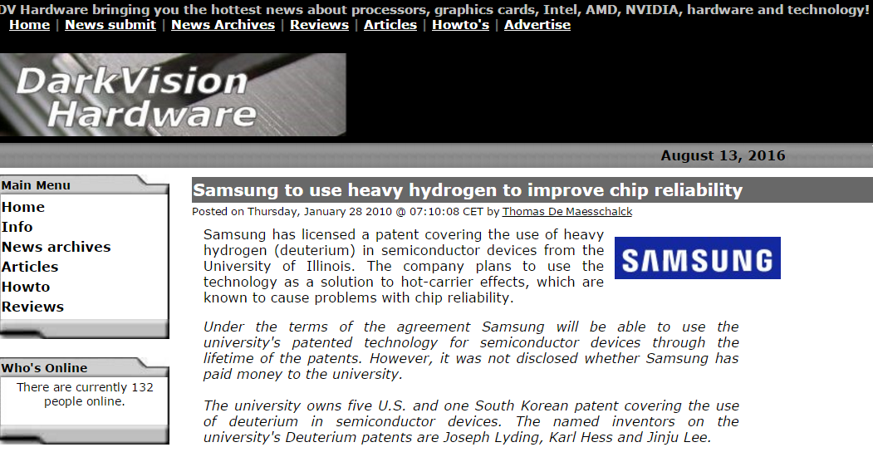
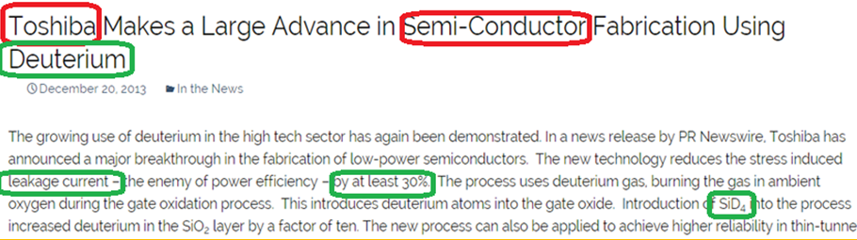
Heavy water supply and demand
Future Demand forecasting
Toshiba work on deuterated semi-conductor

Slide 31
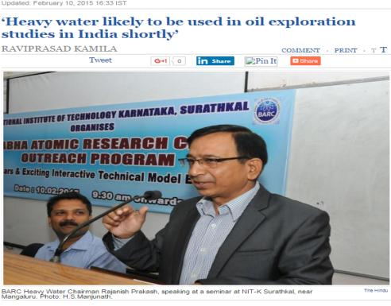
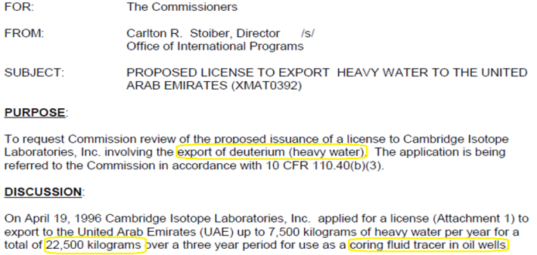
License for exporting heavy water for oil exploration
Heavy water supply and demand
Future Demand forecasting

Slide 32
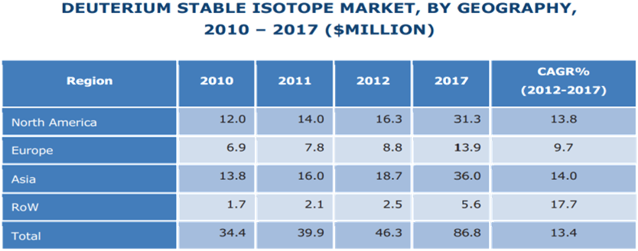
Heavy water supply and demand
Average growth rate demand for deuterium
http://www.marketsandmarkets.com/Market-Reports/asia-pacific-nuclear-medicine-radiopharmaceuticals-market-1140.html

Slide 33
Conclusion
Heavy water is an important and strategic product.
Romanian heavy water plant will be shut down in near future and Canada may no longer supply heavy water.
The application of deuterated drugs, fiber optics and semi-conductors would be increased greatly
It is estimated that demand for heavy water and deuterium would be increased;
just considering the quantity of deuterated drugs that will be produce in future.
Its consuming will surpassed its production.

Slide 34

Thank you for your attention

Slide 35
Changing the organizational chart
Forming the technical and research department
Forming the HSE department
PMO
Technology Innovation Management
R&D committee

Slide 36
Forming the HSE department
- Focusing on Sustainable development and asset integrity
People
Environment
Properties
Reduce significantly the rate of incidents and events
Involving the department responsible directly in safety issues
Green Industry (H₂S Removing , water treatment and etc.)
Risk Based Inspection
Taking advantage of the maintenance standard like ISO 14224
Determine the appropriate time for overhaul period by using technical method
Manufacturing spare parts and equipment
Entrepreneurship - accepting the risk of failure in manufacturing

Slide 37
Make the great credit for human resource management system
Establishing Suggestion system and it`s committee
Evaluating and measuring performance systematically by indicators and criterions ( employee performance , group performance and organizational objectives ) and compensating it
Determining the correlation between performance versus training and suggestion by regression method
Utilization of training management system

Slide 38
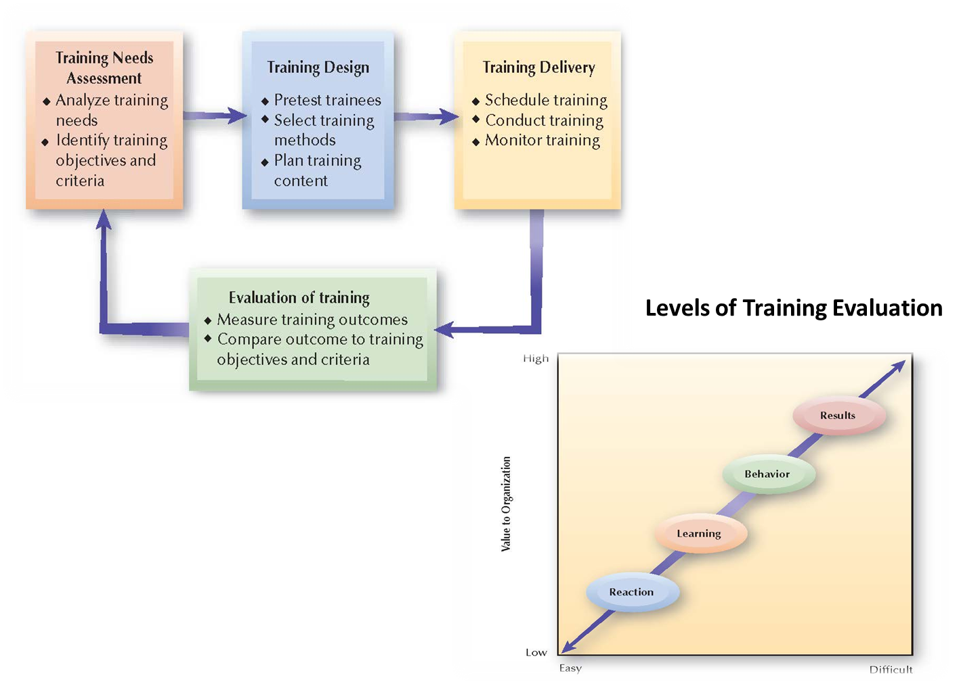
Systematic Training Process

Slide 39
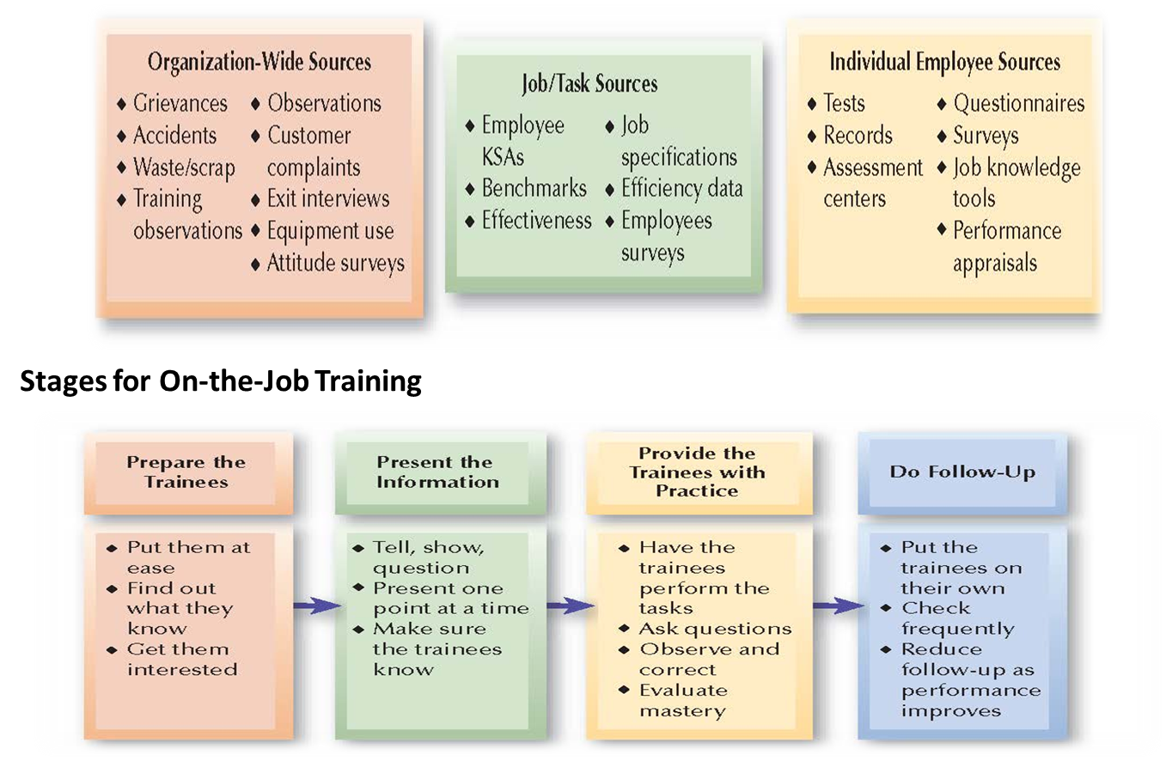
Sources of Information for Training Needs Assessment

Slide 40
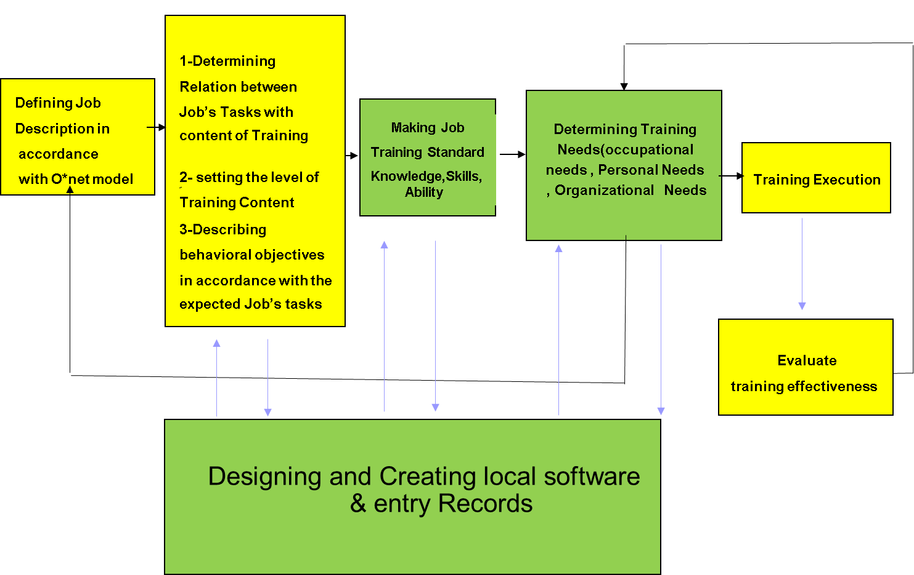
Developing training management system

