Slide 1



Reliability In Bushehr NPP
WANO Moscow Centre workshop
Nuclear Power Plant Equipment Reliability Management
23-26 November 2021

Slide 2

Contents
Plant Location
A Brief History of the Plant
Organizational Chart
BNPP Data Bank Software
Equipment Repairs Data Bank
Form for Collecting Information needed for Reliability Calculation
How to Collect Information and Calculate the Reliability Indicators
Output/Results of Equipment Operation Reliability Analysis
Required Actions in case of Decrease of Reliability
Document Developed by the Operating Company
Documents Used in Developing Reliability Related Documents of the BNPP

Slide 3
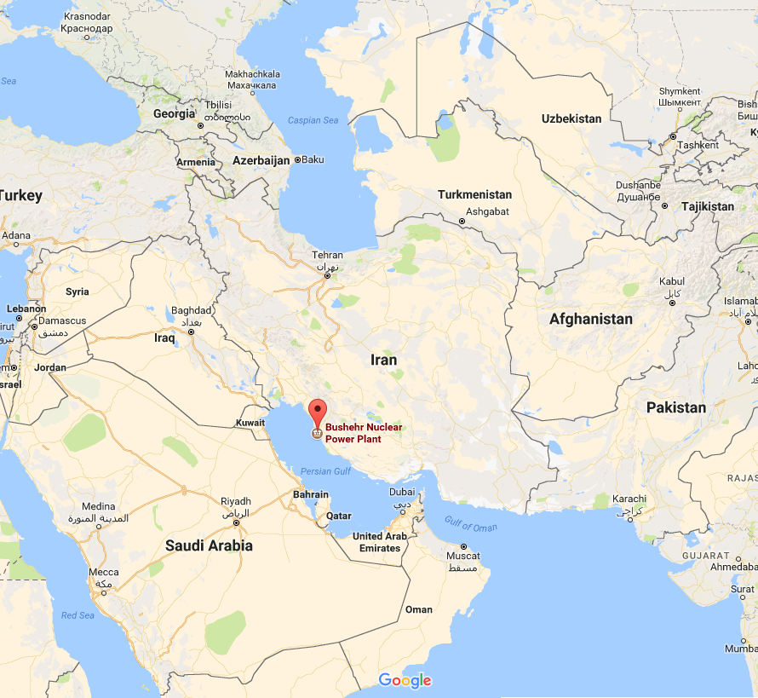
BNPP Location
The BNPP is located in the southwest of the Iran, on the coast of the Persian Gulf and southeast of the Bushehr city.

Slide 4
Plant History
Subject | Date
Synchronization with the National Power Grid | 02.09.2011
Commercial Operation | 24-09-2013
First Refueling | 07-04-2014→13-05-2014
Sixth Refueling | 29-04-2020 →31-05-2020
Delivering 50437486 MW/h nuclear power to the national power grid | 02-10-2021

Slide 5
Organizational Chart
Managing Director (Plant Manager)
Systems and Equipment Performance Analysis Management
Vibrations Analysis and Diagnosis Group
Equipment Modification
Ageing Management and Reliability Group
Group Head
Technical Indicators
Ageing Management Expert
Reliability Expert
Ageing Management Expert
Deputy for Technical and Engineering
Chief Engineer

Slide 6
72 Equipment Selected for Reliability Monitoring
YD10D001 | TH10D001 | VJ11D001
YD20D001 | TH20D001 | VJ21D001
YD30D001 | TH30D001 | VJ31D001
YD40D001 | TH40D001 | VJ41D001
VC10D001 | TH15D001 | TA31D001
VC20D001 | TH25D001 | TA32D001
VC30D001 | TH35D001 | TA33D001
VC40D001 | TH45D001 | RL12D001
VE11D001 | TH18D001 | RL22D001
VE21D001 | TH28D001 | RL32D001
VE22D001 | TH38D001 | RM11D001
VE23D001 | TH48D001 | RM12D001
VE31D001 | TW10D001 | RM13D001
VE41D001 | TW20D001 | RG12D001
VE42D001 | TW30D001 | RG22D001
VE43D001 | TW40D001 | RG32D001
TF10D001 | RS17D001 | GY10D001
TF11D001 | RS27D001 | GY11D001
TF20D001 | RS37D001 | GY20D001
TF21D001 | RS47D001 | GY21D001
TF30D001 | RS12D001 | GY30D001
TF31D001 | RS22D001 | GY31D001
TF40D001 | RS32D001 | GY40D001
TF41D001 | RS42D001 | GY41D001

Slide 7
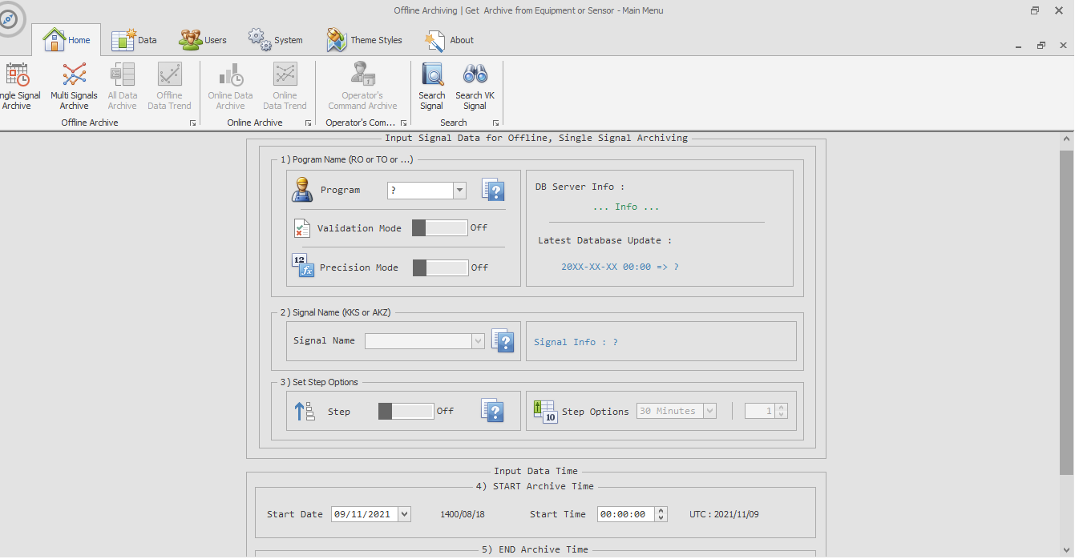
BNPP Data Bank Software

Slide 8
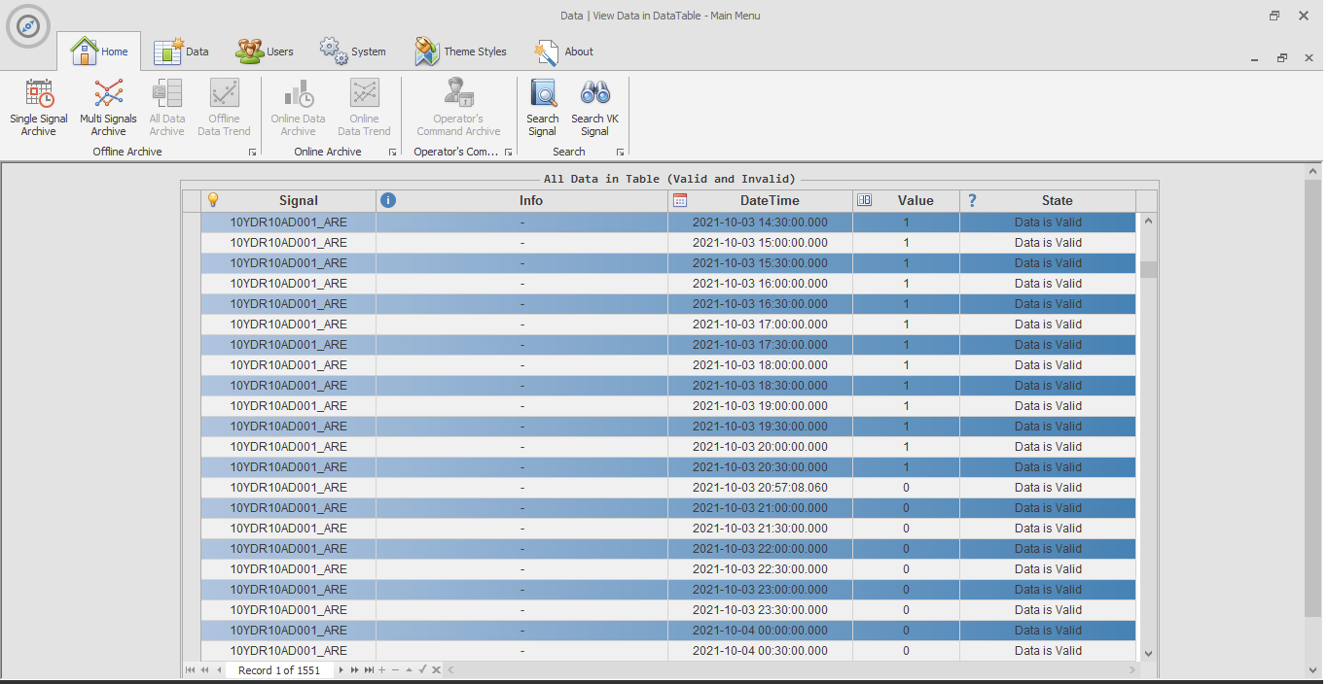
BNPP Data Bank Software

Slide 9
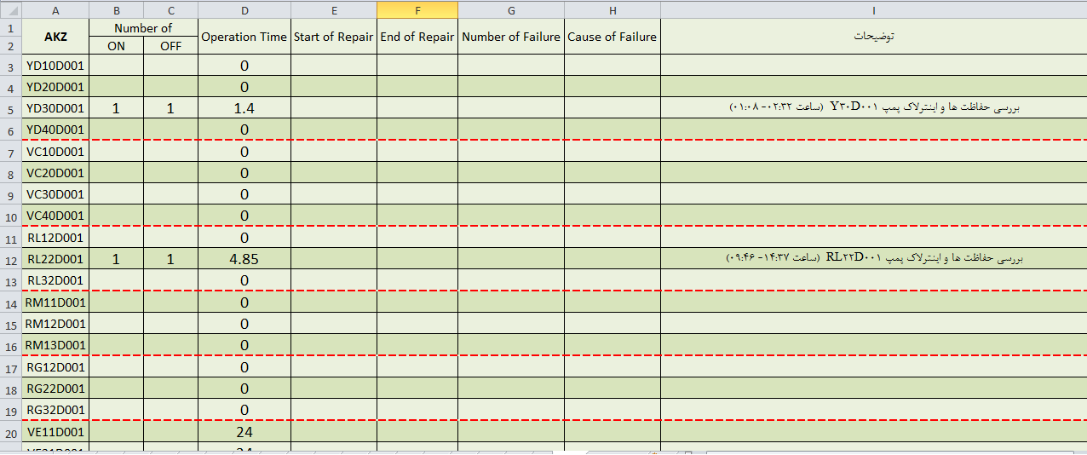
Equipment Run Time Data Bank

Slide 10
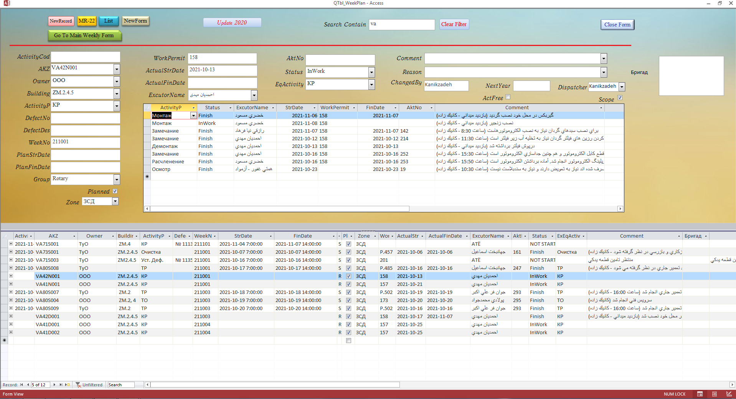
Equipment Repairs Data Bank

Slide 11
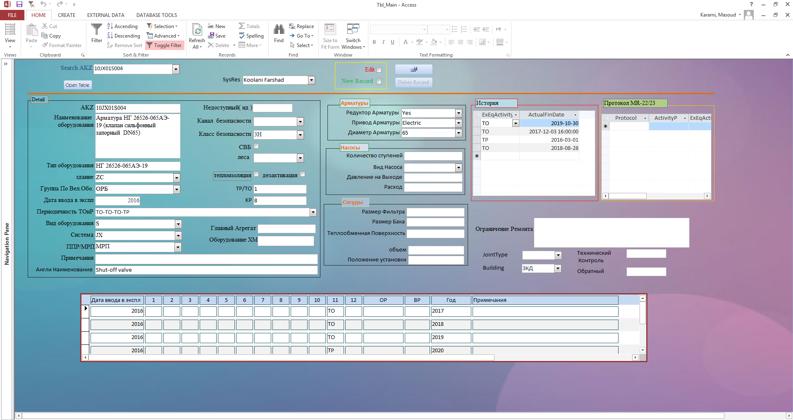
Equipment Repairs Data Bank

Slide 12
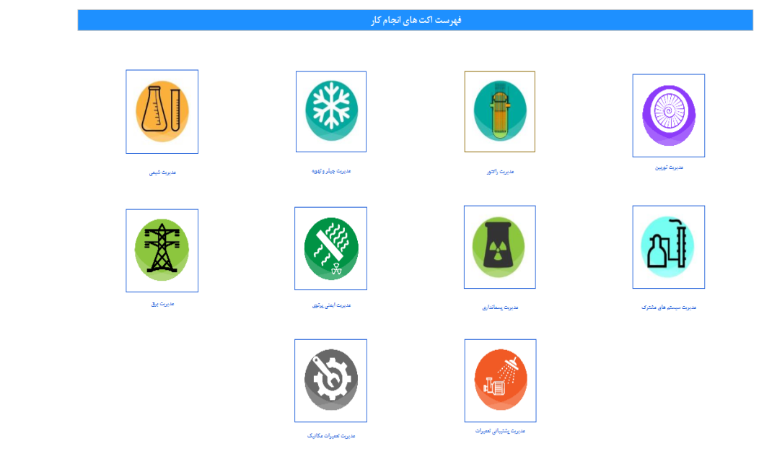
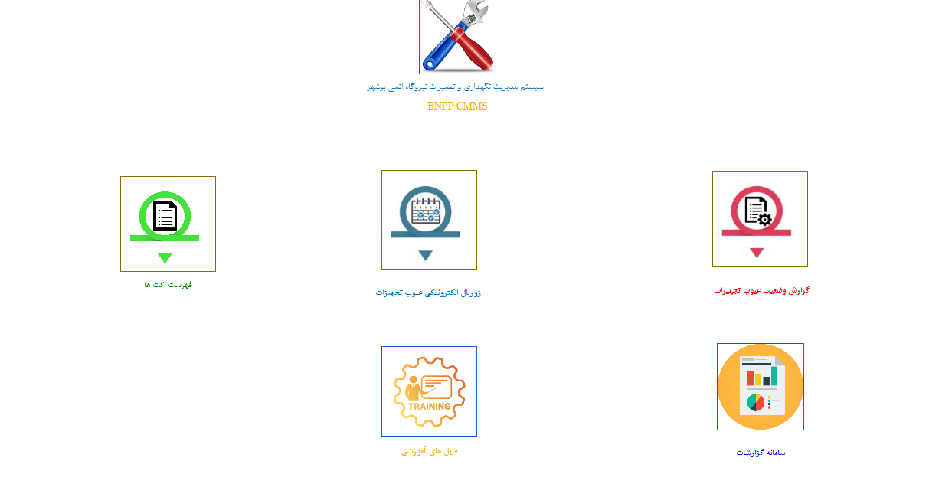
List of Acts of Repair Activities

Slide 13
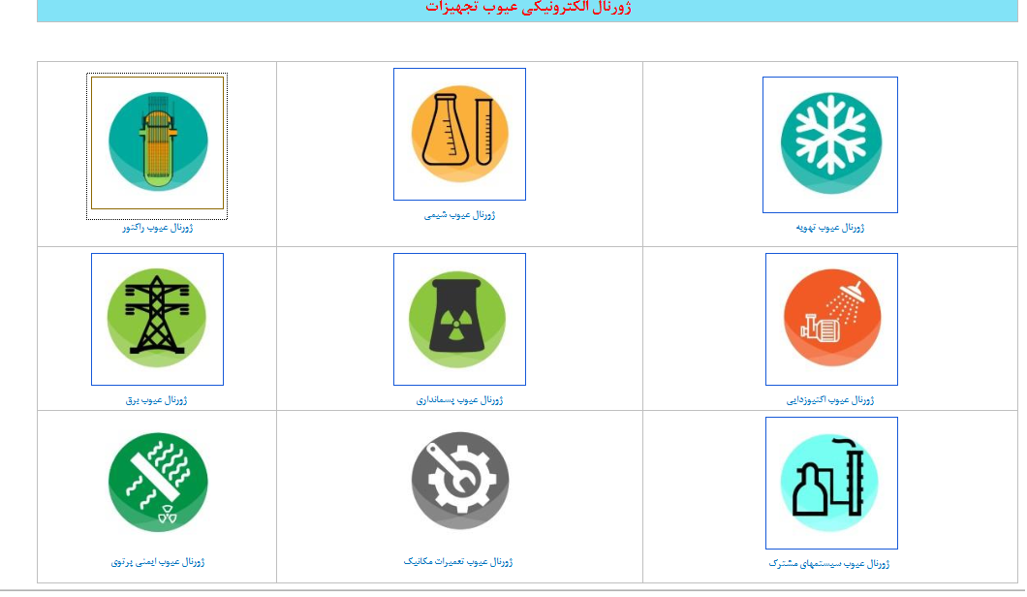
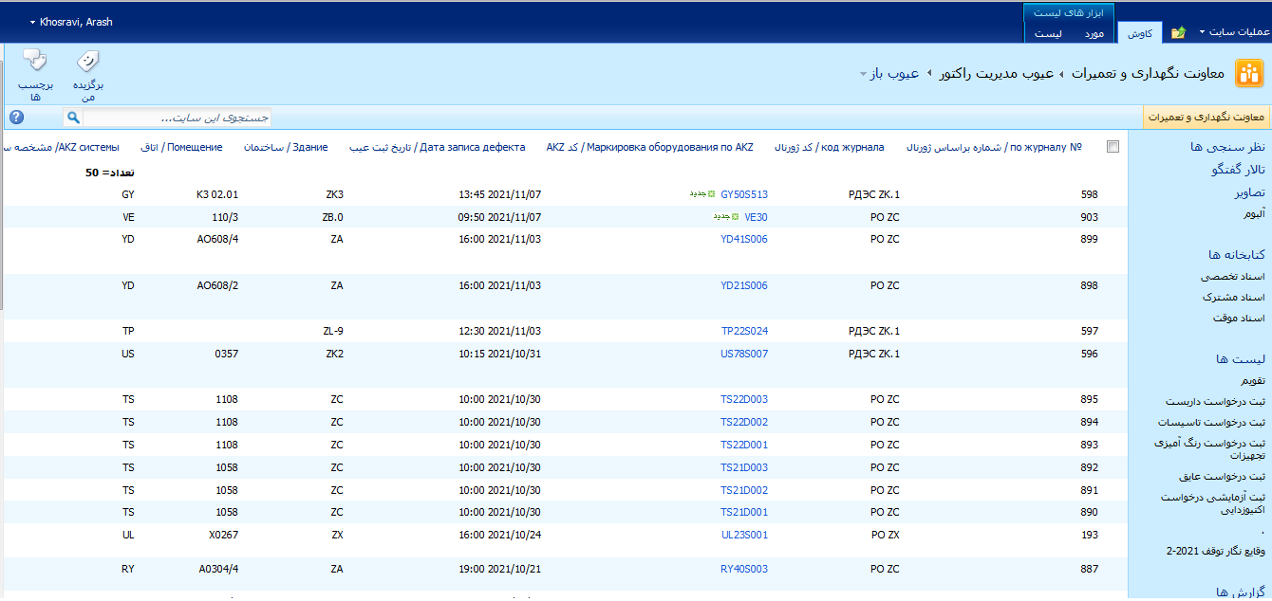
Equipment Defects Electronic Logbook

Slide 14
Form for Collecting Information needed for Reliability Calculation
Row | Equipment Code | MTBF) (MTTF Mean Time Between Failures, Mean Time To Failure (hour) | Time Period | Total Run Time | آمار خرابي Failure Statistics | Time of Fixing the Failure | Planned/Unplanned Repairs | Defect Type/Method of Defect Removal

Slide 15
How to Collect Information and Calculate the Reliability Indicators
Reviewing the previous failures of equipment
Reviewing the equipment defects
Calculating the equipment down time for repair
Investigating the failures of this type in other plants
Implemented corrective actions (Repair, Replacement)
Reviewing the reports on deviations and perturbations, equipment failure mechanisms, analysis of failures
failure mechanisms, analysis of failures
Calculating the run time of equipment
Reviewing the operating documents and equipment passport
Reviewing the equipment failure
Calculating the equipment reliability indicators
Calculating and controlling the Mean Time Between Failures
Calculating and controlling the indicators of Mean Time To Failure
Controlling the equipment service life
Controlling the predetermined run time of different parts of equipment such as radial-axial bearing and radial bearing and gaskets
Providing report on a quarterly basis

Slide 16
Output/Results of Equipment Operation Reliability Analysis
If the value of the obtained MTBF is bigger than the MTBF in accordance with the equipment design basis document, the equipment has sufficient reliability.
If the calculated value of the MTBF of the equipment is smaller than the Mean Time To Failure (in accordance with the regulations), the equipment does not have sufficient reliability.

Slide 17
Required Actions in case of Decrease of Reliability
If the reliability of equipment decreases, to compensate, the following actions should be taken:
Changing the maintenance program
Changing the components and assemblies with decreased reliability
Changing the operating conditions
Filling up on spare parts in the warehouse
Improving the incoming control of spare parts
Improving the technology of repairing and replacing

Slide 18
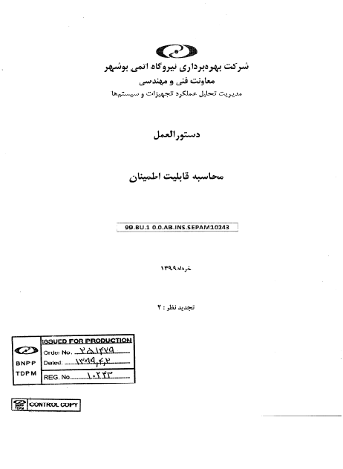
The Documents Developed by the Operating Company

Slide 19
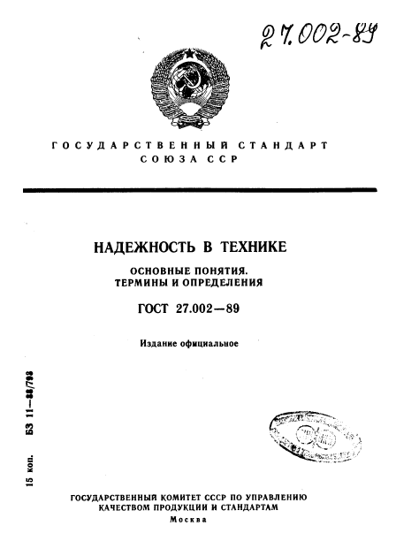
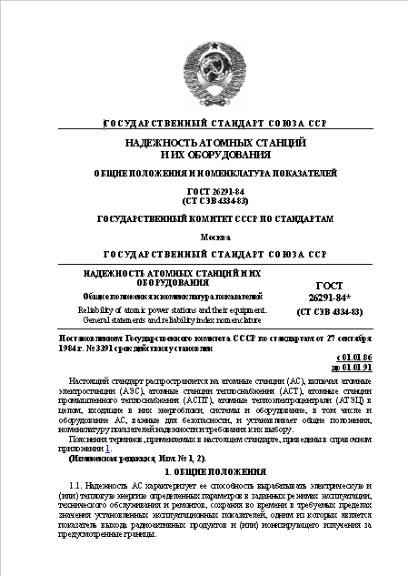
Documents used in Developing the Ageing related documents of the BNPP
RELIABILITY OF ATOMIC POWER STATIONS AND THEIR EQUIPMENT.GENERAL STATEMENTS AND RELIABILITY INDEX NOMENCLATURE (GOST 26291-84).
RELIABILITY IN TECHNICS.GENERAL PRINCIPALS.TERMS AND DEFINITIONS (GOST 27.002-89).

Slide 20
Thank You for Your Attention

