Slide 1




BNPP Technical Support

Slide 2
BNPP Technical Support
Technical Support of BNPP separated in 2 areas:
Internal Technical Support
External Technical Support
The highly trained and qualified experts of BNPP have the responsibility of Internal Technical support services at Bushehr NPP.
In this presentation, External Technical Support would be submitted.

Slide 3
Strategic Plan
Due to the unique design of BNPP and the first experience of NPPD in the field of Nuclear Power Plants (NPPs) Operation, and also lack of competent and qualified engineering companies in this regard; it is important to create an Organization to manage and supply External Scientific and Technical Support Services of BNPP.
In this regard, by codifying policies and requirements for organizing Technical Support and considering the experiences of BNPP-1 construction phases, NPPD has established TAVANA Company as a trustee of Technical Support services.
In addition, NPPD has concluded a Contract with RosenErgoAtom Consortium in order to utilize the capabilities of the qualified companies and transfer and institutionalize knowledge and experience.

Slide 4
External Technical Support
External Technical Support is based on Contract No. CNT-ETS/4100-1 dd. 25.02.2015 between Nuclear Power Production and Development Company (NPPD) as Principal and Consortium comprising:
Joint Stock Company ROSENERGOATOM Co. (REA)
Joint Stock Company ATOMTECHEXPORT
Joint Stock Company RUSATOMSERVICE
As the Contractor
Contract duration : 2015-2019;
Contract start date: February, 2016

Slide 5
Subject of the Contract
The Contractor undertakes to render the following Technical and Engineering Support under this Contract and as per the Principals request for the areas of:
Operation of BNPP Power Unit No .1;
Maintenance and repair of BNPP-1;
Modernization of BNPP-1;
Organizational Support to TAVANA company;
Supply of Computers Codes and related training;
Required Training of the Principal’s/TAVANA personnel;
Verifying completed activities done by Principal’s/TAVANA Company;
Technical Support and Consultancy services for new NPP Units.

Slide 6
Some projects within the framework of TSC
SBEOI elaboration
Connection of mobile equipment to the primary and secondary system (Stress Test Subject)
Modernization of I&C systems:
Methods for investigation of disturbances in NPP operation
Preparation for OSART mission

Slide 7

Technical Support Organization
NPPs Safety Development
& Improvement Company(TAVANA)
NPP’s Safety Development & Improvement Company (TAVANA) is responsible for the Technical Support of the BNPP-1.
The company was established in 2013.

Slide 8
Establishment of Group of Participants (GOP)
Due to the scope of activities in technical support field and the necessity of using maximum power of internal companies, it was decided to create a partnership group consists of 6 subsidiary companies of AEOI.
Therefore, on November 2016, the partnership group was created under TAVANA Company’s leadership. In addition, main tasks and responsibilities of each company were defined separately.

Slide 9
External Organizational Interfaces (GOP)

Slide 10
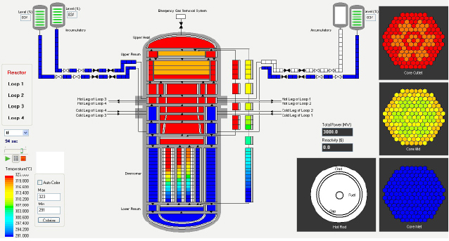
Area of Nuclear Engineering
  Radiation Protection and Emergency Planning
  Thermal Hydraulic and Accident Analysis
  In-Core Fuel Management and Reactor Physics
  Probabilistic Safety Analysis (PSA)
  Radioactive Waste Management
  Accident Analysis
  OPEX

Slide 11
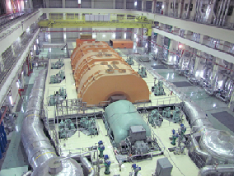
Area of Engineering and Technical
  Optimization of plant performance & Long term activities:
Optimization of plant operation/maintenance instructions procedures/programs
Control and assessment of design changes and modifications
Control/management of Corrosion/Erosion
Modernization of systems and equipment
Chemical & Process Management
Ageing & Plant life management
Configuration Management(CM)
Root Cause Analysis (RCA)
Equipment Qualification

Slide 12
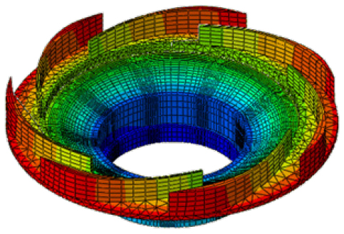
Current Main Activities of TAVANA Co.
Preparatory work for Development of the Comprehensive TH model for DSA.
Calculation of Residual Heat Released from the Spent Fuel Assemblies;
Consultancy Services for Handling and Midlife Storage of Spent Fuel;
Calculation of Neutron Physics Parameters for the Fifth Fuel Cycle;
Development of integral corrosion/erosion management program.
Analysis of Fuel Operation during the Current (fourth) Fuel Cycle
Design of the reactor surveillance specimens tests laboratory.
Development of Ageing and Lifetime Management program
Development of root cause analysis (RCA) methods.
Modernization of Radiation Monitoring System.
Software Design for Annual Refueling Process
Vibration fatigue life analysis of TG.
Radioactive Waste Management.
Establishment of LPSA.
Stress Test Programme.

Slide 13
Perspective of TS
Considering the contract with REA Consortium and the potential capabilities of Iranian Companies (Group of Participants) in Technical Support fields, it is expected that Iranian Companies could acquire the required qualifications, competencies and technical and scientific abilities -during the contract execution in order to carry out some of the activities independently. This would come into practice just by the effective and continuous cooperation and planning of the Russian Companies.

Slide 14
Thank You

