Slide 1

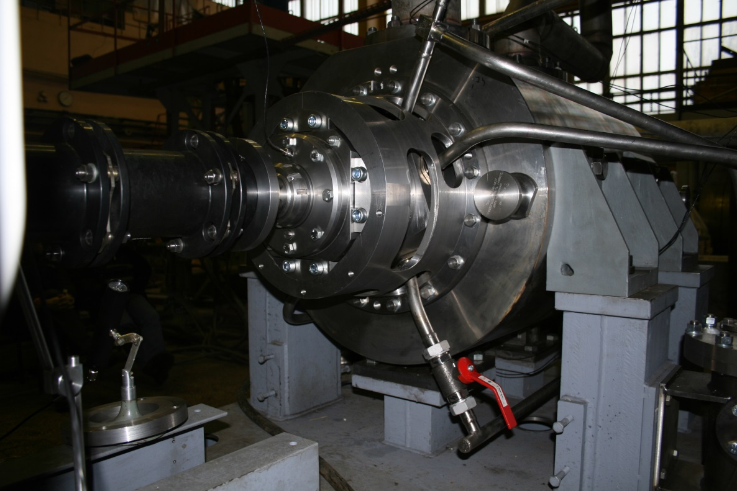
Joint Stock Company
“Central Design Bureau of Machine Building”
Basic design of auxiliary feed water pump
© 2017 • JSC «CKBM»

Slide 2


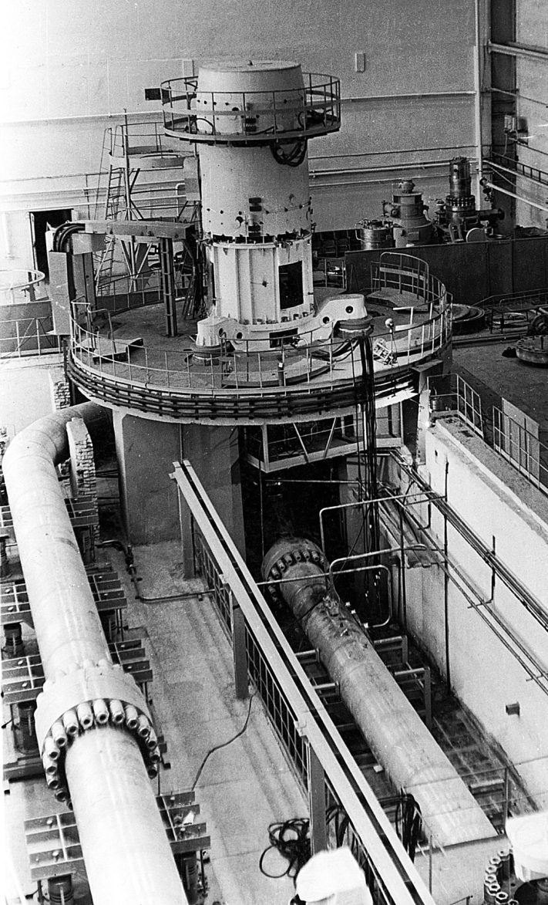
About
● "Central Design Bureau of Machine Building" ("CDBMB“ or “CKBM” in russian) was established in 1945. Our company has over 70 years experience in the development of pump equipment and automated and/or remotely-operated load-lifting, reloading, transport and technological protection complexes.
● JSC "CDBMB" is the only designer and manufacturer of Reactor Coolant Pump Sets for VVER reactors.
● JSC "CDBMB" is an integrated provider of equipment design, manufacture, supply, installation supervision, start-up and commissioning, warranty and post-warranty maintenance.
● JSC "CDBMB" has unique equipment for full-scale testing. JSC "CDBMB" performs full-scale testing of pumps of various types and intended use at a temperature of coolant up to 300°С and pressure up to 25MPa.
© 2017 • JSC «CKBM»
Notes:
17.09.13
2
2

Slide 3
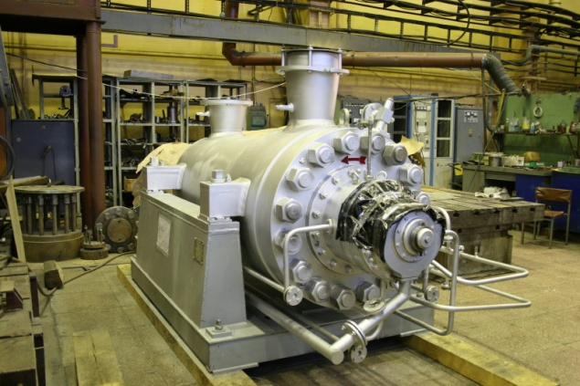
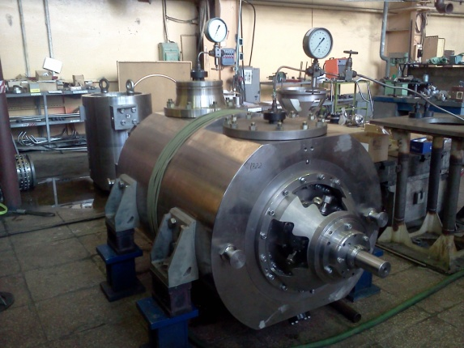
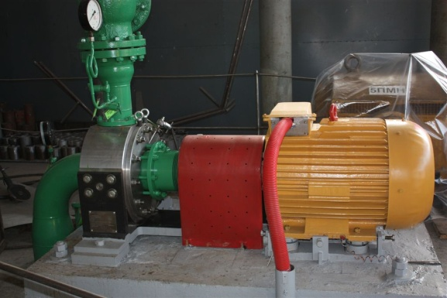
Product line
Main feed water pump
PE 380-185 А
Beloyarsk NPP
Emergency and scheduled cooling pump
АCN 800-15А
Novovoronezh NPP
Pump for industrial water
ACN 160-120А
Beloyarsk NPP
The product range includes:
Feed pumping units rated capacity up to 3000m3/h, rated head up to 2500m.
Multi-stage pumps for chemical liquid and for borated water, rated capacity up to 1000m3/h, rated head is up to 800m.
Different consol pumps (industrial water, repair, fire, booster, etc.) rated capacity up to 1500m3/h, rated head up to 250m.
© 2017 • JSC «CKBM»

Slide 4
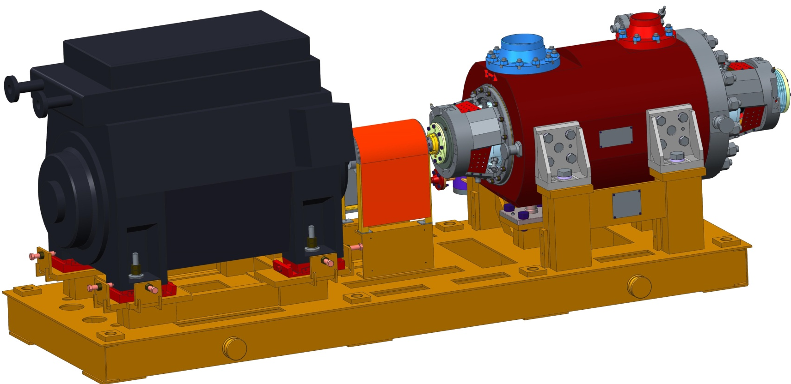
Main view
Pump АPE 150-90А
Electric motor
Flexible plate coupling
Pump
● Rated capacity, m3/h - 150
● Rated head, m – 850
● Speed of rotation, rpm – 3000
● Allowable cavitational stock, m – 6
● Engine power, kW - 630
● Voltage, V – 6000
Base plate

Slide 5
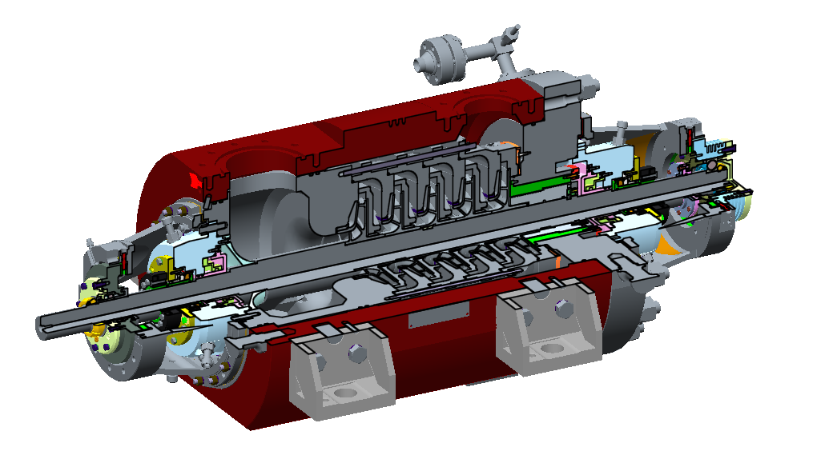
Features
Advantages of multistage
pump design
● Pump cartridge design provides for easy demounting of internals without disassembly of external casing and pipelines
● The manufacturing of body parts from forgings without using welded joints provides for improving design reliability due to decrease of internal stresses in body parts
● The unique technology of manufacture of impellers combines CNC machining and welding of two discs. It improves accuracy of manufacture, hydraulic performance of impeller and vibration performance of pump
© 2017 • JSC «CKBM»

Slide 6
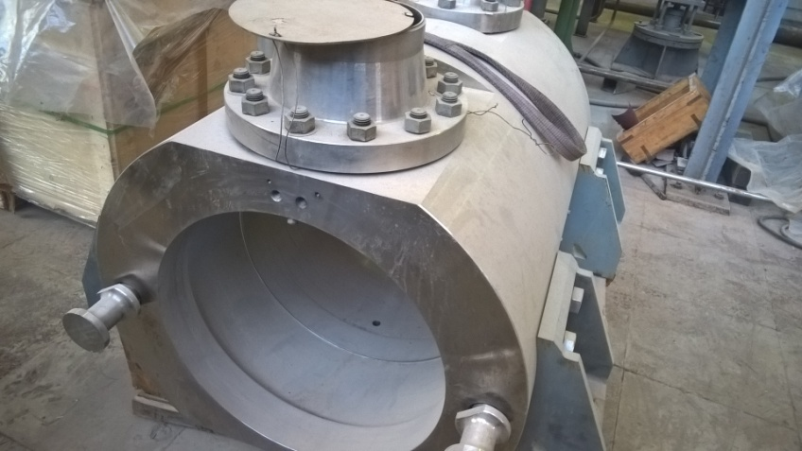
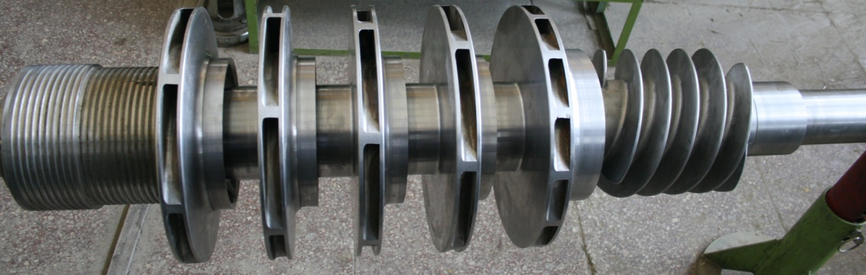
Features
Pump case manufactured using cylindrical forgings.
Inlet branch pipe and outlet branch pipe connects to body by bolt joint.
Sealing by thermally expanded graphite, lifetime as long as case itself.
Impellers manufactured from forgings on CNC machines by JSC "CDBMB“ reserved technology using welding of main and covering disks.

Slide 7
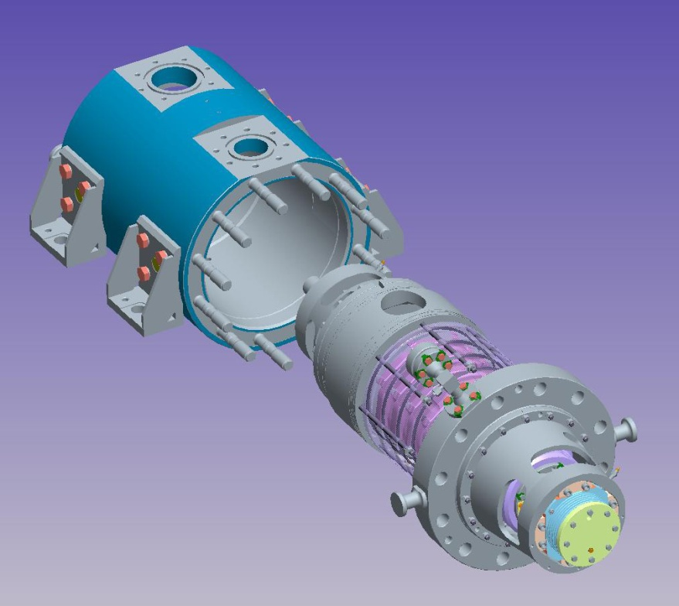
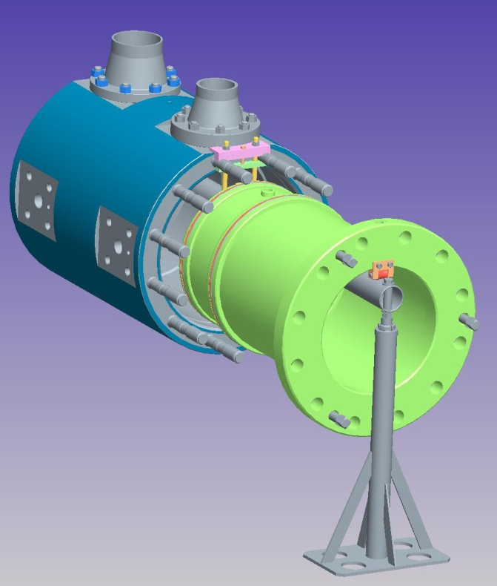
Hydraulic test on NPP
Dismantling of pump cartridge
Special device for hydraulic body testing

Slide 8
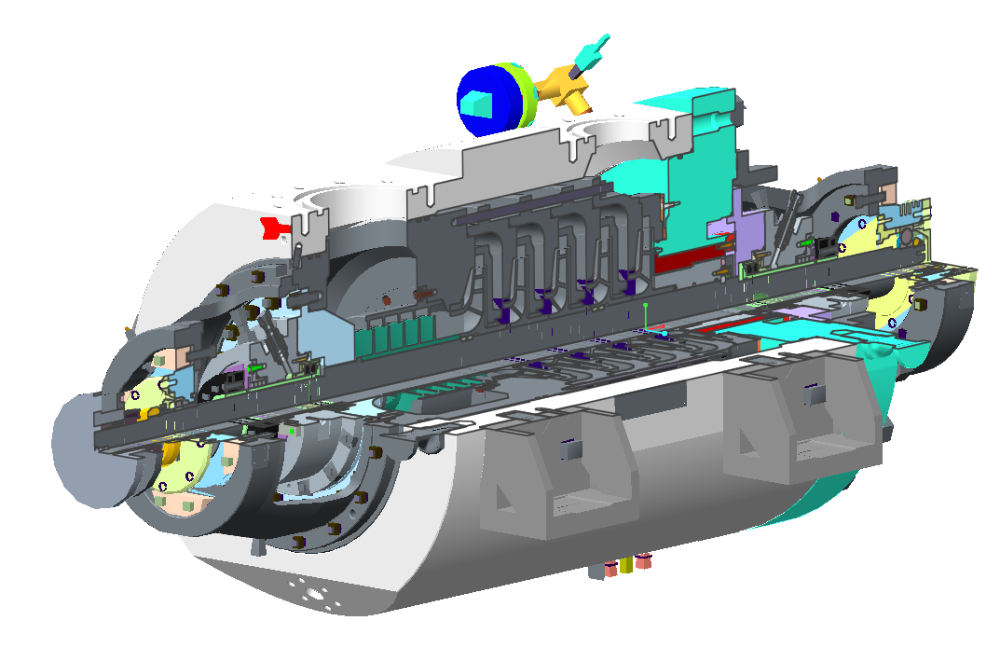
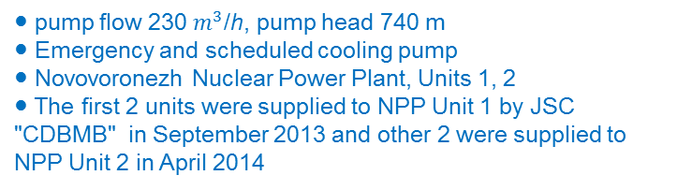
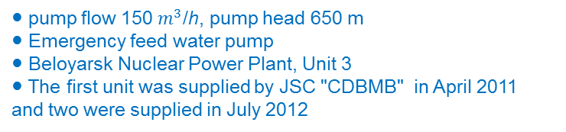
References
Pump АPE 150-56А – 3 Unit
In service from 2011
● pump flow 150 $m^{3}$/h, pump head 650 m
● Emergency feed water pump
● Beloyarsk Nuclear Power Plant, Unit 3
● The first unit was supplied by JSC "CDBMB" in April 2011 and two were supplied in July 2012
Pump АCN 230-65А – 4 Unit
In service from 2015
● pump flow 230 $m^{3}$/h, pump head 740 m
● Emergency and scheduled cooling pump
● Novovoronezh Nuclear Power Plant, Units 1, 2
● The first 2 units were supplied to NPP Unit 1 by JSC "CDBMB" in September 2013 and other 2 were supplied to NPP Unit 2 in April 2014

Slide 9
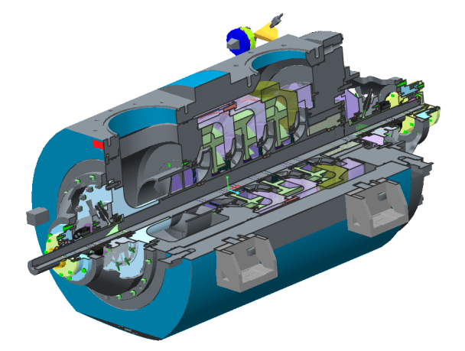
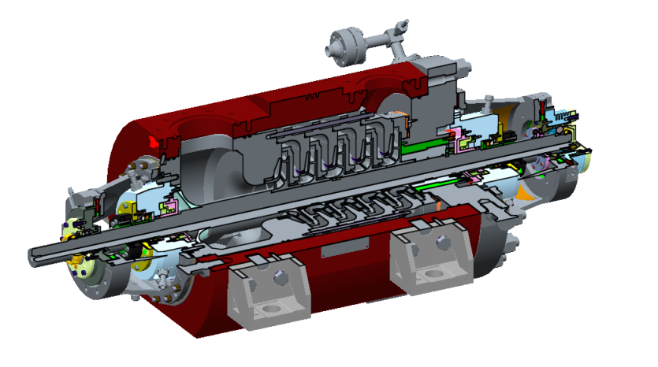
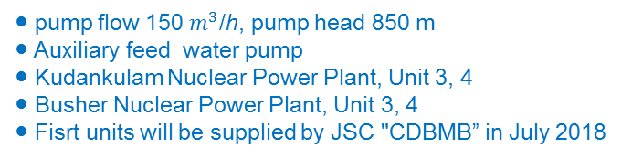
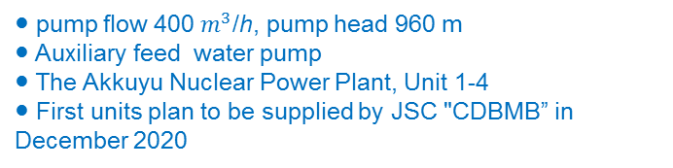
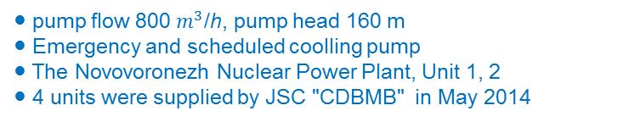
References
Pump АCN 800-15А – 4 Unit
In service from 2015
● pump flow 800 $m^{3}$/h, pump head 160 m
● Emergency and scheduled coolling pump
● The Novovoronezh Nuclear Power Plant, Unit 1, 2
● 4 units were supplied by JSC "CDBMB" in May 2014
Pump АPE 150-90А – Kudankulam NPP - 2 Unit
Busher NPP – 4 Unit
● pump flow 150 $m^{3}$/h, pump head 850 m
● Auxiliary feed water pump
● Kudankulam Nuclear Power Plant, Unit 3, 4
● Busher Nuclear Power Plant, Unit 3, 4
● Fisrt units will be supplied by JSC "CDBMB” in July 2018
Pump АPE 400-90А (Project) – Akkuyu NPP - 4 Unit
● pump flow 400 $m^{3}$/h, pump head 960 m
● Auxiliary feed water pump
● The Akkuyu Nuclear Power Plant, Unit 1-4
● First units plan to be supplied by JSC "CDBMB” in December 2020

Slide 10
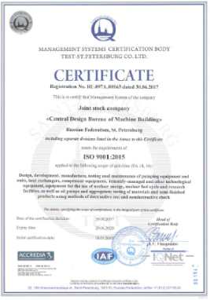
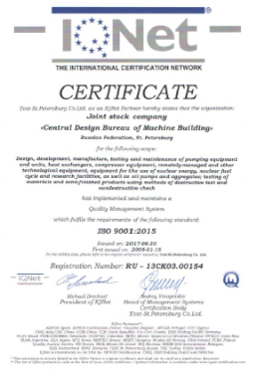
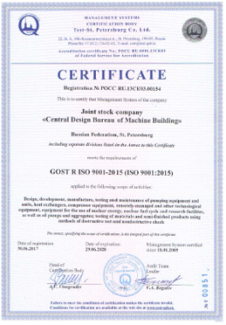
Quality Assurance Policy
● Quality assurance of designed, manufactured and delivered products
at the global stage;
● Quality control at all stages of design, manufacturing and maintenance of the equipment;
● Warranty, maintenance and supervision
for equipment operation;
● Compliance of quality management
system with the requirements of ISO 9001;
● Availability of all required licenses including licenses for nuclear energy use;
● Compliance with the requirements of International Standard API 610
© 2017 • JSC «CKBM»

Slide 11
Thanks for your attention!
Joint Stock Company
«Central Design Bureau of Machine Building»
(JSC «CKBM»)
190020, Russian Federation, Saint Petersburg,
nab. Obvodnogo kanala, 138, bldg.1B
Tel./fax:+7 (812) 676-63-00
E-mail: postbox@ckbm.ru
Deputy Chief Designer for pump equipment:
Agrinskiy Andrei Nikolaevich

