Slide 1
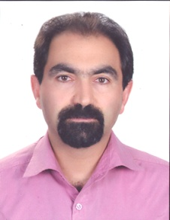
Khorram Talebieiji
Country: IRAN
Organization: NPPD Co.
Experiences: 20 year
Career:
  M.S : Nuclear Engineering
  BNPP Project QA department
    Audit of Contractors
    Assessment of Contractors QA Documents
    Obtaining Permits

