Slide 1




Integrated risk Management In NPPD
Nuclear Power Production & Development Company Of Iran

Slide 2
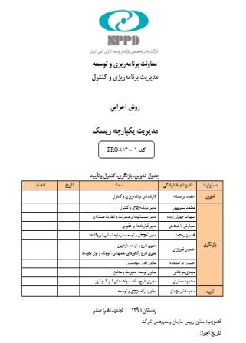
Organizations of all types and sizes face internal and external factors and influences that make it uncertain whether and when they will achieve their objectives. The effect this uncertainty has on an organization's objectives is “risk”.
Integrated risk management

Slide 3
NPPD Risk Management System
Phase 0
No Experience
No Reference
Phase 1
Documentation
Process
Phase 2
Advance Method
Implementation
Innovation

Slide 4
Risk Management Standard
ISO31000:《Risk management -Principles and guidelines on implementation》
SOER 2015: Risk Management Challenges
PMBOK Sixth Edition
IAEA
Risk Management
ISO3100
IAEA
PMBOK GUIDE
SOER
(WANO)

Slide 5
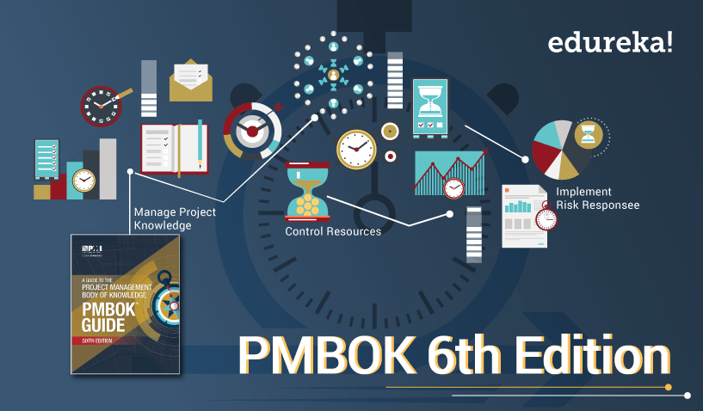
NPPD Risk Management System
Enterprise Risk Management
Standard:
ISO 31000-( IAEA-SOER)
Goals:
    Safety
    Power Generation
    Strategy
    Financial
Project Risk Management
Standard:
PMBOK Sixth Edition
Goals:
    Safety
    Quality
    Schedule
    Cost
    Scope

Slide 6
Risk Management Sections In NPPD
NPPD
(Headquarters)
Program of units 2 and 3 of Bushehr
Bushehr Nuclear Power Plant
Internal projects of the NPPD

Slide 7
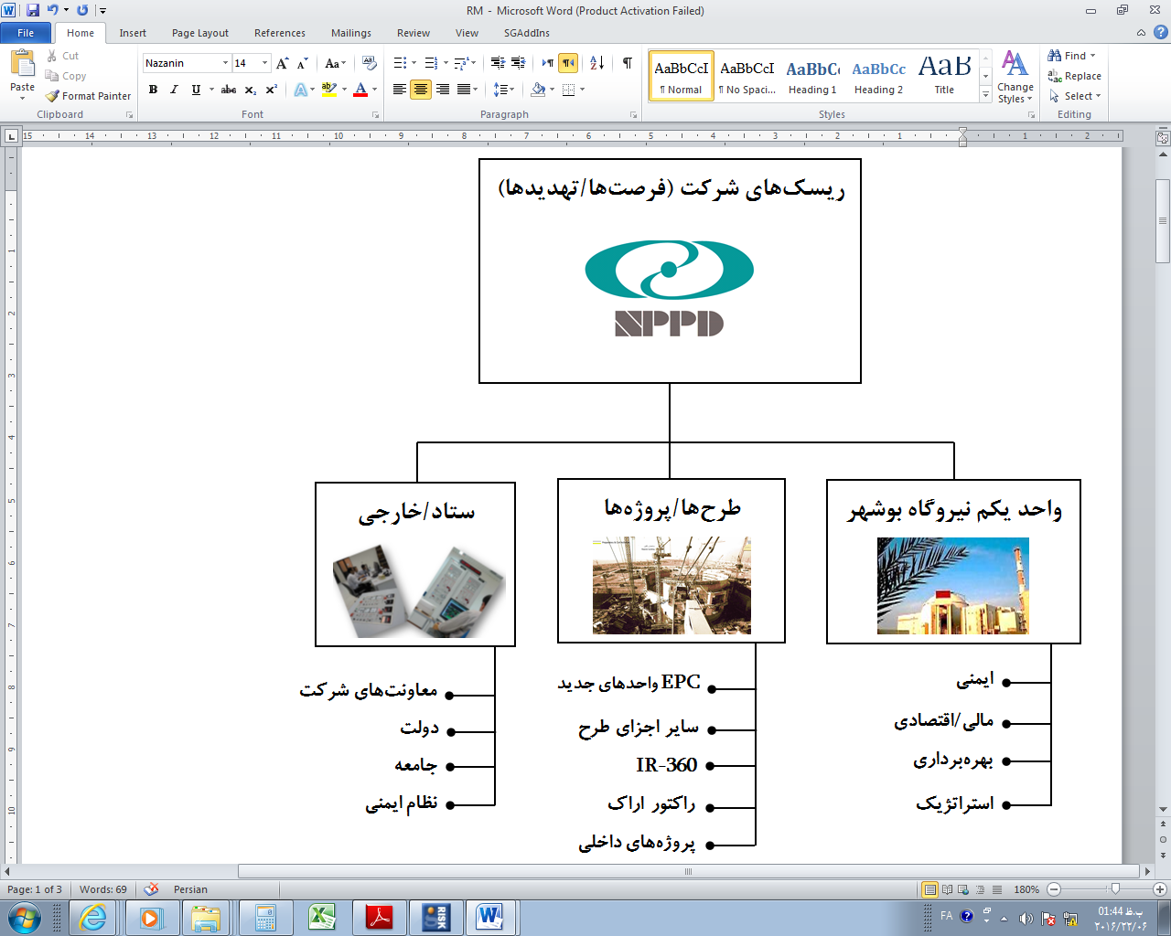
Framework Risk Management In NPPD
NPPD Risks (O/T)
In/Ex
Projects/ Program
BNPP
    Safety
Power Generation
    Strategy
Financial
    Units 2&3 Bushehr
    Internal Projects
    Safety
Power Strategy
    Operation
Financial/Economical
    Safety
Power Strategy
    Operation
Financial/Economical

Slide 8
NPPD Risk Management committee
Corporate RM committee
Enterprise
Project RM committee
Project

Slide 9
Steps of the Risk Management Process
Step:2
Qualitative & Quantitative Risk Analysis
Step:3
Plan And Implement
Risk Response
Step:4
Monitor Risks
Step:1
Identify Risks

Slide 10
Questions
What is the structure of risk management in your company?
What is the model of enterprise risk management in your company?
What is the model of Project risk management in your company?
What are the steps of implement risk management processes in your company?
What is the risk breakdown structure in your company?
What is the relationship between risk management and other areas (Schedule, cost, Scope ,…)?
What is the threshold of risk accepting in your company?
How do you identify risk, risk assessment, risk response, and risk monitoring and control?
What are the strategies for responding to risk in your company? And how do you set these strategies?

Slide 11


