Slide 1


The Iranian nuclear Power
program policies
Behrooz Kamalvandi
Deputy President of The Atomic Energy Organization of
Iran for International, Legal and Parliament Affairs
Turkey-MENA Nuclear Industry Congress
2016 May 12-13, Istanbul

Slide 2
Contents
Introduction
Perspective of developing the nuclear energy in the world
Situation of resources, production and consumption of energy I.R.IRAN
Reasons for developing the nuclear energy Programme in I.R.IRAN
History of nuclear energy in IRAN and current status
Iran Nuclear Agreement (JCPoA)
JCPoA Impact on Iran’s Nuclear Programme
IRAN’s advantages in nuclear energy applications development
Conclusions

Slide 3
Introduction
  Energy is the most important factor in socio-economic development
  Electricity plays vital role in development of industrial infrastructures, in economic development and in improving life styles and standards in the countries
  The world will need greatly increased energy supply in the next 20 years, especially cleanly-generated electricity.
  Nuclear power is the most environmentally benign way of producing electricity on a large scale.
  Iran have to use energy mix option and especially developing the nuclear power plants as a necessary part of energy mix in long term programs.

Slide 4
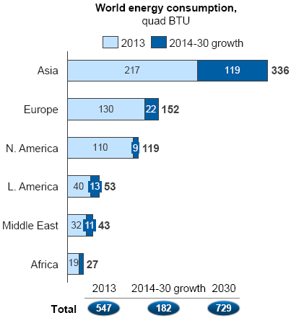
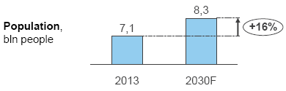
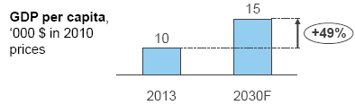
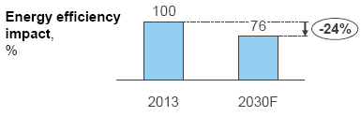
Perspective of developing the nuclear energy in the world
  Over the next few decades, population and income growth are expected to create new demands for energy
Key drivers for energy demand

Slide 5
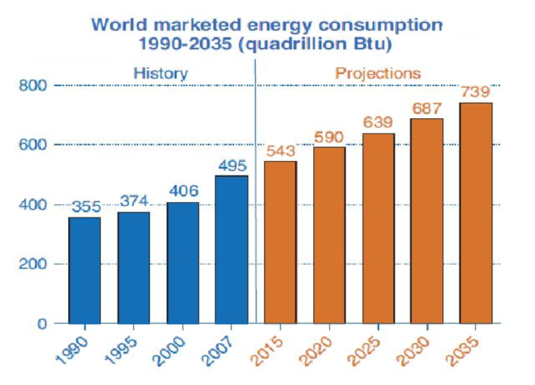
world energy demand
  From 2000 to 2010 total world primary energy demand grew by 26%.
  From 2010 to 2035 it is projected to grow by 45%.

Slide 6
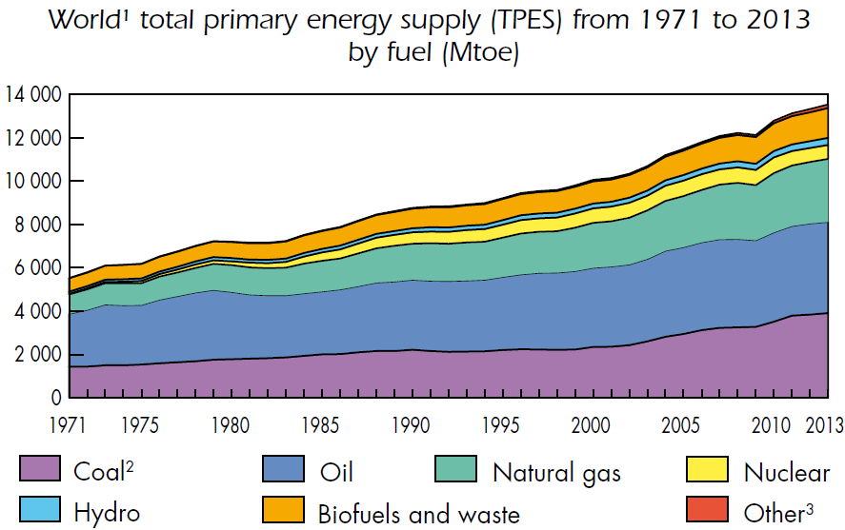
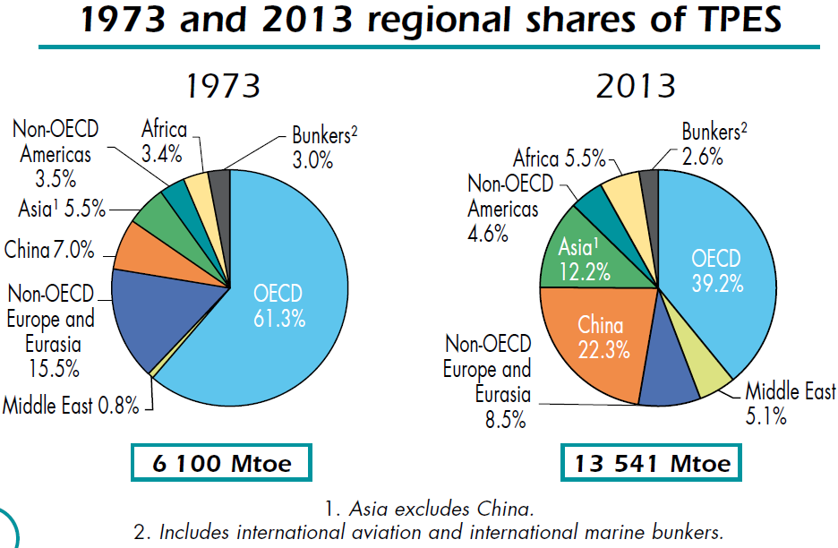
World total primary energy supply (TPES)

Slide 7
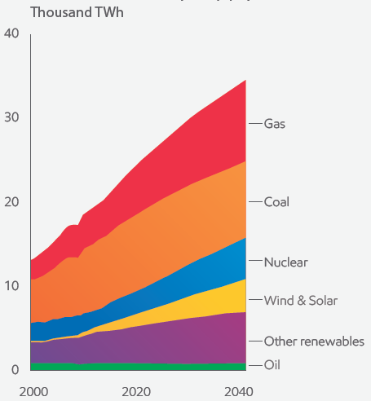
Outlook for Global electricity supply
ExxonMobil: By 2040, natural gas, nuclear and renewables are expected to deliver more than 70 percent of the world’s electricity.
Source: 2015- The Outlook for Energy : A View to 2040 (By ExxonMobil)

Slide 8
  Although wind and solar each are expected to exceed global nuclear capacity by 2040, installed capacity does not tell the whole story about how much electricity will actually be generated.
  Because nuclear is a “base load” technology, its capacity will generate electricity about 80 to 85 percent of the time
  Wind and solar, however, have much lower effective capacity utilization levels because they are intermittent sources
  As a result, even by 2040, wind and solar each will meet far less electricity demand than nuclear power.

Slide 9
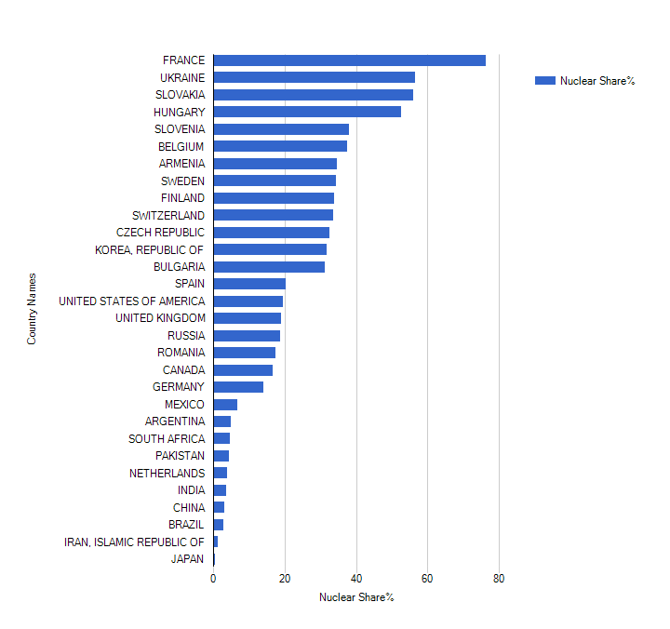
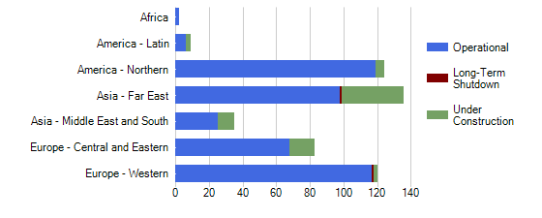
Demand for the Nuclear Energy
  Nuclear power provides about 11% of the world’s electricity, and 21% of electricity in OECD countries
[IAEA,PRIS]

Slide 10
Situation of resources of energy
Situation of resources, production and consumption of energy I.R.IRAN
  Total reserve of accessible crude oil and gas liquidities is allocated about 11.4 percent of world crude oil reserve.
  About 98 percent of primary energy production is providing from oil and natural gas resources.
  Natural gas, with a reserve of 13.18 trillion cubic meters forms about 15.5 percent of world natural gas reserve

Slide 11
Electric Power generation in Iran
  Nominal capacity of power plants reached the record of 73152 MW in 2014
  Iran faced with complicated challenges in energy field
  Rate of electricity demand is about 8% and more than 30% of total natural gas consumption in Iran goes to electricity generation.

Slide 12
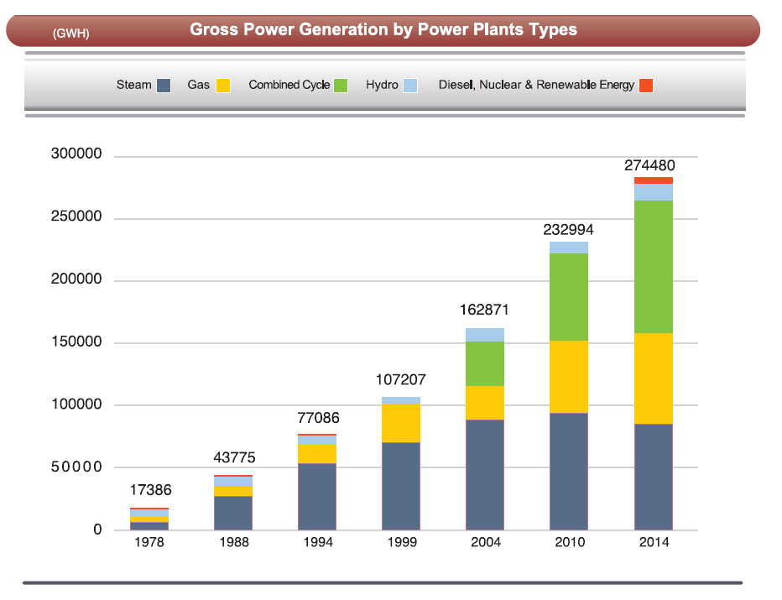
Electric Power generation in Iran

Slide 13
Power generation in Iran
Iran trades electricity with Afghanistan, Armenia, Azerbaijan, Iraq, Pakistan, Syria, Turkmenistan and Turkey. Net export is about 6 TWh/yr. turkey and Iraq account for 90% of exports.
In mid-2015 generating capacity was 74 GWe. Iran plans to boost generating capacity to 122 GWe by 2022, with substantial export potential.

Slide 14
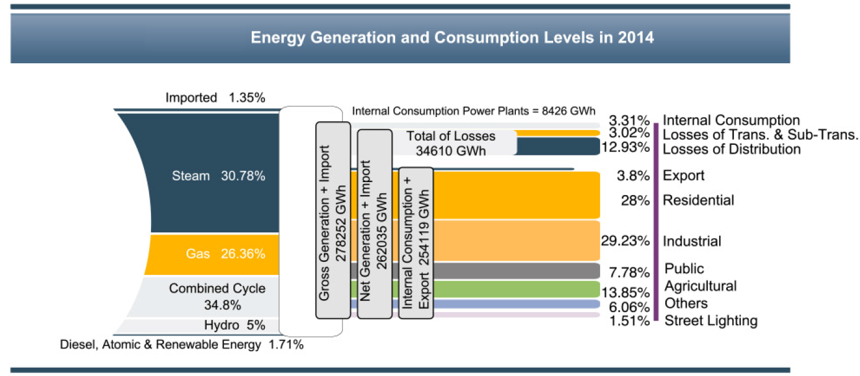
Generation leveling of electricity in Iran
In 2014, Electric energy consumption has been increasing by 8.1% comparing with it in the previous year, reaching 219653 GWh.

Slide 15
Needs of Country's developing programs for energy
Reasons for developing the nuclear energy Programme in I.R.IRAN
  Vision document and developing programs of Iran consider high, sustained and fast economical growth (8.6% economical growth rate)
  In conjunction with the goals of country vision document, on 2025 in nuclear field, Islamic Republic of Iran will be the first one in peaceful nuclear technology in the region
  Depending on GDP growth, the electricity demand will be at least about 123000 MWe by the year of 2025

Slide 16
The necessities arise from
energy security point of view
  Fossil resources are not the ideal resources for supplying secure energy in long terms
  Supplying energy by hydro-electric power on great extension failed on because a great part of Iran is arid and waterless desert
  Renewable energy sources such as wind, solar, geothermal can not have share in producing the primary energy because of their technical, geographical limitations and uncompetitive price with other sources
  The capacity of constructible power plants on mentioned sources (hydro & renewable energy ) in 2025 are very little in comparison with total need of the country

Slide 17
Environmental consideration and sustainable development
The fossil fuels are considered as the main resources of energy in Iran and in the same time they play the main role in environmental contaminations
Techno-economic advantages
Low fuel cost of NPP and low social cost , longer lifetime periods, capability for supplying base load and by-products of nuclear power plants can be considered as some techno-economic advantages of nuclear power plants in Iran .

Slide 18
Influence on the development of other sectors
Nuclear power technology is considered as multidisciplinary
Construction and commissioning of nuclear power plant require common and harmonic activities of modern and advanced different science & technologies

Slide 19
Legal and National Obligations and Bases
Basis on Islamic revolution Leader notice, One of Iran's general policies, in energy section is related to nuclear energy: Effort to achieve nuclear science & Technology and construct nuclear power plants to supply a part of Iran's energy and training fields is necessary
Iran's Atomic Energy Council approved : Construction of atomic power plants generate power is one of Iran Government's principal goals and policies
Iran's Atomic Energy Council approved : Generating 10% to 20% of country's needed electricity by nuclear power plants

Slide 20
History of Nuclear Energy in IRAN
1959: Start of academic nuclear education
1966: Construction and Operation of Tehran Research Reactor
1970-78:
Studies of SRI ( Stanford Research Institute) for energy planning: Forecasting for nuclear power sharing: 9000 MW (%16)
Establishment of Atomic Energy Organization of IRAN (AEOI)
Bushehr NPPs Contract with KWU (2 reactor)
Darkhowin (Karon) NPPs Contract with Framatom (2Reactor)
6 agreement with Germany for construction of 6 NPP,
Beginning of Nuclear fuel cycle research and development including airborne uranium exploration (more than a third of country)
Construction of research laboratories for nuclear studies
Establishment of Esfahan nuclear technology center.

Slide 21
Intergovernmental Agreement with Russia for completion of BNPP-1 in 1992,
Signing Contract, 1995
Nuclear fuel cycle technology achievement (1990-2002),
Design and construction of Heavy water production plant,
Designing and construction of IR-40 (Iranian HWR),
Development of fusion and laser research and non-power nuclear application in medicine, agriculture and industry,
BNPP-1, First grid connection, Sept. 2011,
BNPP-1, Reach to 1000 Mwe, Aug 2012,
BNPP-1, Provisional Acceptance - Iranian Operator,Sept.2013
After Islamic revolution in 1979

Slide 22
History of the first unit of Bushehr Nuclear Power Plant(BNPP1)
 | Type | MWe gross, net | Construction start | Commercial operation
Bushehr 1 | VVER-1000/446 | 1000,915 | 1975, 1994 | Sept 2013
Total (1) | 915 MWe net
  Bushehr 1
  In 1957 a civil nuclear program was established under the US Atoms for Peace programme.
  In 1974 a target of 23,000 MWe of nuclear capacity to free up oil and gas for export. Preliminary agreements with Siemens KWU and Framatome for four nuclear power plants were signed.

Slide 23
History of the first unit of Bushehr Nuclear Power Plant(BNPP1)
  Construction of two 1,293 MWe (gross) PWR units was started 18 km south of Bushehr in Bushehr province on the Persian Gulf by Siemens KWU, based on the Biblis B reactor in Germany in 1975.
  After the Islamic revolution, work was abandoned early in 1979 with unit 1 substantially complete and unit two about half complete. The plant was damaged by Iraqi air strikes in 1984-88.

Slide 24
History of the first unit of Bushehr Nuclear Power Plant(BNPP1)
  In 1992, the governments of the Islamic Republic of Iran and the Russian Federation signed a bilateral agreement on the completion of unit one of BNPP.
  A 1000 (MW) VVER type nuclear power reactor is operating in Iran, after many years construction, and a second is planned.
  The anticipated 7 TWh/yr from the Bushehr reactor frees up about 1.6 million tonnes of oil (11 million barrels) or 1800 million cubic meters of gas per year, which can be exported for hard currency.

Slide 25
Current status of nuclear energy in IRAN
Considering Iran's capacity to generate about 73000 MW of electricity in 2014, the share of nuclear power in the country’s electricity capacity is about 1.4 percent.
The total electricity produced by the BNPP1 in 2011-2015 was about 13563 GWh.
During the four years operation of BNPP1(2011-2014), the total amounts of fossil fuels that have been saved is equivalent to 22 million barrels of crude oil.
Furthermore, during this period, the emission of 13 million tons of pollutants has been prevented.
SUM | 2015 | 2014 | 2013 | 2012-2011 | year
13563.7 | 3546.7 | 4140.1 | 4268.3 | 1608.8 | BNPP-1 Production (GWh)

Slide 26
Non-Power Nuclear applications in Iran
Seawater desalination
Food and agriculture application: food preservation, increasing genetic variability and crop production and etc.
Medicine application : using radiation and radioisotopes for diagnosis and therapy of various medical conditions, producing radiopharmaceuticals and etc.
Industrial applications: oil and gas exploration, radioactive tracers, road construction and etc.

Slide 27
Nuclear Power Development program in Iran
  Construction of two more units of the Bushehr nuclear power plant (BNPP-1,2) are due to start in the nearest future. The BNPP-1,2 are the VVER-1000,AES92 type with 1057 MWe output.
  Iran is planning to develop Small Modular Reactor and are negotiating with china on construction of SMRs.
  The Darkhowin Nuclear Power Plant (IR-360) is a planned nuclear power plant located about 70 kilometers south of Ahvaz, Iran at the Karun river. The plant detailed design is under preparation.

Slide 28
Iran Nuclear Agreement (JCPoA)
  The Joint Comprehensive Plan of Action (JCPOA) known commonly as the Iran deal, is an international agreement on the nuclear program of Iran reached in Vienna on 14 July 2015 between Iran, the P5+1*
  *The five permanent members of the United Nations Security Council-China, France, Russia, United Kingdom, United States- plus Germany, and the European Union.

Slide 29
JCPoA (cont'd)
  On January 2016, the parities (E3/EU+3) started to implement JCPOA. After JCPOA went into effect, all nuclear-related sanctions imposed on Iran by the European Union, the UN Security Council and the US were lifted.
  Following the implementation of the JCPOA, European countries, as well as advanced nuclear Asian states such as Japan, China and South Korea are expected to cooperate with Iran to enhance its nuclear energy capacities.

Slide 30
JCPoA Impact on Iran Nuclear rogramme
developing international relations with countries with nuclear technology
enhancing and strengthening of nuclear technology in Iran
Rationalization and optimization of the nuclear development program with Eco-technical and localization approach

Slide 31
JCPoA Impact on Iran Nuclear Programme
Cooperation field:
Cooperation in strengthening in the field of nuclear safety
Cooperation in training of Iranian human resource
Cooperation in supplying of valid codes, instruments and equipment related to nuclear energy and nuclear safety
Cooperation in Small Modular Reactor technology development plans

Slide 32
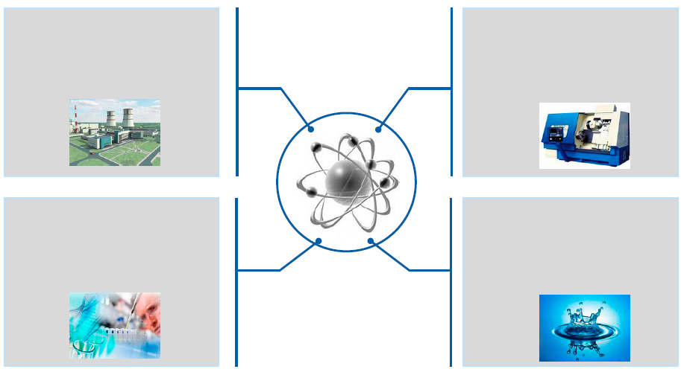

Nuclear power development in IRAN means not only large scale power production, but also additional advantages
IRAN’s advantages in nuclear energy applications development
Power production
Industry development
New jobs
Creation of manufacturing facilities
Base Load
Science development
R&D
New technologies development
Alternative use
Seawater desalination
Heat generation

Slide 33
IRAN’s advantages in nuclear energy applications development
  IRAN sees 8 percent growth/year under post sanctions, and Depending on GDP growth, Iran plans to boost generating capacity to 122 GWe by 2022.
Iran has a young and educated population which need job. Nuclear energy development can play an important role in job creation and economic growth in Iran.
Iran has a good human resource in nuclear sector. There are several universities that training human resource in nuclear physics, nuclear medicine and reactor and fuel cycle engineering and etc.

Slide 34
IRAN’s advantages in nuclear energy applications development
Water shortage in Iran reaches critical levels. Nuclear desalination is generally very cost-competitive with using fossil fuels and can paly an important role in desalinating needs in Iran.
Iran has gained public awareness and acceptance of nuclear energy.
Nuclear energy has became a national pride for Iranian people.
Iran has gained engineering and management experience in nuclear energy.

Slide 35
Conclusion
Iran plans to boost generating capacity to 122 GWe by 2022, so in order to properly respond to the huge rate of energy demand, nuclear power will paly important role in electricity generation in iran.
In view of the decreasing trend of fossil fuel resources in Iran and in view of various economic and environmental advantages of nuclear power, until renewable sources of energy prevail, nuclear power is believed to play an important role. Thus, for the coming decades Iran plans to expand utilization of its nuclear power capacity as one of the most reliable and safe source of its energy supply.

Slide 36
Conclusion
Nuclear power technology is considered as multidisciplinary, and Influence on the development of other sectors
IRAN welcomes other international opportunities of cooperation on construction of NPPs in Iran.
Taking in to account the existed infrastructures, NPPD Co. is in position to offer training services in the field of NPP operation and maintenance to the interested countries.

Slide 37
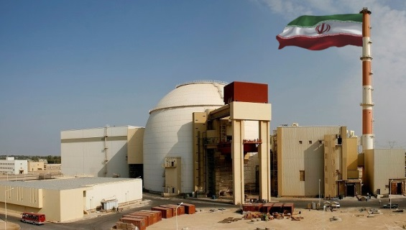
Thank you for your attention

