Slide 1
Periodic Safety Review
Project INSC IRN3.01/16 Lot 2 “Support in the Stress Test Exercise”
NPPs Safety development and improvement company
(TAVANA)
Nov. 2021

Slide 2
IAEA Requirement
Safety of Nuclear Power Plants: Commissioning and Operation (SSR-2/2 Rev. 1)
Requirement 12: Periodic safety review
Systematic safety assessments of the plant, in accordance with the regulatory requirements, shall be performed by the operating organization throughout the plant’s operating lifetime, with due account taken of operating experience and significant new safety related information from all relevant sources.
Safety reviews such as periodic safety reviews or safety assessments under alternative arrangements shall be carried out throughout the lifetime of the plant, at regular intervals and as frequently as necessary (typically no less frequently than once in ten years). Safety reviews shall address, in an appropriate manner: the consequences of the cumulative effects of plant ageing and plant modification; equipment requalification; operating experience, including national and international operating experience; current national and international standards; technical developments; organizational and management issues; and site related aspects. Safety reviews shall be aimed at ensuring a high level of safety throughout the operating lifetime of the plant

Slide 3
Regulatory Body Requirement
According to the approved concept an intermediate level regulation containing general requirements is developed that fit to the levels of Regulatory Body legal pyramid as follows:
The uppermost level legal regulations for safety and security of the safe use of atomic energy in the field of nuclear facilities and activities are established in Act on Atomic Energy Organization (1974) and Act on Radiation Protection (1989).
The second level containing the fundamental principles for safe use of atomic energy is presented in “General Safety Principles for Nuclear Facilities and Radiological Activities
The third level of the legal system is the “General Safety Regulation for Nuclear Facilities and Activities. This document contains requirements that are of general nature for each facilities and activities.
The fourth level contains regulations in the structure specified by the General Nuclear Safety Regulations. These specific nuclear safety regulations are detailed and tailored to the types of the facilities and activities. This document is one of the parts of these regulations.
At the fifth level there are regulatory guidelines in certain specified areas where it is justified, considered necessary by the Regulatory Body or requested by the Licensees.

Slide 4
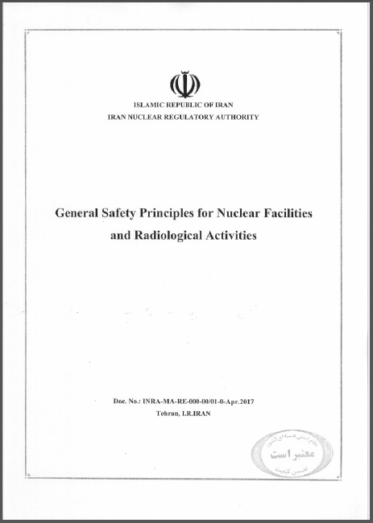
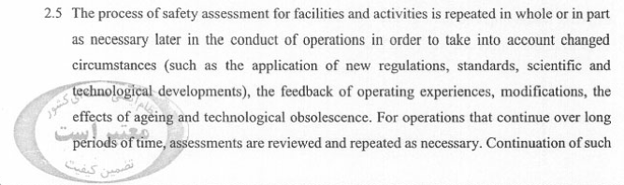
INRA Requirement

Slide 5
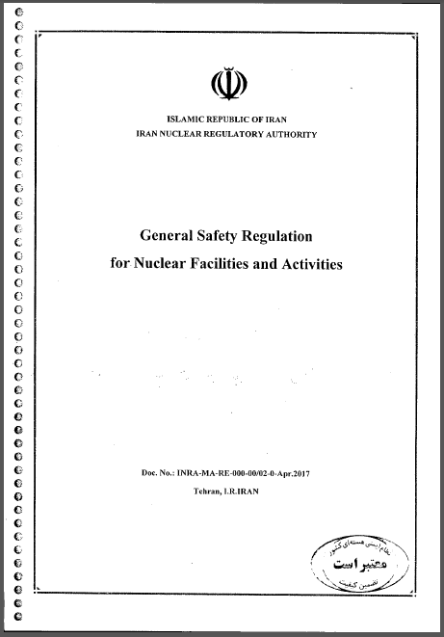
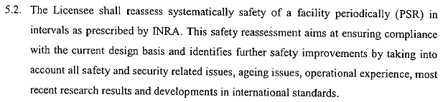
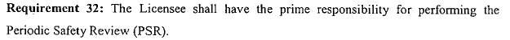
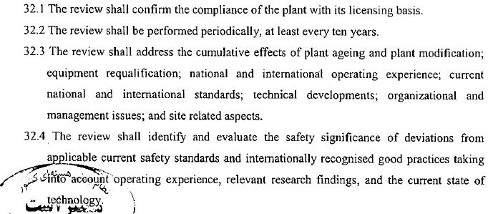
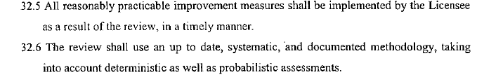
INRA Requirement on PSR

Slide 6
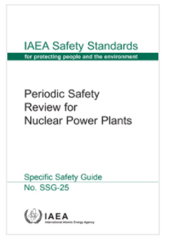
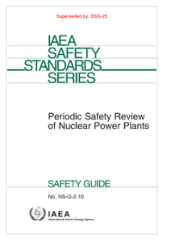
Methodology on PSR
No. SSG-25
2013
No. NS-G-2.10
2003
The purpose of this Safety Guide is to provide recommendations and guidance on the conduct of a PSR for an existing nuclear power plant. This Safety Guide is intended for use by operating organizations, regulatory bodies and their technical support organizations, consultants and advisory bodies.

Slide 7
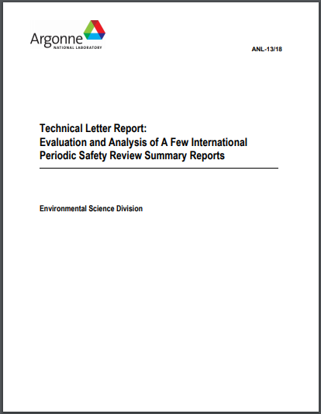
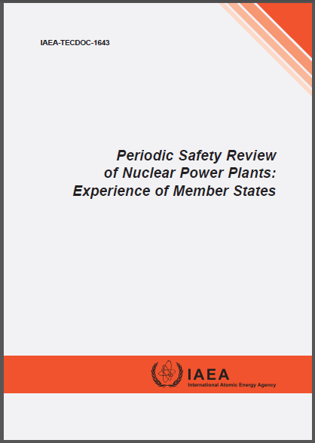
Experience of other countries
ANL-13/18
2013
IAEA-TECDOC-1643
2010

Slide 8
REVIEW PROCESS
The activities of the operating organization can be divided into three steps:
(1) Preparation for the PSR project;
(2) Conduct of the reviews of safety factors;
(3) Analysis of the findings (including the global assessment), and preparation of a program of safety improvements.
The following documents should be produced during the conduct of the PSR to provide the information required by different stages of the process described in this Safety Guide:
The basis document for the PSR;
Safety factor report(s);
The global assessment report;
The final PSR report, including the integrated implementation plan.

Slide 9
REVIEW PROCESS
The 14 safety factors recommended in this Safety Guide are listed in the following:
Safety factors relating to the plant
(1) Plant design;
(2) Actual condition of structures, systems and components (SSCs) important to safety;
(3) Equipment qualification;
(4) Ageing.
Safety factors relating to safety analysis
(5) Deterministic safety analysis;
(6) Probabilistic safety assessment;
(7) Hazard analysis.
Safety factors relating to performance and feedback of experience
(8) Safety performance;
(9) Use of experience from other plants and research findings.

Slide 10
REVIEW PROCESS
Safety factors relating to management
(10) Organization, the management system and safety culture;
(11) Procedures;
(12) Human factors;
(13) Emergency planning.
Safety factors relating to the environment
(14) Radiological impact on the environment.

Slide 11
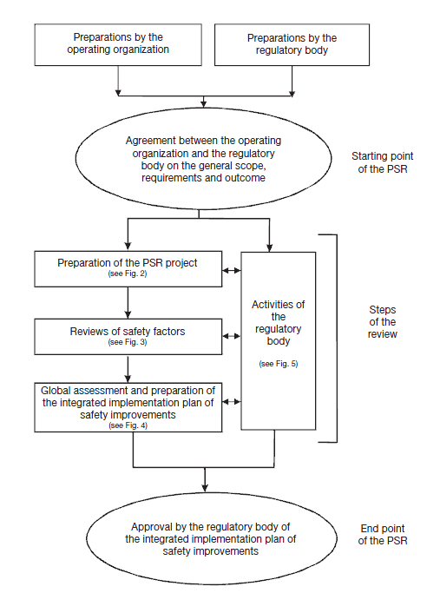
REVIEW PROCESS
Overall process for a PSR of a nuclear power plant

Slide 12
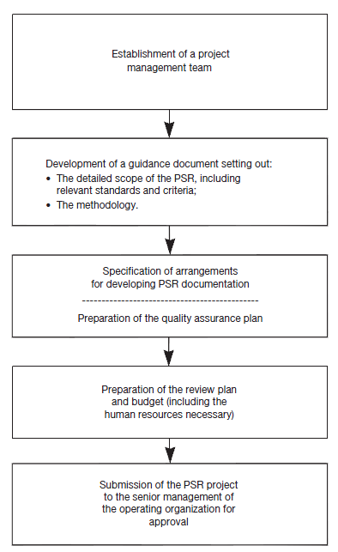
REVIEW PROCESS
Process for the preparation of the project for the PSR.

Slide 13
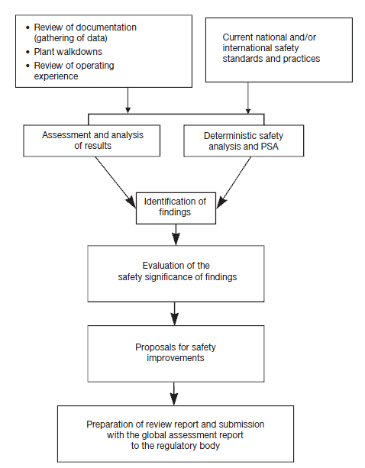
REVIEW PROCESS
Process for the review of each safety factor

Slide 14
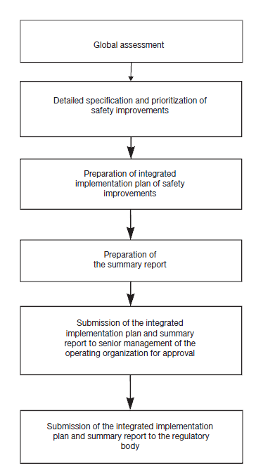
REVIEW PROCESS
Process for global assessment and preparation of the integrated implementation plan
of safety improvements.

Slide 15
PSR Activity
Development of review guideline by TAVANA for each safety factor includes the following topics:
Purpose and scope of review
Responsibilities
Safety criteria (requirements)
Review methodology
Review process
documentations

Slide 16
PSR Activity
The tentative high-level activity of the PSR is as the following:
No. | PSR High Level Task
1 | Development of revised PSR basis document in accordance with Regulatory Body guide
2 | Establishment of PSR of Plant project and project team
3 | Submission of revised PSR basis document to Regulatory Body for approval
4 | Development of review requirement criteria per each safety factor, to benchmark against.
5 | Submission of safety factor review requirement criteria to Regulatory Body for information
6 | Development of project processes, guides, templates, and training
7 | Collection of plant performance data, internal and external OE, and finalize plant equipment review scope
8 | safety factor review performance
9 | Submission of safety factor review reports to Regulatory Bodyfor review
10 | Performance of global assessment
11 | Development of finding resolutions and implementation schedule
12 | Compilation of final PSR report
13 | Submission of final PSR report to Regulatory Body

Slide 17
Conclusion and comments
PSR provides an effective way to obtain an overall view of actual plant safety and the quality of the safety documentation, and to determine reasonable and practical modifications to ensure safety or improve safety to an appropriate high level.
On the basis of international experience, it is reasonable to perform a PSR about ten years after the start of plant operation.
To provide a timely input, the PSR should be completed within three years.
Issues:
- How much human resources should be considered for the project?
- Who is the responsible for developing PSR basis document?

Slide 18
THANK YOU
Comments?

