Slide 1
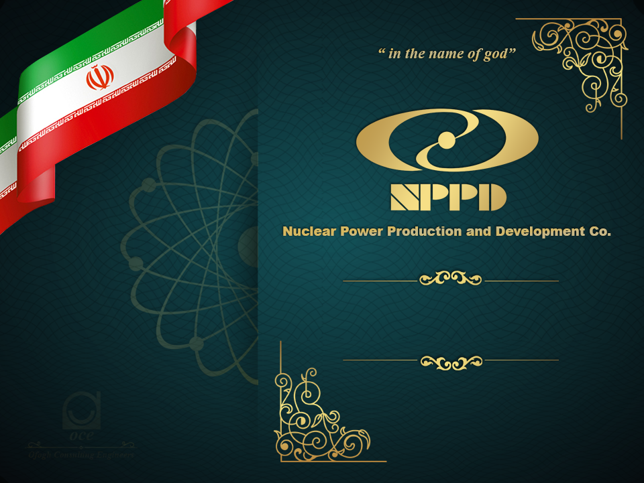
Construction of Nuclear
Power Plants

