Slide 2
Sergey Frolov
Deputy Director
WANO-MC
WANO Post-Fukushima Projects

Slide 3
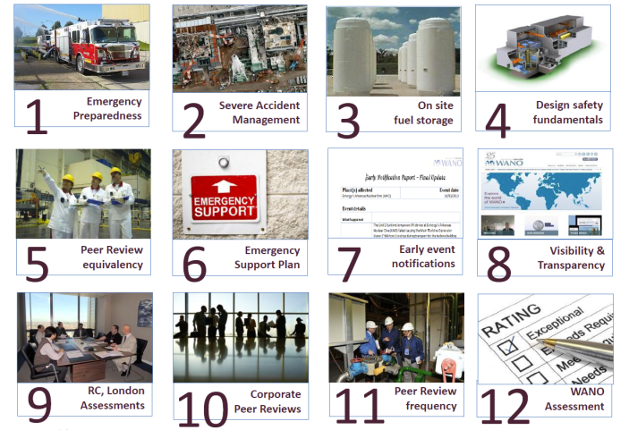
Implementation of Mitchell
Commission’s recommendations

Slide 4
1. Emergency Preparedness
Documents:
PO&C 2013. Emergency Preparedness.
Revision 1 of the How to Review Emergency Preparedness (How-to) document.
Self Assessments of NPPs in all regions starting with the 1st quarter 2014 (in MC – by January 1, 2015)

Slide 5
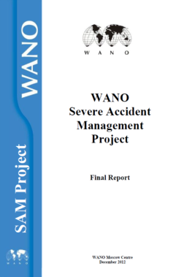
2. WANO SAM Project Deliverables
A SAM Working Group completed its work on 26 December 2012.
A Working Group's final report included the following documents:
Peer Review PO&C for SAM area in two languages.
How to Review the SAM area for PR team members in two languages.
Additional criteria for the SAM area for corporate peer reviews in two languages.

Slide 6
2. WANO Moscow Center’s SAM Activities
Additional review of the SAM area during a peer review:
Tianwan NPP, 11-26 September 2014
Loviisa NPP, 12-27 March 2015
Balakovo NPP *, 14-29 May 2015.
SAM and Emergency Preparedness TSMs and Benchmarking Visits:
2012 – 4
2013 – 1
2014 – 2
2015 – 7*.
* Plans for the current year

Slide 7
2. WANO-MC SAM Project
  1 January 2015 – Preliminary reports were received from plants (but for Bushehr and Kudankulam NPPs)
  3 – 5 March 2015 – A SAM and EP Self Assessment Working Meeting
  1 May 2015 – Plants provided final self assessment reports for the SAM area with corrective actions.
  1 June 2015 – WANO-MC Final Report prepared.
  30 June 2015 – Regional Centres provided Final Reports for the SAM area.
  30 August 2015 –Final Report for the SAM area prepared.

Slide 8
3. On-Site Spent Fuel Storage
Documents:
SOER 2011-3, Fukushima Daiichi Nuclear Station Spent Fuel Pool/Pond Loss of Cooling and Makeup
How-to review SOER 2011-3 recommendation implementation
All WANO peer review teams must start reviewing SOER recommendation implementation at member plants after May 2014.

Slide 9
4. Design Basis
Documents:
Principles for Design Basis Management were issued.
The First How-to Version
Plans are to develop a Self-Assessment Guideline and propose using it on a voluntary basis

Slide 10
4. Design Basis
Eleven NPPs have completed or are doing a pilot project in 2014-2015.
(BWR, PHWR, AGR, VVER)
Road Map
BGM 2015 – 0%
BGM 2017 – 50%
BGM 2017 – 100%

Slide 11
5. Equivalency
Policy Document 8, Equivalency
A review of JANSI equivalency was completed.
A review of INPO equivalency to take place in late 2015-early 2016.

Slide 12
6. Crisis Communications Plan
GL 2012-4, Crisis Communications, were developed
A crisis communications plan will be developed / approved in June / September 2015, respectively.
A Memorandum of Understanding was signed with the IAEA.
Emergency Response Plan Training will be provided.
WANO-AC uses INPO resources for US planst and some other plants
WANO-PC – Draft Plan prepared – will come into force in 2nd Quarter 2015
WANO-TC - Draft Plan prepared

Slide 13
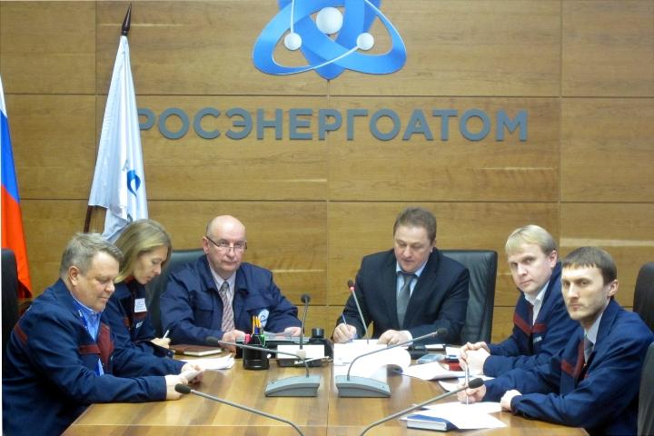
6. Crisis Communications Plan

Slide 14
7. Early Notification Strategy
An Early Notification Strategy was developed in February 2014.

Slide 15
8. Openness and Transparency
Openness
Communication tools upgraded
Transparency
A 2013 Highlights Report, a new extended report highlighting last year’s most significant events including information on WANO member participation in WANO programmes was issued.
WANO governors adopted a resolution not to share peer review reports with the public
A WANO public website was upgraded to add interactive components, such as a world map, videos, etc.
WANO's 25th Anniversary Celebrations took place.
Youth Inititaive was launched.

Slide 16
9. Self-Assessment
Assessmnet
All procedural documents were developed.
All regional and LO self-assessment reports and an overall WANO Self-Assessment Report were issued.
A Corrective Action Plan.
A Followup Assessment
All procedural documents were developed.
TC - 31 March – 4 April 2014.
PC - 12-16 May 2014.
AC - 14-18 July 2014. MC - 27-31 October 2014.
LO - 10-14 November 2014.
A Summary Report – 17-21 November 2014.

Slide 17

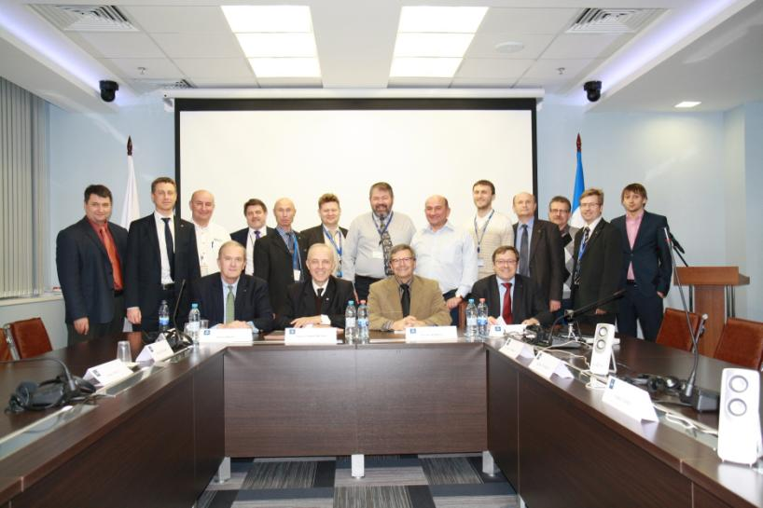
WANO-MC Self Assessment Follow-up
Notes:
Миссии технической поддержки (МТП) входят в программу ВАО АЭС «Техническая поддержка и обмен».

Slide 18
WANO Regional Assessment Follow-up Results
 | Date | AFIs | Satisfactory | On Track | At Risk | Unsatisfactory
Tokyo Centre | March | 10 | 0 | 6 | 4 | 0
Paris Centre | May | 9 | 1 | 7 | 1 | 0
Atlanta Centre | July | 3 | 1 | 2 | 0 | 0
Moscow Centre | October | 9 | 2 | 7 | 0 | 0
London Office | November | 11 | 1 | 9 | 1 | 0
Cross-Cutting Issues | November | 5 | 0 | 3 | 2 | 0
Totals thus far |  | 31 | 5 | 35 | 8 | 0

Slide 19
10. Corporate Peer Reviews
A Corporate Peer Review Guideline (WPG-07) was developed.
A 'How to’ Guidance was developed.
A Corporate Peer Review Traning was provided.
All regional centres have developed corporate peer review schedules.
All WANO members will have hosted a corporate peer review by 2018.
WANO-MC conducted two corporate peer reviews in 2014.

Slide 20
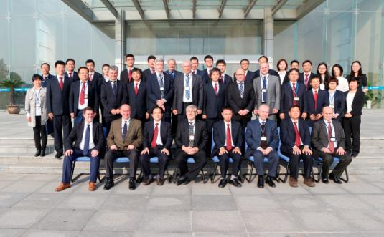
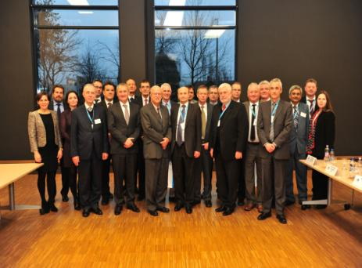
10. Corporate Peer Reviews

Slide 21
11. Peer Review Frequency Changed to Every Four Years
All plants will receive a peer review at least once every six years.
WANO-MC has been conducting peer reviews at a new frequency since 2014.
After 2019, all peer reviews will be conducted every four years.

Slide 22
12 . Post Peer Review Plant Assessments
Documents:
WANO Assessment Policy Document
WANO Assessment Guideline
WANO Assessment Committees were set up in all regional centres.
Pilot projects in all regional centres – since September 2014
The first results will be presented at the WANO CEO Executive Session during the BGM 2015.
A total of 17 assessments were completed so far.

