Slide 1



BNPP-1 Status and Familiarity with BNPP Operation Company

Slide 2
History of BNPP-1
Original design was 1290 MWe PWR by KWU
Construction for 2 Units started 1974 and stopped ..in 1979
Contract for BNPP-1 completion, VVER 1000, ..was effective in 1996 between NPPD & ASE
Addendum No.1 to the Contract in 29.08.1998
First criticality in 08.05.2011
First grid connection in 03.09.2011
Provisional Acceptance in 23.09.2013
Notes:
Summery of Bushehr NPP-1
Contribution of local industries in the BNPP-1
Program for enhancing of local participation in .future NPPs in area of:
- Design

Slide 3
General Information about BNPP-1
Bushehr NPP site is located in the northern part of the Persian Gulf Coast.
Development of design RP В-446 taking into account the already available KWU equipment and civil structures;
Thermal power of reactor- 3000 MW;
Electrical power- 1000 MW;

Slide 4
Stages of Establishment and Registration of BNPP-1 Operation Company
Operation Company of BNPP-1 was established with the aim of producing the safe, reliable, economic and stable electrical energy from the first power NPP in Iran on May 16, 2007.
On August 23, 2009 the Operation Company of BNPP-1 was qualified by NNSD with No.NNSD-CLR-0297 for performing the operating activities

Slide 5
Training and Qualification of Personnel
Training the basics of NPPs;
Training the basics of thermal Power Plants in Iran;
Teaching specialized and technical Russian language;
Training in Russia: courses for reactor, turbine, electricity, chemistry and dosimetry, I&C, commissioning, training at simulator of reference NPP (Unit 4 of the Balakova) and apprenticeship at Balakova NPP;
  Complementary training courses for complying the reference NPP with BNPP in Iran;
  Participating in assembling and commissioning BNPP;
  Participating in switching and operating activities during the commissioning period in the Contractor's structure and under the Contractor’s control and management;
  Practical training in BNPP simulator;
  Obtaining the independent work permit and approving the qualifications of MCR by NNSD;

Slide 6
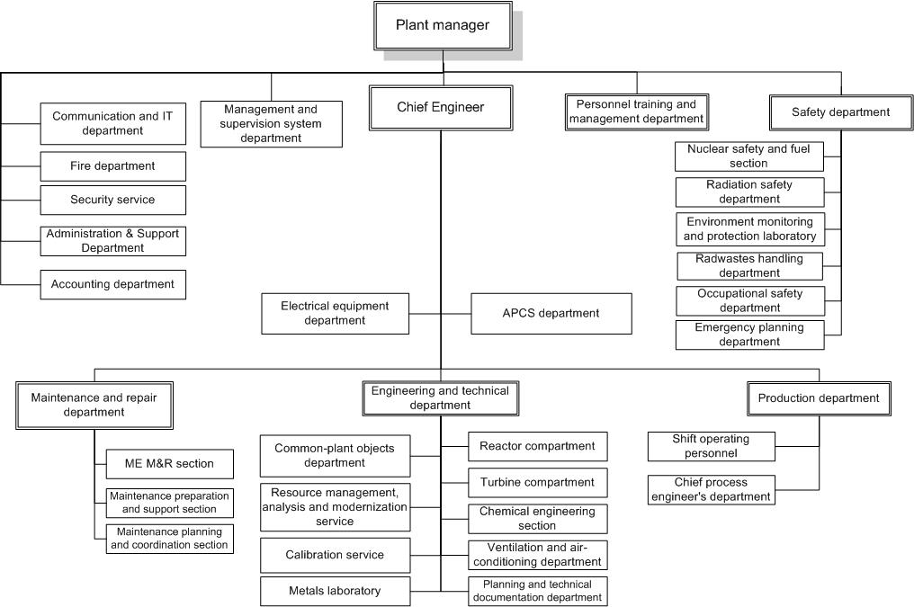
BNPP Organizational Chart

Slide 7
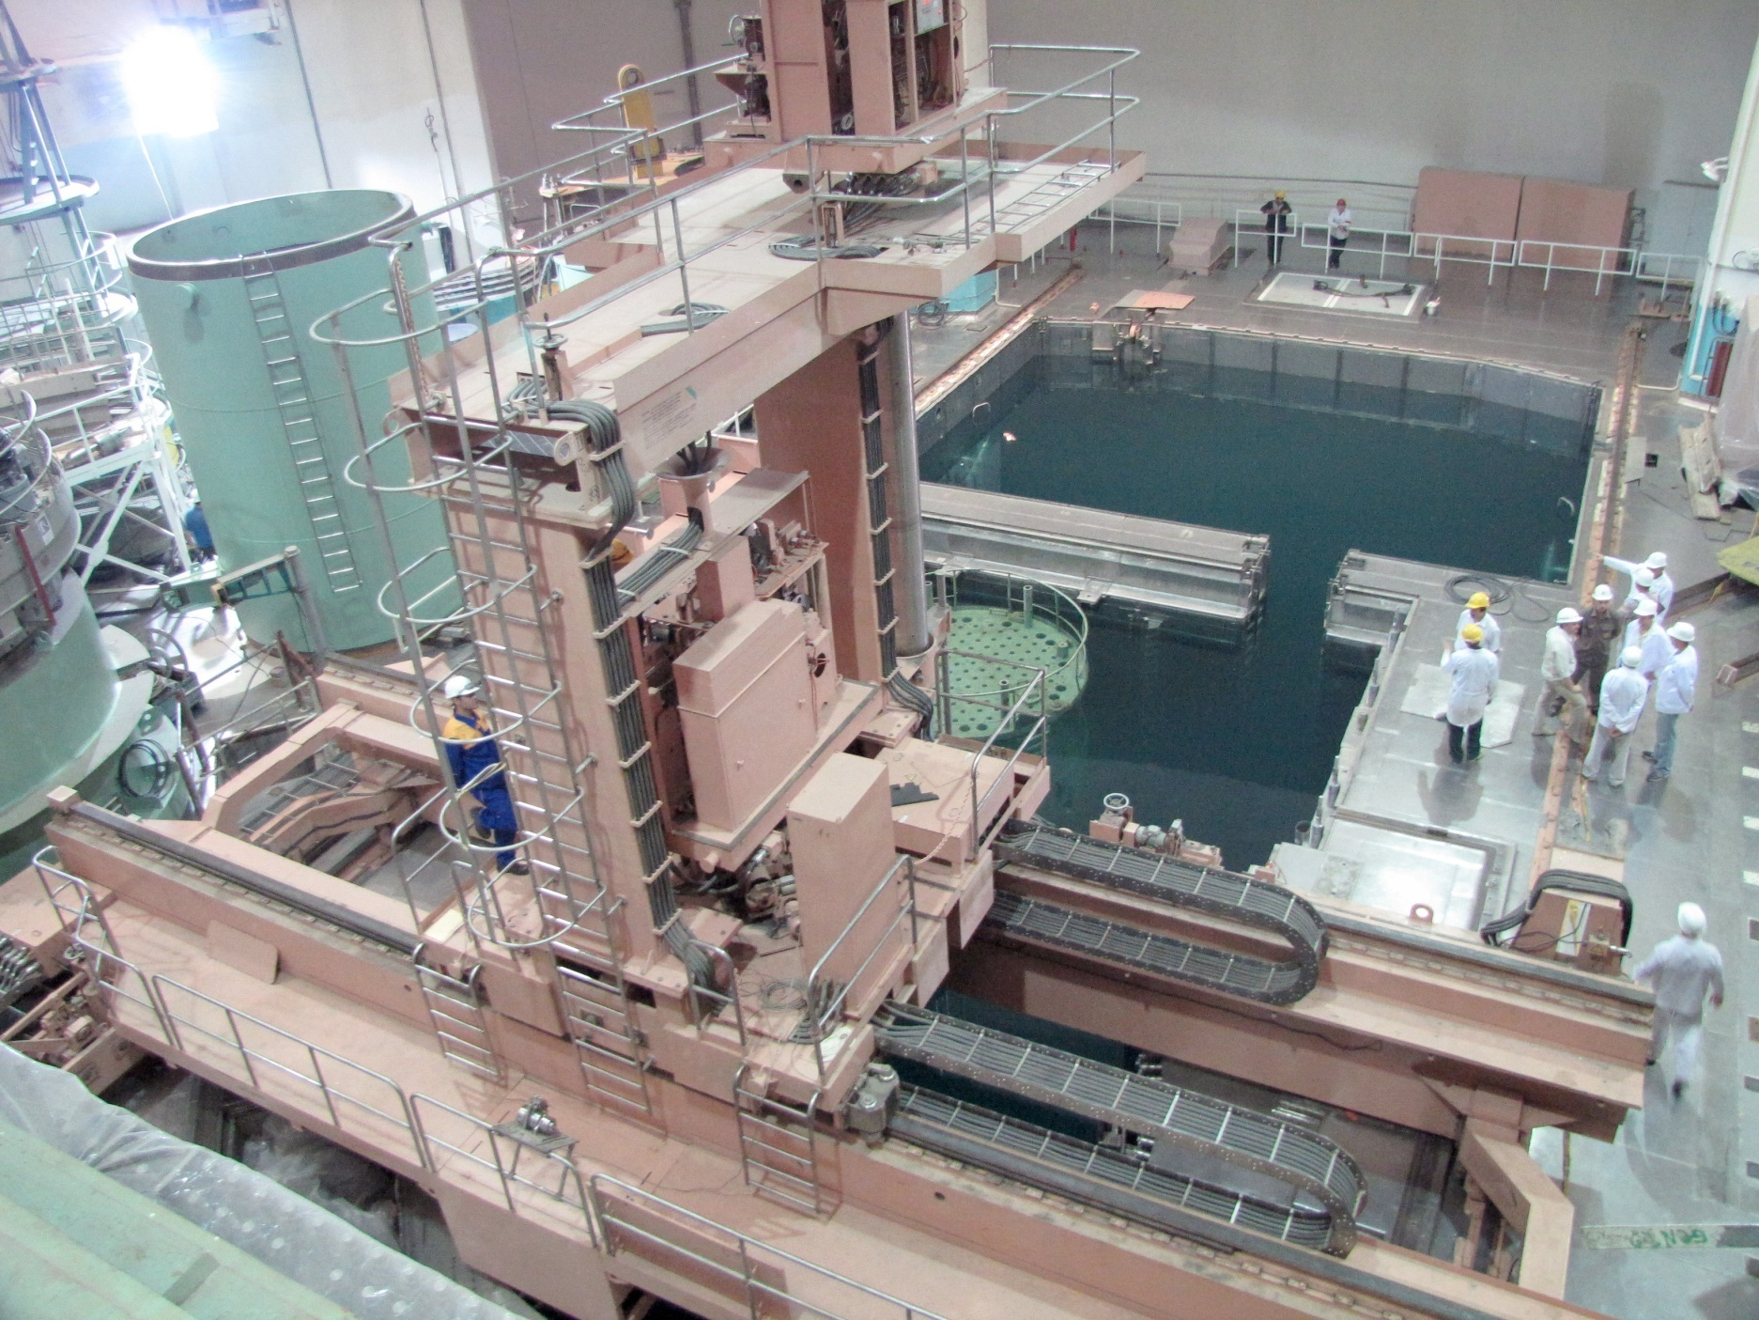

Slide 8
Key events during the putting in operation of Bushehr” NPP-1
Since July 2009 till February 2010 the hydraulic tests of primary circuit under pressure 35 MPa and 250 MPa, hydraulic tests of secondary circuit under pressure 110 MPa and steel containment tests were conducted.
On May 8, 2011 at 11:12 a.m. the minimum controllable level was achieved , id est., self-maintaining reaction of fuel fission was launched in the reactor core.
On September 3, 2011 at 11:29 p.m. Bushehr NPP-1 was connected to the national grid.
On the eve of September 4, 2011 the IAEA registered Bushehr nuclear power plant as an operating plant.
On September 23, 2013 the preliminary acceptance of the power unit took place and power unit 1 was transferred for operation to the management of the Principal personnel.

Slide 9
Measures in Support of BNPP-1
Three years of contract with RF for support in the ..area of plant maintenance
Three years contract with RF for assistance during ..operation
Establishment of IRI specialized companies in ..maintenance, technical support and equipment ..supplier with emphasize on localization
Agreement for low and medium level waste ..transportation and storage
Notes:
Summery of Bushehr NPP-1
Contribution of local industries in the BNPP-1
Program for enhancing of local participation in .future NPPs in area of:
- Design

Slide 10
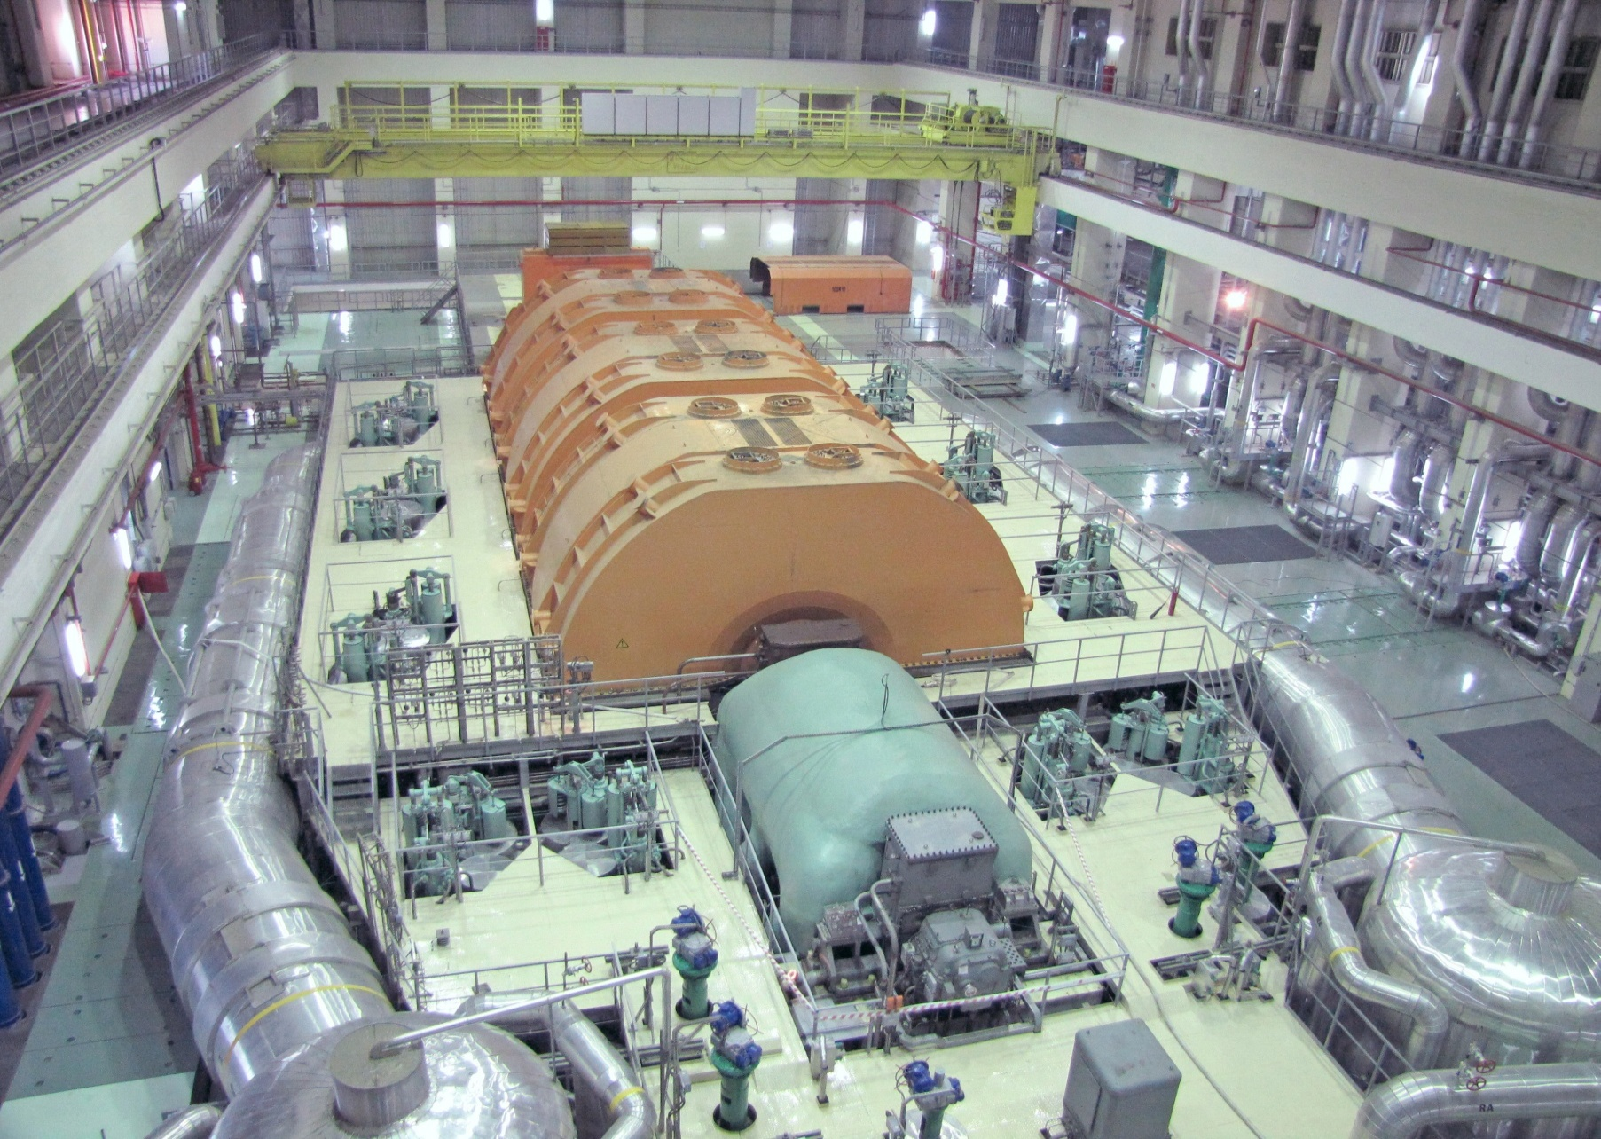

Slide 11
The amount of Produced Electrical Power
produced electrical energy before Provisional acceptance: 3760X10⁶ KWh | produced electrical energy after Provisional acceptance until beginning of scheduled preventive overhaul: 2980X10⁶KWh

Slide 12
International cooperation
International organizations IAEA, WANO pay sufficient attention to the process of completion and putting in operation of “Bushehr” NPP Unit I.
A lot of expert missions and workshops took place at BNPP site with participation of IAEA experts in field of start-up and commissioning.
Moscow branch of WANO also performed technical support mission in commissioning field and conducted WANO Peer Review meeting in BNPP-1 0n 2011 and its follow-up on 2013.

Slide 13
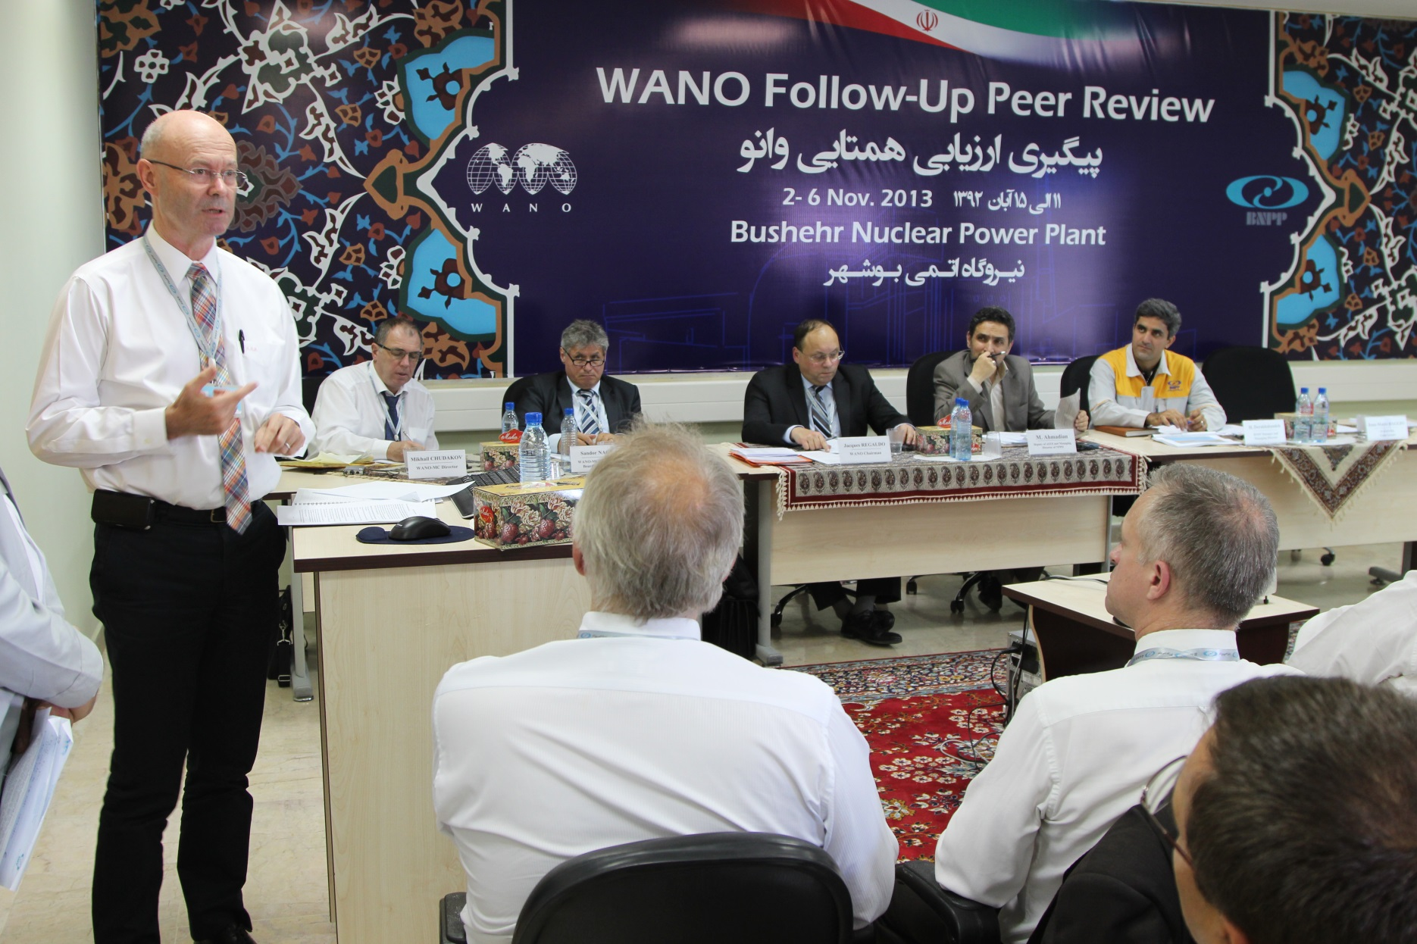

Slide 14
THANKS FOR YOUR ATTENTION

