Slide 1
Enhancing Institutional Strength in Depth in the Nuclear Industry
Jozef Zlatnansky
IAEA, Vienna
Technical Meeting
13 - 16 December 2021

Slide 2
Robust & Effective Oversight
Effective Oversight
is one of key attributes to achieve high levels of safety in all circumstances and all challenges …

Slide 3
Governance and Oversight
Roles and responsibilities of licensee organization including corporate functions is to ensure that arrangements are in place to ensure effective governance and oversight of nuclear safety as an overriding priority;
Ensuring that robust line and independent oversight arrangements are in place and effectively functioning is responsibility of top management in building institutional strength in depth of nuclear organization to achieve excellence and sustainability of operational safety performance;
In addition to line management and corporate oversight (monitoring and control of safety performance) two independent layers support decision making and strength in depth in nuclear utility- internal independent nuclear oversight and external oversight;

Slide 4
Independent Nuclear Oversight
Independent Nuclear Oversight (NOS) monitor, evaluate and assess nuclear safety performance and provides senior leaders at site and corporate level up-to Board of Directors (BoD) with relevant, objective and independent assessments of safety performance throughout the organization;
In addition, this function should identify areas for improvement of those behaviours, practices and processes affecting safety, in order to prevent major safety-related events, other challenges or near misses happening or reoccurring;
External oversight - Nuclear Safety Advisory Committees (NSACs) with membership of independent senior nuclear experts and external peer reviews should be part of independent oversight function – (IAEA OSART missions, WANO peer reviews etc.)

Slide 5
Effective Oversight
Effective line management oversight and independent nuclear oversight are one of the key functions related to a strong leadership for safety, efficient integrated management system, robust safety culture and principles for continuous improvement processes to achieve operational excellence;
The independent oversight function is to ensure that leaders and decision makers at various levels in the organisation have direct access to the results of the independent oversight;
The important factor for effective NOS performance and reporting of independent assessments should be defined to fit the purposes and structure of the individual operating organisation taking into account its particular size and complexity, as well as cultural aspects;

Slide 6
Nuclear Oversight Mission
NOS Mission (Example) should include :
fulfill the role of one of diverse information sources to be used by both corporate level and site line management to understand and close performance gaps;
promotes excellence in nuclear power plant operations by the identification of performance shortfalls and provision of insights into their causes and contributors;
provide senior leaders up to the Board of Directors – with objective independent assessment of NPP sites and fleet performance, focusing on opportunities for improvement and on nuclear safety challenges;

Slide 7
Effective Nuclear Oversight
Institutional Strength in Depth of nuclear organization would require that a robust oversight process including independent nuclear oversight be in place to effectively fulfil its mission, roles and responsibility;
The independent nuclear oversight function has been created in many nuclear utilities to strengthen organizational defense-in-depth in safety performance after Fukushima Daiichi accident;
Strong Leadership for Safety of all senior managers including corporate level and and BoD members is prerequisite for an effective independent nuclear oversight function (NOS).
Reference: WANO/IAEA Guideline GL-2018-01, PL-2019-01

Slide 8
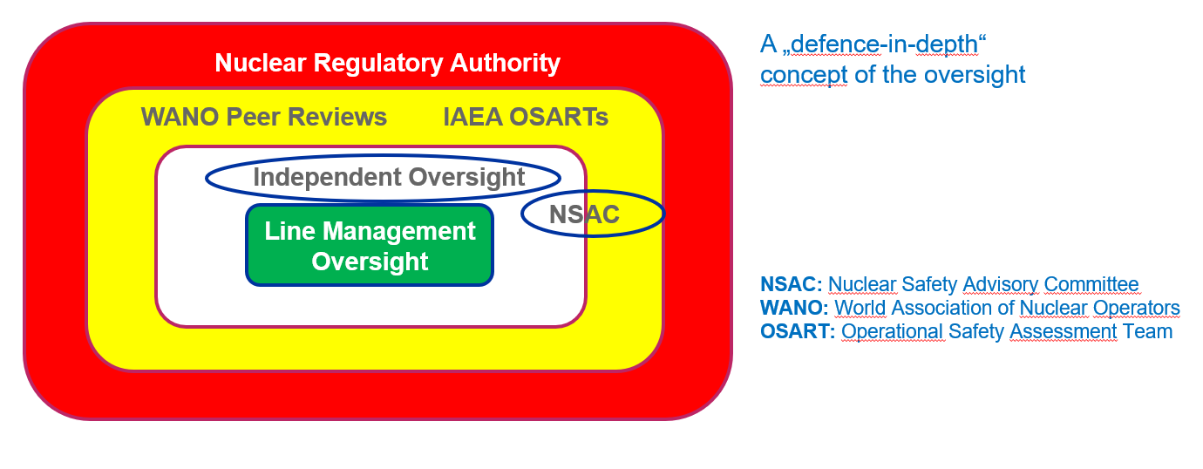
Example of Oversight Concept

Slide 9
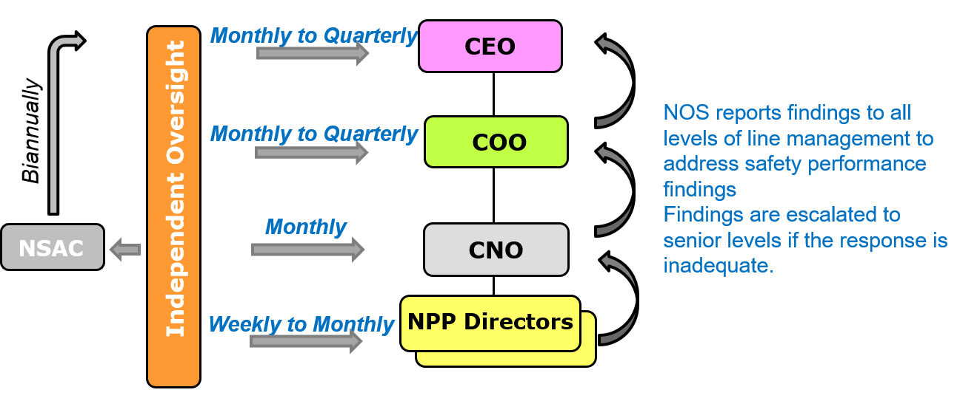
Example of NOS reporting
Reporting
Escalation

Slide 10
Effective Nuclear Oversight- Principles
Board of Directors (BoD) and senior management establish and value arrangements to enable the independent assessment of safety performance (NOS) throughout the organization including corporate and periodically review findings;
Responsibilities, accountabilities, reporting lines and authorities for NOS performing an independent assessments are clearly identified, understood and implemented;
The established arrangements ensure that independent assessments have sufficient capability and capacity to discharge their responsibilities;
Personnel undertaking independent assessments should be independent from the operational line and have sufficient authority to undertake their duties;
Independent oversight provides the directors and senior management up the BoD with an independent perspective of performance at the nuclear site(s) and within the corporate organisation referenced to highest industry standards.

Slide 11

Effective NOS in Continuous Improvement Process
Trending
Performance Indicators
Effective Oversight
RESULTS
Performance
Assessment
Task Assignment
Effectiveness Reviews
Benchmarking
Action Tracking
Standards
LEADERSHIP
AND OVERSIGHT
Self Assessments
Resource Management
Implementing
Solutions
Performance Monitoring
Industry OE
Management Oversight/ Reinforcement
Excellence
in Performance
Improvement
Independent Oversight
Problem Reporting
Organizational Accountability
Behaviour Observations
KNOWLEDGE AND SKILLS
CULTURE
GAPS
ACTIONS
Analyzing, Identifying Planning Solutions
Business Planning Considerations
Management Review & Approval
Problem Analysis
Action Planning

Slide 12
Effective Nuclear Oversight
Basic elements of an effective NOS function:
Accountability of senior managers and BoD members for NOS function;
Rotation of competent staff in NOS as part of succession planning process for site director and relevant corporate level positions (CNO,COO..);
Key Performance Indicators for NOS performance in place;
  Effective NOS should (as minimum) identify gaps and all opportunities for improvement before any external international per reviews like WANO or OSART…

Slide 13
Thank you!
Notes:
Thank you!

