Slide 1
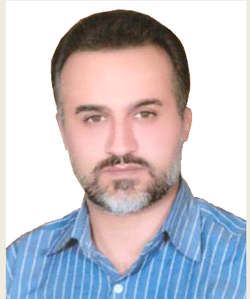
Sohrab Choupanzeydeh
IRAN
Nuclear Power Production & Development Co.
Quality Manager of NPPD Co.

