Slide 1
Overview of Safety Culture
Analytic Approach

Slide 2
Two different approaches to culture
Strategy
Culture
Technology
Culture
Technology
Management
system
Management
system
Safety
system
Strategy
Safety
system
Culture as one variable amongst others:
Culture as something inherent in all aspects of the organisation:
The Variable Approach
The Metaphor Approach
Notes:
What do we mean by ”culture”? Relate the two views to what has been discussed earlier during the day.
Working with e.g. strategy means working with culture

Slide 3
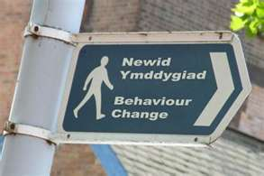
Common misunderstandings in nuclear
Change culture through attitude surveys
Managers implement culture
Campaigns change behaviours
One safety culture
‘One fits all’
Linear
Notes:
”Implement” – how would that work? No, we can influence!
”One safety culture” – subculture issues, one homogeneous culture is not the objective

Slide 4
From culture to safety culture
The concept of culture is descriptive
The concept of safety culture is normative
Notes:
Normative framework: what is good and not good?

Slide 5
Descriptive/normative
Descriptive
Normative
‘is’
Based on data and a theory of culture
‘should’
Based on data, a theory of culture and a norm
Descriptive must come before the normative!
Notes:
Relate this to the course, we postpone the normative until the very end.

Slide 6
The concept of safety culture
The normative content of safety culture:
  It sets standards for behaviour and values
  It is related to practices known to lead to safety
  It focuses on certain limited aspects of the organization
When analysing culture, the normative and descriptive aspects must be separated
  Being evaluative in the descriptive stage can lead to exclusions
  Being descriptive helps to pick up weak signals
  Being descriptive means having a broad agenda for dialogue
Notes:
The descriptive is fundamental to the normative, you need to be aware of where you are.
You will also be learning things that will not be part of the normative piece.
Relate back to earlier discussions.

Slide 7
Short-term benefits
Ambitious SCSA plan, in combination with transparency in resource allocation, communicates:
  commitment to safety to the organization and stakeholders (e.g. regulatory body). indicates the current state of the organization
  signals top management prioritization of the program
  norms and expectations to the organization
Infuses a way of building important leadership-for-safety skills

Slide 8
Medium-term benefits
An SCSA is the start of SC improvement - is about observation, communication and planful influencing
SCSA team becomes a direct communication link between top management and organizations, circumventing the filtering effect that is always present
Insight into safety culture and its relation to organizational culture makes communication and action easier
Facilitates cross-functional communication - increases efficiency and reduces compartmentalization/silos.
Continuous feedback on program implementation – provides up-to-date information on current state of the safety culture program and progress

Slide 9
Long-term benefits
Organization as a whole develops a greater sensitivity to “soft factors”
Organization develops a team of experienced communicators!
A key to organizational learning:
  Concepts – gain and share understanding of culture and safety culture
  Behaviours – learn about behaviours that contribute and detract from safety
  Impact – identify impact of safety culture on organizational performance
Gain new understanding of role and impact in shaping safety culture across the national nuclear programme

Slide 10
Summary
Safety culture is not a culture; it is a normative interpretation of a culture
Analysis of a culture requires a description of:
  what is - the descriptive analysis, and
  what should be – the normative analysis
This approach avoids premature narrowing of the inquiry process
Allows assessors to see more of the strengths and challenges of the culture
Implementation of the SCSA process provides benefits in the short, medium and long term
Notes:
First bullet: SC is not an object ’out there’
Second: Relates to the continuation of the course

Slide 11


What ‘is’ and what ‘should be’
Notes:
SCSA helps you to understand what you have and where you want to be. (What needs to be done in this picture?)

Slide 12
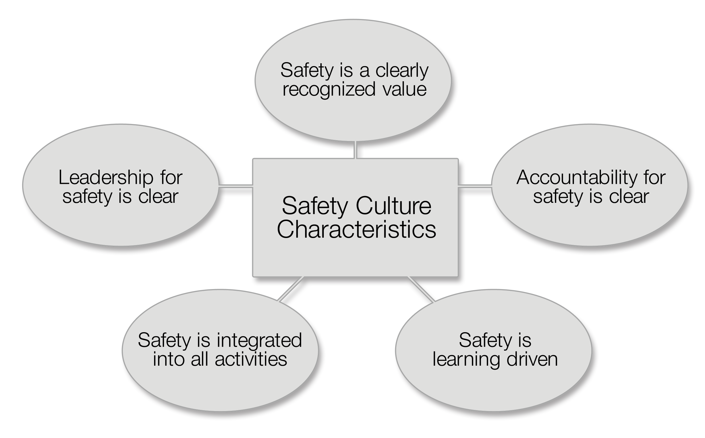
IAEA Safety Culture Framework
Notes:
Relating forward: We will be getting back to this only at the end of the course

