Slide 1
Project INSC IRN3.01/16 Lot 2 “Support in the Stress Test Exercise”
WS on “Implementation of symptom based EOP and SAMG”
STRUCTURE OF CURRENT AND PLANNED SYSTEM OF EOPs AND SAMGs
NPPs Safety Development and Improvement Company
(TAVANA)
Nov 2021

Slide 2
Table of content
Introduction
  2. Content of the AM procedures and guidelines of NPP
      Current Structure
      New Structure
3. Challenges

Slide 3
Introduction
According to the Russian regulatory documents, the emergency operating procedures for the design-basis accidents shall be developed in the form of Accident Elimination Instruction (AEI).
Emergency operating procedures for the beyond-design-basis accidents shall be comprised into the Beyond-Design-Basis Accidents Management Guidance (BDBAMG). BDBAMG shall comprise procedures on beyond-design-basis accidents management at the severe accident preventing stage.

Slide 4
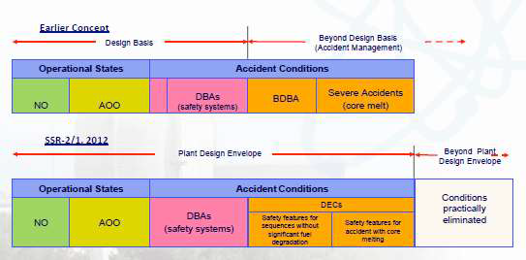
Introduction
Complete set of the emergency operating documentation incorporates such subsets as Accident Elimination Instruction (AEI), Beyond-Design-Basis Accident Management Guidance (BDBAMG) and Severe Accident Management Guidance (SAMG).
AEI
BDBAMG
SAMG

Slide 5
Content of the AM procedures and guidelines for NPP / Current Structure
Currently, the following emergency documentation is in force at NPP:
NPP accident elimination instruction (event-based, including AOPs and EOP for DBAs)
Beyond-design-basis accident management guide (event-based, including EOP for BDBAs)

Slide 6
Content of the AM procedures and guidelines for NPP / Current Structure
According to IAEA (GS-G-4.1) “Format and content of SAR for NPPs Safety analyses “ there should exist the following chapters in SAR of the plant:
  Safety Analyses which covers selected severe accidents with sufficient detail of analysis.
  Emergency Preparedness which covers the arrangements for full range of accidents in particular BDBAs and SAs
“General Safety Regulation for Nuclear Facilities and Activities Requirement 31”: A comprehensive set of procedures and guidelines, including emergency operating procedures (EOPs) and severe accident management guidelines (SAMGs) shall be prepared, covering accident conditions initiated during all operational states.
OSART mission: An important area of OSART is Severe Accident Management. OSART mission for NPP was launched in October 2018.
Stress Tests Self-Assessment: An important area of self-assessment is Severe Accident Management. Stress Test Self-Assessment for NPP was launched in May 2018

Slide 7
Content of the AM procedures and guidelines for NPP / Planned Structure
The decision has been taken to develop the set of symptom-based emergency operating instruction (SBEOI) for NPP power unit :
Accident Elimination Instruction (AEI)
Beyond-Design-Basis Accident Management Guidance (BDBAMG
Severe Accident Management Guidance (SAMG).
Westinghouse approach to symptom-based emergency operating guidelines development is adopted for this purpose.
The main purpose of applying accident management procedures is to maintain and/or recover the fundamental safety functions. Guidelines on severe accidents management are aimed at preserving the safety barriers.
7

Slide 8
Content of the AM procedures and guidelines for NPP / Planned Structure
No | Description of works
1 | Elaboration of Manual for writing of emergency response documentation set procedures and instructions
2 | Database formation for accidents substantiating calculations performance
3 | Elaboration of emergency response documentation set for Bushehr NPP power unit No.1 (Rev.0)
3.1 | Elaboration of an accident elimination instruction (AEI) for all states of the power unit (Rev.0)
3.2 | Elaboration of beyond-design basis accident management guide (BDBAMG) for all states of the power unit (Rev.0)
3.3 | Elaboration of severe accident management guide (SAMG) for all states of the power unit
4 | Elaboration of feasibility study
4.1 | Elaboration of AEI feasibility study
4.2 | Elaboration of BDBAMG feasibility study
4.3 | Elaboration of SAMG feasibility study
5 | Elaborated documents verification and validation performance
6 | Emergency documentation agreeing by NPP and RP design developers, BNPP, NNSD
6.1 | AEI agreeing by NPP&RP design developers. AEI amendment
6.2 | BDBAMG agreeing by NPP&RP design developers. BDBAMG amendment
6.3 | SAMG agreeing by NPP&RP design developers. SAMG amendment
6.4 | AEI agreeing by BNPP, NNSD. AEI amendment
6.5 | BDBAMG agreeing by BNPP, NNSD. BDBAMG amendment
6.6 | SAMG agreeing by BNPP, NNSD. SAMG amendment
7 | BNPP personnel training
8 | Translation of the elaborated documentation into English
9 | Amendment of FSAR. Amended portion approval by the NPP and RP design developers

Slide 9
Content of the AM procedures and guidelines for NPP / Planned Structure
NPP accident management
Preventing stage
Beyond-Design-Basis Accidents Management Guidance (BDBAMG)
main purpose
maintain and/or recover the fundamental safety functions
Mitigaton stage
Severe Accident Management Guidelines (SAMGs)
main purpose
preserving the safety barriers
9

Slide 10
Content of the AM procedures and guidelines for NPP / Planned Structure
The critical safety functions for NPP
Unit power operation | shutdown reactor and in the spent fuel pool
Equipment serviceability | Equipment serviceability
Reactor core subcriticality | Reactor core subcriticality
Nuclear fuel cooling | Nuclear fuel cooling
Heat removal from the primary circuit to the secondary one
Primary circuit integrity | Primary circuit integrity
Confinement integrity
Fullness - primary circuit coolant inventory
CSF “Equipment serviceability” is intended for shutdown reactor. CSF “Subcriticality” and “Nuclear fuel cooling” are used for the shutdown reactor and for the spent fuel pool as well.

Slide 11
Content of the AM procedures and guidelines for NPP / Planned Structure
Following safety barrier states have been defined for NPP:
  Fuel matrix and fuel element shells integrated by a meaning nuclear fuel (CD);
Primary circuit boundary (GK);
  Reactor vessel (KR);
  Containment leak tight enclosure (GO).

Slide 12
Content of the AM procedures and guidelines for NPP / Planned Structure
PLANT DAMAGE STATE CATEGORIZATION
The primary circuit boundary (GK)
GK 0 – The primary circuit boundary not damaged.
GK 1 – A small leak from the primary circuit inside the containment.
GK 2 – Mean and large leaks from the primary circuit inside the containment.
GK 3 – The primary circuit coolant evaporation via the pressurizer safety valves (PSV).
GK 4 – The leaks from the primary into secondary circuit.
GK 5 – Inter-circuit leaks and leaks outside the containment.
Nuclear fuel (CD)
CD 0 – An extent of nuclear fuel damage does not exceed the limits, established for
the normal operation.
CD 1 – An extent of nuclear fuel damage does not exceed the limits, established for
the design basis accidents. The upper limit corresponds to one hundred per
cent depressurization of fuel elements’ shells.
CD 2 – A severe damage of nuclear fuel exceeding the limits established for the
design basis accidents.
CD 3 – A complete destruction or melting of nuclear fuel.

Slide 13
Content of the AM procedures and guidelines for NPP / Planned Structure
PLANT DAMAGE STATE CATEGORIZATION
Reactor vessel (KR)
KR 0 – reactor vessel not damaged.
KR 1 – reactor vessel destruction at a high pressure in the reactor plant.
KR 2 – reactor vessel destruction at a low pressure in the reactor plant.
Leaktight enclosure and isolation valves (GO)
GO 0 – Leak through leaktight enclosure leakiness does not exceed the limits,
established for the design basis accidents.
GO 1 – Damage of a leaktight enclosure with the leakiness sizes, exceeding the
design basis limits, up to the moment of an accident arising or in the accident
initial period.
GO 2 – Damage of a leaktight enclosure due to welding penetration of a containment
basement, leading to corium release into NPP rooms and radioactive
matters’ late release into environment.
GO 3 – Containment leaktight enclosure bypass at leaks from the primary into
secondary circuit, at inter-circuit leaks and leaks from the primary circuit
outside the containment.

Slide 14
Content of the AM procedures and guidelines for NPP / Planned Structure
The criterion for entering the symptom-based AEI for Russian NPPs with VVER-type reactors, should an accident occur at the Unit at power operation, is a signal generation for the emergency protection actuation or safety systems actuation.
Changeover from AEI to BDBAMG shall be performed at any of critical safety functions violation with the caveat that if the maximum degree of any CSF violation severity is unsatisfactory CSF state, it is permissible to continue the accident management within AEI.
The criteria for changeover from BDBAMG to SAMG are as follows:
high temperature at the core outlet;
low level in the reactor (states «shutdown for repair», «refueling»);
low level in spent fuel pool.

Slide 15
Content of the AM procedures and guidelines for NPP / Planned Structure
Requirements to AEI content
TABLE OF CONTENTS (PART-1)
Emergency protection actuation or safety systems actuation(A‑0)
Actuation of the reactor emergency protection (AD‑0.1)
Cool-down through natural circulation (AD‑0.2)
Primary or secondary circuit coolant leakage(A-1)
Withdrawal of safety systems from operation(AD‑1.1)
…
TABLE OF CONTENTS (PART-2)
Drop of individual FA, transfer cask, airtight container to transportation section when carrying out TPO (FTS-1)
Loss of the Unit auxiliary power supply in the “cold” condition (FC-2/CC)
Primary circuit leakage in the “shutdown for repair” Unit condition (PCL-2/SR)
Leakage from SFP (RFP), RIIC (compensated cladding leakage) (LSFP-1)
…

Slide 16
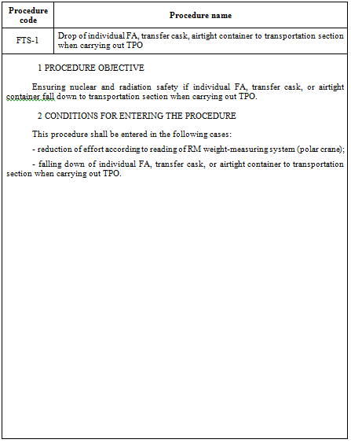
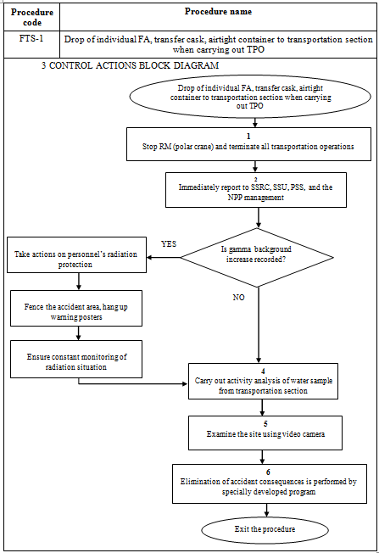
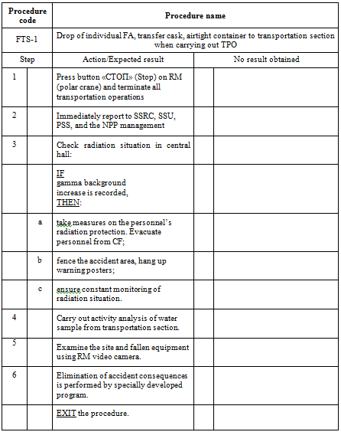
Content of the AM procedures and guidelines for NPP / Planned Structure
Requirements to AEI content
Symptom-based procedures for personnel actions on accidents elimination, that are included in AEI symptom-based part, has been developed on methodology basis, adopted by Westinghouse at developing Optimum Recovery Guidelines (ORG) that make part of Emergency Response Guidelines (ERG).

Slide 17
Content of the AM procedures and guidelines for NPP / Planned Structure
Requirements to AEI content
Unit at power operation
Designation | Procedure | Procedure purpose
А-0 | Emergency protection actuation or safety systems actuation | Diagnostic procedure
AD-0.1 | Actuation of the reactor emergency protection | Used for the modes without safety systems actuation
AD-0.2 | Cool-down through natural circulation | Used for the modes without safety systems actuation
А-1 | Primary or secondary circuit coolant leakage | Used based on the primary or secondary circuit leakage symptoms availability
AD-1.1 | Withdrawal of safety systems from operation | Used for withdrawal of safety systems from operation
AD-1.2 | Cool-down after accident with the primary or secondary circuit leakage | Used for the modes with operating safety systems
ARZ-1.2 | Primary circuit coolant release beyond the confinement | Used for the RP cooldown at leakage beyond the confinement
А-2 | SG isolation at the second circuit leakage | Used for isolation of water and steam emergency SG
А-3 | Leakage from the primary circuit into the secondary one | Used at the initial phase of leakage from the primary circuit into the secondary one
AD-3.2 | Leakage from the primary circuit into the secondary one - cooldown through blowdown | Used for the RP cooldown at leakage from the primary circuit into the secondary one
AD-3.3 | Leakage from the primary circuit into the secondary one - cooldown through steam discharge | Used for the RP cooldown at leakage from the primary circuit into the secondary one
ARZ-3.1 | Leakage from the primary circuit into the secondary one - recovery through maintaining departure from the nucleate boiling ratio. | Used for the RP cooldown at large leakage from the primary circuit into the secondary one
ARZ-3.2 | Leakage from the primary circuit into the secondary one - recovery in saturated state | Used for the RP cooldown at large leakage from the primary circuit into the secondary one and non-closure of the secondary circuit steam-discharge facilities

Slide 18
Unit at shutdown reactor
Content of the AM procedures and guidelines for NPP / Planned Structure
Requirements to AEI content
Procedure
blackout at the unit state “cold”
blackout at the unit state “shutdown for repair”
blackout at the unit state “refueling”
leakage from the primary circuit at the unit state “cold”
leakage from the primary circuit at the unit state “shutdown for repair
leakage from the primary circuit at the unit state “refueling”
small leakage from the primary circuit into the secondary one at the Unit state “cold”

Slide 19
Content of the AM procedures and guidelines for NPP / Planned Structure
Requirements to BDBAMG content
CSF-0 “Equipment serviceability” restoration procedure
FR-E.1. Loss of the Unit auxiliary power supply
FR-E.2. Power supply recovery without ECCS protections actuation
FR-E.3. Impossibility to control the Unit from the MCR
FR-E.4. Flooding of the minus elevations of the reactor compartment
…
SUBPROCEDURES – STANDARD ACTIONS BLOCKS (SAB)
SAB-1. Actions at reactor EP actuation
SAB-2. Turbine plant trip with vacuum break
SAB-3. Turbine plant trip without vacuum break
….

Slide 20
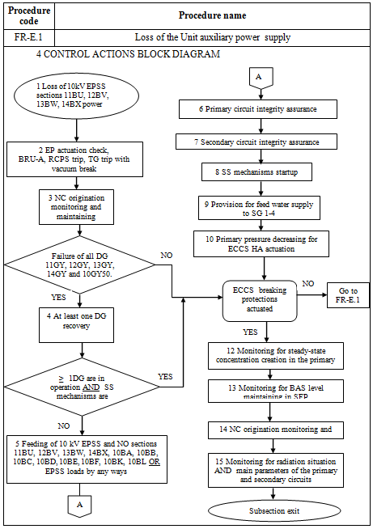

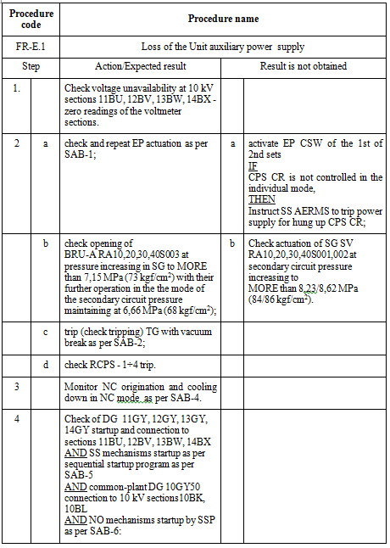
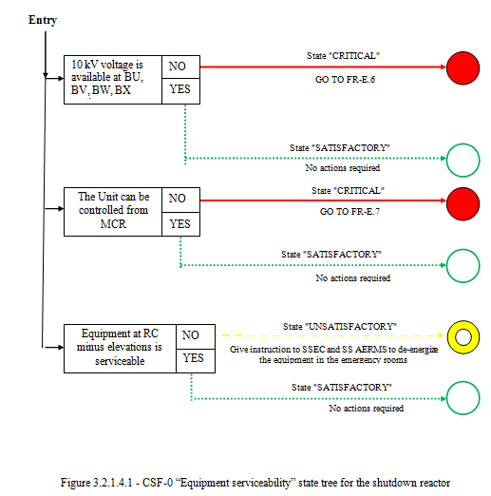
Content of the AM procedures and guidelines for NPP / Planned Structure
Requirements to BDBAMG content
This “Beyond-the-design-basis accident management guidance (BDBAMG) for all power Unit conditions” has been developed using “symptom-based” approach based on BDBAMG for the Russian NPPs V-320 RP type Units, which were developed based on methodology adopted by Westinghouse company (USA) during “Function Restoration Guideline (FRG)” development comprised into “Emergency Response Guideline (ERG)” set.
CSF violation degree | CSF satisfactory state | CSF unsatisfactory state | CSF severe state | CSF extreme state
Symbol

Slide 21
Content of the AM procedures and guidelines for NPP / Planned Structure
Requirements to BDBAMG content
CSF-1: Equipment serviceability
Loss of the Unit auxiliary power supply
Power supply recovery without ECCS protections actuation
Impossibility to control the Unit from the MCR
Flooding of the minus elevations of the reactor compartment
Challenge of complete primary coolant loss

Slide 22
Content of the AM procedures and guidelines for NPP / Planned Structure
Requirements to BDBAMG content
CSF-2 Subcriticality
Unit power operation | Emergency protection failure to operate or spontaneous ascension at power after shutdown
 | Loss of the reactor core subcriticality
shutdown reactor | Increase of neutron power or decrease of the reactor power excursion at the Unit state “Refueling
 | Decrease of boric acid concentration in the primary circuit coolant
spent fuel pool | Decrease of boric acid concentration in the spent fuel pool

Slide 23
Content of the AM procedures and guidelines for NPP / Planned Structure
Requirements to BDBAMG content
CSF 3: Heat removal from the primary circuit to the secondary one
Heat removal failure from the primary circuit to the secondary one

Slide 24
Content of the AM procedures and guidelines for NPP / Planned Structure
Requirements to BDBAMG content
CSF 4: Primary circuit integrity
Unit power operation | After cooling or pressure increase at low temperature
Unit shutdown | Pressure increase at low temperature

Slide 25
Content of the AM procedures and guidelines for NPP / Planned Structure
Requirements to BDBAMG content
CSF 5: Confinement integrity
High pressure in the confinement
Pressure buildup in the confinement

Slide 26
Content of the AM procedures and guidelines for NPP / Planned Structure
Requirements to BDBAMG content
CSF 6: Nuclear fuel cooling
Unit power operation | Reactor core overheating
 | Reactor core insufficient cooling
shutdown reactor | Reactor core insufficient cooling at the Unit “cold” state
 | Reactor core insufficient cooling at the Unit “shutdown for repair” state
 | Reactor core insufficient cooling at the Unit “refueling” state
the spent fuel pool | Spent fuel pool unwatering
 | Coolant boiling in the spent fuel pool
 | Spent fuel pool coolant heat up or level decrease

Slide 27
Content of the AM procedures and guidelines for NPP / Planned Structure
Requirements to BDBAMG content
CSF 7: Fullness - primary circuit coolant inventory
Loss of primary circuit coolant
Sump tank low level

Slide 28
Content of the AM procedures and guidelines for NPP / Planned Structure
Requirements to SAMG content
Test block diagram:
Item No. | Measured parameter | Condition for changeover to guideline | Guideline title | Guideline purpose
1 | Water level in all SG | < (L01) | SAG-1 | Supply water to SG
2 | Pressure in the primary circuit | > (P01) | SAG-2 | Reduce primary circuit pressure
3 | Core temperature Level in reactor | > (T01) < 0 | SAG-3.1 | Supply water to the primary circuit
4 | Level in SFP | < (L02) | SAG-3.2 | Supply water to spent fuel pool
5 | Pressure in the primary circuit, Pressure in the containment Dose rate in the containment | drop, surge surge | SAG-4 | Supply water into the containment
6 | Radiation level at NPP site | > (R01) | SAG-5 | Decrease fission products release
7 | Pressure in leak-tight compartments | > (P02) | SAG-6 | Control leak-tight compartment conditions
8 | Hydrogen concentration in the leak-tight compartments |  | SAG-7 | Reduce leak-tight compartment hydrogen concentration

Slide 29
Content of the AM procedures and guidelines for NPP / Planned Structure
Requirements to SAMG content
Test block diagram:
Guideline “Supply water to the steam generators”
Guideline “Decrease primary circuit pressure”
Guideline “Supply water to the primary circuit”
Guideline “Supply water into the SFP”
Guideline “Supply water into the confinement”
Guideline “Manage fission products release”
Guideline “Manage confinement conditions”
Guideline “Decrease hydrogen concentration in the confinement”

Slide 30
Content of the AM procedures and guidelines for NPP / Planned Structure
Requirements to SAMG content
Serious challenge tree:
Guideline “Mitigate fission products release”
Guideline “Decrease confinement pressure”
Guideline “Manage hydrogen inflammability in the confinement”
Guideline “Manage confinement vacuum”

Slide 31
Content of the AM procedures and guidelines for NPP / Planned Structure
Requirements to SAMG content
SAMG exit guidelines:
Guideline “Long-term monitoring actions”
Guideline “SAMG effect termination”
Guidelines for MCR:
Guideline “Initial actions at MCR at severe accident”
Guideline “Activities at MCR after AMT actions commencement”;
Auxiliary calculation means:
“Flow rate required for the core flooding”;
Guideline “SAMG effect termination”
“Flow rate required for residual heat removal”;
“Evaluation of hydrogen combustion probability”.

Slide 32
Unit at shutdown reactor
Content of the AM procedures and guidelines for NPP / Planned Structure
Requirements to SAMG content
Test block diagram:
Guideline “Supply water to the primary circuit”
Guideline “Supply water into the SFP”
Guideline “Supply water into the confinement”
Guideline “Manage fission products release”
Guideline “Manage confinement conditions”
Guideline “Decrease hydrogen concentration in the confinement”
The other guidelines are similar to those comprised into BDBAMG set at the Unit power operation.

Slide 33


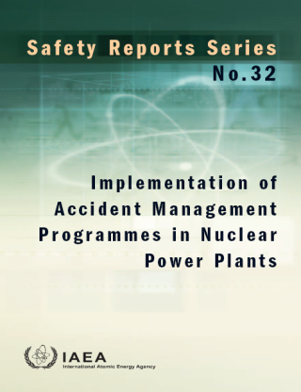
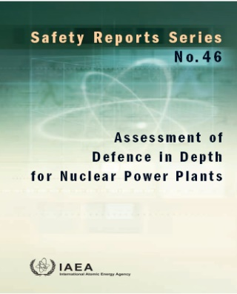
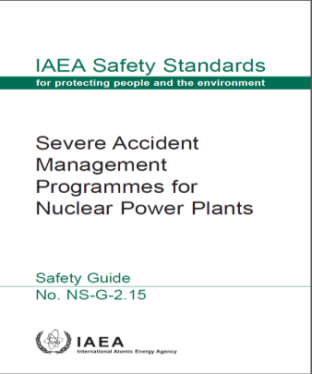
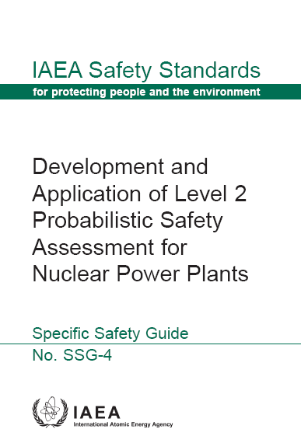
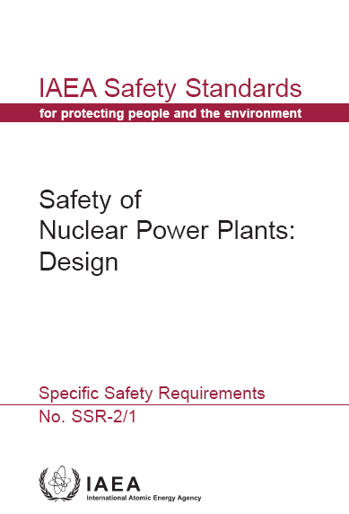
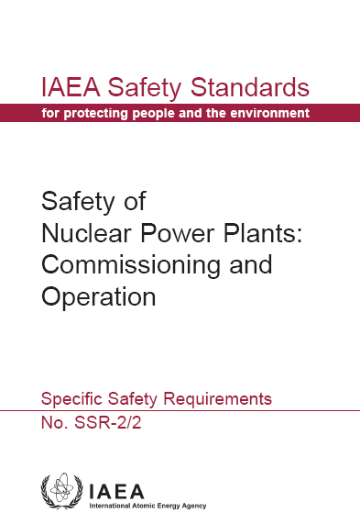
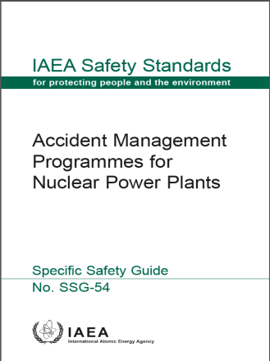
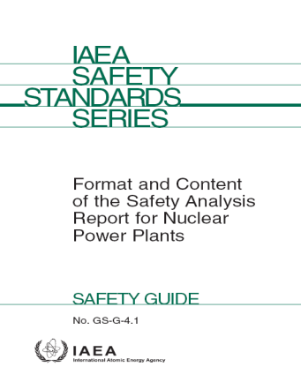
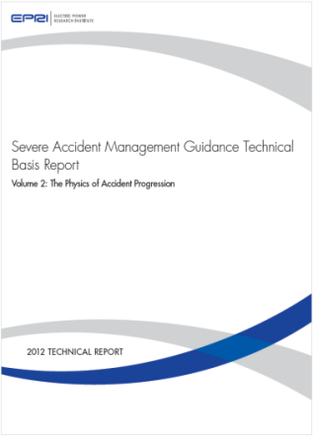
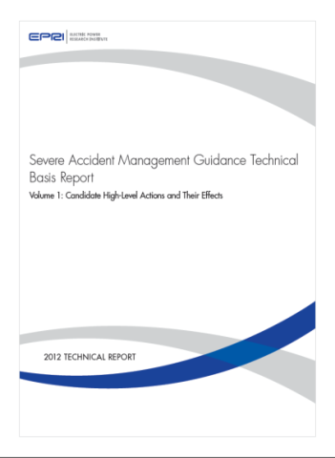
Challenges
In-depth technical review of main projects deliverables

Slide 34
Challenges
The impact of available mobile equipment on development of emergency operating procedures and guidelines
The detailed connection design to plant systems not developed yet.
Additional mobile pumps to make-up SFP, primary circuit not procured yet.

Slide 35
Challenges
On-site and off-site emergency plan update after development of emergency operating procedures and guidelines
Identification of new EOPs and SAMGs impact on plant EP.
Stages and breakdown of plant EP update

Slide 36
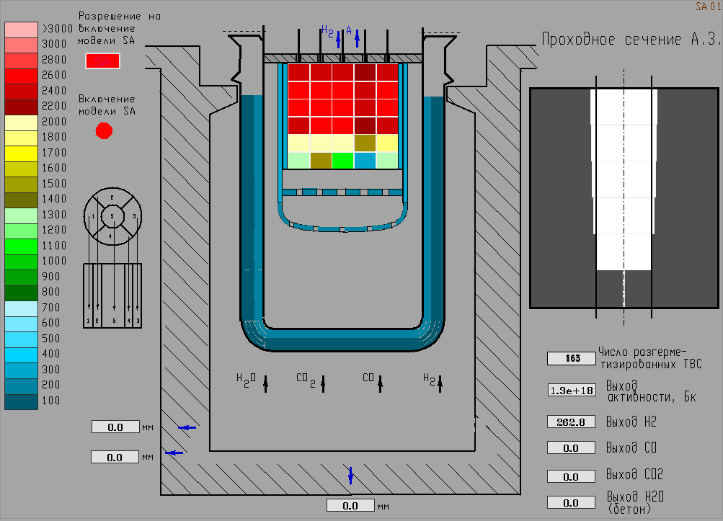
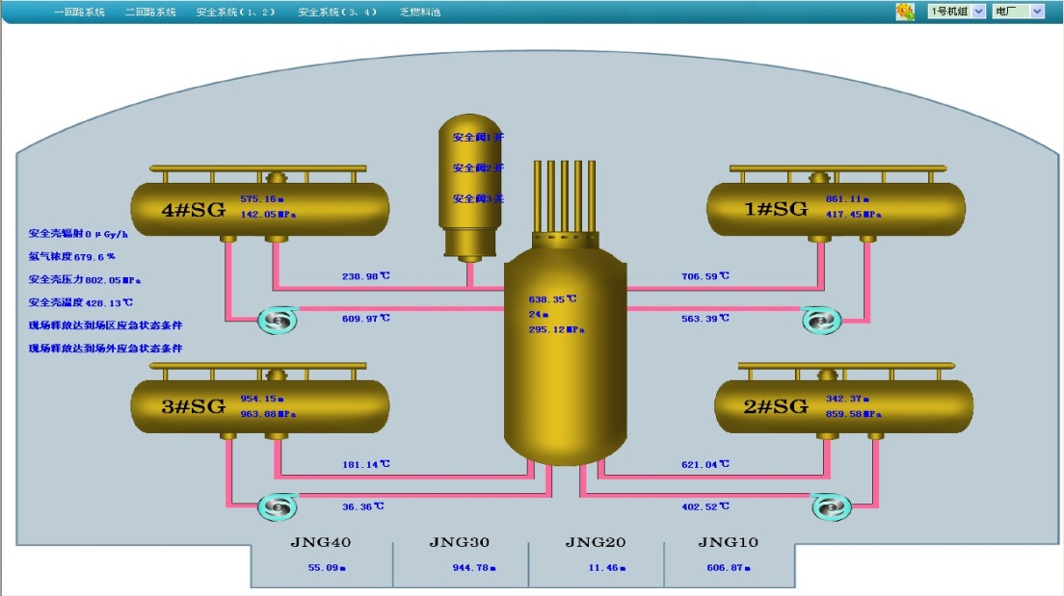
Challenges
Development of a Severe Accident Analyzer Software for NPP
Requirements for SA software development
Capabilities of SA software
Validation and Verification of SA software

Slide 37
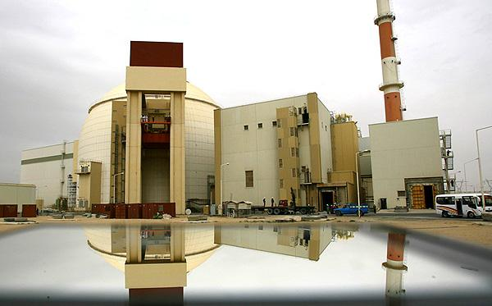
Thanks for your attention!

