Slide 1
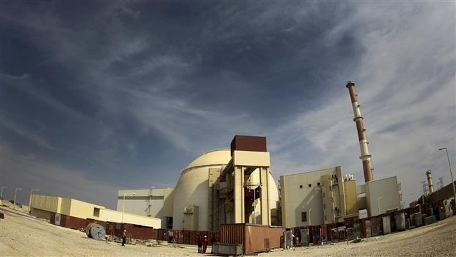
EXTRABUDGETARY PROGRAMME
ON
INTERNATIONAL
GENERIC AGEING LESSONS LEARNED
Iran Nuclear Regulatory Authority
Third meeting of the Working Group 1
Hungary, 3-6 April, 2017
Ali Takht Ardeshir

Slide 2

Contents
  IGALL Purpose
  IGALL Objectives
  Working groups
  AMP
  TLAA
  Proposals for phase 4
  INRA Regulations on AM
  Conclusion
Iran Nuclear Regulatory Authority

Slide 3
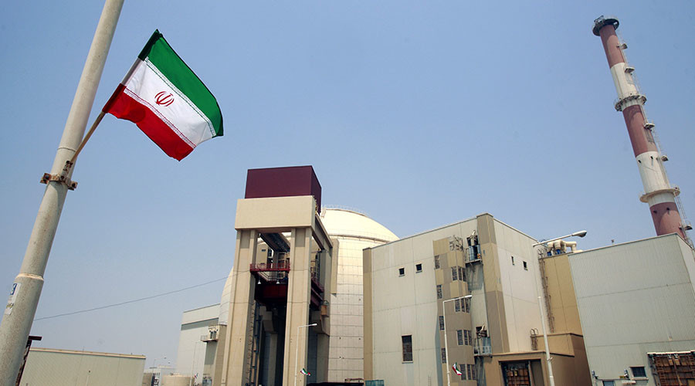
1- IGALL Purpose
IGALL: INTERNATIONAL GENERIC AGEING LESSONS LEARNED
The purpose of the IGALL Programme is:
  To assist regulators and operators of nuclear power plants to maintain the required safety level during operation, taking into account the existing degradation mechanisms, and
  To provide generic support in identification of criteria and practices at the national level applicable to continued operation of the plants.
In this context, LTO of a NPP is intended to indicate operation beyond an established time frame defined by the licence term, the original plant design, relevant standards or national regulations operation
Iran Nuclear Regulatory Authority

Slide 4
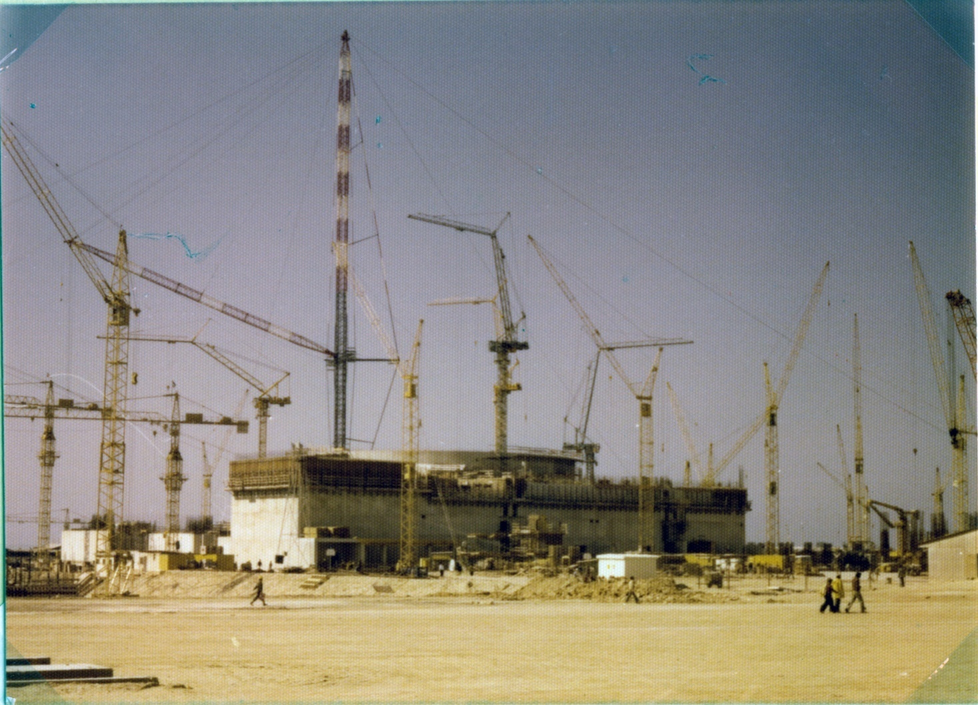
2- IGALL objectives
The objective of the IGALL Programme is to develop the “International Generic Ageing Lessons Learned Document,” which will provide:
  A technical basis and practical guidance on managing ageing of mechanical, electric and I&C components, and civil structures of nuclear power plants important to safety;
  A common internationally recognized basis on what constitutes an effective ageing management programme;
  A knowledge base on ageing management for design of new plants, design reviews, etc., and a roadmap to available information on ageing management;
  A collection of proven ageing management programmes for SSCs important to safety developed and implemented in various types of water moderated reactors, which will be periodically updated.
Iran Nuclear Regulatory Authority

Slide 5
3- Working groups
The Programme activities in the Phase 3 (2016-2017) are implemented in three Working Groups (WG) that are guided and coordinated by the Programme Steering Committee (SC). The three WGs deal with the following areas:
  Working Group on mechanical components (WG1);
  Working Group on electrical and I&C components (WG2);
  Working Group on civil structures (WG3).
Iran Nuclear Regulatory Authority

Slide 6
3- Working groups
Main objectives of IGALL working groups at the current stage are as follows:
  Finalize the review of all AMPs, TLAAs, and AMR table and approve all documents;
  Finalize the improvement of consistency and completeness of definitions, particularly of ageing effects/degradation mechanisms to be included in SRS 82;
  Collection of new proposals to be treated during IGALL, Phase 4.
  Review Section 2 of SRS 82 and collect proposals for next revision.
Iran Nuclear Regulatory Authority

Slide 7
4- AMP
An AMP (Ageing Management Programme) is a set of plant activities relating to understanding, prevention, detection, monitoring and mitigation of a specific ageing effect on a structure, component or group of components.
Plant activities include maintenance, in-service inspection, testing and surveillance as well as operational conditions and technical support programmes.
Iran Nuclear Regulatory Authority

Slide 8
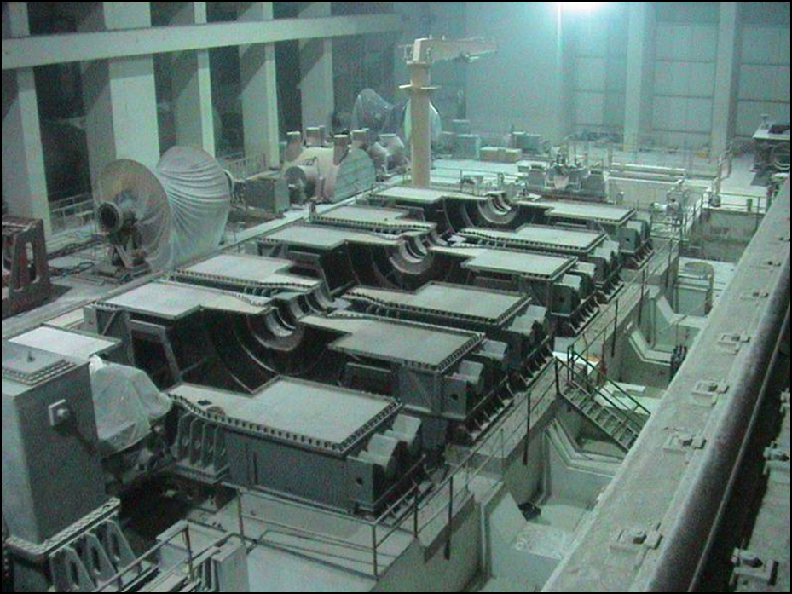
4- AMPs attributes
Scope of the AMP based on understanding ageing
Preventive actions to minimize and control ageing degradation
Detection of ageing effects
Monitoring and trending of ageing effects
Mitigating ageing effects
Acceptance criteria
Corrective Actions
Operating experience feedback and feedback of research and development results
Quality management
Iran Nuclear Regulatory Authority

Slide 9
5- TLAAs
TLAA: Time Limited Ageing Analyses
TLAAs are plant specific safety analysis that consider time and ageing and involve SSCs within the scope of ageing management.
Iran Nuclear Regulatory Authority

Slide 10
5- TLAAs criteria
Involve SSCs within the scope of LTO
Consider the effects of ageing degradation
Involve time limited assumptions defined by the current operating term.
Were determined to be relevant by the plant in making a safety determination as required by national regulations
Involve conclusions related to the capability of the SSC to perform its intended function.
Are contained or incorporated by reference in the CLB (Current Licensing Basis).
AMR
Iran Nuclear Regulatory Authority

Slide 11
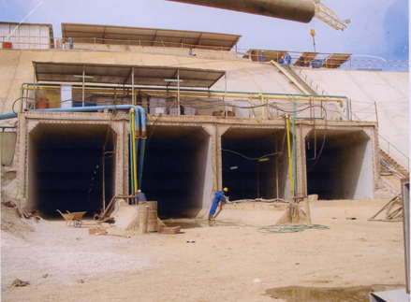
7- PROPOSALS FOR PHASE 4
Guidance for regulators to review NPPs preparedness for safe LTO.
Use descriptions of the further evaluations which are identified in the “further evaluation” column of the NRC GALL AMR table are defined in SRP, part 3.1.2.2 for improvement of IGALL, column “further action”.
Use US NPPs plant-specific AMPs and plant-specific AMR line items for IGALL enhancement.
Use NRC Interim Staff Guidance for IGALL enhancement (updated or new AMPs).
Incorporate fatigue analysis of steel containment (US NRC Regulatory Guide 1.57) into IGALL.
Iran Nuclear Regulatory Authority

Slide 12
6- PROPOSALS FOR PHASE 4
Create a WG on development of TECDOC (and/or AMPs) for delayed construction periods, prolonged outages and post final shutdown.
Consider new designs (e.g. EPR) and evaluate the differences.
Develop a statement/description how to handle maintenance measures and processes for active components in the interaction with AMP.
Develop training for “junior” experts.
Improve IGALL public website.
Iran Nuclear Regulatory Authority

Slide 13
6- PROPOSALS FOR PHASE 4
Check completeness of definitions for “structure/component”, “critical location/part”, “material”, and “environment”
Improve guidance on use of IGALL.
Expand the evaluation of repair/replacement/operating conditions.
Consolidation of existing documents, especially for WG1 AMPs.
Monitoring of Ageing Management Effectiveness as part of Safety Report.
Invite observers, e.g. from new built companies, on a regular basis.
Iran Nuclear Regulatory Authority

Slide 14

7- INRA Regulations on AM
  Inclusion of AM in IRNA’s top level regulation documents “General Safety Principles for Nuclear Facilities and Radiological Activities ” and “Safety regulation of nuclear facilities”
  Developed a document entitled "Ageing Management Safety Regulation for nuclear facilities”
Iran Nuclear Regulatory Authority

Slide 15

7- INRA Regulations on AM (Cont’d)
AM in INRA Documents Pyramid
IAEA Docs
INRA Docs
Safety Fundamentals (SFs)
SF1
General Safety Principles for Nuclear Facilities and Radiological Activities (GSP)
General Safety Requirements (GSRs)
GSR Part 4
Safety regulation of nuclear facilities
Specific Safety Requirements (SSRs)
SSR-2/1, SSR-2/2, NS-R-4
AM Safety Regulation for nuclear facilities
PSR
LTO
Programmatic guidelines, component specific guideline, Review guidelines, Model guidelines, Guidelines on activities for effective life management, guidelines for research reactors (such as: SSG-10, SSG-12, NS-G-2.3, NS-G-2.6, NS-G-2.12, and NS-G-4.2)
General& Specific Safety Guides (SGs)
Iran Nuclear Regulatory Authority

Slide 16

7- INRA Regulations on AM (Cont’d)
General Safety Principles for Nuclear Facilities and Radiological Activities
  The process of safety assessment for facilities and activities is repeated in whole or in part as necessary later in the conduct of operations in order to take into account changed circumstances (such as the application of new regulations or scientific and technological developments), the feedback of operating experience, modifications and the effects of ageing. For operations that continue over long periods of time, assessments are reviewed and repeated as necessary. Continuation of such operations is subject to these reassessments demonstrating that the safety measures remain adequate by complying with the respective safety requirements.
Iran Nuclear Regulatory Authority

Slide 17
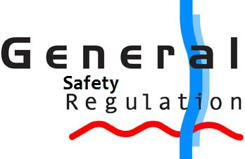
7- INRA Regulations on AM (Cont’d)
INRA General Safety Regulation for Nuclear Facilities and Activities
  Requirement 29: The operating organization shall develop and implement an Ageing Management Programme (AMP) to identify all ageing mechanisms relevant to structures, systems and components (SSCs) important to safety, determine their possible consequences, and determine necessary activities in order to maintain the operability and reliability of these SSCs.
Iran Nuclear Regulatory Authority

Slide 18
7- INRA Regulations on AM (Cont’d)
Ageing Management Safety Regulations for nuclear facilities
Iran Nuclear Regulatory Authority

Slide 19

8-Conclusion
Ageing management of SSCs is one of the most important safety factors which should be implemented proactively through out the lifetime of NPPs and should be addressed properly in regulatory documents.
Regulatory body should be informed and involved from the very beginning stage of the plant lifetime especially in design stage.
Experience gained of the AM activities should be considered in the future project planning.
Sharing of AM experiences and engagement on the International activities lead to strengthen all the AM aspects on the Regulatory side.
Iran Nuclear Regulatory Authority

Slide 20
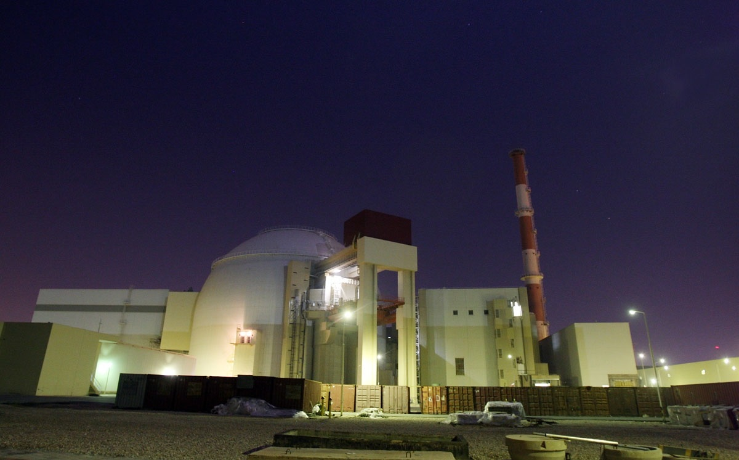

THANK YOU FOR YOUR ATTENTION
Iran Nuclear Regulatory Authority

Slide 21

Iran Nuclear Regulatory Authority

