Slide 1
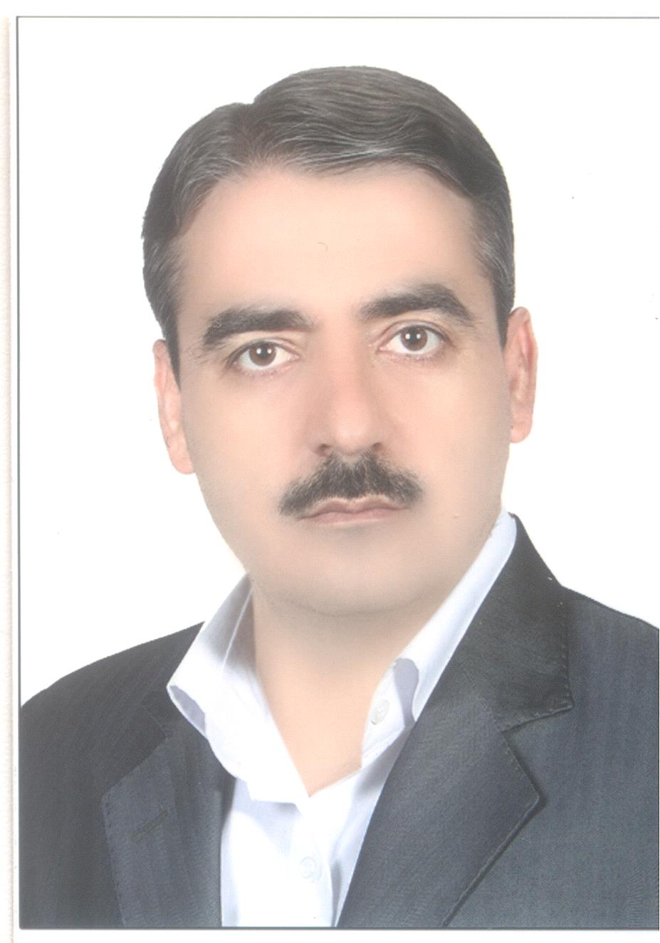
Gholamreza Mohebbi
Country: IRAN
Organization: NPPD Co.
Experiences: 14 year
Career:
  B.S : Civil Engineering
  BNPP Project Management office
    Supervision on Civil & structure
    Managing of Civil & structure section

