Slide 1



Slide 2

AEOI
The Role of Nuclear Power in
I.R. of IRAN National Energy Plan for 2030
Kuala Lumpur – Malaysia
January 2015

Slide 3
Contents
Introduction/Assumptions
Electric Power in IRAN
Nuclear Power in IRAN
Planning of Electricity Production by Nuclear Power ~2030
New Nuclear Power Plant Units

Slide 4
Introduction/Assumptions
Energy is the most important factor in socio-economic development,
Electricity will be predominant in increasing energy demand,
Global approach has led policymakers to assess the different sources of energies which are safe and sustainable methods
Role of electricity in development of industrial infrastructures, in economic development and in improving life styles and standards in the countries.
Mixed energy or using combination of different power production methods is a suitable option in order not to depend on one resource

Slide 5
Electric Power in IRAN
National electricity production , 1967-2012 (TWh)
300
150
0
Average annual growth rate: 11.59%
1967 1990 2012

Slide 6
Electric Power in IRAN
Capacity , Production and Sharing in 2012
Technology sharing percentage
Total Nominal capacity: 69306 MW
Total production: 255805 GWh

Slide 7
Electric Power in IRAN
Fossil Fuel Sharing in electricity production , 1967-2012

Slide 8
Electric Power in IRAN
Share of Fossil Fuels in electricity production-2012

Slide 9
Electric Power in IRAN
Iran's electricity network always relies on fossil-fueled thermal power plants. (Before BNPP-1: 94.4% of electricity from fossil fuel, 4.8% hydro-electric and 0.8% is renewable-After 92.5%, fossil fuels, 2% Nuclear and …)
Fossil resources are not the ideal resources for supplying secure energy in long terms
Hydro-electric power on great extension is not possible due to geological nature of the land.
Renewable energy sources such as wind, solar, geothermal do not have major share in producing the primary energy due to the technical limitations and lack of enough justification.
The capacity of constructible power plants on mentioned sources (hydro & renewable energy) in 2030 is very little in comparison with total need of the country

Slide 10
Main Factors in Identifying Energy Resources
Fossil fuels price and Its fluctuation trends
  Instability of fossil fuels price,
  Reliance on burning liquid fuels will have high economic costs
Available fossil fuels will be insufficient
Diversity and security of energy resources (supplies)
Importance of sustainable development and environmental protection
Cost of generated electricity in power plants

Slide 11
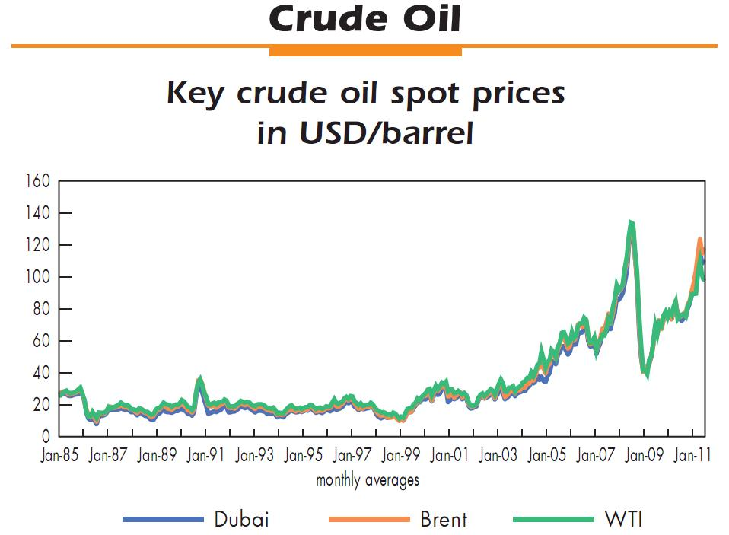
Main Factors in Identifying Energy Resources

Slide 12
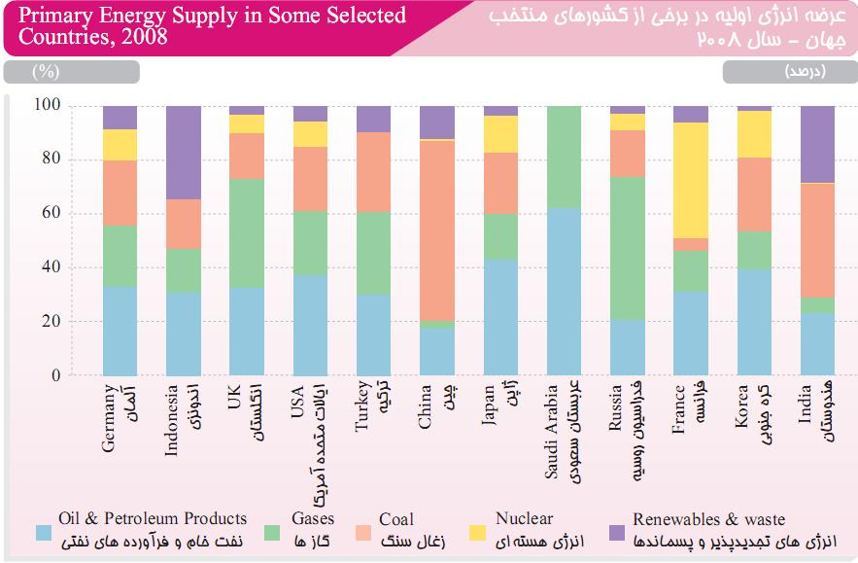
Main Factors in Identifying Energy Resources

Slide 13
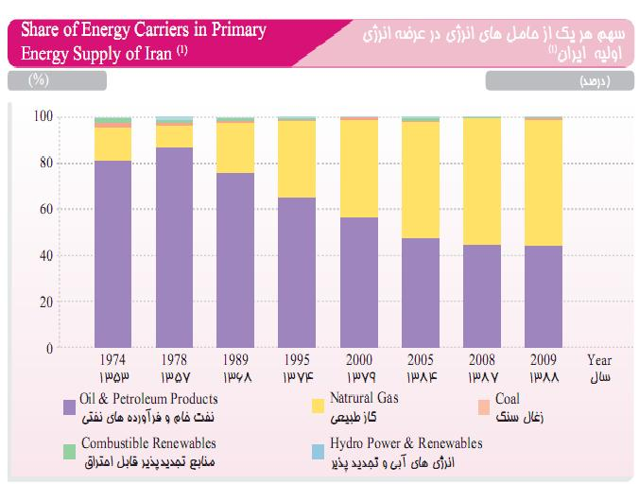
Main Factors in Identifying Energy Resources

Slide 14
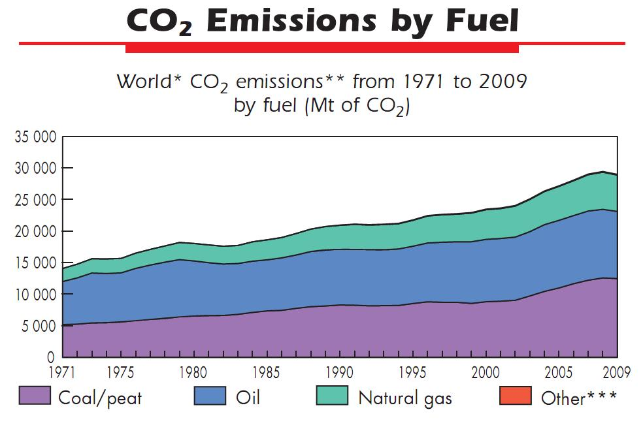
Main Factors in Identifying Energy Resources

Slide 15
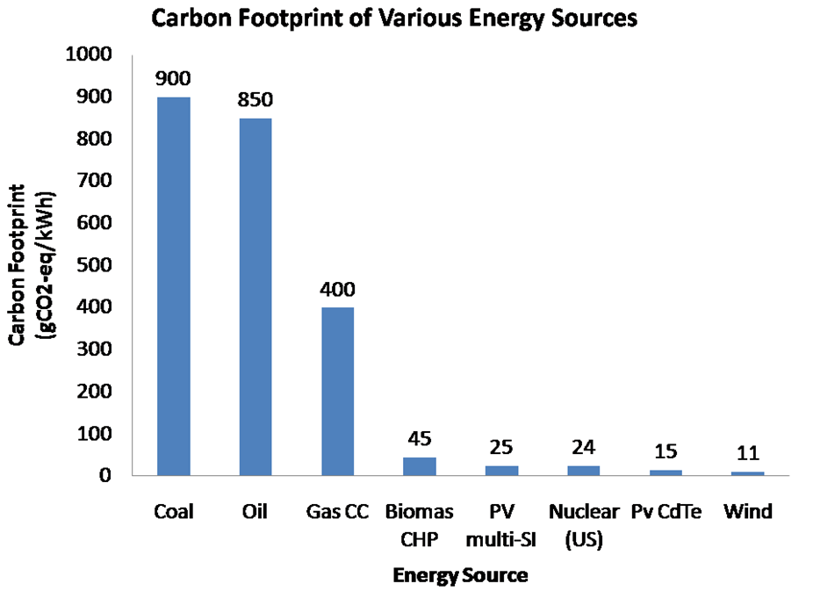
Main Factors in Identifying Energy Resources

Slide 16
Main Factors in Identifying Energy Resources- IRAN
Nuclear energy is a compelling solution to the nation’s energy demand for following reasons:
  Security of supply
  Environment
  Economic
  Industrial development
Nuclear Power is a proven, environmentally attractive and cost competitive electricity generation option.

Slide 17
History of Energy Planning in IRAN
Studies of SRI ( Stanford Research Institute)
  Planning period: 1975-1997
  Forecasting for electricity demand: 55000 MW
  Forecasting for nuclear power sharing: 9000 MW (%16)
Studies of Sharif Sc.&Tech university
  Planning period : 1989-2021
  Forecasting for electricity demand: 52000 MW
  Forecasting for nuclear power sharing: 1160 MW (%21)

Slide 18
History of Energy Planning in IRAN
Studies of AEOI and the council of Nuclear Energy of Iran
  Planning period: 2001-2021
  Forecasting for electricity demand: 47000-60000 MW
  Forecasting for nuclear power sharing: 4000-1000MW (%6-%13)
Studies of Power Ministry Research Institute
  Planning period : 2006-2026
  Forecasting for electricity demand: 123000MW
  Forecasting for nuclear power sharing: 15000MW (%12)

Slide 19
History of Nuclear Energy in IRAN
‍Contracts and agreements between AEOI and Int. contractors to build NPP
before the Islamic Revolution in IRAN
name of Contractors | Nominal Capacity, MW | Name of NPP |  | No.
KWU - Germany | Bushehr NPP-1 | 1293 | C | 1
KWU - Germany | Bushehr NPP-2 | 1293 | C | 2
Framatom - France | Karon NPP-1 | 953 | C | 3
Framatom - France | Karon NPP-2 | 853 | C | 4
KWU - Germany | Esfahan NPP-1 | 1293 | A | 5
KWU - Germany | Esfahan NPP-2 | 1293 | A | 6
KWU - Germany | Saveh NPP-1 | 1293 | A | 7
KWU - Germany | Saveh NPP-2 | 1293 | A | 8
BBC - Germany | Azerbaijan NPP-1 | 1300 | A | 9
BBC - Germany | Azerbaijan NPP-2 | 1300 | A | 10

Slide 20
History of Nuclear Energy in IRAN
 | Year
Start of academic nuclear education | 1959
Operation of TRR | 1968
Establishment of AEOI – Bushehr NPP Contract (KWU) | 1974
Intergovernmental Agreement with Russia for completion of BNPP-1 | 1995
Changing to Turn-Key contract | 1998
BNPP-1, First grid connection | Sept. 2011
BNPP-1, Reach(Achieve) to 1000 MWe | Aug 2012
BNPP-1, Provisional Acceptance to Iranian Operator | Sept. 2013

Slide 21
Bushehr Nuclear Power Plant-1 (BNPP-1)
Construction started in 1974, KWU design, 2 PWR units each 1293 MWe
Construction stopped in 1980
In Jan. 1996 contract was effective with RF to complete the unit-1 based on VVER-1000 type446 (modified version of 320) with most utilization of KWU available building & equipment
First criticality achieved in 08.05.2011
Unit connected to the grid on 03.09.2011
Unit provisional acceptance in 23.09.2013

Slide 22
What was gained
Updating nuclear standards,
Competency building in National Companies for suitable contribution in the program,
Engineering experience in Project Management,
Sufficient training in new generation for Operation,
Participation of trained operators in commissioning phase which enabled them prepared for proper repair & maintenance activities and refueling,
Planning for development suitable Technical infrastructure,
Involvement of universities and research institutes in appropriate subjects,
Upgrading nuclear safety infrastructure including Regulatory Body, and;
Public awareness and acceptance

Slide 23
Concerns on the Bushehr Nuclear Power Plant Program
More than 35 years under construction,
Heavy preservation program within long steady state and construction period,
Destructions due to the air rides,
Modified plant with two technologies,
Loss of some equipments due to the “integration” program,
Loss of trained experts of original program

Slide 24
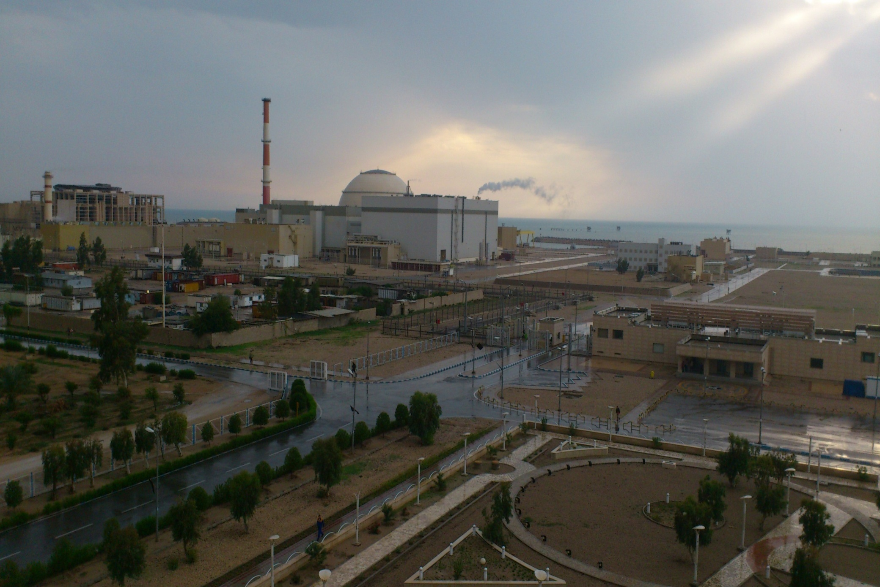
Benefits of Bushehr NPP-1 operation 2012-2014
Electric production, more than 10 Twh – End Of 2014
Saving more than 2.8 Billion liters fossil fuel
Preventing to release environmental pollutions , 8-10 million tons in year, approximately.

Slide 25
Reasons for developing the nuclear power in the I.R. of IRAN
Needs of the Country's developing programs for energy
The necessities arise from energy security point of view
Diversification of power generation sources through implementation of NPP
Environmental consideration and sustainable development
Limitation of energy sector's impact on environment – restriction on SO2, NOx and CO2 emissions
Techno-economic advantages
Influence on the development of other sectors
  Possibility of using the oil resources to produce higher-value products
  Iran has to use energy mix option and especially developing the nuclear power plants as a necessary part of energy mix in long term programs

Slide 26
Nuclear Power Planning for Electricity Production by ~2030
Recent Study conducted by Nuclear Power Production & Development Company (NPPD Co.)
  Goal: To determine the share of nuclear energy in the country's electric power sector
  Time of study: 2010
  Planning period : 2010-2030
  Planning Model: WASP – IAEA (Wien Automatic System Planning)
  WASP (Wien Automatic System Planning Package) is specific Model for Planning of electrical energy and simulate the systems of electricity production and consumption. WASP determines which need to be generated by the power plants.

Slide 27
Nuclear Power Planning for Electricity Production by ~2030
conducted by Nuclear Power Production & Development Company (NPPD Co.)
The share of nuclear power in electricity generation
Techno - economic considerations for Development of nuclear power plants by WASP
Access to advanced Technologies, Diversification and security of energy and Environmental impact

Slide 28
Nuclear Power Planning for Electricity Production by ~2030
WASP Features
WASP
Study
Environmental
Economical
Technical
Wien Automatic System Planning Package

Slide 29
Nuclear Power Planning for Electricity Production by ~2030
WASP Required Data
  Type of candidate power plants and Its Capacity
  Investment cost
  Type of fuels (fossil, nuclear and …)and Thermal value
  Fuel price
  Power Plant Efficiency
  Operating & maintenance costs
  Lifetime
  Entrance time of under construction power plants
  Composition of fuel used in the different seasons
  Construction time
Different scenarios were defined based on the parameters of each candidate plant and the results were analyzed.
First load required and electricity capacity for 2010~ 2030 was determined.
Then 36 scenarios were performed by WASP

Slide 30
Estimating Demand of electricity Capacity for 2010~ 2030
Average annual growth rate: 5.5%

Slide 31
The capacity for development of alternative power in base scenario- 2030

Slide 32
New Nuclear Units -BNNP 2 & 3
Technical requirements related to the construction of the new units
Technical requirements
GEN 3+, PWR reactors, 60 years life-time
Standardization ⇒ shorter licensing and construction time
Shorter maintenance period
Longer fuel cycles (extend to 18 months)
Less radioactive waste
Fresh water cooling
More than 90 % LF (in base load operation mode)
Safety increasing solutions
Passive safety systems
Mitigation and prevention of severe accidents
Higher protection against internal and external events
High volume and strong press-tested concrete containment
Long term and reliable containment cooling
Melted core cooling with core catcher
Independent safety systems including power supply
Increased passive safety systems
Hydrogen removal by passive recombinators
Mobile EDGs & Diesel pump
Protection against external hazards
Seismic hazards
Extreme meteorology
Airplane crash
Accidents form other industrial sources
Electromagnetic interference

Slide 33
New Nuclear Units -BNNP 2 & 3
Main technical specification
Reactor type: AES-92 (Modified 2008)
Thermal power, 3012 MWe
Electric power, 1057 MWe
Efficiency , > 35 %
Power consumption, 83 MWe
Total availability factor, 93 %
Plant design service life, 60 years

Slide 34
New Nuclear Units -BNNP 2 & 3
New Project preliminaries & Milestones
Completion of Long-Term Planning of IRAN for Electricity Production
2010
2011
Completion of the technical studies and technological requirements related to the Construction of the new units
2012-13
NPPD and Rosatom (ASE) direct negotiation
Intergovernmental agreement signed between AEOI & Rosatom, NPPD and ASE signed the contract (2 Units),
Start Site Engineering survey
Nov. 2014
Next
Final commitment and Submission of documents for construction licence
2015
2024
Commercial operation, BNPP Unit 2
2026
Commercial operation, BNPP Unit 3

Slide 35
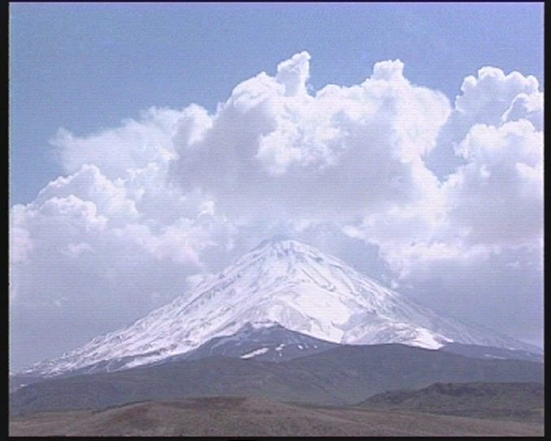
Looking for:
Sustainable Development
Thanks for your attention…

