Slide 1

BGM Regional Center Update
March 26 / 27

Slide 2
Agenda
High Level Schedule of Events / Allowances
Overview of Facilities
Status of Meeting Planning
Open Items
Regional Center Input

Slide 3
BGM Program Overview
October 3: ELT Meeting
October 4: Regional GBs, Lunch, WANO-GB, Welcome Reception at Hotel
October 5: BGM Closed Session, Lunch, BGM Open Session, Dinner at Royal Ontario Museum
October 6: BGM Open Session, Lunch, Open Session, NEA Awards, Dinner, and Entertainment
October 7-10: Post BGM Tours – Darlington/Bruce (Niagra Falls), Calvert Cliffs (Washington DC), Vogtle (Savannah)

Slide 4
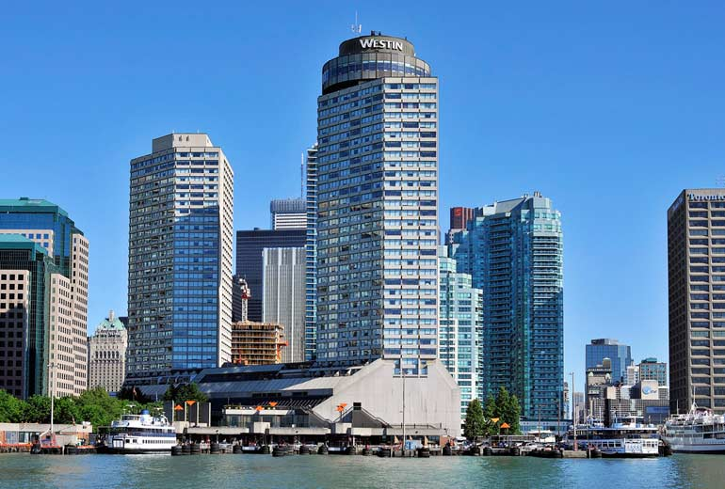
Westin Hotel

Slide 5
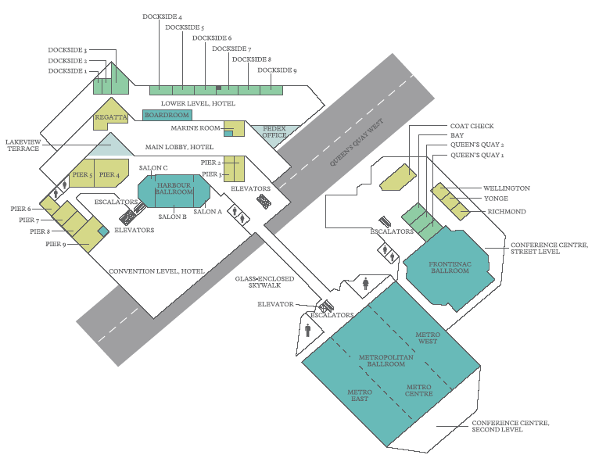

Slide 6
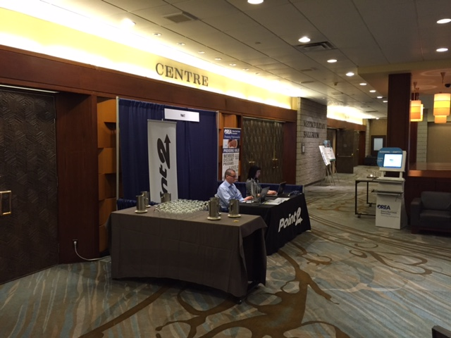
Outside BGM Conference Room

Slide 7
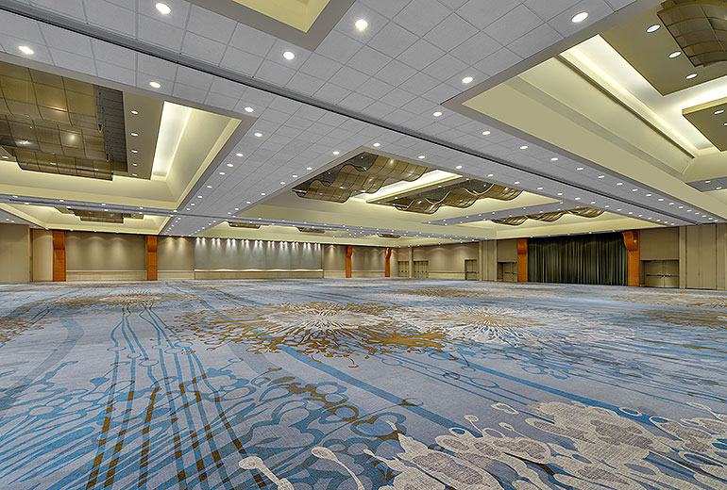
BGM Conference Room

Slide 8
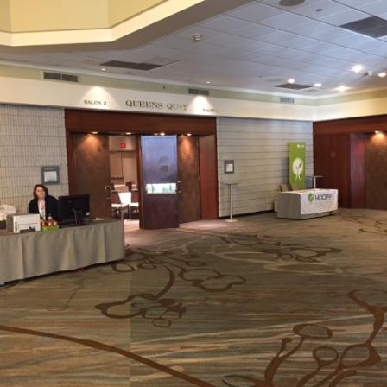
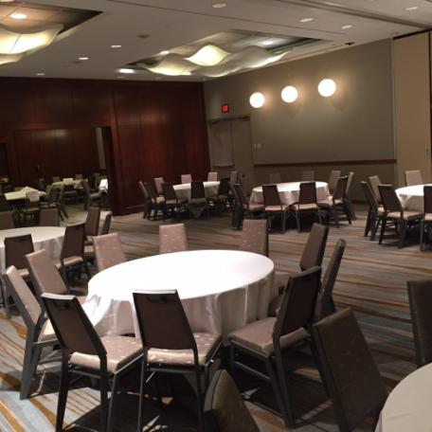
WANO – GB Room Queens Quay

Slide 9
Status of Meeting Planning
Technical Program
Technical Program
Theme of Meeting and Draft Approved
BGM Logo and Branding Developed
Key Note Speaker Selected
BGM Slide Templates Created
Upcoming Milestones
Receipt of NEA Nominations: April 30
Mailing of Invites and BGM Brochures: April 10
Finalize Selection of Panelists: July 1

Slide 10
Status of Meeting Planning
Logistics
Completed Milestones
BGM Day Tours and Post BGM Venues Finalized
Upcoming Milestones
Webcast with RCs to go over BGM logistics: April 7
Registration Web Page Opens: April 7

