Slide 1
OE Reporting concerns
Kris Mertens
ELT
19 June 2019
DISTRIBUTION CLASSIFICATION:
[LIMITED]

Slide 2
OE Reporting concerns – Context (FYI)
  ELT October 2018 – Discussion of PA Annual Programme Report
    Low event reporting was raised as a cross cutting issue in the Internal Assessment Report
    Need to have a more detailed analysis of non-reporting by members; particular plants might have unique reasons for low reporting; RCs might provide a more informative view.
    Need to identify those members with specific reporting concerns, and provide them to the ELT
  ELT February 2019 – Discussion of specific OE reporting concerns
    Need to focus on members who are not reporting required events, rather than on a “minimum number” (*)
    Suggestion to resolve I.A. cross-cutting issue: perform audit by WANO Reps to ensure we receive the SIG & NOT events
(*) OE Reference Manual does not specify “minimum” number of event reports

Slide 3
OE Reporting concerns - Overview
=> Task (ELT Minutes 16/02/2019)
    “to present a proposal on how to audit and identify where we have reporting concerns by members. WANO representatives can look at the report and compare the plant performance to identify where there are specific concerns. The regional directors can then on a case by case basis deal with the reporting problems.”
  Issues to be addressed:
    Audit of member reporting practices
    Identification of low-reporting members

Slide 4
OE Reporting concerns – Current situation
Current auditing practices (how do we know we get the event reports we should get)
  Crosschecks with PI data have been expanded. Very useful to detect issues with SCRAMS not reported, fuel failures, safety system unavailability's (*)
  Periodic verification of IAEA IRS database
  Press releases, media, …
  Peer Reviews: attention to AIPs, internal “condition reports”, power histories, … In some cases, OE AFIs have been developed!
(*) More useful to improve PI data quality

Slide 5
OE Reporting concerns – Current situation
The way forward
  Continue current initiatives, streamline where needed. LO to provide governance & oversight.
  Further expand collaboration with PR programme to ensure attention to AIP contents w/r to missing event reporting. Once practice is well-embedded, involve WANO Reps to include further verifications (cf. MC practices).

Slide 6
OE Reporting concerns – Current situation
Current formats to report OE reporting trends
  Bar graphs, showing number of (SIG + NOT + TRE) events as well as OTHER events, reported over a fixed period, on a station basis
  Bullet graphs, showing number of events reported over a fixed period (e.g. 2018), vs. WANO index (as a measure of performance), per unit.

Slide 7
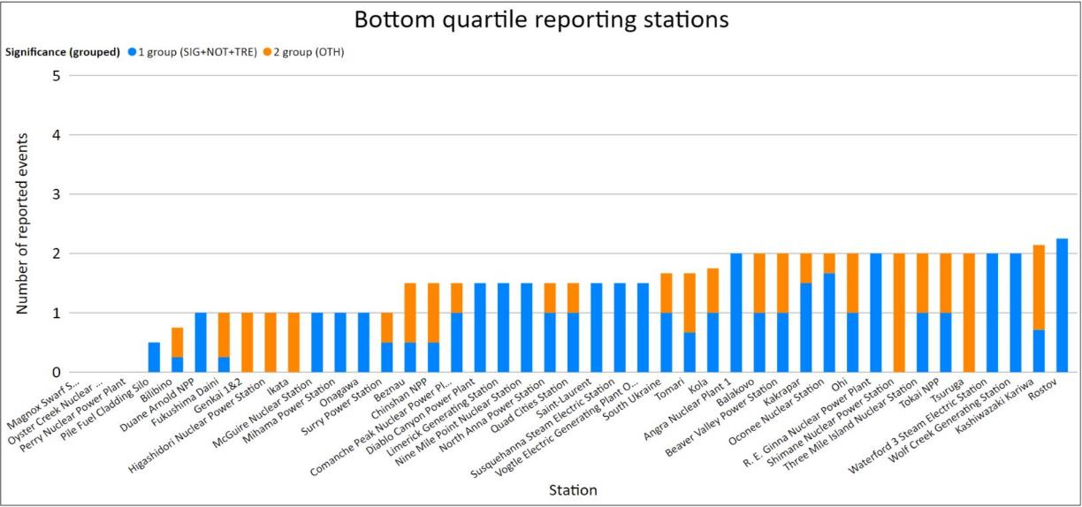
OE Reporting concerns – Current situation
Bar graph example:

Slide 8
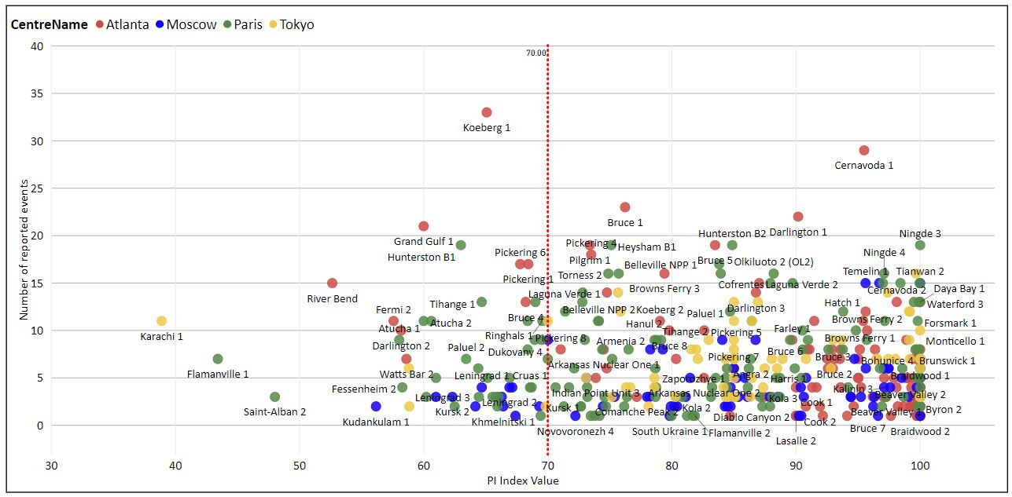
OE Reporting concerns – Current situation
Bullet graph examples:

Slide 9
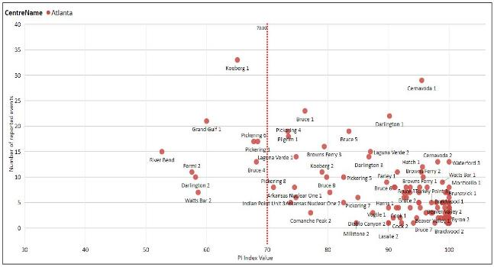
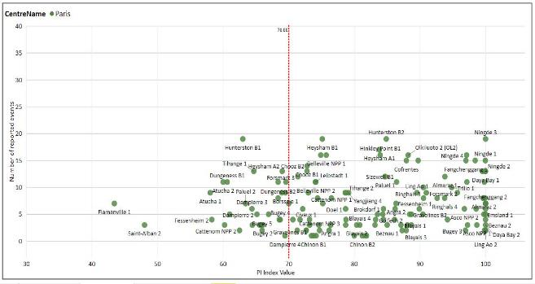
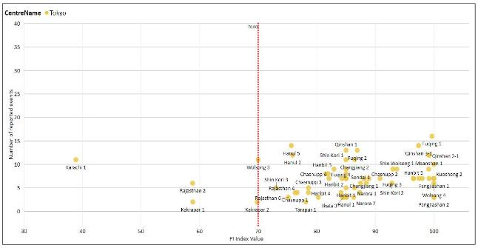
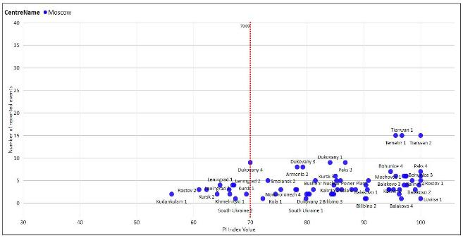
OE Reporting concerns – Current situation
Bullet graph examples:

Slide 10
OE Reporting concerns – Current situation
Pros & cons:
 | Bar graph | Bullet graph
+ | Allows to make distinction between (SIG/NOT/TRE) event reports vs. OTHER event reports. Unambiguous. | Allows to make distinction between good and bad performers, and take that into account in decision making. Might allow to visualise evolution in time
Δ | Does not allow to make distinction between good and bad performers. Does not allow to easily visualise evolutions. | No distinction between SIG/NOT/TRE events and OTHER events.

Slide 11
OE Reporting concerns – Proposals
Proposal 1: cut-off below “X” (e.g. 1) in bar graph
Units with reporting concern

Slide 12
OE Reporting concerns – Proposals
Proposal 2: lower left quadrant in bullet graph
Units with reporting concern

Slide 13
OE Reporting concerns – Proposals
Proposal 3: “zoning” in bullet graph

Slide 14
OE Reporting concerns – Discussion
Discussion
  Given the drawbacks of proposals 1 and 2, we’d suggest to further develop proposal 3.
  Since the index-value of each unit is calculated quarterly, an update to the list of units with reporting concerns can be produced quarterly as well.
  Additional qualifying information could be easily incorporated (e.g. mean reporting time of SIG/NOT/TRE events).
  The graph format might allow further refinement (e.g. by varying colour and size of the bullets).
  This approach might be of use for the member performance dashboard as well.

Slide 15
OE Reporting concerns – Conclusion
Summary proposal
  Audit: at this stage, focus on further collaboration with PR teams to get useful feedback on event reporting (AIP, power histories).
  Low reporters: implement proposal 3, generate periodic report for ELT, LLT, maybe WANO Reps.
  Complement with RC input w/r to low reporters, to ensure site-specific explanatory information is included.

