Slide 1
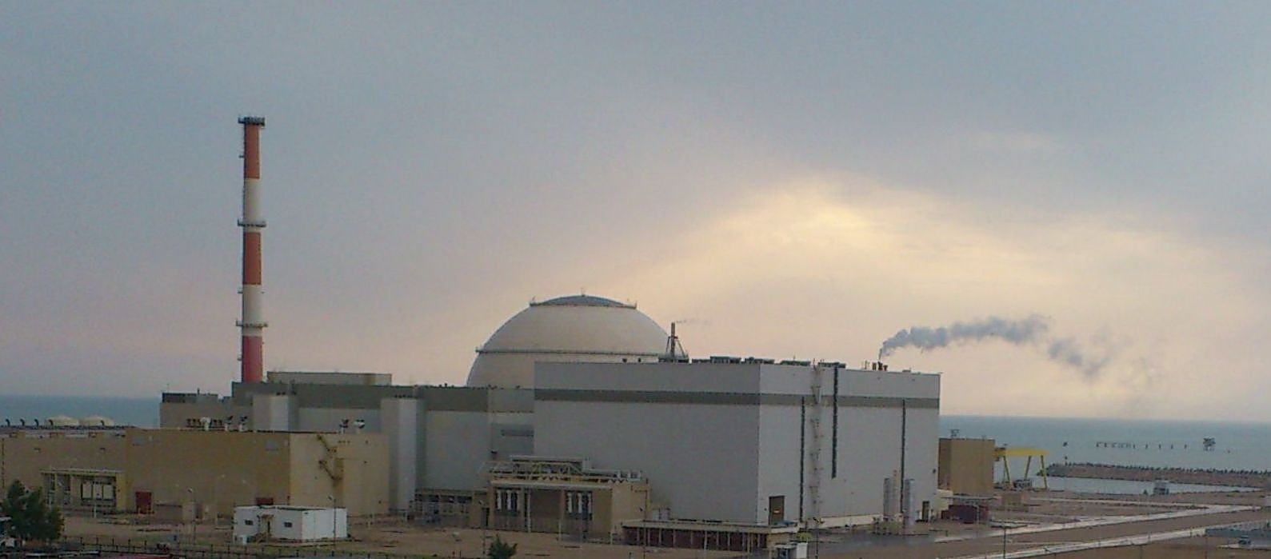
Nuclear Power Production & Development Co.of Iran
BNPP-1 Status
Report to
Review and Planning Meeting
for IAEA-IRAN TC Projects
Tehran, 15-17 Feb. 2015

Slide 2
Table of Content
A – Major Activities in 2014,
First Planned Outage for Refueling
Technical support contract with REA
Establishment of TS company
Performance of guarantee tests
Finalization of contract for new units
Notes:
Summery of Bushehr NPP-1
Contribution of local industries in the BNPP-1
Program for enhancing of local participation in .future NPPs in area of:
- Design

Slide 3
Table of Content
B- Plan Activities in 2015,BNPP-1
Delivery third cycle fuel
Decision to utilize new fuel,TVS-2M
Preparation for planned outages
Readiness for WANO Peer Review
Obtaining license for operation
Follow up stress test result
Follow up SAM
Notes:
Summery of Bushehr NPP-1
Contribution of local industries in the BNPP-1
Program for enhancing of local participation in .future NPPs in area of:
- Design

Slide 4
Table of Content
B. Plan Activities in 2015, New Units
Overall time schedule
Activities related to the new units
- Engineering survey
- Study for desalination plant
- Site mobilization
- Management of local participation
Notes:
Summery of Bushehr NPP-1
Contribution of local industries in the BNPP-1
Program for enhancing of local participation in .future NPPs in area of:
- Design

Slide 5
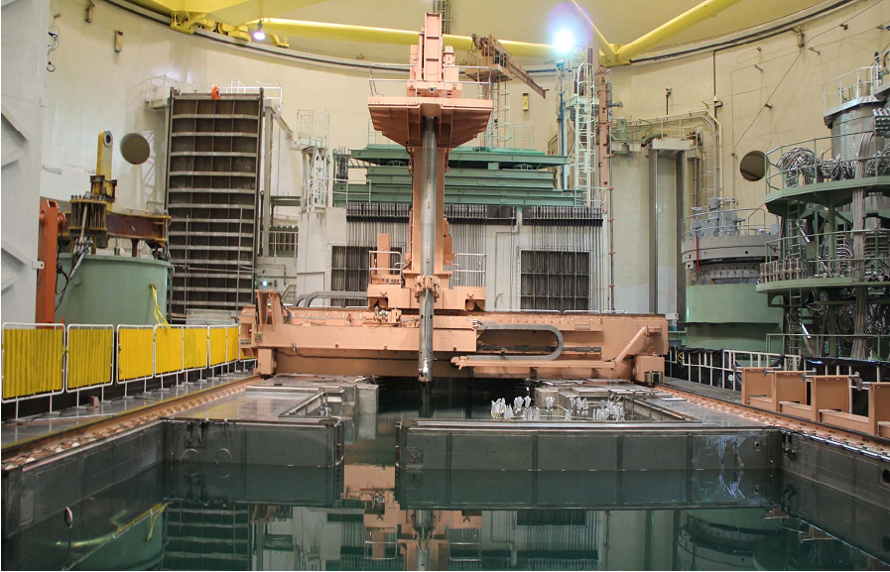
Major Activities in 2014,
First BNPP-1 Planned Outage
Notes:
Summery of Bushehr NPP-1
Contribution of local industries in the BNPP-1
Program for enhancing of local participation in .future NPPs in area of:
- Design

Slide 6
Scope of RF contractors; reactor & reactor auxiliary ..building, I&C, safety systems and Turbo generator
Scope of IRI contractors; non active buildings, all ..preparatory works within scope of RF contractors, ..fuel handling & refueling machine operation and ..welding services
First Planned Outage 04.02.2014 - 25.06.2014
Notes:
Summery of Bushehr NPP-1
Contribution of local industries in the BNPP-1
Program for enhancing of local participation in .future NPPs in area of:
- Design

Slide 7
First Planned Outage 04.02.2014 - 25.06.2014
Outage duration 140 days, 65% more than the plan ..and due to:
- First experience;
- Interface between RF and IRI contractors;
- Performing some repeated tests from commissioning …stage.
Notes:
Summery of Bushehr NPP-1
Contribution of local industries in the BNPP-1
Program for enhancing of local participation in .future NPPs in area of:
- Design

Slide 8
Major Activities in 2014,
Technical Support
In line with NPPD overall responsibility to support BNPP-1 for safe and reliable operation:
Contract with RF operating organization, REA, was ..agreed in the scope of :
- Nuclear engineering
- Optimization of plant performance
- Supply of equipment in emergency situation
- Strengthening of TAVANA co. capabilities
Notes:
Summery of Bushehr NPP-1
Contribution of local industries in the BNPP-1
Program for enhancing of local participation in .future NPPs in area of:
- Design

Slide 9
Major Activities in 2014,
Technical Support
Establishment of TAVANA as the external technical support Co. for BNPP-1 with the objectives:
Capability building in the area of Nuclear ..engineering
Identification of local general engineering ..capabilities;
Cooperation with REA;
Expand the scope of local participation.
Notes:
Summery of Bushehr NPP-1
Contribution of local industries in the BNPP-1
Program for enhancing of local participation in .future NPPs in area of:
- Design

Slide 10
Major Activities in 2014, Performance of Guarantee Tests
Test Result | Contract Provision | Index Description
929.15 | 915(MWe) | Net electrical output | 1
88.10 | 98(Mwe) | Unit auxiliary Consumers | 2
1229 | 12402(KJ/KWhr) | Weighted average net heat rate | 3
Notes:
Summery of Bushehr NPP-1
Contribution of local industries in the BNPP-1
Program for enhancing of local participation in .future NPPs in area of:
- Design

Slide 11
Major Activities in 2014,
Contract for New Units
Contract for new units was signed on Nov.11.2014
Reactor type, VVER-1000 generation 3+
Reference plant is Kudankulam with consideration of set of modifications as reflected in the App.A.
Notes:
Summery of Bushehr NPP-1
Contribution of local industries in the BNPP-1
Program for enhancing of local participation in .future NPPs in area of:
- Design

Slide 12
Major Activities in 2014,
Contract for New Units
Value | Characteristics
1057 | Gross electrical power , not less than (MWe) | 1
83 | Unit power consumption, not more than(MWe) | 2
93 | Availability factor(%) | 3
4*100 | Safety system | 4
72 | Battery life for accident monitoring (hr) | 5
1.4*SSE | Beyond design base earthquake | 6
4*33% | Passive primary circuit heat removal by air | 7
Diesel pump & generator | Supply of equipment for post sever natural events | 8
100% | Molten core localization and cool down system | 9
Notes:
Summery of Bushehr NPP-1
Contribution of local industries in the BNPP-1
Program for enhancing of local participation in .future NPPs in area of:
- Design

Slide 13
Plan Activities in 2015,BNPP-1 BNPP-1 Fuel
Fuel for the Third cycle is under verification at the ..moment by IAEA in the manufacturer premises and ..will deliver shortly as planned.
Decision making regarding fuel supplier proposal to ..shift to new fuel,TVS-2M, with 18 months cycle for ..BNPP-1.
Notes:
Summery of Bushehr NPP-1
Contribution of local industries in the BNPP-1
Program for enhancing of local participation in .future NPPs in area of:
- Design

Slide 14
Plan Activities in 2015,BNPP-1 Planned outages
In 2015 two outages were planned:
- first one 01.03.2015 till 25.04.2015, auxiliary works ...only, without opening the reactor,
- Second one starts from 01.09.2015 routine major ...repair including refueling.
Notes:
Summery of Bushehr NPP-1
Contribution of local industries in the BNPP-1
Program for enhancing of local participation in .future NPPs in area of:
- Design

Slide 15
Plan Activities in 2015,BNPP-1
Readiness for WANO Peer Review
Cooperate ( NPPD) Peer Review will be conducted in ..Nov./Dec. 2015 and its pre-visit will be in May 2015.
Preparatory activities have been started since middle ...of 2014 and a workshop is planned next week by ..WANO.
BNPP-1Peer Review will be conducted in June 2015.
Notes:
Summery of Bushehr NPP-1
Contribution of local industries in the BNPP-1
Program for enhancing of local participation in .future NPPs in area of:
- Design

Slide 16
Plan Activities in 2015,BNPP-1
Operation License
60% of required documentation for obtaining operation license are ready for submission to INRA and NPPD are in close contact with the regulator to fulfill their remaining requirements.
Notes:
Summery of Bushehr NPP-1
Contribution of local industries in the BNPP-1
Program for enhancing of local participation in .future NPPs in area of:
- Design

Slide 17
Plan Activities in 2015,BNPP-1
Safety Improvement
Procurement of equipment for sever natural event, ..expect to be delivered to the site in third quarter 2015
- Mobile diesel generator
- Mobile diesel pump
Works on the conceptual design has been initiated
Notes:
Summery of Bushehr NPP-1
Contribution of local industries in the BNPP-1
Program for enhancing of local participation in .future NPPs in area of:
- Design

Slide 18
Plan Activities in 2015,BNPP-1
Safety Improvement
Working team has been assigned to dealt with SAM
Programme for development and implementation of ..severe accident management guidelines in Bushehr ..NPP Unit 1 has been developed based on WOG
Also our experts based on the plant capability and ..design features are working on the some measures ..with minor modification in the area of :
- Fuel pool cooling
- Primary circuit cooling through SG
Notes:
Summery of Bushehr NPP-1
Contribution of local industries in the BNPP-1
Program for enhancing of local participation in .future NPPs in area of:
- Design

Slide 19
Plan Activities in 2015,New Units Overall Time Schedule
Months after commencement date* | Activity
21 | Basic design including PSAR, PSA | 1
33 | First concrete | 2
98 | Physical start up | 3
108 | Provisional acceptance | 4
*- Commencement date is related to the site data preparation and handover to the .....Contractor
- Unit 2 with 18 months time lag
Notes:
Summery of Bushehr NPP-1
Contribution of local industries in the BNPP-1
Program for enhancing of local participation in .future NPPs in area of:
- Design

Slide 20
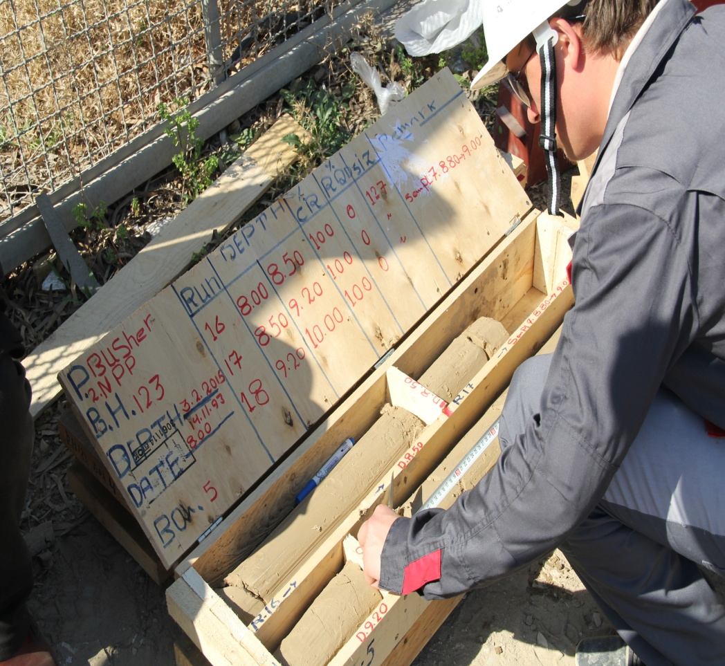
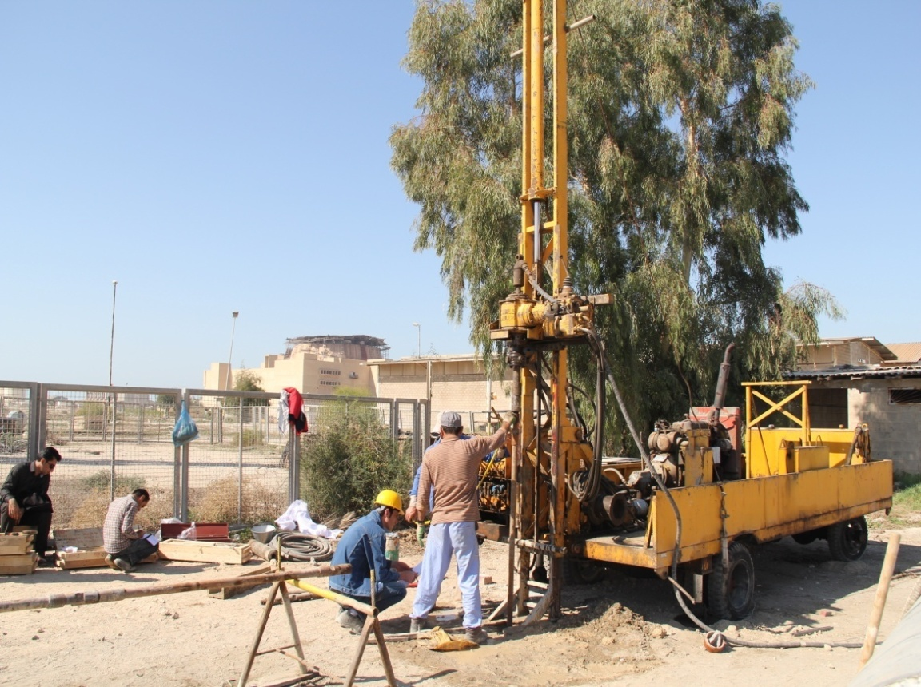
Plan Activities in 2015,
Related to the New Units
Site engineering survey for preparation of site data has been started jointly with the cooperation of the ASE.
Notes:
Summery of Bushehr NPP-1
Contribution of local industries in the BNPP-1
Program for enhancing of local participation in .future NPPs in area of:
- Design

Slide 21
Plan Activities in 2015,
Activities Related to the New Units
General site layout were agreed
Activities related to the residential camp and site ...infrastructures have been started.
Study for the sea water desalination is conducted ..with the cooperation of the Ministry of Power.
Notes:
Summery of Bushehr NPP-1
Contribution of local industries in the BNPP-1
Program for enhancing of local participation in .future NPPs in area of:
- Design

Slide 22
Plan Activities in 2015,
Related to the New Units
Preparation of the potential local suppliers / ..manufacturers for the Contractor’s consideration
Establishment of local General Contractor for ..management of works under NPPD responsibility
Notes:
Summery of Bushehr NPP-1
Contribution of local industries in the BNPP-1
Program for enhancing of local participation in .future NPPs in area of:
- Design

Slide 23
Thank you
for
your attention
Notes:
Summery of Bushehr NPP-1
Contribution of local industries in the BNPP-1
Program for enhancing of local participation in .future NPPs in area of:
- Design

Slide 24
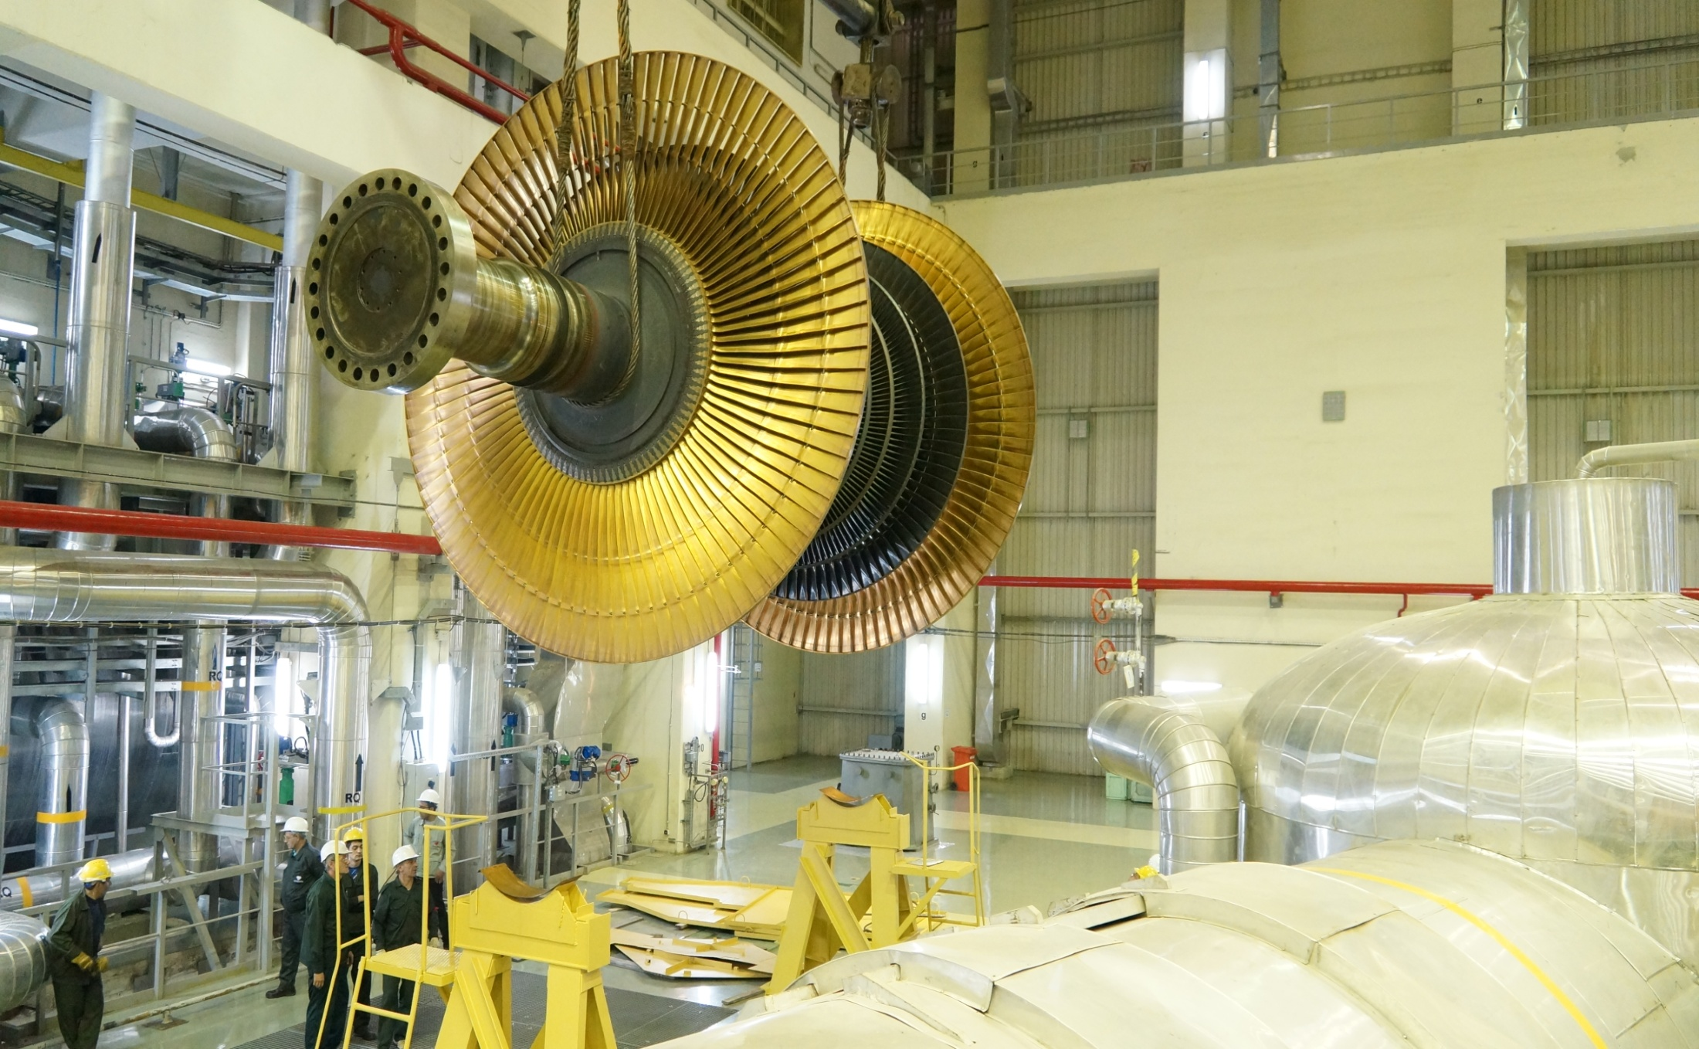
Inspection of LPC-2
Notes:
Summery of Bushehr NPP-1
Contribution of local industries in the BNPP-1
Program for enhancing of local participation in .future NPPs in area of:
- Design

Slide 25
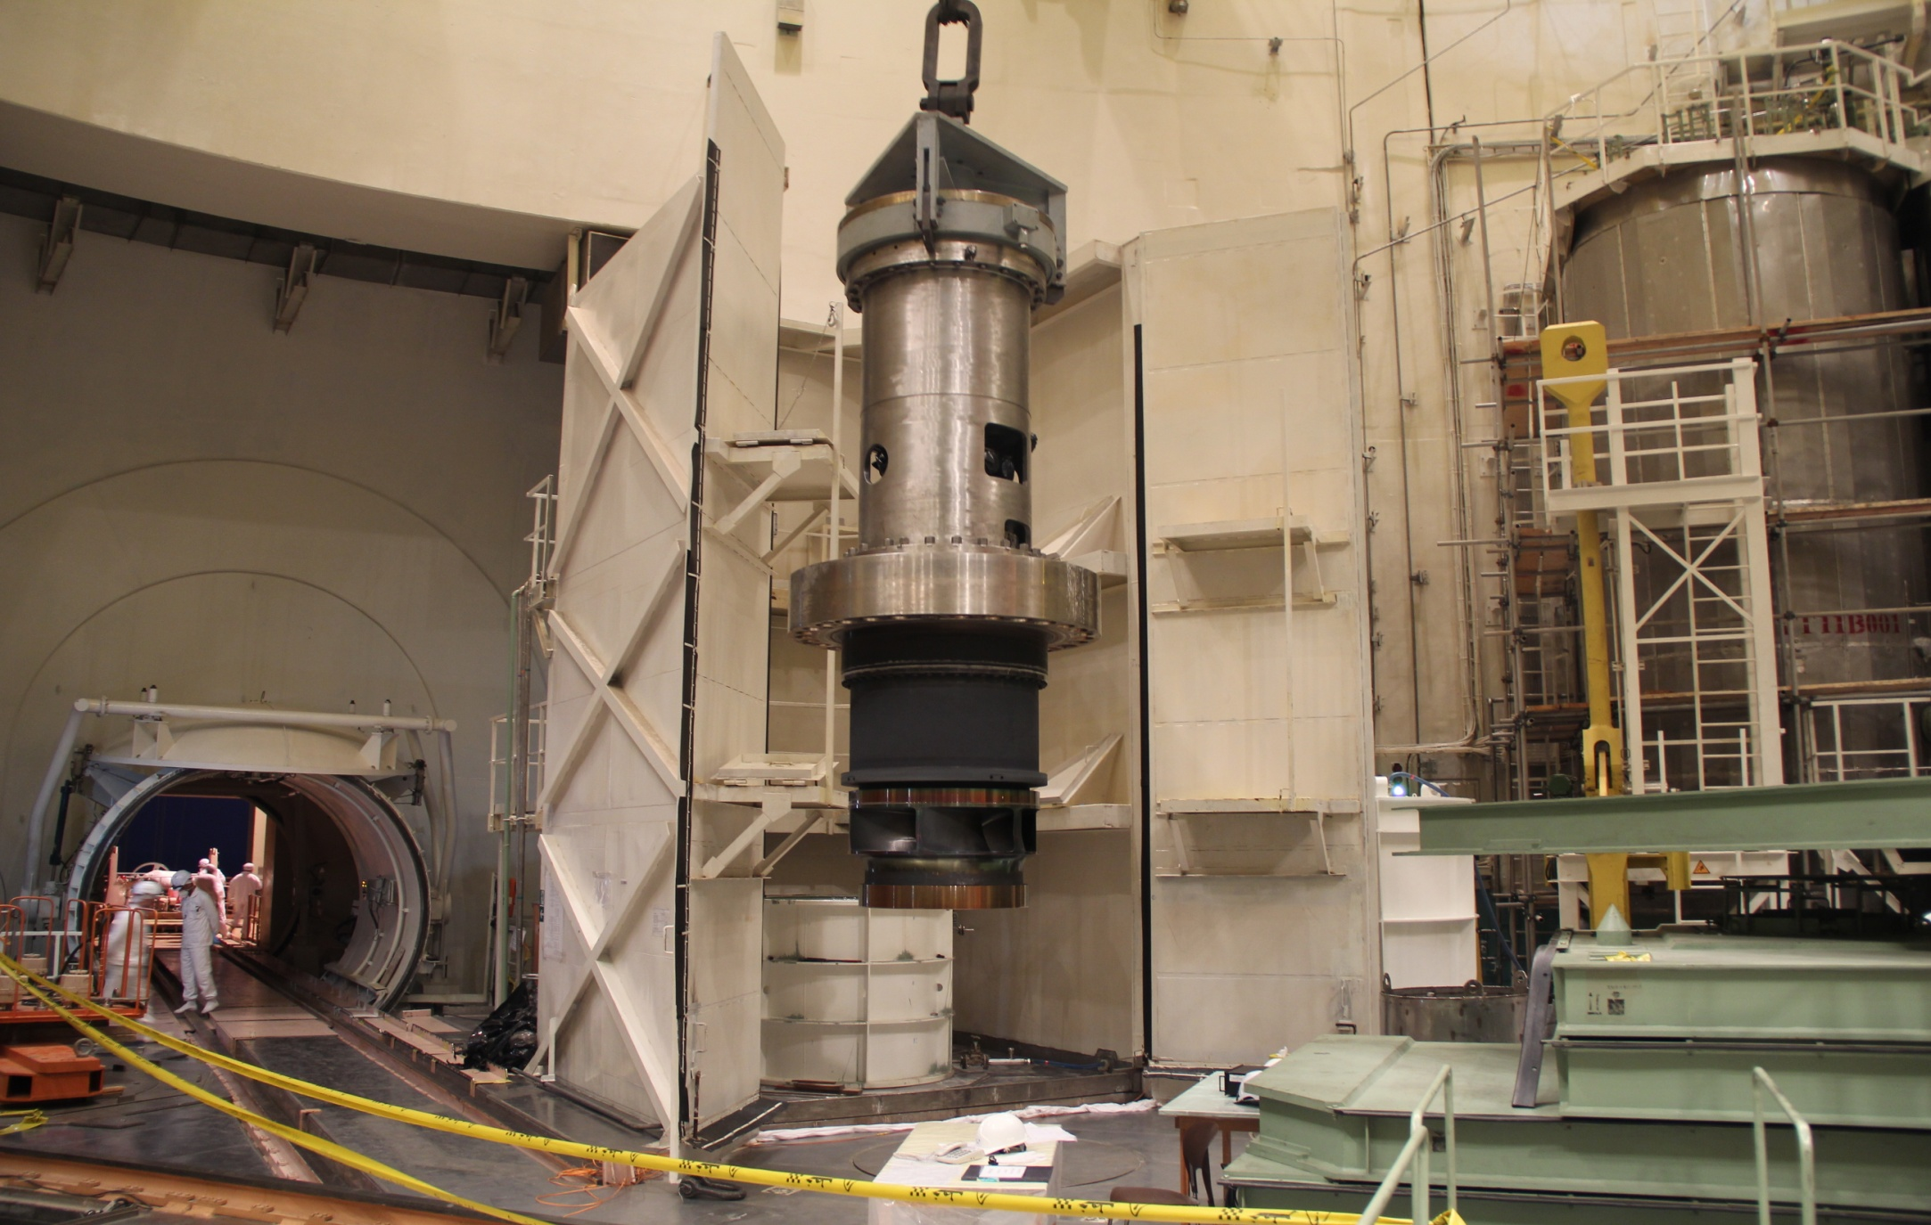
Removable part of RCP after decontamination
Notes:
Summery of Bushehr NPP-1
Contribution of local industries in the BNPP-1
Program for enhancing of local participation in .future NPPs in area of:
- Design

