Slide 1
Hart Solutions LLC
The Power of Collaboration
To Improve Safety
Christopher A. Hart
Presentation to
IAEA
December 14, 2021

Slide 2
The Speaker
Former Chairman, Vice Chairman, and Member, US National Transportation Safety Board (investigates transportation accidents, determines cause, and recommends improvements), 2008 – 2018
Assistant Administrator, Deputy Assistant Administrator, US Federal Aviation Administration (aviation safety regulator), 1995-2005
Deputy Administrator, US National Highway Transportation Safety Administration (motor vehicle safety regulator), 1994-5

Slide 3
Challenge Conventional Wisdom
Conventional wisdom:
Safety improvements usually also
reduce productivity
Lesson learned from
proactive aviation safety programs:
Safety can be improved in a way
that also results in
immediate productivity improvements
(which helps make the safety improvements sustainable)

Slide 4
Process Plus Fuel
Creates a Win-Win
Improved Safety
System Think
Process
AND
Information From
Front Lines
Improved
Productivity

Slide 5
The Challenge: Increasing Complexity
More System
interdependencies
  Large, complex, interactive system
  Often tightly coupled
  Hi-tech components
  Continuous innovation
AIRLINES
PILOTS
CONTROLLERS
The System
MECHANICS
MANUFACTURERS
INVESTIGATOR
Safety issues are more
likely to Involve
interactions between
parts of the system
REGULATOR

Slide 6
Effects of Increasing Complexity:
More “Human Error” because
The System is more likely to be error prone
Operators are more likely to encounter unanticipated situations
Operators are more likely to encounter situations in which “by the book” may not be optimal (so they create “workarounds”)

Slide 7
The Result:
Front-line staff who are
- Highly trained
- Competent
- Experienced,
Trying to do the right thing, and
Proud of doing it well
. . . Yet they still commit
Inadvertent
human errors

Slide 8
The Solution: System Think
Understanding how a change
in one subsystem
of a complex system may
affect other subsystems
within that system

Slide 9
“System Think” via Collaboration
Bringing all parts of a complex system together to collaboratively
  Identify potential issues
  PRIORITIZE the issues
  Develop solutions for the prioritized issues
  Evaluate whether the solutions are
    Accomplishing the desired result, and
    Not creating unintended consequences

Slide 10
When Things Go Wrong
How It Is Now . . .
How It Should Be . . .
You are highly trained
and
If you did as trained, you would not make mistakes
so
You weren’t careful enough
so
You should be PUNISHED!
You are human
and
Humans make mistakes
so
Let’s also explore why the system allowed, or failed to accommodate, your mistake
and
Let’s IMPROVE THE SYSTEM!

Slide 11
Fix the Person or the System?
Is the person clumsy?
Or is the problem . . .
The step???

Slide 12
Enhance Understanding of
Person/System Interactions By:
- Collecting,
- Analyzing, and
- Sharing
Information

Slide 13
Objectives:
Make the System
(a) less
error prone
and
(b) more
error tolerant

Slide 14
The Health Care Industry
To Err Is Human:
Building a Safer Health System
“The focus must shift from blaming individuals for past errors to a focus on preventing future errors by designing safety into the system.”
U.S. Institute of Medicine, Committee on Quality of Health Care in America, 1999

Slide 15
Major Source of Information:
Hands-On Front-Line Employees
“We knew about
that problem”
(and we knew it might hurt
someone sooner or later)

Slide 16
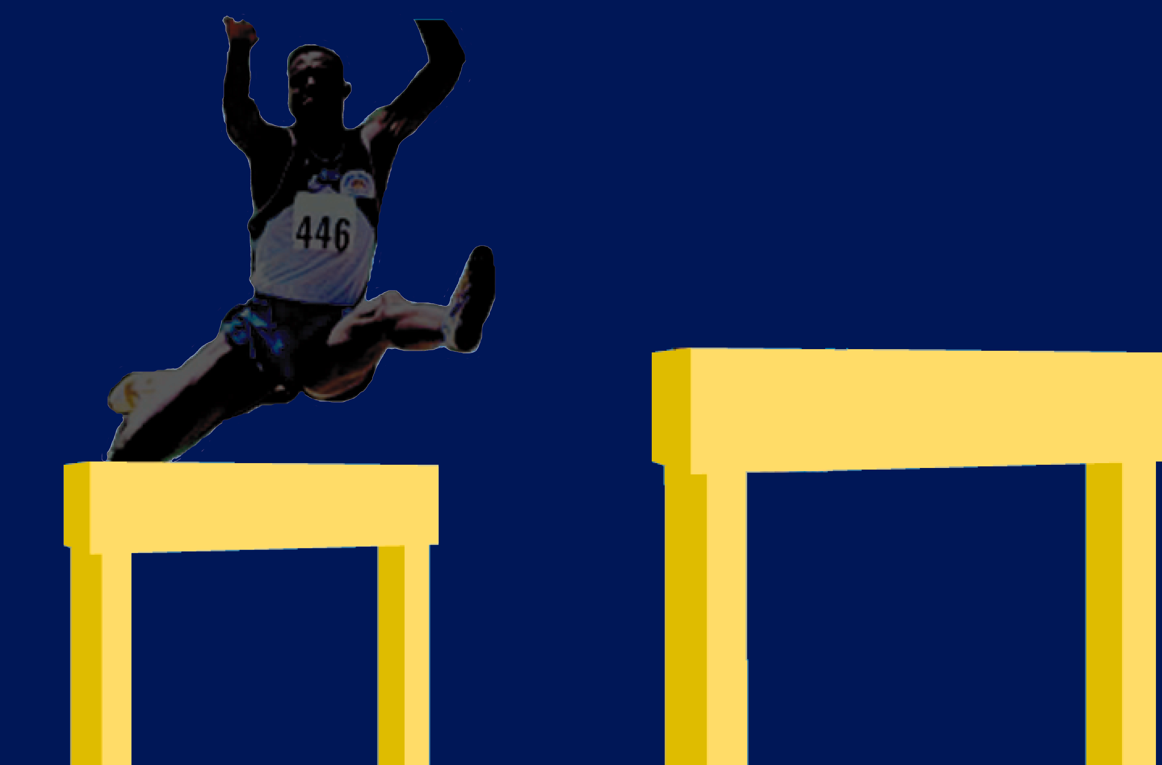
Next Challenge
Improved analytical tools
Legal/cultural issues
As we begin to get over the first hurdle, we
are challenged by the next one . . .

Slide 17
From Data to Useful Information
Developing tools and processes to convert
large quantities of data into useful information
DATA
Smart Decisions
Identify
issues
PRIORITIZE!
Develop
solutions
Evaluate
effectiveness
Data Sources
Info from
front
line
staff
USEFUL
and
other
sources
INFORMATION
Analysts
Tools
Processes

Slide 18
Aviation Success: Commercial Aviation Safety Team (CAST)
83% decrease in fatal accident rate
in less than ten years
largely because of
System Think
fueled by
proactive safety information programs
P.S. CAST is completely VOLUNTARY

Slide 19
Success Beyond Expectations
When CAST began, many safety experts believed that aviation was already very safe and unlikely to improve
Collaboration also
  Reduced the likelihood of unintended consequences
  Enabled significant improvement without generating any new regulations

Slide 20
Aviation “System Think” Success
CAST engaged all participants in identifying problems and developing and evaluating remedies
Airlines
Manufacturers
  With the systemwide effort
  With their own end users
Air Traffic Organizations
Labor
  Pilots
  Mechanics
  Air traffic controllers
Regulator(s)
AIRLINES
PILOTS
CONTROLLERS
The System
MECHANICS
MANUFACTURERS
INVESTIGATOR
REGULATOR

Slide 21
Improved Not Only Safety,
But Also Immediate Productivity
Ground Proximity Warning System
  S: Reduced warning system complacency
  P: Reduced unnecessary missed approaches,
  saved workload, time, and fuel
Flap overspeed
  S: No more potentially compromised airplanes
  P: Significantly reduced need to take airplanes
  off line for VERY EXPENSIVE (!!) disassembly,
  inspection, repair, and re-assembly

Slide 22
Manufacturer “System Think” Success
Aircraft manufacturers seek input, beginning early in the design process, from
- Pilots
(User friendly)
(Maintenance friendly)
(System friendly)
- Mechanics
- Air Traffic Services

Slide 23
Moral of the Story
Anyone who is
involved in the problem
should be
involved in developing the solution

Slide 24
Major Paradigm Shift
Old: The regulator identifies a problem, develops solutions
  Industry skeptical of regulator’s understanding of the problem
  Industry fights regulator’s solution and/or implements it begrudgingly
New: Collaborative “System Think”
  Industry involved in identifying problem
  Industry “buy-in” re interventions because everyone had input, everyone’s interests considered
  Prompt and willing implementation
  Interventions evaluated . . . and tweaked as needed
  Solutions probably more effective and efficient
  Unintended consequences much less likely

Slide 25
Challenges of Collaboration
Human nature: “I’m doing great . . . the problem is everyone else”
Participants may have competing interests, e.g.,
  Labor/management issues
  May be potential co-defendants
Regulator probably not welcome
Not a democracy
  Regulator must regulate
Requires all to be willing, in their enlightened self-interest, to take off their ”Me” hat and think of the System
TRUST

Slide 26
So . . . Is Safety Good Business?
Safety implemented well
  Improves safety more effectively
  Creates benefits greater than the costs
Safety implemented poorly
  Is often not as effective as expected at improving safety
  Probably reduces productivity
  Can be very costly

Slide 27
Effects of CAST on Safety
CAST
Focuses on safety rather than compliance
Facilitates and encourages development of a robust industry-wide safety culture
Improves relations between participants, e.g. labor and management, operators and manufacturers, regulators and everybody
Improves safety the most efficient way

Slide 28
Could CAST Improve Safety
In Other Industries?
Other transportation industries
Nuclear power
Chemical manufacturing
Petroleum exploration, refining
Healthcare
Banks (financial risk)
Other

Slide 29
Focusing on Safety vs. Compliance
Regulations create a “regulatory floor of compliance”
Focusing on safety creates a higher level of safety than the regulatory floor of compliance because
  Regulations don’t fit every situation
  Some situations have no applicable regulations
CAST has not generated any new regulations because it placed the industry far above the regulatory floor of compliance

Slide 30
What If No Applicable Regulations?
If focus is on compliance: Do whatever is necessary to comply, then the task is done
If focus is on safety: Accomplish the desired result in the safest way, but always seek continuous improvement

Slide 31
Conclusions
Safety issues in complex systems usually involve human/system interface issues
Human/system interface issues can be addressed effectively and efficiently by collaboration that (a) includes all parts of the complex systems and (b) is fueled by information about errors and near misses
Collaboration improves safety more effectively if the focus is on safety rather than compliance
Collaboration can help ensure that safety improvement programs also improve productivity, which makes the safety improvements more sustainable
The aviation industry collaborative process is transferable to other potentially hazardous industries

Slide 32
Thank You!!!
Questions?
Christopher A. Hart
Hart Solutions LLC
chris@hartsolutionsllc.com
202-680-4122

