Slide 1



Aging management at the Bushehr NPP
WANO Moscow Centre workshop
Nuclear Power Plant Equipment Ageing Management
29 September-01 October 2020

Slide 2

Contents
Plant Location
A Brief History of the Plant
Organizational Chart
Seminars and Workshops
Ageing Management Program
Ageing Management Program (AMP) Flowchart
Categorization of the Screened Equipment
Methodology
Ageing Databank Software
Document Developed by the Operating Company
Documents Used in Developing Ageing Related Documents of the BNPP

Slide 3
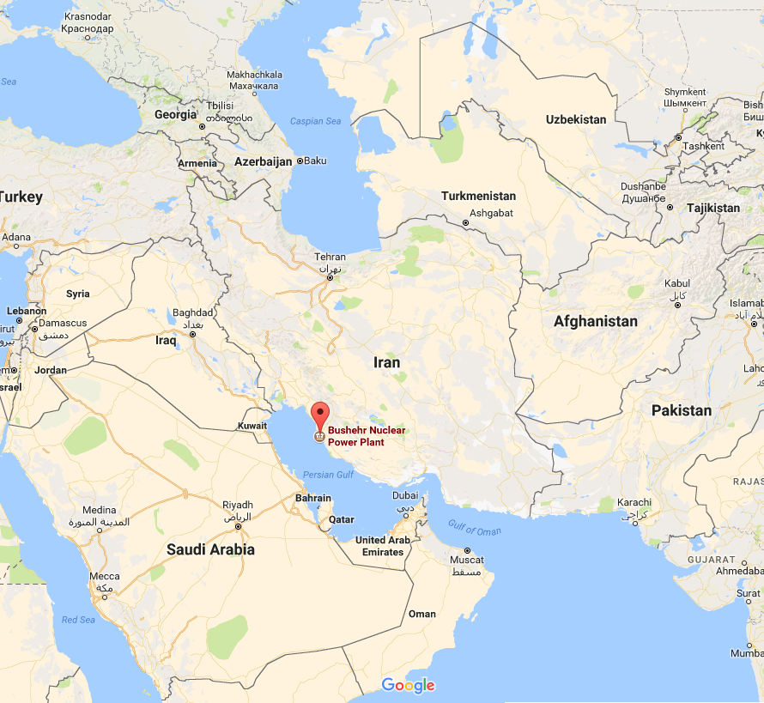
Ageing Management
BNPP Location
The BNPP is located in the southwest of the Iran, on the coast of the Persian Gulf and southeast of the Bushehr city.

Slide 4
Ageing Management
Plant History
Subject | Date
Synchronization with the National Power Grid | 02.09.2011
Commercial Operation | 24-09-2013
First Refueling | 07-04-2014→13-05-2014
Sixth Refueling | 29-04-2020 →09-06-2020
Delivering 40494417 MW/h nuclear power to the national power grid | 31-08-2020

Slide 5
Ageing Management
Managing Director (Plant Manager)
Systems and Equipment Performance Analysis Management
Vibrations Analysis and Diagnosis Group
Equipment Modification
Ageing Management and Reliability Group
Group Head
Technical Indicators
Ageing Management Expert
Reliability Expert
Ageing Management Expert
Deputy for Technical and Engineering
Chief Engineer

Slide 6
Ageing Management
Specialized meeting and training workshop in the field of ageing management
Ageing management workshop Vienna 2013
Technical visit of aerospace research institute and RAZI laboratory Tehran 2016
Specialized meeting with ROSENRGATOM Expert Tehran September 2017
Specialized meeting with ROSENRGATOM Expert Bushehr 2017
Specialized meeting with OSART Expert Bushehr 2017
Ageing management workshop Tehran January 2018 (IAEA)
Ageing management workshop Tehran May 2018 (IAEA)
Ageing management workshop UJV 2018

Slide 7
Ageing Management Program
One of the important and effective activities in this project is developing Ageing Management Program (AMP) for each one of screened equipment. For this propose, it is necessary that by having accurate knowledge about a particular equipment and identifying the possible failure mechanisms and the points susceptible to failure, the required data would be gathered and by determining the current status of the equipment, corrective or preventive solutions would also be provided. Based on this, the AMP for the BNPP reactor unit has been presented in this document based on the standards governing the design of the WWER nuclear power plants, the documents provided by the IAEA and the experiences of other countries in the world.

Slide 8
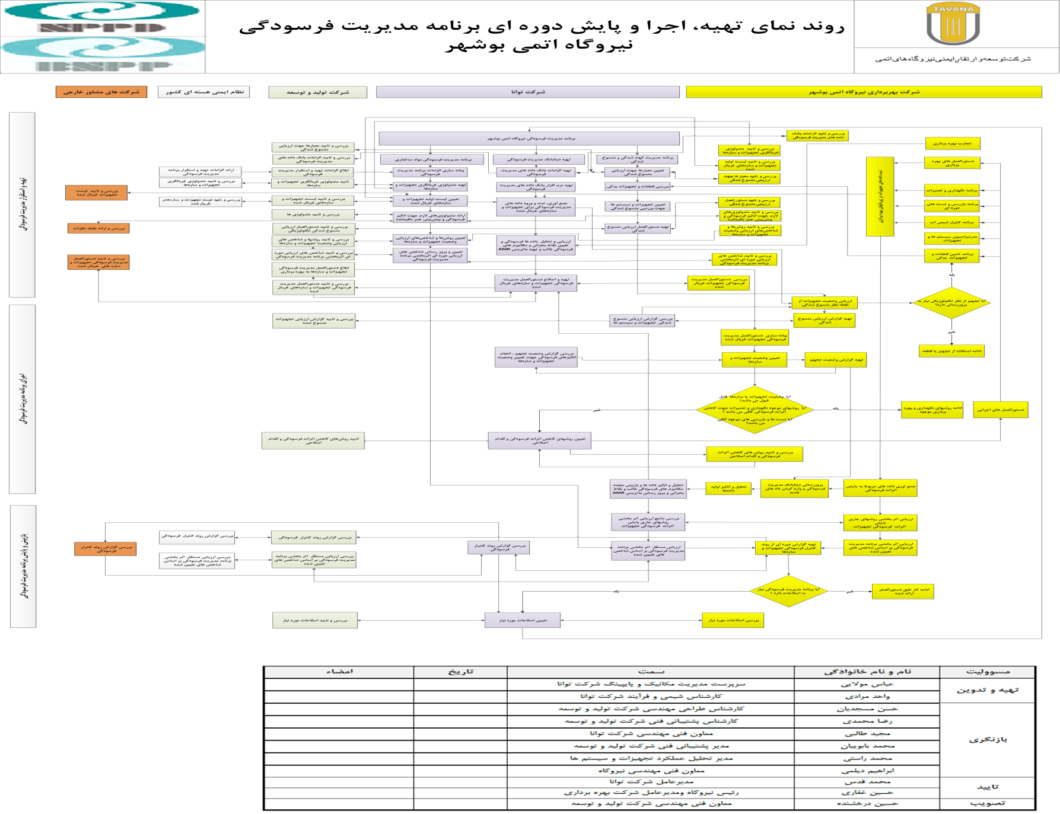

Slide 9
Ageing Management
Flowchart of Development, Implementation and Periodic Monitoring of the AMP at the BNPP
External Consulting Companies
National Nuclear Safety Department (NNSD)
Nuclear Power Production and Development Co. (NPPD)
TAVANA Co.
BNPP Operating Co.
Developing and Establishing Ageing Management
Implementing the AMP
Reviewing and Monitoring the AMP

Slide 10
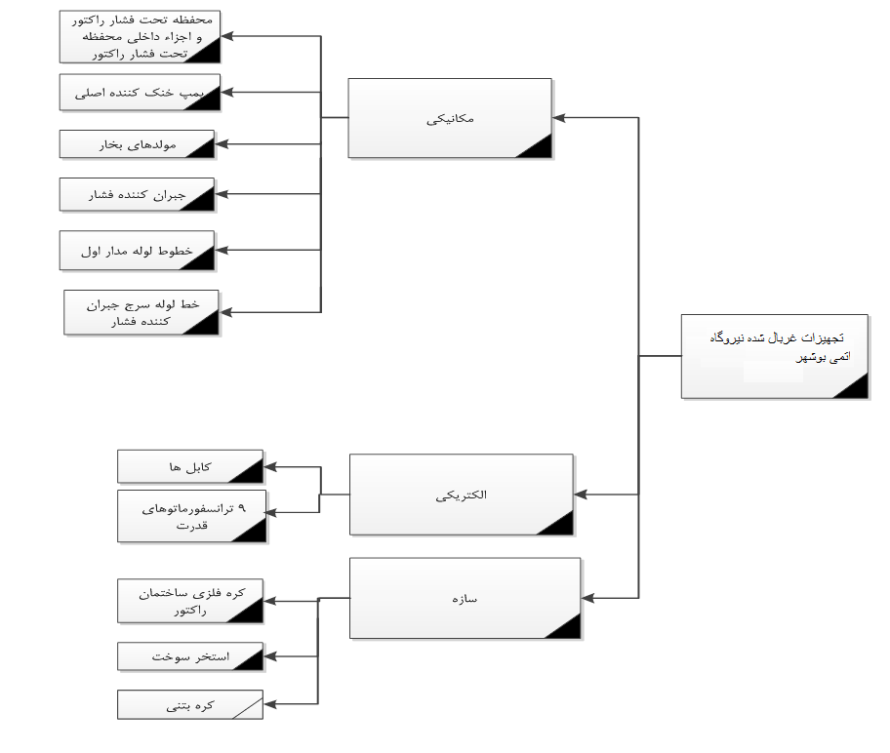
Ageing Management
Categorization of the Screened Equipment of the Ageing Management at the BNPP

Slide 11
Ageing Management
Screened Equipment of the BNPP
Mechanical:
Reactor Pressure Vessel and the Vessel Internals
Reactor Coolant Pump (RCP)
Steam Generators
Pressurizer
Primary Circuit Pipelines
Pressurizer Surge Pipeline
Electrical:
Cables
9 Power Transformers
Structure:
Reactor Building Steel Containment
Fuel Pool
Concrete Containment

Slide 12
Ageing Management
Methodology
One of the important and effective activities in this project is to determine the standard and efficient methodology for analyzing the ageing mechanisms taking into account the operating time period. In this part of the project, it is necessary to specify the status of the equipment correctly by having accurate knowledge of how to use the operating data and how to calculate the time-varying parameter that indicates the degree of severity of each failure mechanism. Based on this, it is necessary to prepare a specific list of failure mechanisms for equipment and systems of a NPP, to conduct the necessary assessments for each of them and, then, based on these assessments and studying the required standards, to present a specific process for assessment and analysis of each failure mechanism.

Slide 13
Ageing Management
Methodology
For the purpose of determining the list of ageing analyses for which accurate and structured methodology needs to be determined and developed, various sources can be introduced as the basis and reference for the work and each of them choose a different process for determining the list of necessary analyses. Recently, an assembly of countries active in the area of ageing management organized by the IAEA, through the implementation of a program titled “International Generic Ageing Lessons Learned” (IGALL), started to issue a list of Time Limited Ageing Analyses (TLAA), which should be considered in the AMP of the NPPs, on an ongoing basis and by using the experiences of the member countries. Complete details related to the characteristics and manner of determining the TLAA has been presented in the reference No.1 published by the IAEA. The Table.1 shows the list of the aforementioned analyses.
International Generic Ageing Lessons Learned(IGALL)
Time Limited Ageing Analysis(TLAA)

Slide 14
Ageing Management
Methodology (Continued)
Table.1 – List of Ageing Analyses based on the IGALL Reference
IGALL TLAAs
TLAA101 “Low-Cycle Fatigue Usage”
TLAA102 “RPV Neutron Embrittlement” (Rev. 2015)
TLAA103 “Crack Growth Analyses”
TLAA104 “Corrosion Allowances”
TLAA105 “CANDU/PHWR Fuel Channel Creep”
TLAA106 “Environmentally Assisted Fatigue”
TLAA107 “High-cycle Fatigue for Steam Generator Tubes”
TLAA108 “Fatigue of Cranes”
TLAA109 “PWR RPV Internals Swelling”
TLAA110 “Thermal Ageing of Cast Austenitic Stainless Steels”
TLAA111 “CANDU/PHWR Hydrogen Embrittlement and Delayed Hydride Cracking in Pressure Tubes” (Rev. 2015)
TLAA112 “Main Circulation Pump Flywheel”
TLAA113 “Thermal Stratification”
TLAA114 “Flaw Tolerance Calculation due to Thermal Ageing and Fatigue”
TLAA115 “Fatigue and Thermal Ageing Analysis of Manufacturing Flaws”
TLAA116 “Thermal Ageing of Low Alloy Steels”
TLAA117 “Under Clad Cracking” (Rev. 2015)
TLAA118 “Components With Undocumented Restrictions On Operation”
TLAA119 “High-cycle Thermal Fatigue”
TLAA120 “PWR RPV Internals Vibrations”
TLAA121 “IASCC Fluence Limit for Stainless Steel”
TLAA122 “Thermal Ageing of Martensitic Stainless Steels”
TLAA123 “CANDU/PHWR Calandria Internals Vibrations” (2015)
TLAA201 “Environmental Qualification of Electrical and I&C Components” (Rev. 2015)
TLAA301 “Concrete Containment Tendon Prestress”
TLAA302 “CANDU/PHWR Concrete Strength Reduction due to Creep and Shrinkage”
TLAA303 “Cumulative Fatigue Damage of Containment Liners and Penetrations”
TLAA304 “Foundation Settlement due to Soil Movement”

Slide 15
Ageing Management
Methodology (Continued)
The list collected in the Table.1 can also be generally usable for other NPPs which use pressurized light water technology and a group of failure mechanisms can also be seen that never happens for a station like the Bushehr NPP. Based on this and by reviewing the dominant mechanisms which, based on the experiences of other countries, can happen in a NPP with the VVER design, the list presented in the Table.2 was selected as the initial list of ageing analyses needed in the AMP of the BNPP. The basis for selecting the list of the aforementioned analyses is the reference No.1 and experiences of other countries in the world. It should be mentioned that the aforementioned list is subject to change over time and based on the data recorded on the ageing of equipment ad systems at the BNPP.

Slide 16
Ageing Management
Methodology (Continued)
Table.2 – The list of Ageing Analyses proposed in the AMP of the BNPP
 | Ageing Analyses List
1 | TLAA101 “Low-Cycle Fatigue Usage”
2 | TLAA102 “RPV Neutron Embrittlement”
3 | TLAA103 “Crack Growth Analyses”
4 | TLAA104 “Corrosion Allowances”
5 | TLAA106 “Environmentally Assisted Fatigue”
6 | TLAA107 “High-cycle Fatigue for Steam Generator Tubes”
7 | TLAA109 “PWR RPV Internals Swelling”
8 | TLAA113 “Thermal Stratification”
9 | TLAA116 ,TLAA122 “Thermal Ageing”
10 | TLAA119 “High-cycle Thermal Fatigue”
11 | TLAA120 “PWR RPV Internals Vibrations”
12 | TLAA121 “IASCC Fluence Limit for Stainless Steel”
13 | TLAA201 “Environmental Qualification of Electrical and I&C Components” (Rev. 2015)
14 | TLAA303 “Cumulative Fatigue Damage of steel containment and Penetrations”

Slide 17
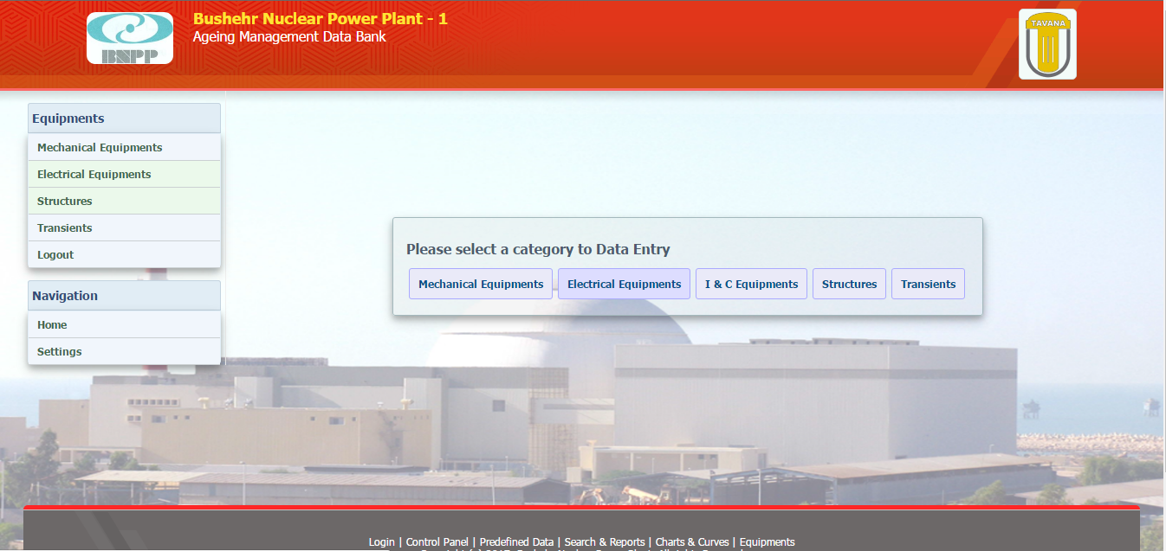
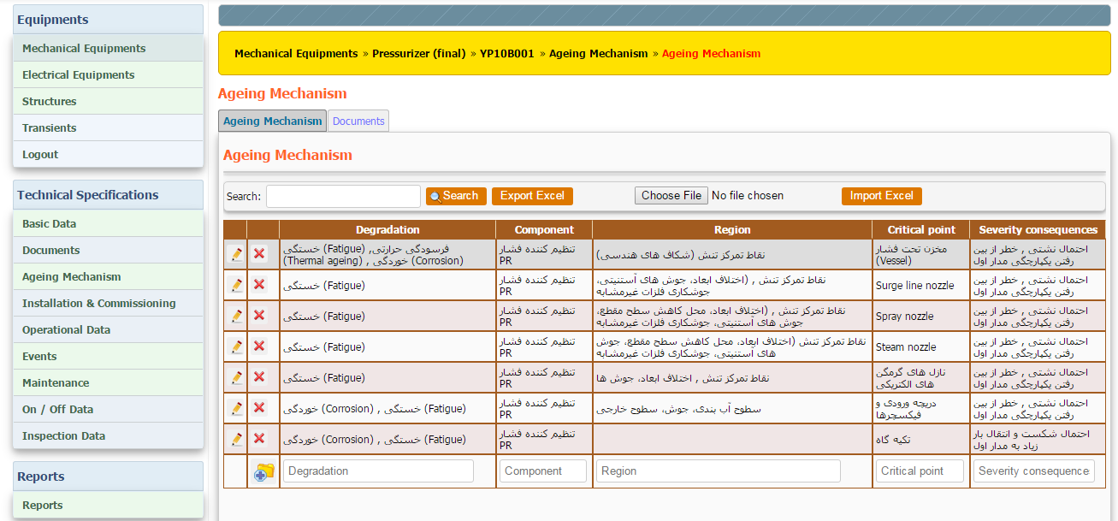
Ageing Management
Ageing Databank Software

Slide 18
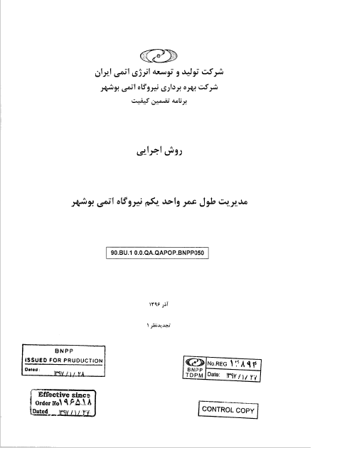
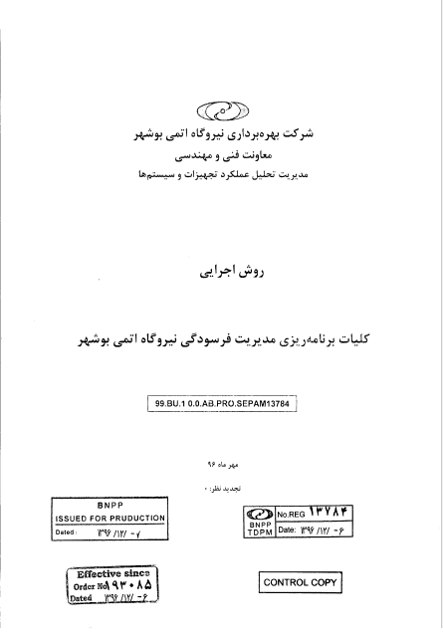
Ageing Management
The Documents Developed by the Operating Company

Slide 19
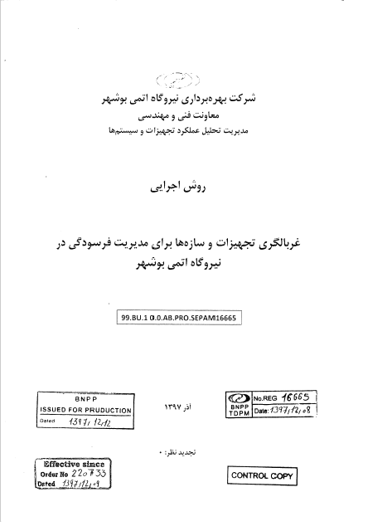
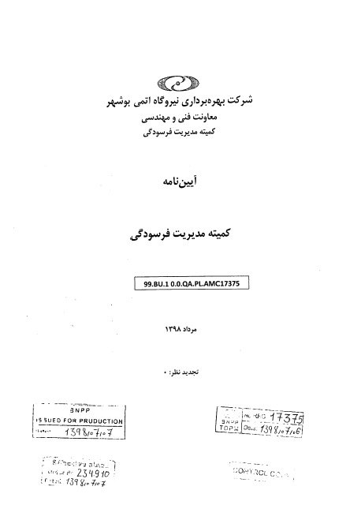
Ageing Management
The Documents Developed by the Operating Company (Continued)

Slide 20
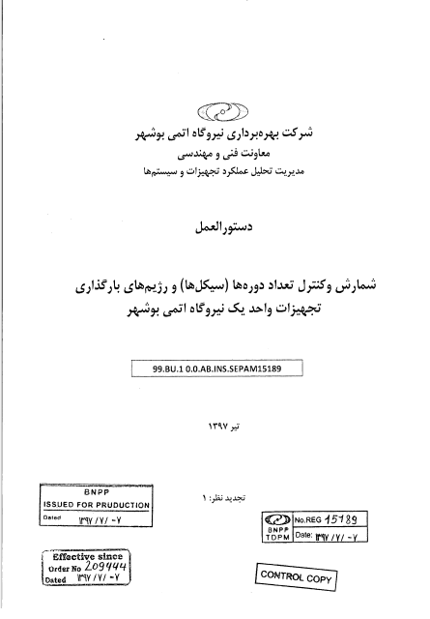
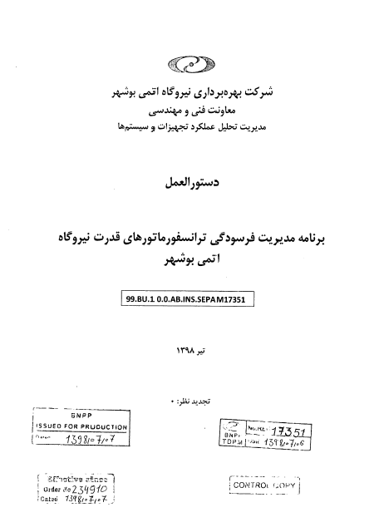
Ageing Management
The Documents Developed by the Operating Company (Continued)

Slide 21
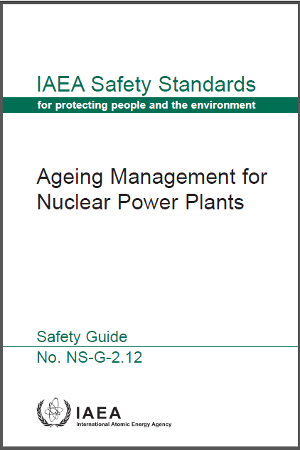
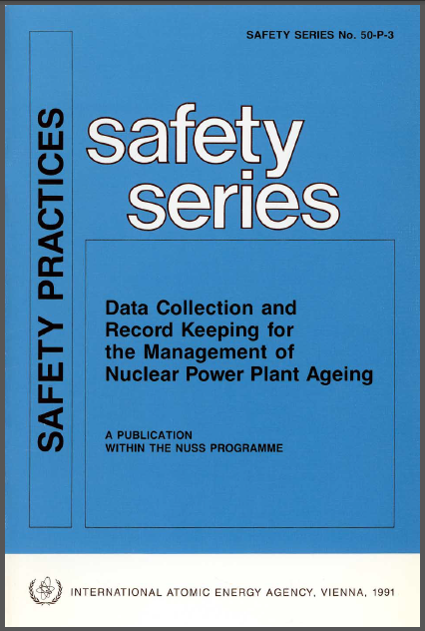
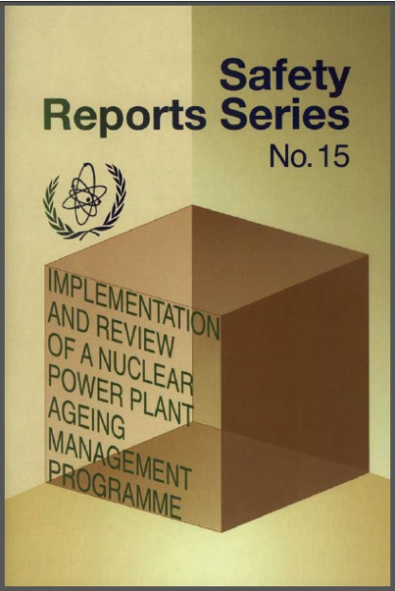
Documents used in Developing the Ageing related documents of the BNPP
Ageing Management
Safety Guide No.NS-G-2.12(IAEA Safety Standard)
Safety Practice Publication No.50-P-3
SRS-No.15 (Safety Reports Series -No.15)

Slide 22
Thank You for Your Attention

