Slide 1



Nuclear Power Production & Development Co.
In the name of GOD
Nuclear Power in
I.R. of IRAN
June, 2014
Hungary
M. Ahmadian
Vice President of AEOI and NPPD Managing Director

Slide 2
Electric Power in IRAN
National electricity production , 1967-2012 (TWh)
300
150
0
Average annual growth rate: 11.59%
1967 1990 2012

Slide 3
Electric Power in IRAN
Capacity , Production and Sharing in 2012
Technology sharing percentage
Total Nominal capacity: 69306 MW
Total production: 255805 GWh

Slide 4
Electric Power in IRAN
Share of Fossil Fuels in electricity production-2012

Slide 5
Electric Power in IRAN
Iran's electricity network relies on fossil-fueled thermal power plants. (Before BNPP-1: 94.4% of electricity from thermal power plants, 4.8% hydro-electric and 0.8% is renewable)
Fossil resources are not the ideal resources for supplying secure energy in long terms
Supplying energy by hydro-electric power is restricted due to water recourses limitations.
Renewable energy sources such as wind, solar, geothermal have a limited share in producing the primary energy because of their technical limitations as well as still high prices.
The capacity of constructible power plants on mentioned sources (hydro & renewable energy ) in 2030 is very little in comparison with total need of the country

Slide 6
Main Factors in Identifying Energy Resources
Fossil fuels price and Its fluctuation trends
  Instability of fossil fuels price,
  Reliance on burning liquid fuels will have high economic costs
Available fossil fuels will be insufficient
Diversity and security of energy resources (supplies)
Importance of sustainable development and environmental protection
Cost of generated electricity in power plants

Slide 7
Main Factors in Identifying Energy Resources
Nuclear energy is a compelling solution to the nation’s energy demand for following reasons:
  Economic
  Environment
  Security of supply
  Industrial development
Nuclear Power is a proven, environmentally attractive and cost competitive electricity generation option.

Slide 8
Long-Term Planning of IRAN for Electricity Production by Nuclear Power ~2030
Reasons for developing the nuclear power plants in the Islamic Republic of Iran
Needs of the Country's developing programs for energy
The necessities arise from energy security point of view
Environmental consideration and sustainable development
Techno-economic advantages
Influence on the development of other sectors
  Possibility of using the oil resources to produce higher-value products
  Iran has to use energy mix option and especially developing the nuclear power plants as a necessary part of energy mix in long term programs

Slide 9
Long-Term Planning of IRAN for Electricity Production by Nuclear Power ~2030
Reasons for developing the nuclear power plants in the Islamic Republic of Iran
Energy efficiency improvement
Increasing security fuel and energy supplies
Diversification of power generation sources through implementation of NPP
Development of new generation sources
Limitation of energy sector's impact on environment – restriction on SO2, NOx and CO2 emissions
Increasing in electricity generation efficiency

Slide 10
History of Nuclear Power Technology in IRAN
 | Year
Start of academic nuclear education | 1959
Operation of TRR | 1968
Establishment of AEOI – Bushehr NPP Contract (KWU) | 1974
Intergovernmental protocol with Russia for completion of BNPP-1 | 1995
Changing to Turn-Key contract | 1998
BNPP-1, First grid connection | Sept. 2011
BNPP-1, Reach(Achieve) to 1000 MWe | Aug 2012
BNPP-1, Provisional Acceptance to Iranian Operator | Sept. 2013

Slide 11
History of Energy Planning in IRAN
‍Contracts and agreements between AEOI and Int. contractors to build NPP before the Islamic Revolution in IRAN
name of Contractors | Nominal Capacity, MW | Name of NPP |  | No.
KWU - Germany | Bushehr NPP-1 | 1293 | C | 1
KWU - Germany | Bushehr NPP-2 | 1293 | C | 2
Framatom - France | Karon NPP-1 | 953 | C | 3
Framatom - France | Karon NPP-2 | 853 | C | 4
KWU - Germany | Esfahan NPP-1 | 1293 | A | 5
KWU - Germany | Esfahan NPP-2 | 1293 | A | 6
KWU - Germany | Saveh NPP-1 | 1293 | A | 7
KWU - Germany | Saveh NPP-2 | 1293 | A | 8
BBC - Germany | Azerbaijan NPP-1 | 1300 | A | 9
BBC - Germany | Azerbaijan NPP-2 | 1300 | A | 10

Slide 12
History of Energy Planning in IRAN
Studies of SRI ( Stanford Research Institute)
  Planning period: 1975-1997
  Forecasting for electricity demand: 55000 MW
  Forecasting for nuclear power sharing: 9000 MW (%16)
Studies of Sharif Sc.&Tech university
  Planning period : 1989-2021
  Forecasting for electricity demand: 52000 MW
  Forecasting for nuclear power sharing: 1160 MW (%21)

Slide 13
History of Energy Planning in IRAN
Studies of AEOI and the council of Nuclear Energy of Iran
  Planning period: 2001-2021
  Forecasting for electricity demand: 47000-60000 MW
  Forecasting for nuclear power sharing: 4000-1000MW (%6-%13)
Studies of Power Ministry Research Institute
  Planning period : 2006-2026
  Forecasting for electricity demand: 123000MW
  Forecasting for nuclear power sharing: 15000MW (%12)

Slide 14
Long-Term Planning of IRAN for Electricity Production by Nuclear Power ~2030
Legal and National Obligations and Bases
According to the supreme leader, One of Iran's general policies, in energy section is related to nuclear energy: Efforts to achieve nuclear science & technology and to construct nuclear power plants for supplying a part of Iran's energy and training fields are necessary
The law approved by the Iran Parliament stipulates: The government has to do necessary measures to supply country with peaceful nuclear technology such as to establish fuel cycle to generate 20000 MW electricity
Iran's Atomic Energy Council approved : Construction of nuclear power plants for generating power is one of Iran government's principal goals and policies
The council of Nuclear Energy of Iran has decided that the Iranian nuclear power generation capacity reach 7000 MW by the year 2021,
  Based on the determined objectives in the State’s 5th development plan

Slide 15
Policies and Legal framework for Nuclear Power Development in IRAN
Long-term View for National Nuclear Power Development
Diversification of production methods and upgrading energy security,
Sustainable development and global common responsibility,
Gaining the technologies for establishment and development of nuclear power plants,
A reasonable share of nuclear power generation in the total power generation of the country,
To produce electricity from nuclear power plants, Pressurized Water Reactors(PWR) will be developed.

Slide 16
Policies and Legal framework for Nuclear Power Development in IRAN
Objectives
Safe and Reliable Operation of Bushehr Nuclear Power Plant – Unit1,
Design and construction of Medium sized nuclear power plant using capacities of Iranian companies,
Implementation of detailed studies, taking possession of and preparing the sites for construction of new nuclear power plants,
Starting the activities for construction of 4000 MW of nuclear power plants including 2 new large scale (PWR) at Bushehr site.
Training of expert manpower in the field of nuclear science and technologies in line with national plan for the NPP development ,

Slide 17
Where are we today?
Owning many graduated and educated human resources on Nuclear Engineering (as an investment on manpower) in two past decades,
Achieving some techniques on nuclear fuel cycling in successful manner,
Gaining professional experience for organization staff in completion of BNPP-1 process,
Constrained involving in internal industries and consulting in completion of BNPP-1,
Obtaining professional experience in design (conceptual, basic & detailed) and reactor construction,
Gaining professional experience in reactor design (conceptual and basic),
Establishment of some research and development infrastructures in Tehran, Esfahan, Yazd and Karaj research centers.

Slide 18
Conclusion
Islamic Republic of Iran by considering world experiences, forecasts regarding world electricity demand trend and solutions for resolving energy challenge in harmonized way with sustainable development requirements and considering requirements for satisfying national vision document necessitates, laws approved by competent national organizations (Islamic parliament of Iran and atomic energy council) and in order to properly respond to the huge rate of energy demand and bearing in mind national capabilities and abilities decide to prepare necessary measures and plans for developing and constructing nuclear power plant up to 20000 MWe nominal power capacity and to supply the needed fuel for mentioned NPPs capacity in safe and reliable way.
In near term program Islamic Republic of Iran aims to start work on constructing NPPs with cumulative nominal capacity of 4000-8000 MWe with foreign cooperation and detailed studies and preparing suitable site for construction of 20000 MW nuclear power plant

Slide 19
Brief Introduction of
Nuclear Power Production & Development (NPPD Co.)
I.R. of IRAN

Slide 20
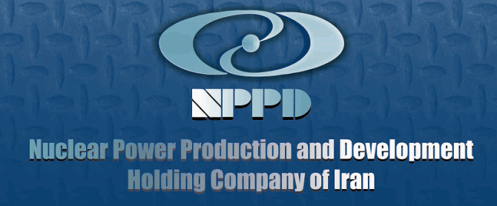
About us
Background
Pursuant to an approval passed by the Higher Administrative Council, the tasks and duties of the Nuclear Power Plant Division of the Atomic Energy Organization of Iran (AEOI) were transferred to Nuclear Power Production & Development Company of Iran (NPPD). The new company's articles of association were approved by the Board of Ministers in 2004 and the executive activities of the company thereafter started to be implemented.
Subject of Activity as per the Articles of Association
Management of and supervision on the company's capital to perform any types of activities in the field of production and development of nuclear power.
Management of and supervision on studies of site selection, design, construction, supply of nuclear fuel, safe operation, decommissioning of nuclear power plants and their installations.
Conduction of all transactions related to nuclear power.

Slide 21
About us
Geographical Area of Activity
The NPPD headquarters is in Tehran, and the company may establish branches or representative offices inside the country through obtaining the approval of the general association and confirmation of the State Management and Planning Organization, with due observance of the rules and regulations related to implementation of its activities in line with the goals mentioned in its articles of association.
Organizational Relationships with the AEOI
NPPD is a subsidiary to the AEOI and works as its policy-making arm in the field of nuclear power plant development in the country.
Subsidiary
Bushehr Nuclear Power Plant Operation Company is the only subsidiary to the Nuclear Power Production and Development Company of Iran.

Slide 22
About us
Plans and Activities
Long-term plan
The company's long-term plan involves management of, and supervision on production and development of nuclear power, selection of potential sites for future projects, and studies of design and construction of up to 7000 - 20000 MW of nuclear power plants within the state's 20-year horizon.
Plans under implementation
Completion and operation of Unit-1 of Bushehr nuclear power plant
Design and construction of Darkhowin 360-MW nuclear power plant
Design and construction of new nuclear power plants
Conduct of site selection studies for 20000 Megawatts of nuclear power
Development of domestic manufacturing of the equipment required for nuclear power plants in order to proceed localization
Training of manpower and upgrading of the level of training in the field of nuclear sciences and technology
Address of headquarters and subsidiaries:
- The NPPD headquarters is located at No. 8, Tandis St., Africa Ave., Tehran, IRAN.
- Bushehr nuclear power plant is located at Halile village, Bushehr, IRAN.

Slide 23
Objectives
Safe and Reliable Operation of Bushehr Nuclear Power Plant – Unit1,
Design and construction of Medium sized nuclear power plant using capacities of Iranian companies,
Implementation of detailed studies, taking possession of and preparing the sites for construction of new nuclear power plants,
Starting the activities for construction of 4000 MW of nuclear power plants including 2 new large scale (PWR) at Bushehr site.
Training of expert manpower in the field of nuclear science and technologies in line with national plan for the NPP development ,

Slide 24







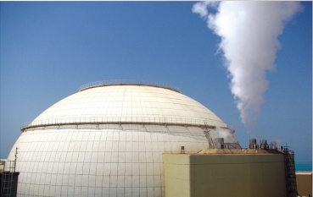




NPPs Development Organization in IRAN
Atomic Energy Organization Of IRAN (AEOI)
Research
Institute
Nuclear Power Production & Development Co.
SABA
NOVIN Co.
SATNA

Slide 25
Duties & Responsibility
BNPP Co.
NPPs Repairs and Support Company (TAPNA Co.)
Responsible for BNPP-1 Operation.
Maintenance & Repairs services and support of NPPs operations.
Modern Industries
Technique Company
NPPs Safety Development
& Improvement (TAVANA Co.)
Design, Construction and Commissioning of Research Reactors
Technical support of BNPP-1.

Slide 26
Duties & Responsibility
EDDIS Company
SURENA Company
Design and Develop of Simulators for Research Reactors and NPPs.
Design and Construction of Darkhowin as Medium size NPP.
OFOG Consulting Company
SATNA Company
Engineering services and Technical consultation for NPPs development.
Localization of Design and Manufacturing NPPs equipments.
Research Institute
SABA NOVIN Company
Implementation Research activities in Nuclear Power industries.
Electricity Marketing

Slide 27
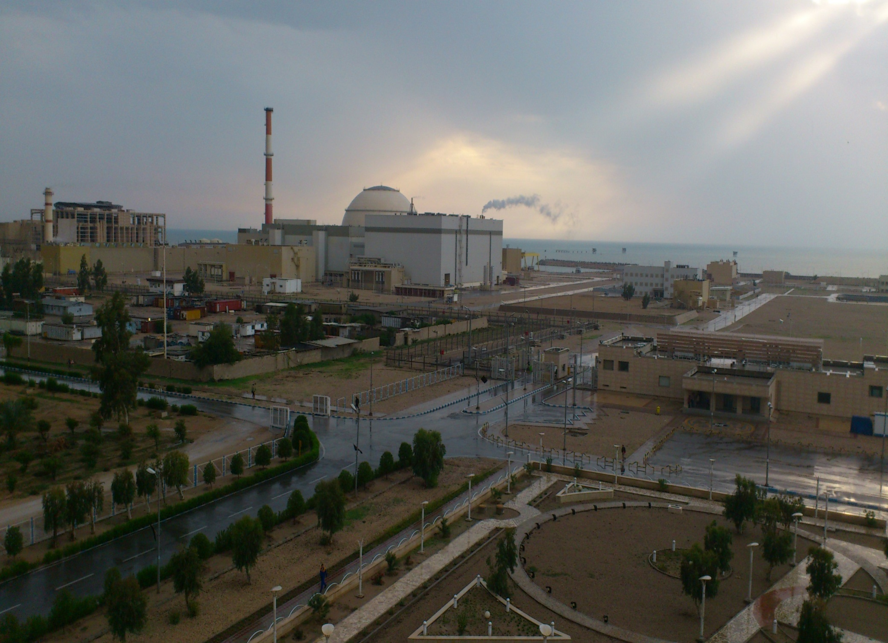
Bushehr NPP-1
Electric production, more than 6 Twh
Saving: gas (natural) about 1,112 million m³ , gasoline 269 million liter, Fuel oil 334 million liter in one year (it is equivalent to 2 Billions liter gasoline in one year)
Preventing to release environmental pollutions ,7 million tons in year, approximately.

Slide 28
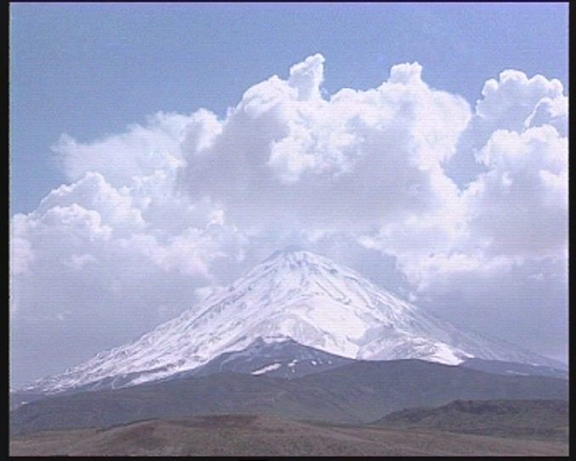
Aim of Iran’s Nuclear Program
Sustainable Development
Thanks for your attention…

